Slide 1
Cryptographic Techniques
Substitution Technique
Permutation Technique
Product Cipher

Slide 2
Substitution Techniques
Mono-alphabetic Cipher
----- Caesar Cipher
----- Modified Caesar Cipher
----- General mono-alphabetic Cipher
Polyalphabetic Cipher
Homophonic Substitution Cipher
Polygram Substitution Cipher

Slide 3
Mono-alphabetic Cipher
The cipher alphabet for each plain alphabet is fixed throughout the encryption process.
If ‘A’ is encrypted as ‘D’, for any number of occurrences in that plaintext, ‘A’ will always get encrypted to ‘D’.

Slide 4
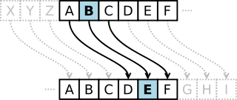
Caesar Cipher

Slide 5
Modified Caesar Cipher
Replace each character by a character which is k position down the order.
Here, the predetermined value of k is the key.
Each character has 25 possibilities of replacement.

Slide 6
General Mono-alphabetic Cipher
No relation exists among the replacement of each alphabets.
For example ----
A → P
B → M
C → A
How many possible keys ???

Slide 7
Polyalphabetic Cipher
Multiple one-character keys are used. The first key encrypts the first character; the second key encrypts the second character, and so on.
Example -----
Vigenere Cipher

Slide 8
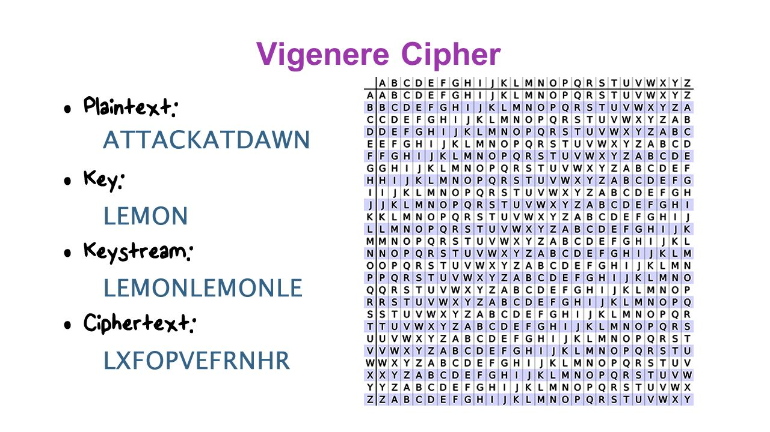
P. T. LETTERS
KEY
LETTERS
Represent {A, B, C, …… Z} by {0, 1, 2, …… 25}
C_{i} =E_{k}(P_{i}) = (P_{i} + K_{i}) mod 26
P_{i} =D_{k}(C_{i}) = (C_{i} - K_{i}) mod 26

Slide 9
Vernam Cipher
Length of binary-key is same as binary-plain text.
c_{i} =e_{k}(p_{i}) = (p_{i} k_{i})
p_{i} =d_{k}(c_{i}) = (c_{i} k_{i})
where c_{i,} p_{i,} k_{i} are the i^{th} binary digits of the cipher text, plain text and key respectively.
represents exclusive-OR operation.
One-time pad is an extended version of Vernam Cipher with random keys (no repetitions).

Slide 10
Homophonic Substitution Cipher
The cipher text character can be any one of the chosen set (i.e., one plain text alphabet can map to more than one cipher text alphabet)
For example -----
X / M / N / O
A
I / Q / S / D
B

Slide 11
Polygram Substitution Cipher
A block of plain text is replaced by a block of cipher text (It does not work on character-by-character basis).
For example -----
HELLO
YEQQW
HELL
TEUI

Slide 12
Permutation Techniques
Columnar Techniques
----- Basic Columnar Technique and its variants
----- Columnar Technique with Multiple Rounds
Rail Fence Technique

Slide 13
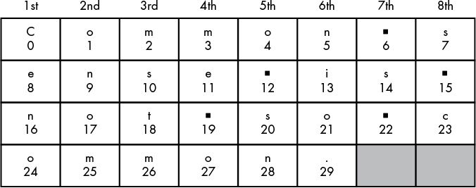
Basic Columnar Technique
Plain Text: Common sense is not so common.
Key: 8 (Number of columns)
Cipher text: Cenoonommstmme oo snnio. s s c

Slide 14
A Variant of Basic Columnar Technique
Plain Text: Common sense is not so common.
Key Pair: 8 (Number of columns), {3,1,7,2,6,8,5,4} (Reading sequence)
Cipher text: mstmCeno s onomnio.s co snme o

Slide 15
Columnar Technique with Multiple Rounds
ROUND 1
Columnar Technique
Key k₁
ROUND 2
Columnar Technique
Key k₂
Plain Text
Cipher Text

Slide 16
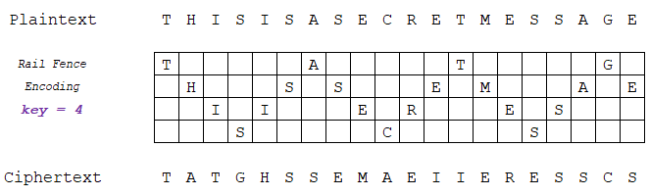
Rail Fence Technique
NOTE: The concept of Reading Sequence and Multiple Round
(like Columnar Technique) can also be used here.

Slide 17
THANK YOU

