Slide 1
Classification of Cryptographic Algorithms (based on Keys)
Symmetric Key Algorithm
Asymmetric Key Algorithm
Notes:
This template can be used as a starter file for presenting training materials in a group setting.
Sections
Sections can help to organize your slides or facilitate collaboration between multiple authors. On the Home tab under Slides, click Section, and then click Add Section.
Notes
Use the Notes pane for delivery notes or to provide additional details for the audience. You can see these notes in Presenter View during your presentation.
Keep in mind the font size (important for accessibility, visibility, videotaping, and online production)
Coordinated colors
Pay particular attention to the graphs, charts, and text boxes.
Consider that attendees will print in black and white or grayscale. Run a test print to make sure your colors work when printed in pure black and white and grayscale.
Graphics, tables, and graphs
Keep it simple: If possible, use consistent, non-distracting styles and colors.
Label all graphs and tables.

Slide 2
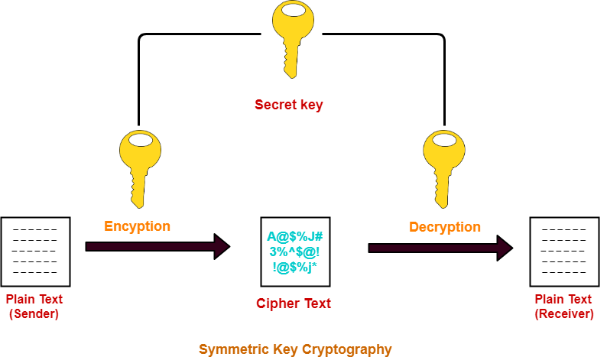
Symmetric Key Algorithm

Slide 3
Problems with Symmetric Key Algorithms
A large number of distinct keys are required.
For n persons, the number of keys required is n*(n-1)/2.
Exchange of key is a big issue.

Slide 4
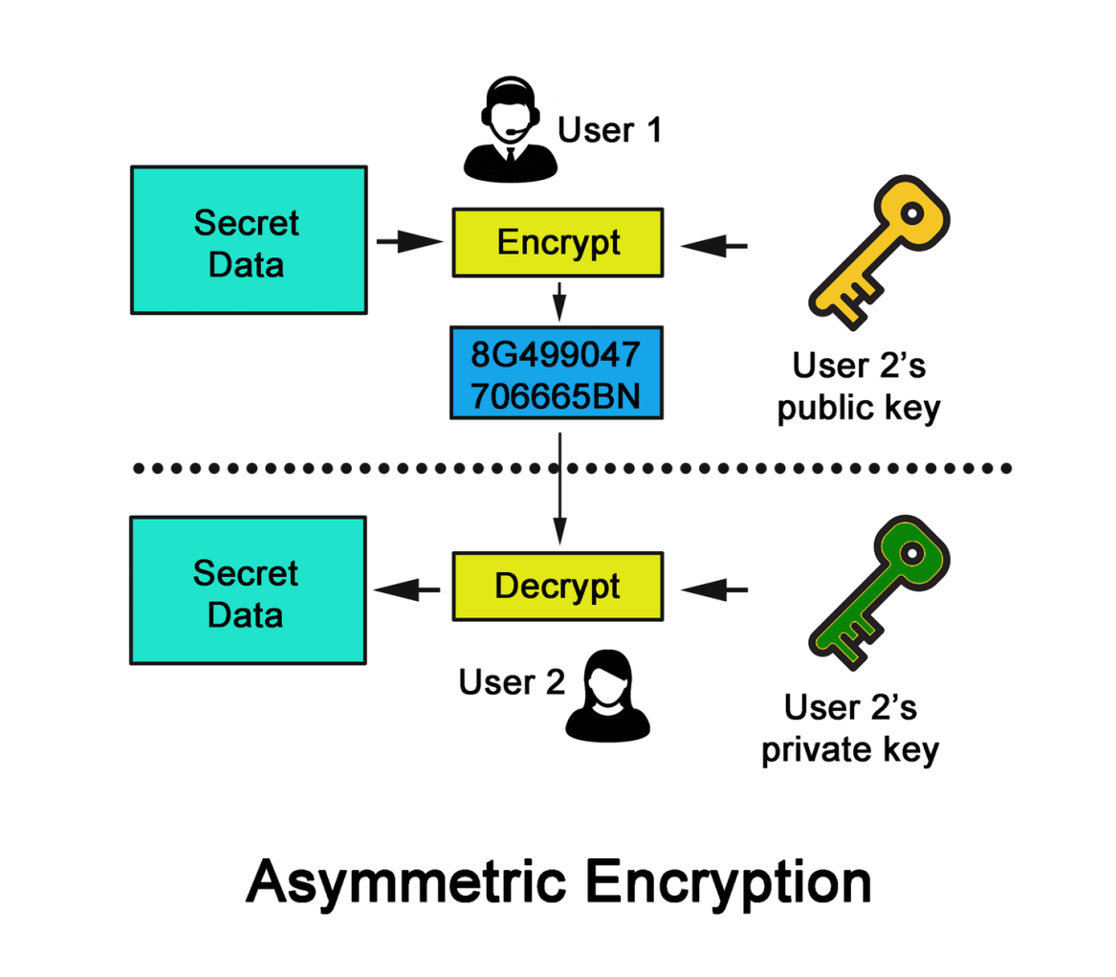
Asymmetric Key Algorithm

Slide 5
Symmetric Vs. Asymmetric Key Algorithm
Same key is used for both encryption and decryption in symmetric key algorithm whereas two different but related keys are used in asymmetric key algorithm, one for encryption and another for decryption.
For n persons, the number of keys required is n*(n-1)/2 for symmetric key algorithm whereas it is 2*n for asymmetric key algorithm.
Key exchange is not a problem of asymmetric key algorithm unlike symmetric key algorithm.
Symmetric key algorithms are faster than asymmetric key algorithms.

Slide 6
Diffie-Hellman Key Exchange / Agreement Algorithm

Slide 7
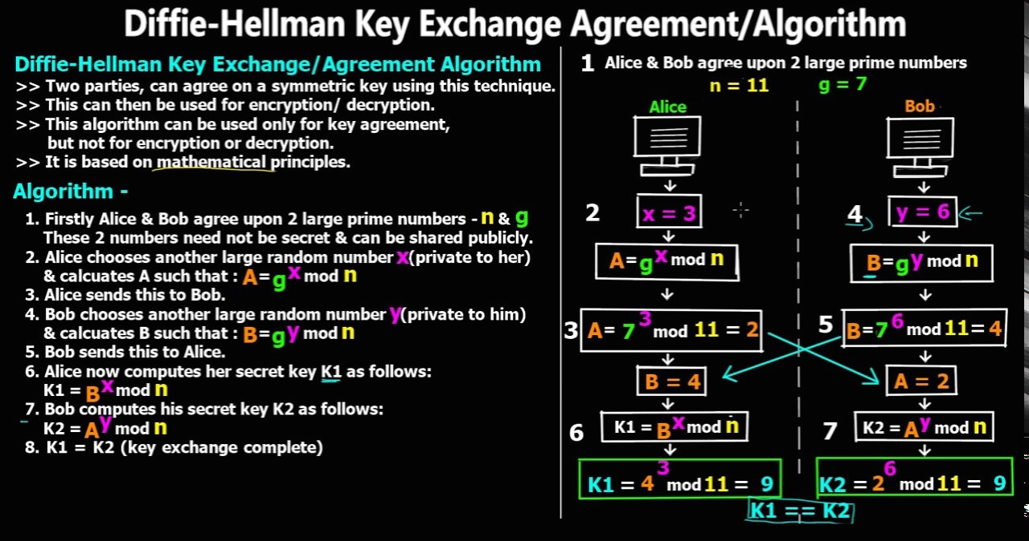

Slide 8
Mathematical Theory Behind The Diffie-Hellman Algorithm
Alice computes ----
K1 = B^{X} mod n ………………… (i) [Ref. step 6 of slide2]
Replacing B = g^{Y} mod n [Ref. step 4 of slide2] in equation (i) we get,
K1 = (g^{Y} mod n)^{X} mod n = (g^{Y})^{X} mod n = g^{XY} mod n … (ii)
Bob computes ----
K2 = A^{Y} mod n ………………… (iii) [Ref. step 7 of slide2]
Replacing A = g^{X} mod n [Ref. step 2 of slide2] in equation (iii) we get,
K2 = (g^{X} mod n)^{Y} mod n = (g^{X})^{Y} mod n = g^{xy} mod n … (iv)
Hence, from equation (ii) and (iii) we can say, K1 = K2 = K is the shared symmetric key.

Slide 9
Man-in-the-middle Attack
Step 1:
Alice
n=11, g=7
Bob
n=11, g=7
Tom
n=11, g=7

Slide 10
Man-in-the-middle Attack
Step 2:
Alice
x=3
Bob
y=9
Tom
x=8, y=6

Slide 11
Man-in-the-middle Attack
Step 3:
Step 4:
Alice
A = g^{X} mod n
=7³ mod 11
=2
Bob
B = g^{y} mod n
=7⁹ mod 11
=8
Tom
A = g^{X} mod n
=7⁸ mod 11
=9
B = g^{y} mod n
=7⁶ mod 11
=4
Alice
A=2, B=4
Bob
A=9, B=8
Tom
A=2, B=8

Slide 12
Man-in-the-middle Attack
Step 5:
Alice
K1 = B^{X} mod n
=4³ mod 11
=9
Bob
K2 = A^{y} mod n
=9⁹ mod 11
=5
Tom
K1 = B^{X} mod n
=8⁸ mod 11
=5
K2 = A^{y} mod n
=2⁶ mod 11
=9

Slide 13
Thank You

