Slide 1
Variations of DES 1. Double DES 2. Triple DES

Slide 2
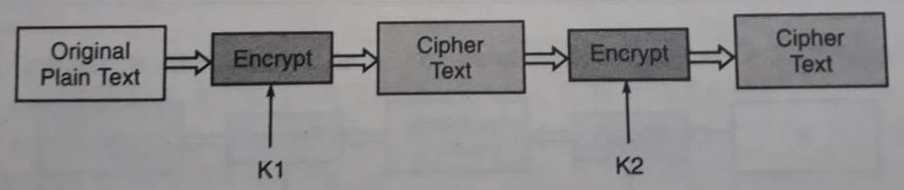
Double DES Encryption

Slide 3
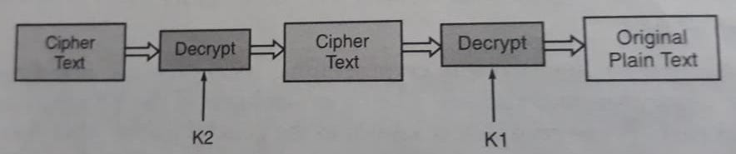
Double DES Decryption

Slide 4
Meet-in-the-middle Attack on Double DES (1/4)
If we use two different keys of n-bit each, the cryptanalyst would need 2^{2n} attempts to crack the key.
But Merkle and Hellman introduced the concept of the meet-in-the-middle attack, which involves encryption from one end, decryption from another end and matching the results in the middle, hence the name meet-in-the-middle attack.

Slide 5
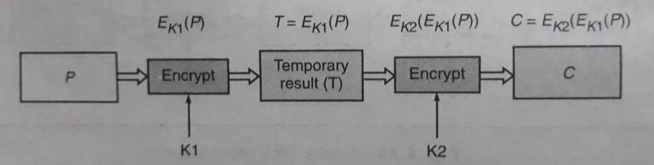
Meet-in-the-middle Attack on Double DES (2/4)
Mathematically Double DES can be expressed as follows:
Here, we assume that the cryptanalyst knows a plain text block P and the corresponding final cipher text block C.

Slide 6
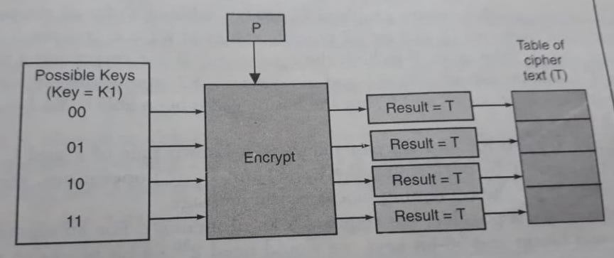
Meet-in-the-middle Attack on Double DES (3/4)
Conceptual view of the cryptanalyst’s encrypt operation

Slide 7
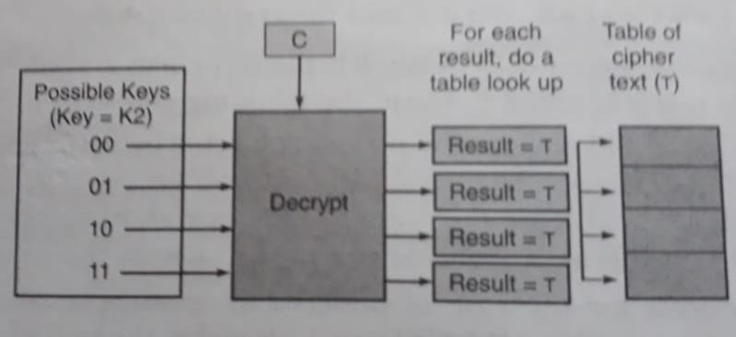
Meet-in-the-middle Attack on Double DES (4/4)
Conceptual view of the cryptanalyst’s decrypt operation

Slide 8
Triple DES
Triple DES is DES – three times.
It comes in two flavours:
One that uses three keys
The other that uses two keys

Slide 9
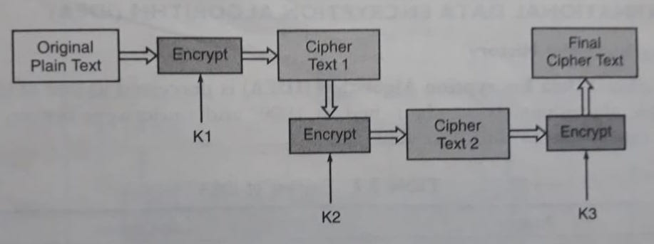
Triple DES with Three Keys

Slide 10
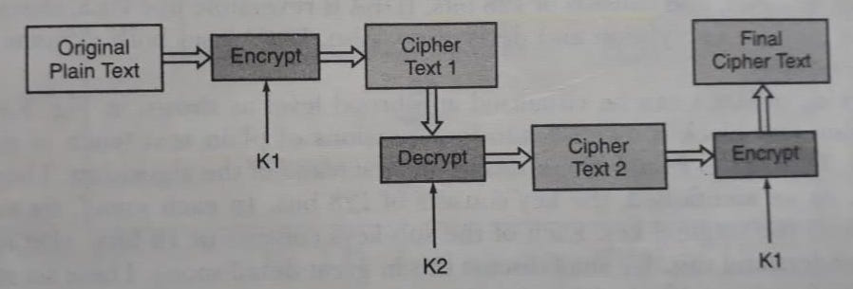
Triple DES with Two Keys

Slide 11
Question Can we use other modes (except ECB) of operations in DES ?
YES

Slide 12
Possible Types of Attacks on Encrypted Message
Cipher Text Only Attack
Known Plain Text Attack
Chosen Plain Text Attack
Notes:
This template can be used as a starter file for presenting training materials in a group setting.
Sections
Sections can help to organize your slides or facilitate collaboration between multiple authors. On the Home tab under Slides, click Section, and then click Add Section.
Notes
Use the Notes pane for delivery notes or to provide additional details for the audience. You can see these notes in Presenter View during your presentation.
Keep in mind the font size (important for accessibility, visibility, videotaping, and online production)
Coordinated colors
Pay particular attention to the graphs, charts, and text boxes.
Consider that attendees will print in black and white or grayscale. Run a test print to make sure your colors work when printed in pure black and white and grayscale.
Graphics, tables, and graphs
Keep it simple: If possible, use consistent, non-distracting styles and colors.
Label all graphs and tables.

Slide 13
Topics for Self-Study
Two Substitution Techniques
(1) Playfair Cipher
(2) Hill Cipher
Key Range and Size
How are they related with cryptanalysis / measuring the strength of a cryptographic algorithm?

Slide 14
Thank You

