Slide 1

This Photo by Unknown Author is licensed under CC BY-SA

Slide 2
This Photo by Unknown Author is licensed under CC BY-SA

Slide 3
This Photo by Unknown Author is licensed under CC BY-SA

Slide 4
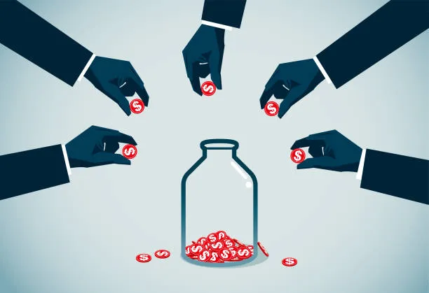
Crowdfunding Analysis

Slide 5


Crowdfunding Analysis

Slide 6
Summary
Company Overview
Kickstarter is an American public benefit corporation based in Brooklyn, New York, that maintains a global crowdfunding platform focused on creativity. The company's stated mission is to "help bring creative projects to life". As of February 2023, Kickstarter has received US$7 billion in pledges from 21.7 million backers to fund 233,626 projects, such as films, music, stage shows, comics, journalism, video games, board games, technology, publishing, and food-related projects.
Kickstarter launched on April 28, 2009 by Perry Chen, Yancey Strickler, and Charles Adler. The New York Times called Kickstarter "the people's NEA". Time named it one of the "Best Inventions of 2010" and "Best Websites of 2011". Kickstarter reportedly raised $10 million funding from backers including NYC-based venture firm Union Square Ventures and angel investors such as Jack Dorsey, Zach Klein and Caterina Fake. The company was based at 58 Kent Street in Greenpoint, Brooklyn until they transitioned to a fully remote workforce after the COVID-19 pandemic.

Slide 7
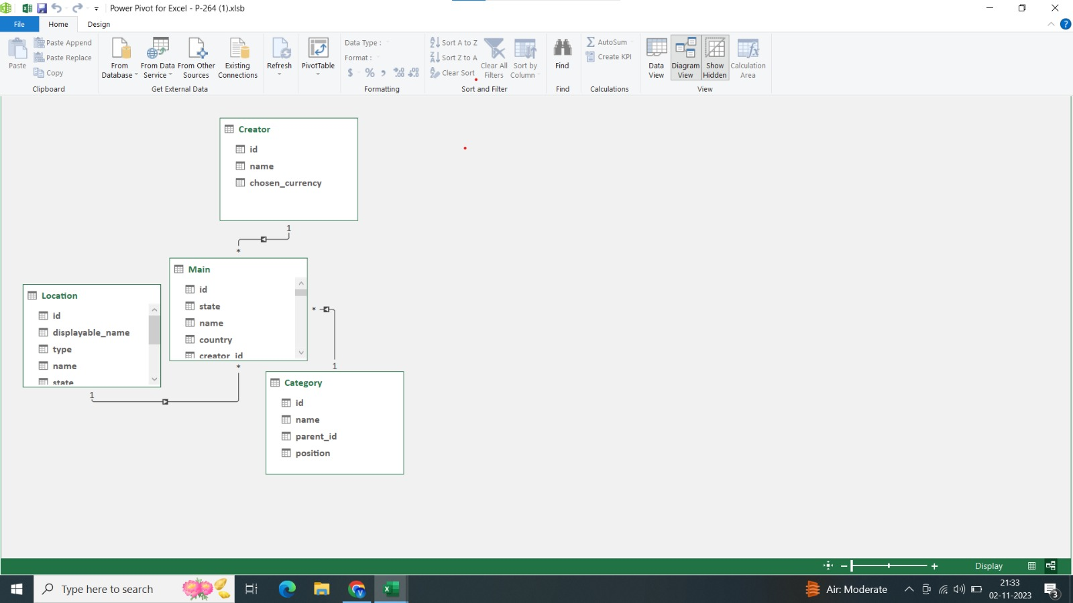
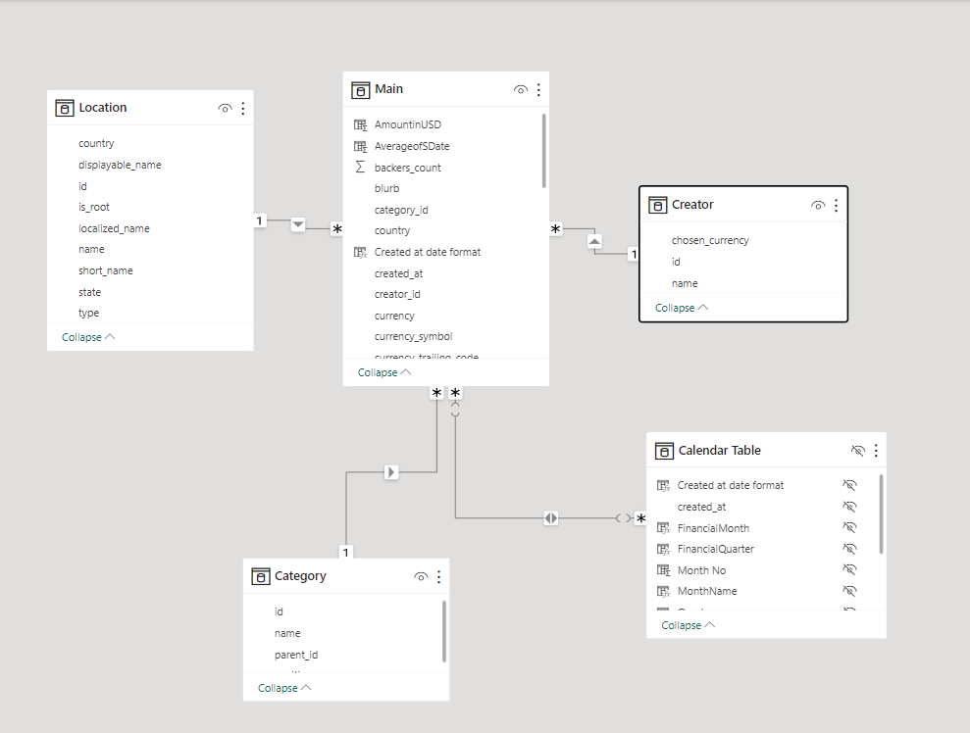
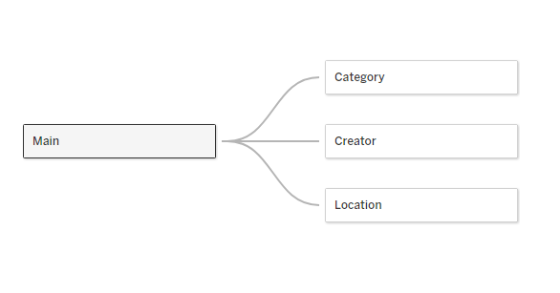
Data
Data Model
Excel
Powerbi
Tableau

Slide 8
Team
Group 6 - Team Members
Karan Parab
Jayshree Palande
Swapnali Lole
Vinay Yadav
Shweta Gohil
Sowjanya Reddy
Sujal Utekar

Slide 9
Problem Statement and Objective
Problem Statement:
Despite having an appealing website interface and intricate detailing, Kickstarter lacks a comprehensive tutorial or crash course that guides new users in creating their own pitches for backers and setting achievable funding goals.
Objective:
The aim is to ensure that the findings are not only relevant and beneficial to both the company and the creators, but also to the backers. This will enhance the overall user experience and effectiveness of the platform.

Slide 10
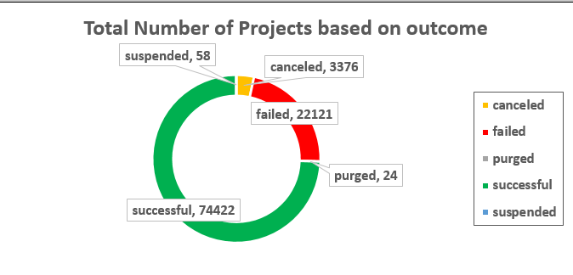
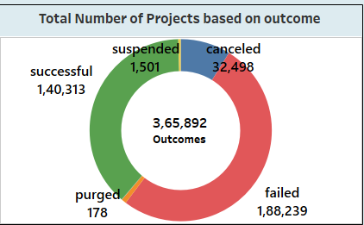
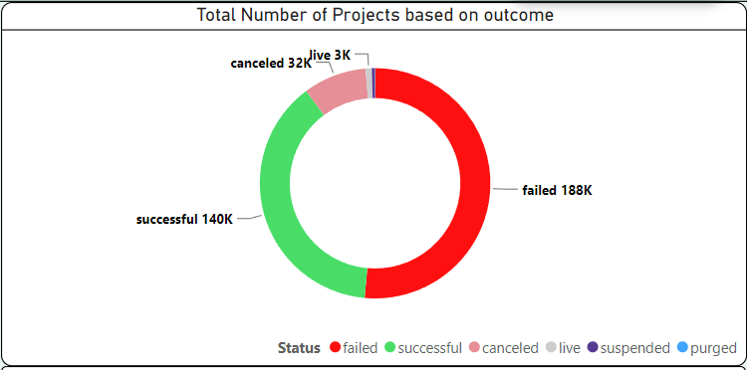
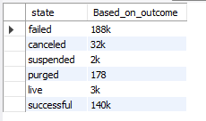
Total Number of Projects - overall
Excel
Tableau
Based on Outcome
Powerbi
MySQL
Based on Location

Slide 11
Total Number of Projects - overall
Excel
Tableau
Based on Outcome
Powerbi
MySQL
Based on Location

Slide 12
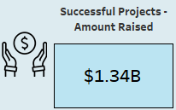
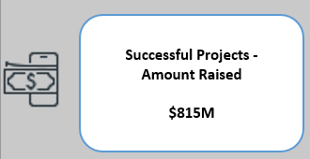
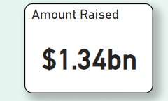

Successful Projects – Amount Raised
Based on Outcome
Excel
Tableau
Amount Raised
Powerbi
MySQL

Slide 13
Successful Projects – Amount Raised
Based on Outcome
Excel
Tableau
Amount Raised
Powerbi
MySQL
Based on Number of Backers

Slide 14
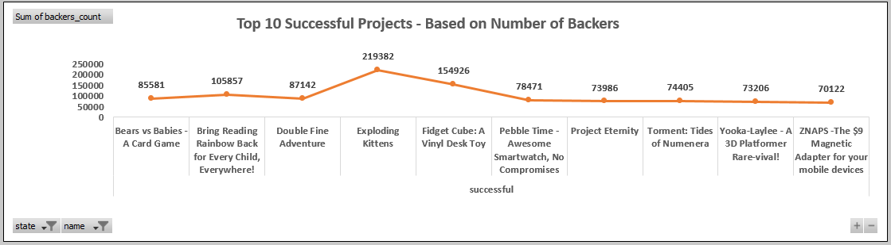
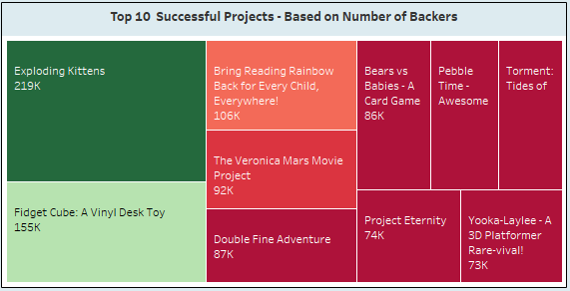
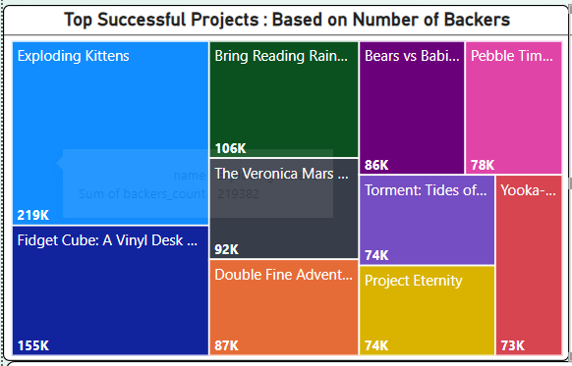
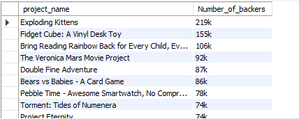
Top Successful Projects : Based on Number of Backers
Based on Year
Excel
Tableau
Based on Number of Backers
Based on Location
Powerbi
MySQL
Based on Category

Slide 15
Top Successful Projects : Based on Number of Backers
Based on Year
Excel
Tableau
Based on Number of Backers
Based on Location
Powerbi
MySQL

Slide 16
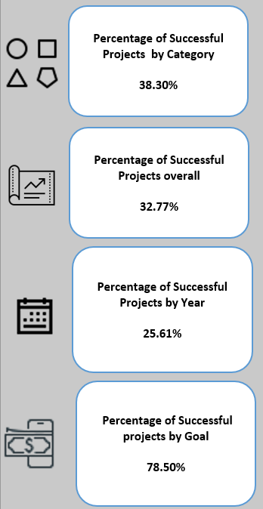
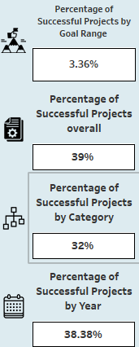
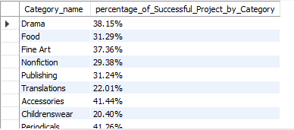
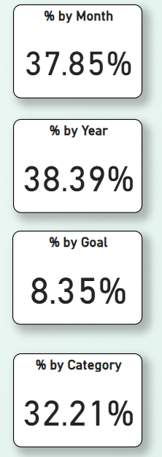
Percentage of Successful Projects by Category
Based on Category
Excel
Tableau
Success %
Based on Outcome
Based on Location
Powerbi
MySQL
Based on Number of Backers

Slide 17
Percentage of Successful Projects by Category
Success %
Based on Category
Excel
Tableau
Based on Outcome
Based on Location
Powerbi
MySQL
Based on Number of Backers

Slide 18
Suggesstions
Suggestion: Kickstarter should place a higher emphasis on projects that hold the potential to revolutionize, bring about change, or simplify people’s lives. It has been observed that many innovative and forward-thinking projects often go unnoticed by backers.
Concern: There is an issue where some projects intentionally set their funding goals lower than necessary, creating an illusion of being over-backed. This practice could potentially discourage other creators, leading to a loss of confidence in their product pitches. This lack of confidence might be contributing to the high number of failed projects over time. It is crucial to address this to maintain a healthy and fair platform for all creators

Slide 19
Suggesstions
Suggestion: Kickstarter should place a higher emphasis on projects that hold the potential to revolutionize, bring about change, or simplify people’s lives. It has been observed that many innovative and forward-thinking projects often go unnoticed by backers.
Concern: There is an issue where some projects intentionally set their funding goals lower than necessary, creating an illusion of being over-backed. This practice could potentially discourage other creators, leading to a loss of confidence in their product pitches. This lack of confidence might be contributing to the high number of failed projects over time. It is crucial to address this to maintain a healthy and fair platform for all creators

Slide 20
THANK
YOU!

