Slide 1
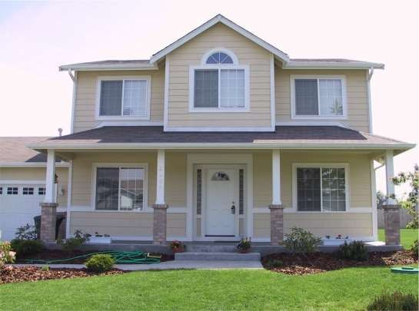
House Sale Price Prediction With GUI
Manoj(17001003030) karan(17001003025)
Mamta Kathuria mam
(Mentor)

Slide 2
-> Introduction
-> Acknowledgement
-> About Dataset
-> Libraries Used
Agenda
-> Gradient Boosting
-> Random Forest
-> Decision Tree
-> Algorithm Comparisons
-> GUI With Tkinter

Slide 3
 Our goal for this project was to use regression and classification techniques in order to estimate the sale price of a house in King County, Washington given the feature and pricing data for around 25,000 houses sold within one year.
Introduction

Slide 4
Acknowledgement
We would like to thank our mentor( Mamta
Kathuria mam) for her advice and inputs on the project.It could only be possible for us to make this project with the help of our mentor.

Slide 5
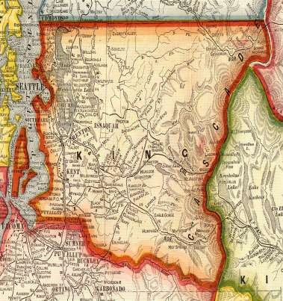
About Dataset
Our dataset comes from a Kaggle competition.
Our dataset contains house sale prices and its features for homes sold in King County, Washington between May 2014 and May 2015.
King County is the most populous county in Washington and is included in the Seattle-Tacoma-Bellevue metropolitan statistical area. The county is considered the 13th most populous county in the United States.
There are 25,000+ observations in the dataset.
There are 21 total attributes in the dataset, five of which we derived from current columns. We are planning to use 16 attributes in our models: all attributes except for id,date, yr_renovated,yr_built,zipcode.

Slide 6
 We chose not to use zipcode because the attributes latitude and
Attribute Percentage
Bedrooms 0.308349598
Bathroom 0.525137505
Sqft_living 0.702035055
Sqft_lot 0.089660861
Floors 0.256793888
Waterfront 0.266369434
View 0.397293488
Condition 0.036361789
4256
Sqft_above 0.605567298
Sqft_basement 0.323816021
Yr_built 0.054011531
Age -0.054011531
Yr_renovated 0.126433793
Age_renovation -0.105754631
Sqft_living15 0.585378904
Sqft_living15_diff 0.405391664
Sqft_lot15 0.082447153
Sqft_lot15_diff 0.050590661
longitude, contains the same and more information and easier to work within our models.
 We checked for missing variables and
the dataset didn’t contain any.
Dataset- Preprocessing

We performed feature selection by looking at the correlation
percentage of each attritube with price.
.
Pipeline is used to perform imputer and standardization
simultaneously.


.
Train and test data are split on the basis of waterfront
variable because of uneven number of zeros and ones number of waterfront in dataset.

Slide 7
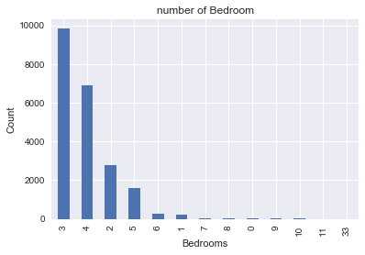
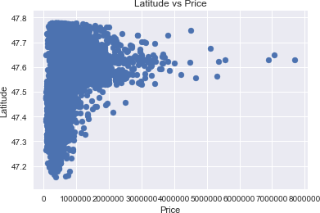
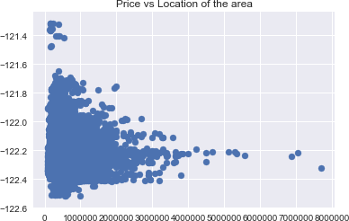
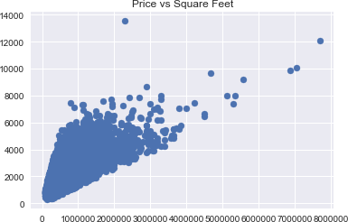
Co-relation
b/w attribute
and price

Slide 8
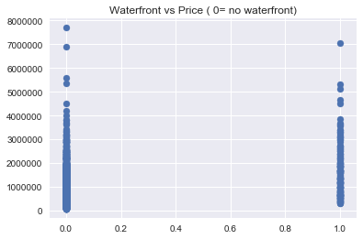
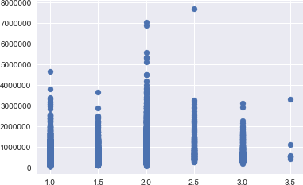
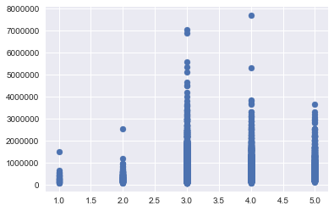
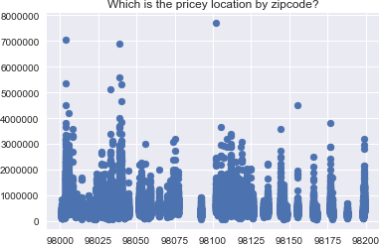
Floor vs Price


Co-relation b/w attribute and price

Condition vs Price

Slide 9
-> Numpy : To perform basic calculation.
10 neurons MSE R-value slope y-intercept MAE
FeedForward
Bayesian 0.0019 0.8941 0.8185 -0.1595 0.0289
FitNet Bayesian 0.0018 0.8951 0.8064 -0.1701 0.0295
FitNet
LevenbergMarquardt 0.0019 0.8931 0.797 -0.1785 0.0294
FeedForward
LevenbergMarquardt 0.0021 0.8826 0.7863 -0.1865 0.0304
100 neurons MSE R-value slope y-intercept MAE FeedForward
Bayesian 0.0019 0.8983 0.8922 -0.0944 0.025
FitNet Bayesian 0.0015 0.9142 0.8715 -0.1128 0.0258
FitNet
LevenbergMarquardt 0.0017 0.9009 0.8209 -0.1574 0.0283
FeedForward
LevenbergMarquardt 0.002 0.8878 0.8053 -0.1714 0.03
->Pandas : To collect dataset and performing changes on dataset.
Libraries Used
->Sklearn : It is the most important library.All the major work is done under this library like splitting the dataset,training and prediction.
->Tkinter : It is used to give the model a graphical interface to the user.

Slide 10
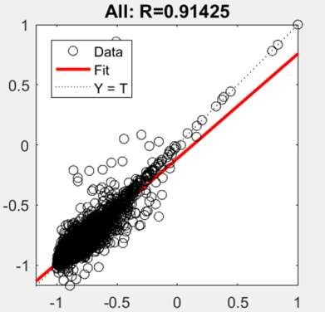
Gradient Boosting Regressor:



"Boosting" in machine learning is a way of combining multiple simplemodels into a single composite model. This is also why boosting is known as an additive model, since simple models (also known as weak learners) are added one at a time, while keeping existing trees in the model unchanged. As we combine more and more simple models, the complete final model becomes a stronger predictor. The term "gradient" in
"gradient boosting" comes from the fact that the algorithm uses gradient descent to minimize the loss.
Gradient Boosting


Slide 11
Random Forest Regressor :
Random forest is a bagging technique and not a boosting technique. The trees in random forests are run in parallel. There is no
interaction between these trees while building







Random Forest
the trees.It operates by constructing a multitude
of decision trees at training time and outputting
the class that is the mode of the classes
(classification) or mean prediction (regression)
of the individual trees.
A random forest is a meta-estimator
(i.e. it combines the result of multiple predictions) which aggregates many decision trees.

Slide 12
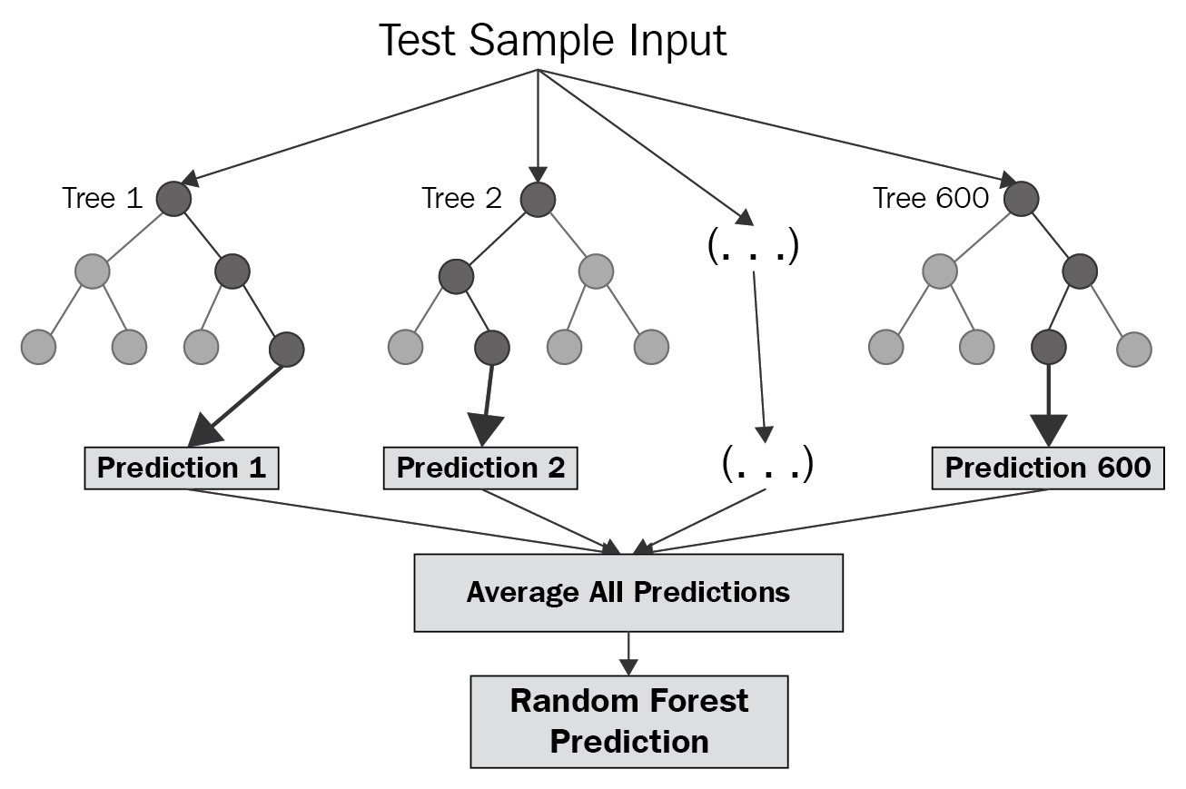
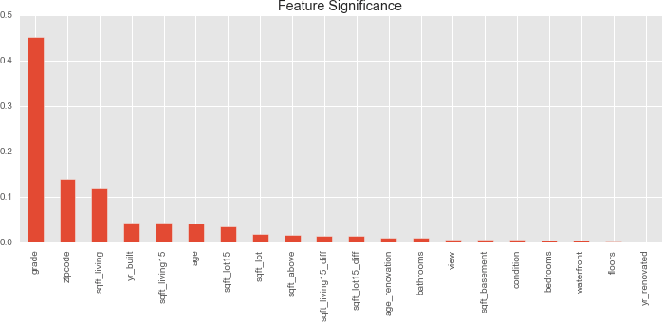
Random Forest


Slide 13
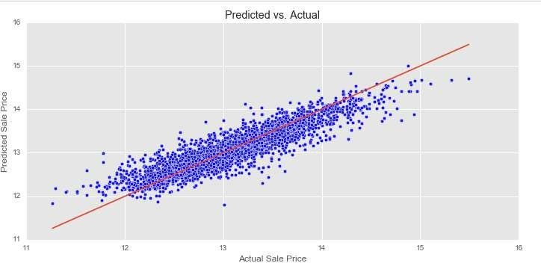
Decision Tree Regressor :

Error, and Explained Variance of each model were calculated to find the quality and performance of the algorithm.
 Model 1 performed the best
 |R-Squared = 0.825 | Adj. R-Squared = 0.825| RMSE = 0.217 |Mean Absolute Error | = 0.157| Explained Variance Score= 0.825
Decision Tree is a decision-making tool that uses a flowchart-like tree structure or is a model of decisions and all of their possibleresults, including outcomes, input costs and utility.
Decision-tree algorithm falls under the category of supervised learning algorithms.It works for both continuous as well as categorical output variables. Decision tree regression observes features of an object and trains a model in the structure of a tree to predict data in the future to produce meaningful continuous output.Continuous output means that the output/result is not discrete, i.e., it is not represented just by a discrete,known set of numbers or values.
Decision Tree

Slide 14
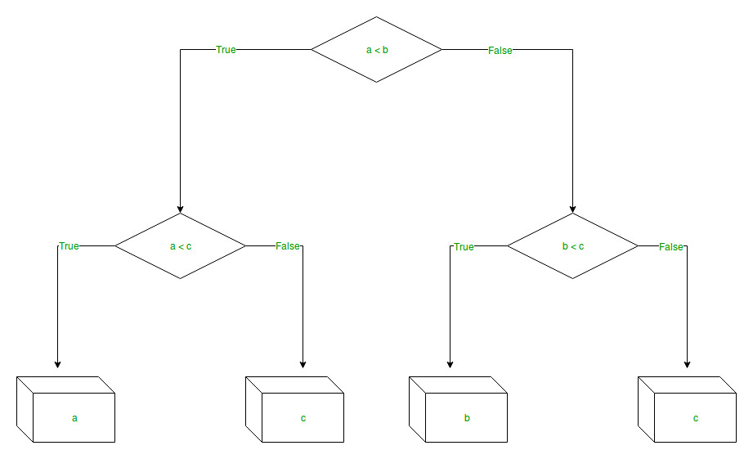
Decision Tree


SVMs only consider points near the margin (support vectors) –
more robust
Disadvantages:
 Due to complexity of the algorithm it requires high amount of memory and takes long time to train the model and predict the test data
 The model is sensitive to optimal choice of kernel and regularization parameters

Slide 15
Tkinter is the standard GUI library for Python. Python when combined with Tkinter provides a fast and easy way to create GUI applications.Tkinter provides a powerful object-oriented interface to the Tk GUI toolkit.
Creating a GUI application using Tkinter is an easy task. All you need to do is perform the following steps −
->Import the Tkinter module.
->Create the GUI application main window.
->Add one or more of the widgets to the GUI application.
->Enter the main event loop to take action against each event triggered by the user.
Tkinter

Slide 16
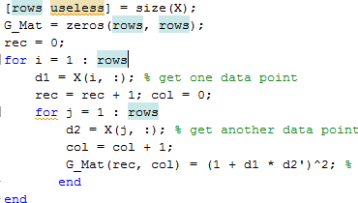




Basic Tkinter GUI
B
Creating Gram matrix from training data
Fit the model using gram matrix
Predict the New X
import Tkinter top = Tkinter.Tk()
# Code to add widgets will go here...
top.mainloop()
Tkinter

Slide 17



Regression Algorithm
-> Gradient Boosting:
Accuracy : Approx 89.4%
Predicted – Predicted – Predicted –
Class 1 Class 2 Class 3 ^{Total Actual}
Actual –
_{Class 1} 1548 2881 8 4437
Actual –
_{Class 2} 678 11473 613 12764
Actual –
_{Class 3} 5 1572 2835 4412
Total
_{Predicted} 2231 15376 3456 21613
Class 1 Class 2 Class 3
Precision 0.53 0.69 0.57
Recall 0.69 0.52 0.35
AUC 0.86 58 0.20
-> Decision Tree
Accuracy : Approx 76.2%
Algorithm Comparisons
-> Random forest
Accuracy : Approx 88.4%

Slide 18
Advantage of Random forest over decision tree
• Bucketed price values into three different groups:
• Less than or equal to 300K (21.2%);
• Greater than 300K
• Less than 700K (58.4%); 700K or greater (20.4%).
• Principle Component Analysis was performed to select the best features.
• Transformed data into a set of linearly uncorrelated variables.
• Chose the two components that accounted for the majority of data variance.
• Ran with 1-3 clusters with different levels of regularization.
• Selected clusters with lowest Negative Log-Likelihood.
• Used posterior probability as a predictor to see if this improved the accuracy.
• The best overall model was with 3 clusters and 0 regularization.
• The best model accuracy and lowest negative log-likelihood was with the posterior
probability with 0.05 regularization
Random Forest aggregates the individual predictions to combine into a final prediction, based on a majority voting on the individual predictions.
It can be shown that an ensemble of independent
Algorithm Comparison
classifiers, each with an error rate e, when combined
significantly reduces the error rate.
Suppose we have 10 independent classifiers, each
with error rate of 0.3,ϵ=0.3
In this setting, the error rate of the ensemble can be computed as below (we are taking a majority vote on the predictions) ϵensemble=∑i=10i=6(10i)ϵi(1−ϵ)10−i≈0.05
It can be seen that with the theoretical guarantees stated above an ensemble model performs significantly well over a single decision tree.

Slide 19
Thank you

