Slide 1

IISC Bengaluru CCE 2022​
Computing for Artificial Intelligence and Machine Learning​
Project - Credit Decision Model in Lending Industry
Submitted by
Chetan Mehatre
Karan Rajput

Slide 2
Background
Industry Overview:
The global FinTech lending market size was valued 449.85 USD Bn in 2020 and is projected to reach 4957.16 USD Bn by 2030, growing at a CAGR of 27.4% from 2021 to 2030.
Top Indian Companies in market -
Jupiter Money
Slice
Fi Money
Unicard
Razorpay
Navi
Facilities provided -
Credit Card
Buy Now Pay Later
Super Card
Personal Loans
Problem Statement:
How to check credit worthiness of a customer?
How much credit limit to be given?
How to decide the interest rate for a particular customer?
Data-Driven Solution:
Predict the probability that customer does not pay back balance their credit card/ pay later card/ super card based on demographic & historical credit history data

Slide 3
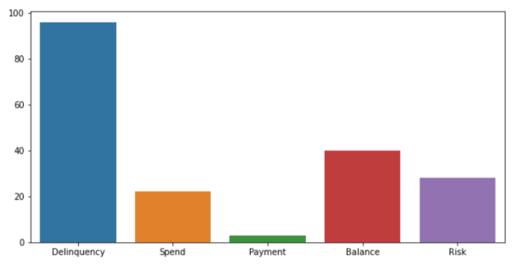
Data:
Source:
American Express is a globally integrated payments company. The largest payment card issuer in the world, they provide customers with access to products, insights, and experiences that enrich lives and build business success.
Shape of data
Rows - 924621
Columns - 190
Performance window - 18 months
Target variable - 120+ DPD latest statement
Features are anonymized and normalized, and fall into the following general categories:
D_* = Delinquency variables
S_* = Spend variables
P_* = Payment variables
B_* = Balance variables
R_* = Risk variables
Pre-Processing/Cleaning:
Stratified sample of 10000 data is chosen
Checking data info
Checking duplicates value
Checking Null Values
Dropped columns with 80% Null values
Filling remaining Null values with appropriate methods

Slide 4
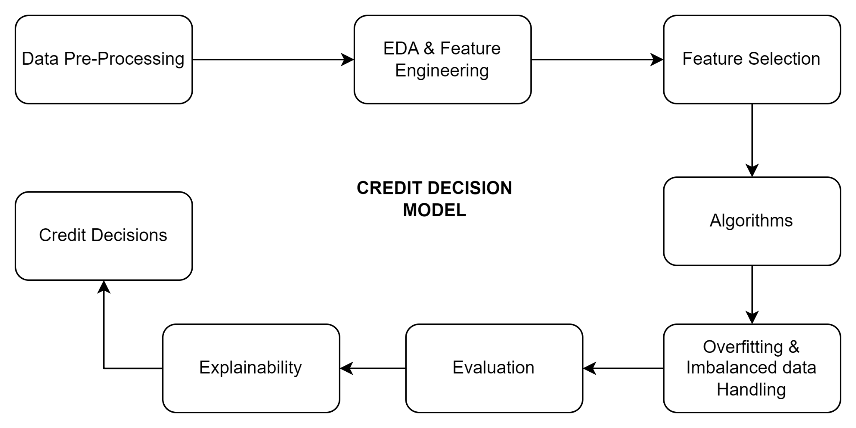
Block Diagram:

Slide 5
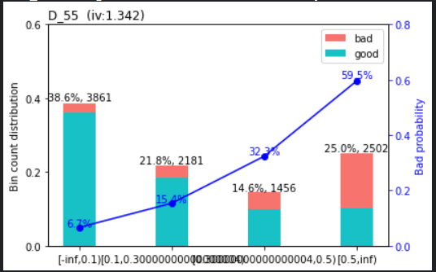
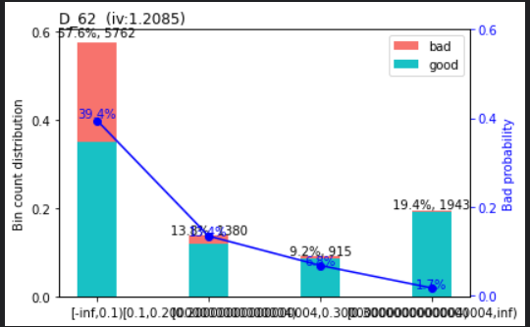
EDA, Feature Engineering & Feature Selection
Univariate Analysis
Log Transformation
Impute null values with appropriate methods
Select top features based on feature importance values
Feature Selection Methods:
Traditional - Bi-variate trend & WoE-IV values
Random Forest feature importance
Bi-Variate Plot: Trend Analysis

Slide 6
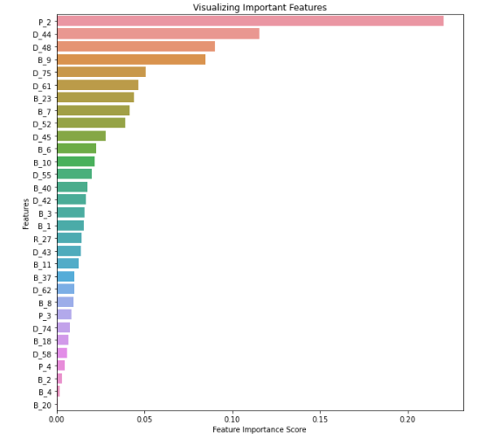
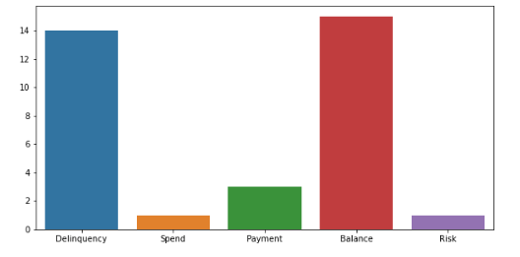
Exploratory Data Analysis
Distribution of features after selecting the top 29 features for further operations, this increases the speed, efficiency and accuracy of machine learning models

Slide 7
Best fit Model:
Algorithms | ROC AUC | Kolmogorov-Smirnov Statistics | Gini
Logistic Regression | Train: 0.93 Test: 0.92 | Train: 73 at decile 4 Test: 75 at decile 3 | Train: 0.8 Test: 0.84
Random Forest | Train: 0.9469 Test: 0.9455 | Train: 75.6 at decile 3 Test: 77.10 at decile 3 | Train: 0.89 Test: 0.89
XGBoost | Train: 0.9767 Test: 0.9674 | Train: 85.7 at decile 3 Test: 82.39 at decile 3 | Train: 0.94 Test: 0.92

Slide 8
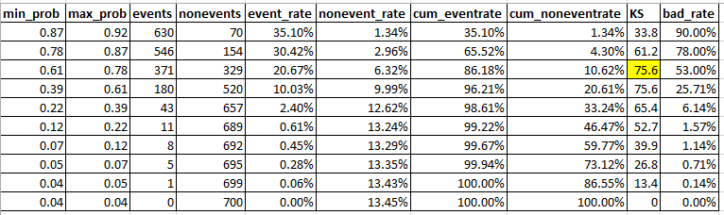
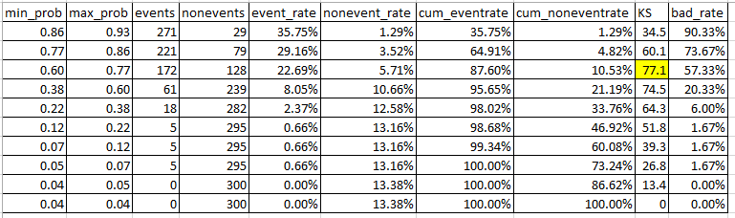
Kolmogorov-Smirnov Table:
Train:
Test:

Slide 9
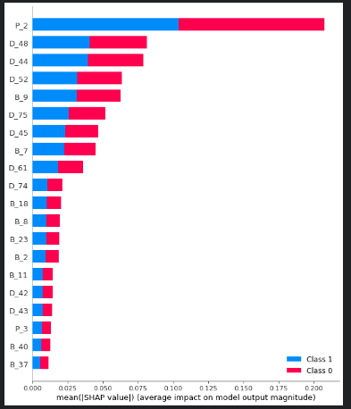
Explainability: Shapley Values

Slide 10
Credit Risk Decisions:
Business Outcome:
Decide threshold to Approve/Reject customers
Dynamic Limit Assignent
Increase / Decrease limit / block card
Risk based pricing
Customer segmentation & Portfolio analysis
Spending behavior analysis

Slide 11
Thank you!

Slide 12
