Slide 1
Children of the Dam:
Evaluating Impacts of Irrigation Dams on Children in India
Karan S. Shakya
(NEUDC 2024)

Slide 2
Agricultural Investments
Investment in the agricultural sector can be crucial for economic development and growth (Gollin 2010) but can also impose significant social and environmental costs (Garcia 2020).
India exemplifies this trade-off. The Green Revolution increased agricultural outputs (Evenson and Gollin 2003), economic productivity (Gollin et al. 2021), and improved population health (Bharadwaj 2020; von der Goltz et al. 2020).
However, this has also incurred unintended costs to environment quality (Brainerd and Menon 2014), human health (Sekhri and Shastry 2023), and possibly social equality (Dhanagare 1987).

Slide 3
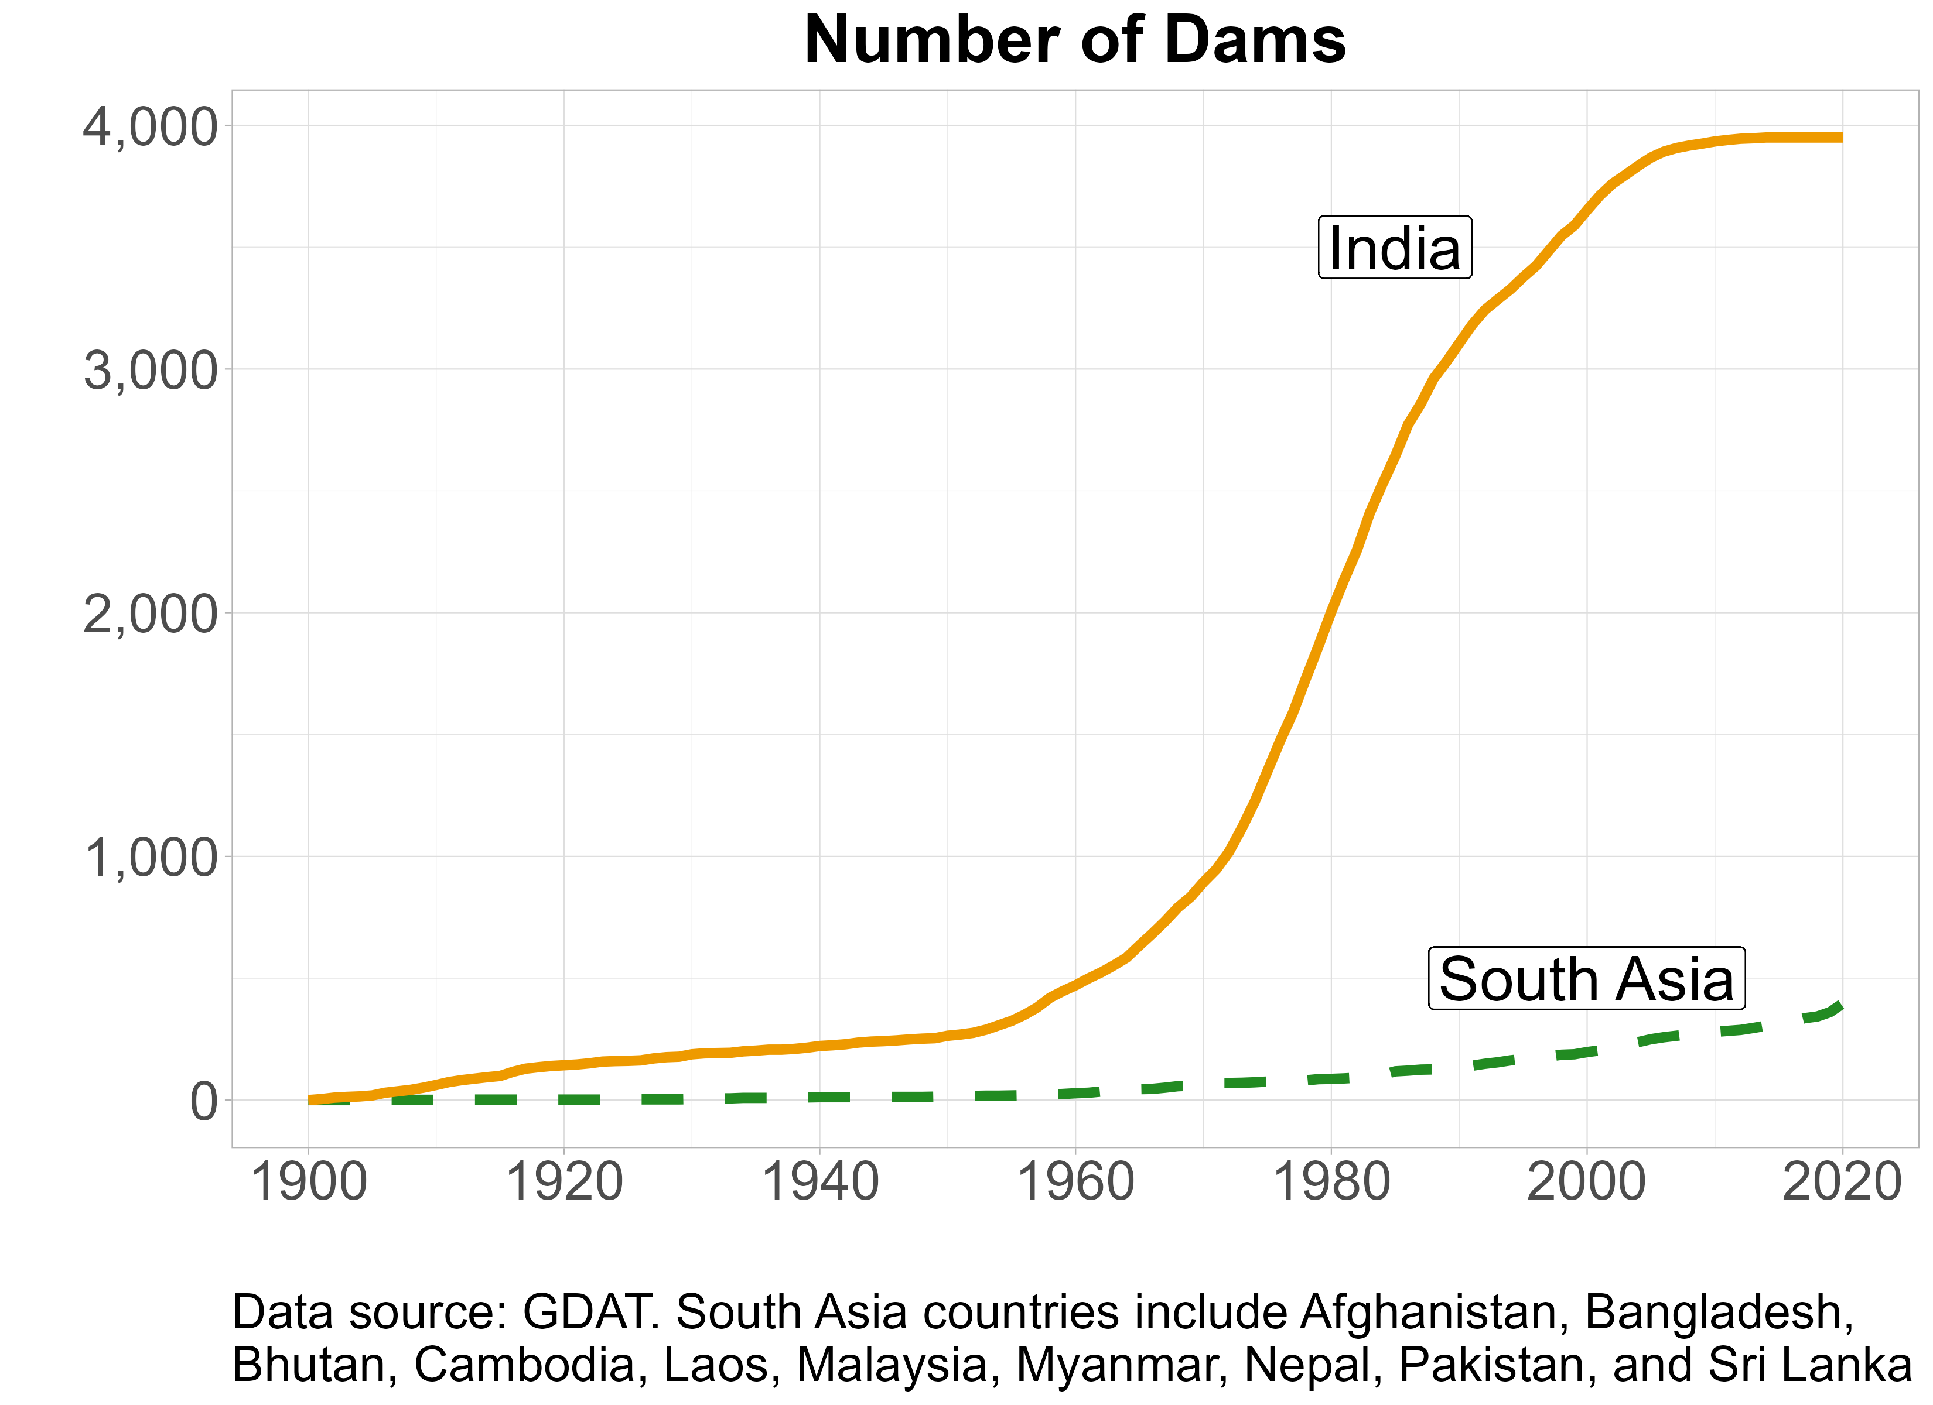
Irrigation Dams
Among the most grandiose, expensive, and contentious of agricultural investments.
Notable benefits for agricultural and economic growth, but at huge costs.
Gap in understanding its effects on human health, especially on children (WCD 2001; Dillon and Fishman 2019).
Dam Types in India

Slide 4
Research Questions
Do irrigation dams affect early childhood mortality in India, and do these effects vary spatially?
2) What are the key channels that could explain the observed health effects?

Slide 5
Antecedents and Contributions I
Motivated by the work of Duflo et al. 2007, who show that irrigation dams in India (1971-1999) increase agricultural productivity and reduce poverty in downstream districts only.
Consistent findings for agricultural productivity observed in the African context (Strobl and Strobl 2011; Blanc and Strobl 2014).
Effects on child health outcomes in African context (Mettetal 2019; Chakravarty 2011*).
Extend the assessments of early-childhood mortality and potential channels in the context of India 1990 to 2014.
I use a spatially finer unit of analysis: river basin boundaries, which have a more intuitive upstream/downstream relationship.

Slide 6
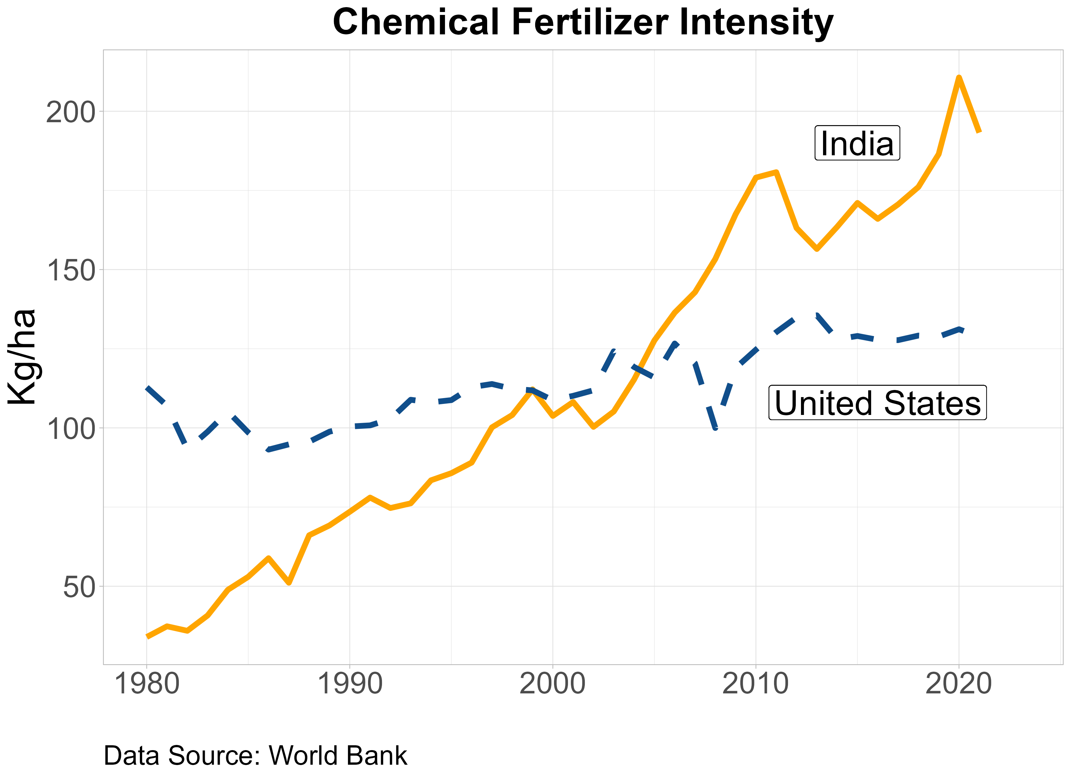
Antecedents and Contributions II
In India, chemical fertilizer intensity is increasing at a rapid rate.
High exposure to agrichemicals is linked to environmental degradation (Devi et al. 2022) and higher child mortality rates (Brainerd and Menon 2014).
Provide evidence that dam-induced increases in agrichemical exposure can be linked to mortality.
Crop Yield Trends

Slide 7
Data (1990 - 2014)
Survey | National Family Health Survey (2 waves: 2015/16 and 2019/21) Global Dam Database ICRISAT Agricultural Panel Surveys CPCB Water Quality Monitoring Database
Remote | HydroSHEDS Product: River Basin + Rivers Land Cover Indicators Malaria Atlas Agricultural Productivity (NDVI) Rainfall + Temperature

Slide 8
Identification Strategy
Non-random placement of irrigation dam biases the estimates.
Identifying causal relationships through an instrumental variable strategy using river gradients to predict the construction of dams (Duflo et al. 2007).
A high gradient, as opposed to a flat or steep gradient, increases the likelihood of irrigation dam constructions.
Generate time-varying predictions by interacting river gradients with dam construction trends over time and across states with varying shares of dam.
Dam Likelihood
First Stage Equation

Slide 9
Second Stage
$$Y_{irt}=β_{0}+β_{1}{\hat{Dam}}_{irt}+β_{2} {\hat{LDam}}_{irt}^{Up}+X_{irt}+γ_{r}+φ_{t}+ε_{irt}$$
Predicted dam in each river basin.
Controls include river gradient trends, geographic and household/mother variables, and number of non-irrigation dams.
Strong instruments (Stock and Yogo 2005).
Exogeneity in state-shares of dams (Goldsmith-Pinkham et al. 2020).
$$i=Child; r=River basin; t=Year$$
Pre-trends in Mortality

Slide 10
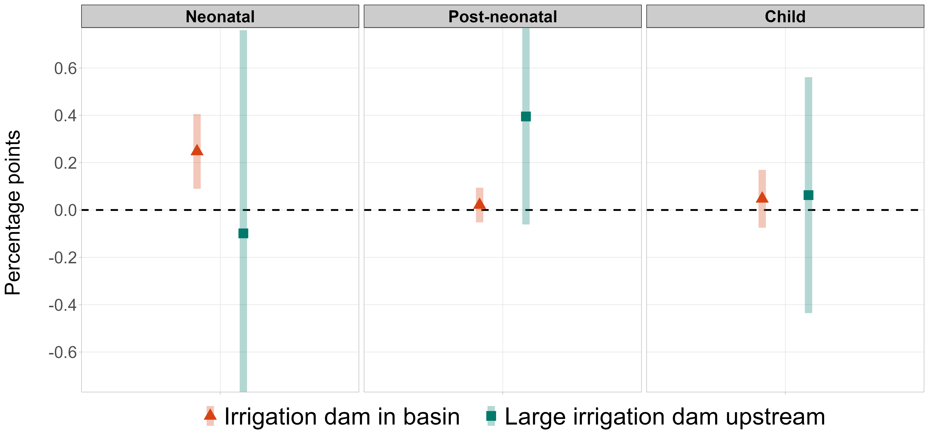
Early-Childhood Mortality
Regression Table

Slide 11
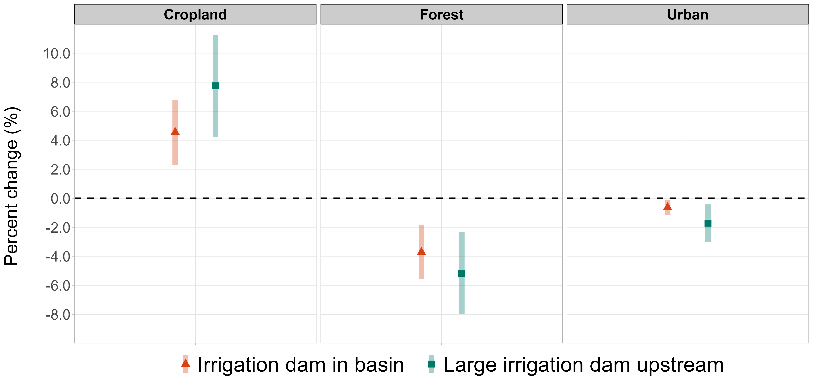
Land Cover Changes
Malaria Indicators

Slide 12
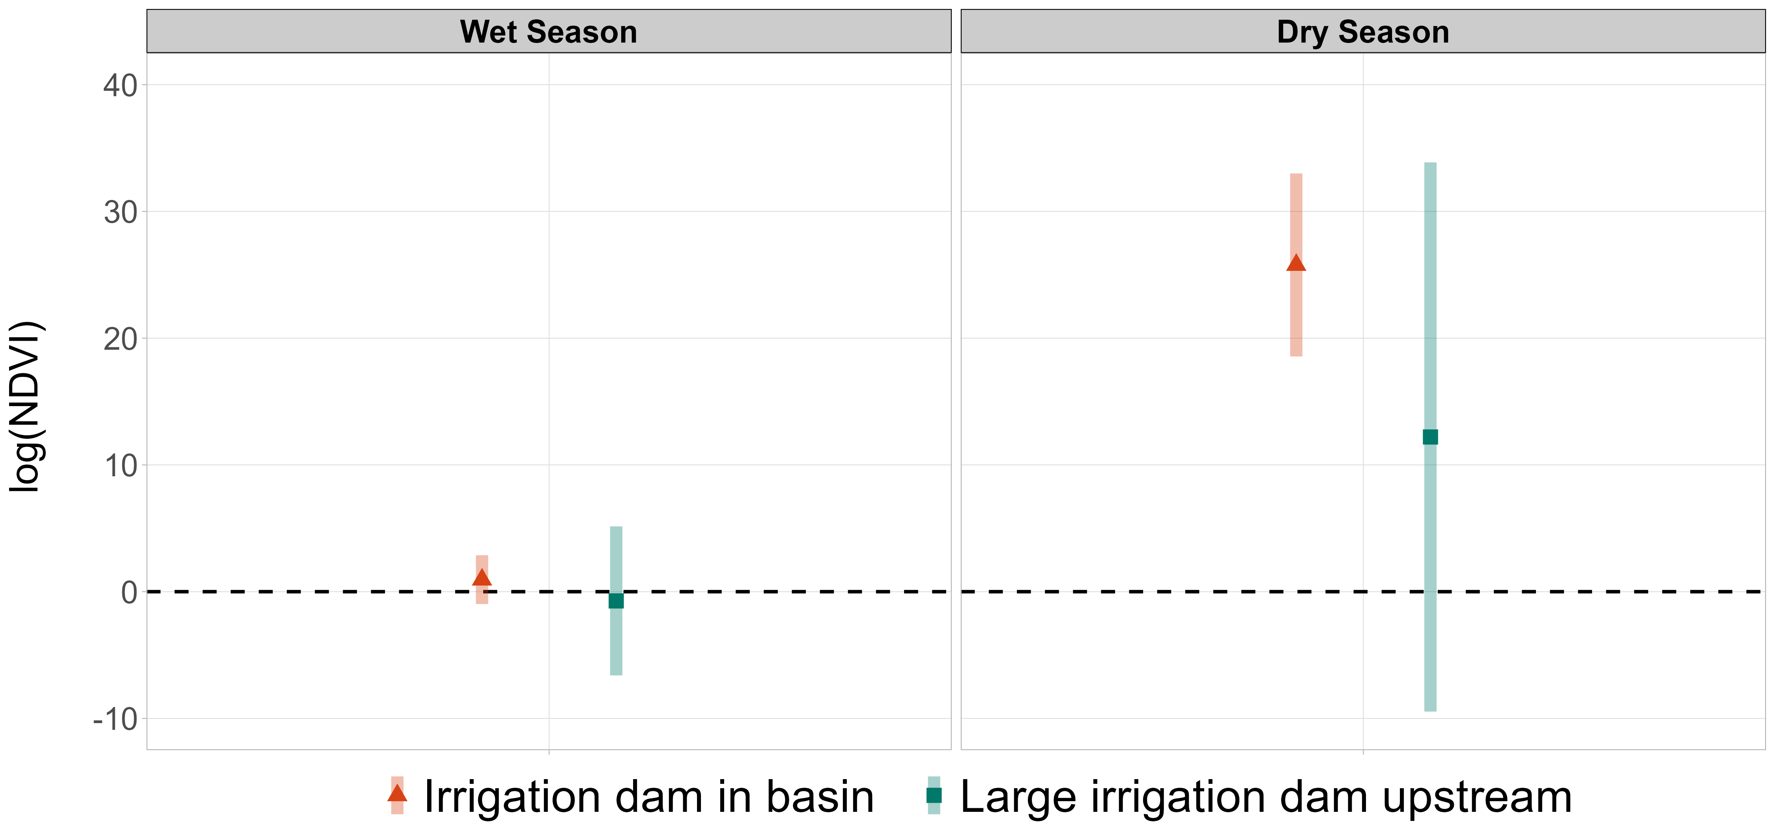
Agricultural Productivity

Slide 13
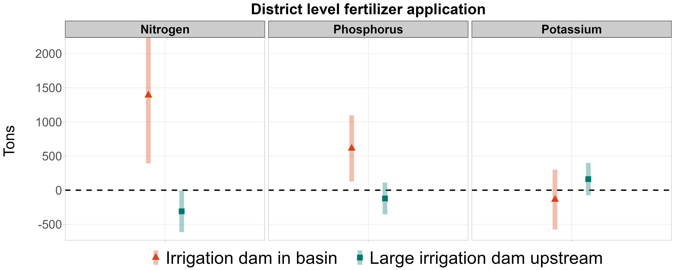
Agrichemical Exposure
Water quality data: local irrigation dams are associated with an increase of ‘high nitrate levels’ (>10 mg/L) by roughly 3.6%.

Slide 14
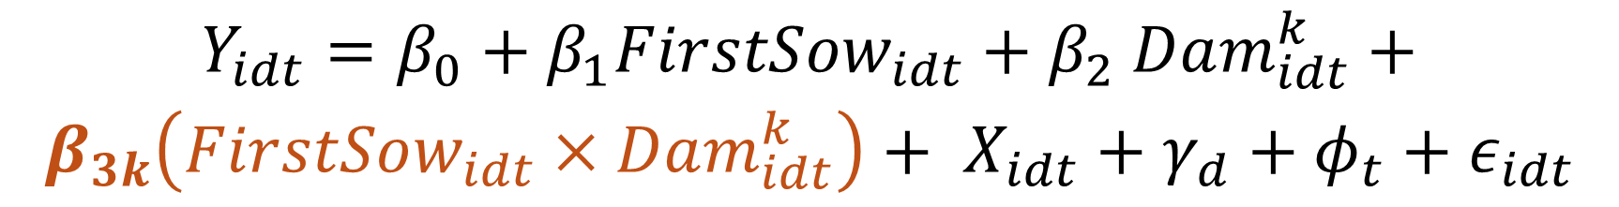
Sowing Season – Identification
High exposure to agrichemical fertilizer during the first-trimester is extremely harmful to infants (Brainerd and Menon 2014; Manassaram, Backer, and Moll 2006).
Typically, fertilizer applications is highest during the sowing period (basal application and top-dressing).
A time when NDVI starts to rise rapidly.
Compare the health outcomes of children whose first-trimester overlaps with their districts’ sowing period and assess whether increased dam intensity worsens these health risks.
$$Y_{idt}=β_{0}+β_{1}FirstSow_{idt}+β_{2} Dam_{idt}^{k}+$$
$$β_{3k}\left(FirstSow_{idt}×Dam_{idt}^{k}\right)+ X_{idt}+γ_{d}+φ_{t}+ε_{idt}$$

Slide 15
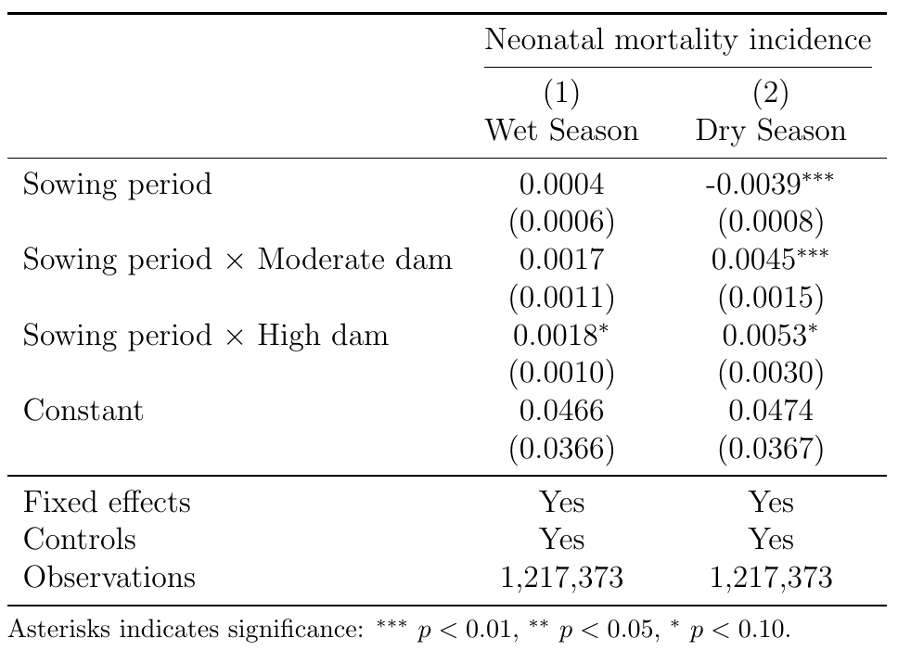
Sowing Season – Results

Slide 16
Conclusion
Irrigation dams in India increase neonatal mortality rates in river basins where they are constructed. Cost-benefit assessments need to account for these unintended consequences.
Increased exposure to agrichemicals due to dam-induced increases in productivity could explain observed health results.
Quantify the loss incurred due to these irrigation dams.
Thank You
shakya.11@osu.edu

Slide 17
Additional Slides

Slide 18
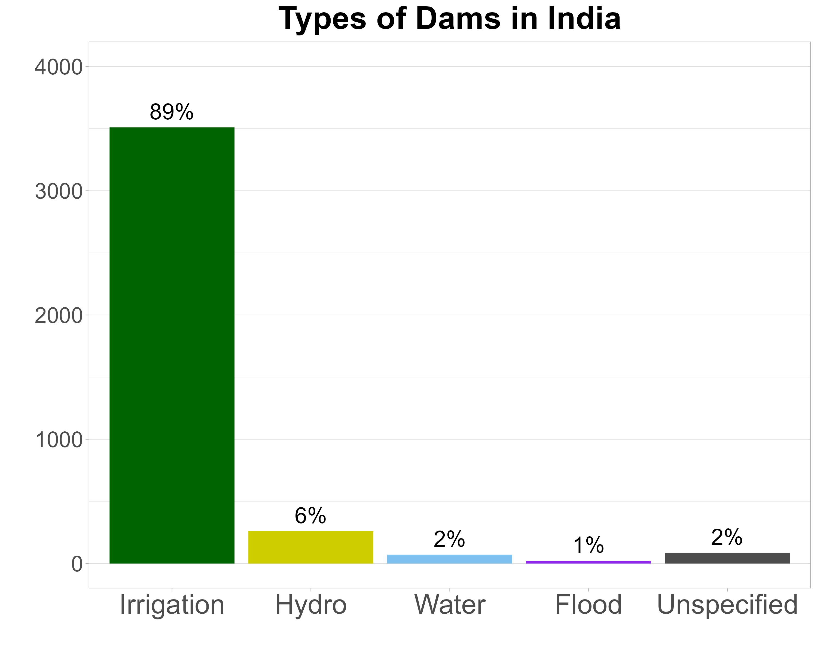
Dams in India
Irrigation Dams

Slide 19
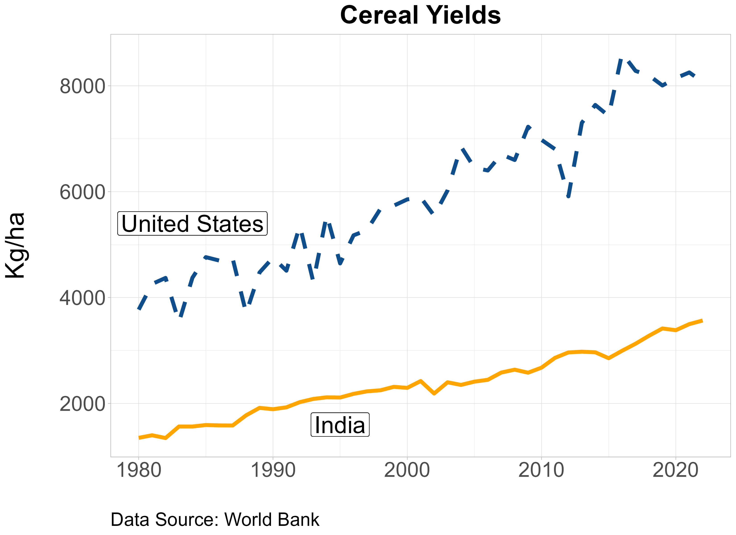
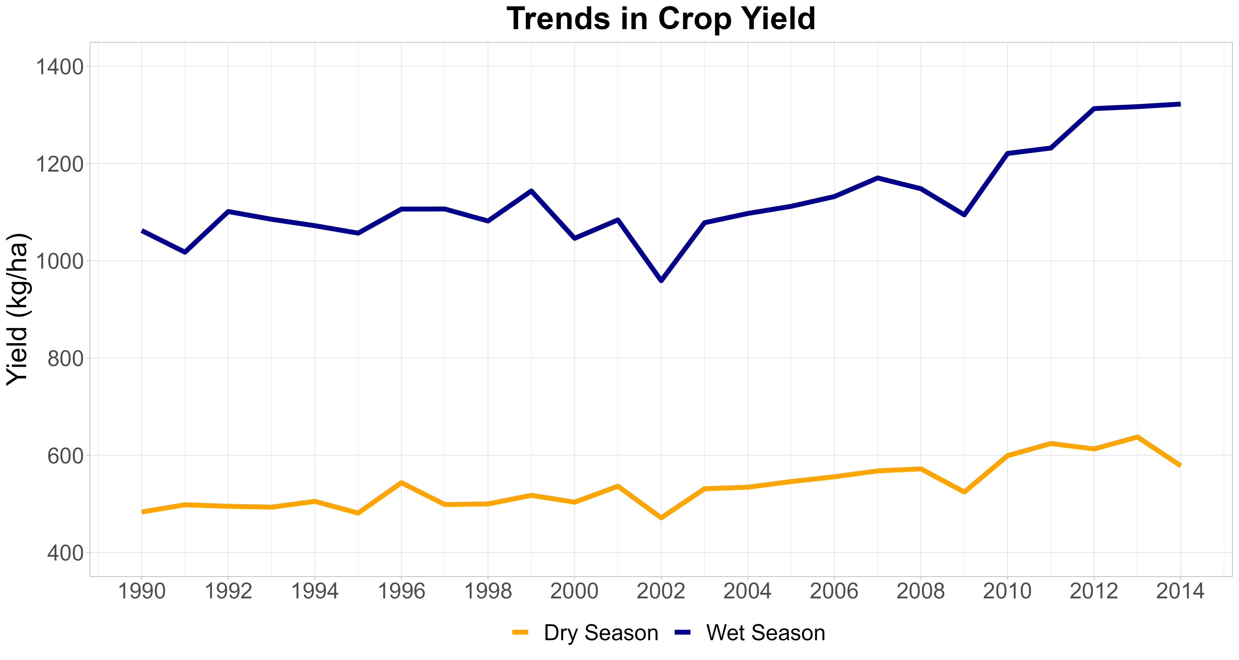
Crop Yield Trends
Chemical Fertilizers

Slide 20
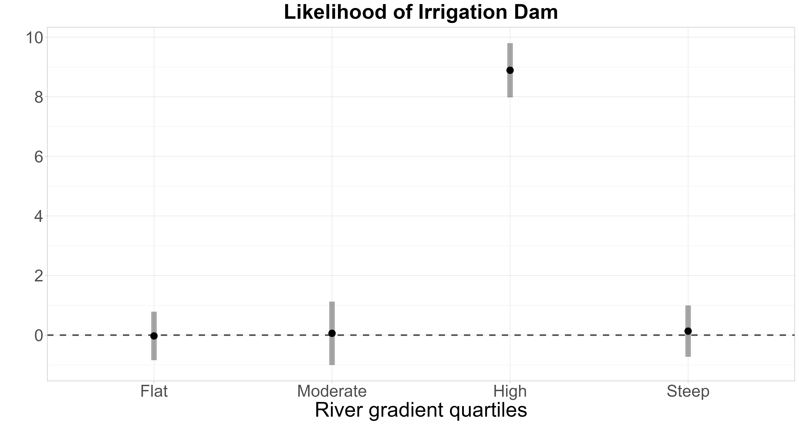
Dams and River Gradients
Identification Strategy

Slide 21
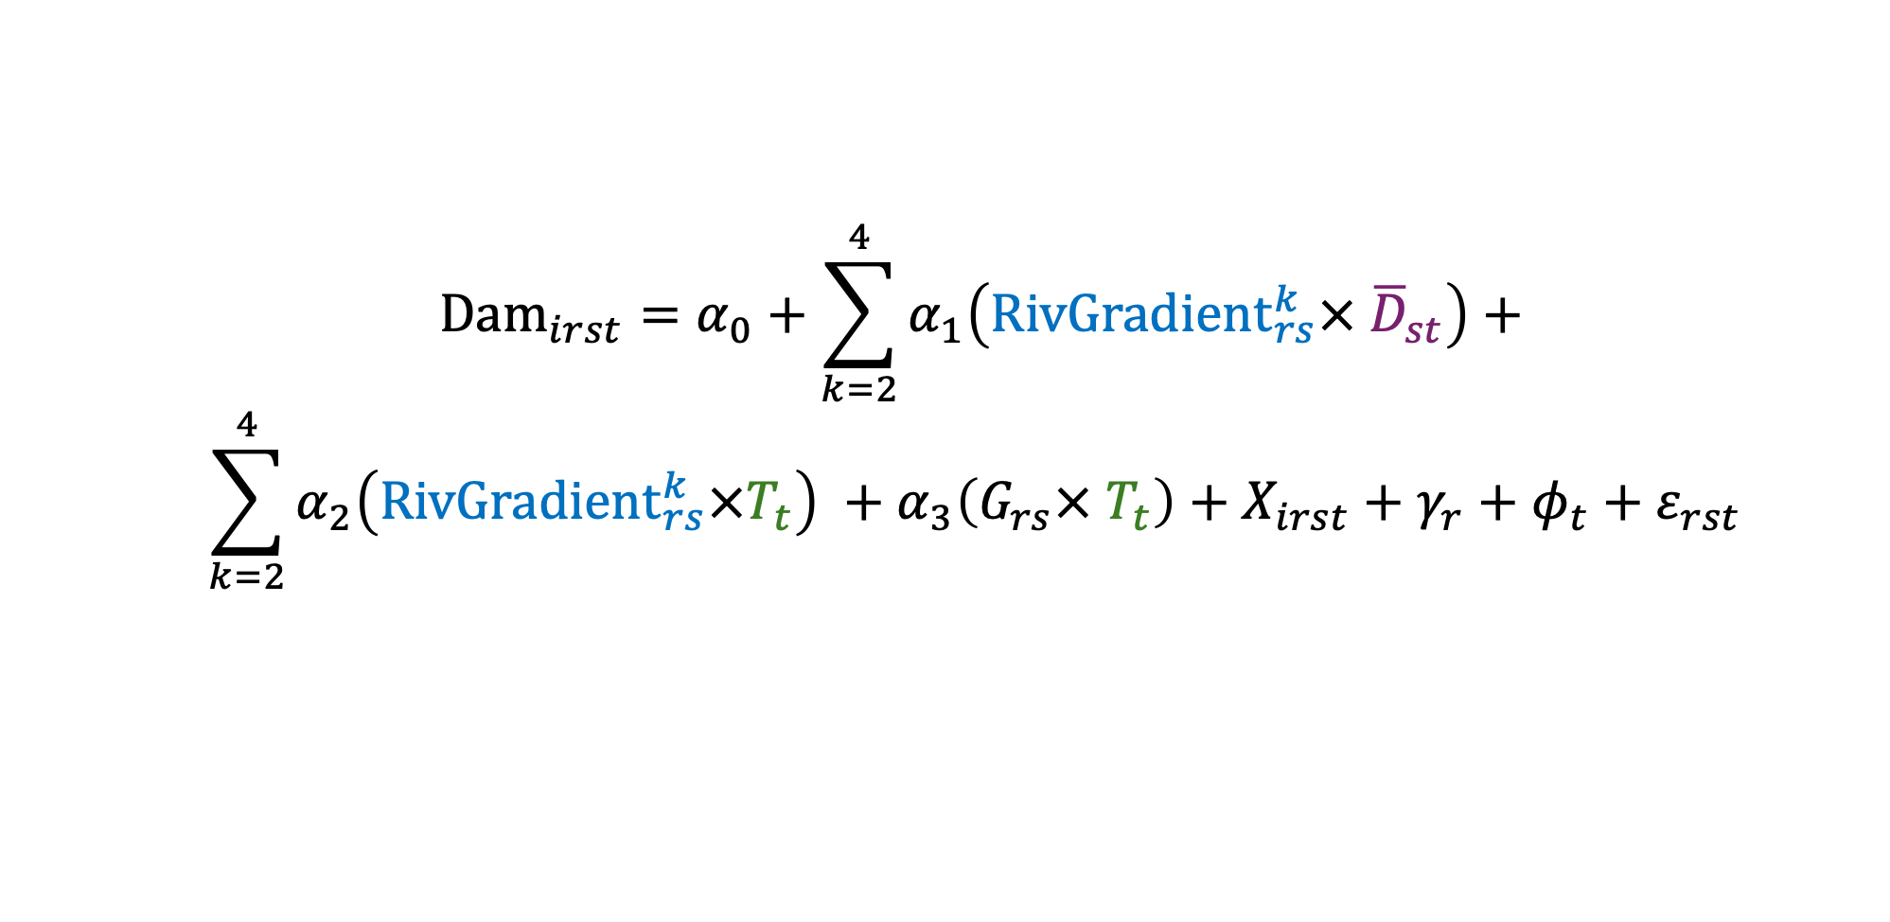
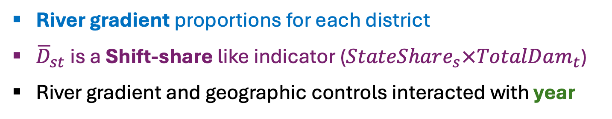
First Stage
$$Dam_{irst}=α_{0}+\sum_{k=2}^{4}{α_{1}\left(RivGradient_{rs}^{k}× {\overline{D}}_{st}\right)+}$$
$$\sum_{k=2}^{4}{α_{2}\left(RivGradient_{rs}^{k}×T_{t}\right) }+α_{3}\left(G_{rs}× T_{t}\right)+X_{irst}+γ_{r}+φ_{t}+ε_{rst}$$
River gradient proportions for each district
${\overline{D}}_{st}$is a Shift-share like indicator ($StateShare_{s}×TotalDam_{t}$)
River gradient and geographic controls interacted with year
$$i=Child; r=Region; s=State; t=Year$$
Identification Strategy

Slide 22
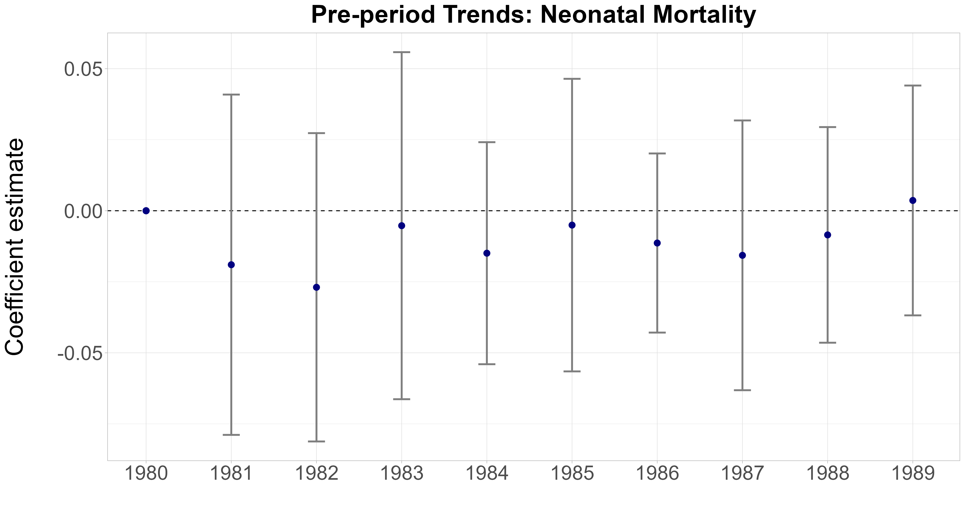
Pre-Trends across State-Shares
Second Stage

Slide 23
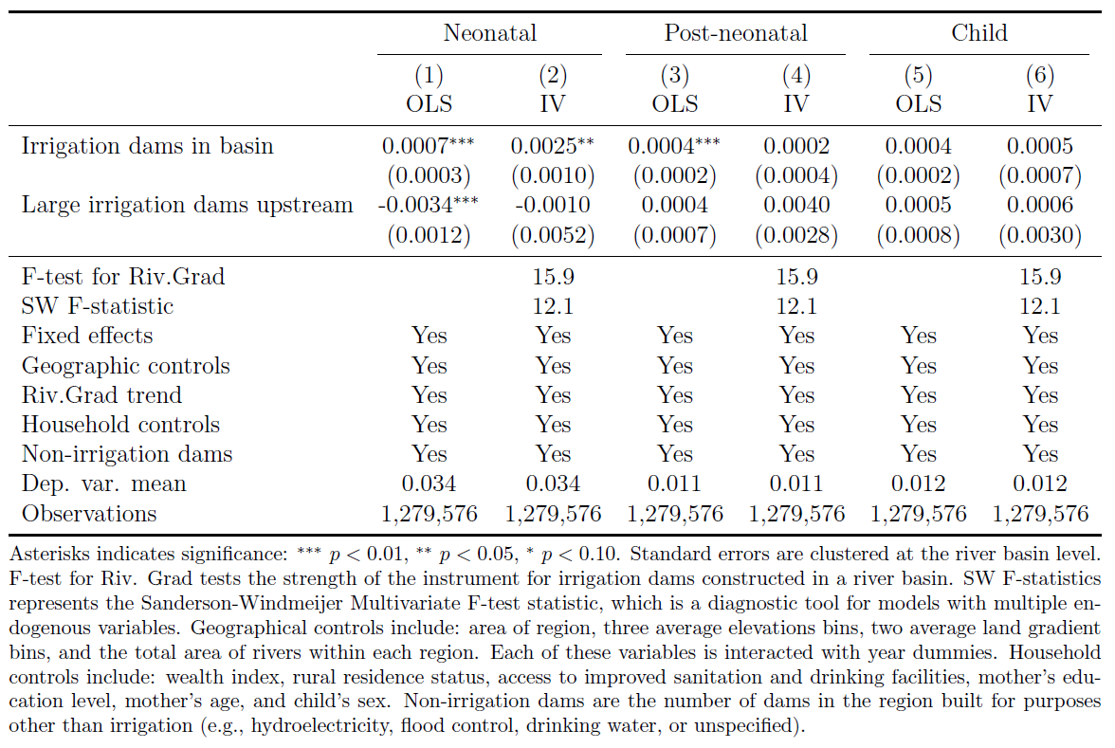
Early Childhood Mortality
Mortality

Slide 24
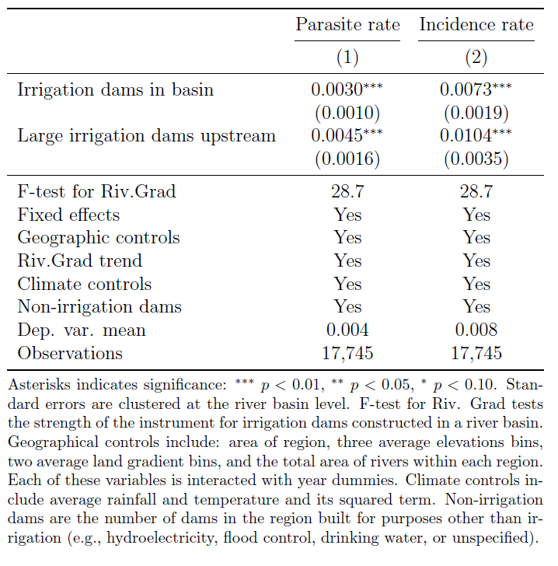
Malaria Indicators
Land Cover

