Slide 1

Stock Market Prediction
Bachelor of Technology
In
COMPUTER SCIENCE AND ENGINEERING
Submitted by
Karan Singh Bisht( 1613310098 )
Kamal Singh (1613310095)
Ravindra Kothiyal (1713310905)
Narendra Mehra(1613310123)
Under the supervision of
Ms. Vandana Bharti (Assistant Professor CSE)

Slide 2
Introduction
Stock Market prediction and analysis is the act of trying to determine the future value of a company’s stock.
Plays a vital role in the growth of the industry and commerce.
Both investors and industry are involved in stock market.
The stock market is the primary source for any company to raise funds for business expansions.
If the demand for a company's stock is higher, then the company share price increases.
if the demand for company's stock is low then the company share price decrease.
The fluctuation of stock market is violent and there are many complicated financial indicators.

Slide 3
Literature Survey/Existing System
There are many statistical models available for forecasting stock trends and choosing an appropriate model for a forecasting application depends on the format of the data.
Previous Work:
Regression: Regression is a machine learning algorithm based on supervised learning. It performs a regression task. Regression models a target prediction value based on independent variables.
LSTM: The long-short term memory is a type of recurrent neural netwok that stores past observations into its memory and during training it learns when to use this memory.
ARIMA: 'Auto Regressive Integrated Moving Average' is actually a class of models that 'explains' a given time series based on its own past values, that is, its own lags and the lagged forecast errors, so that equation can be used to forecast future values.

Slide 4
Problem Statement
Stock market is considered too uncertain to be predictable due to huge fluctuation of the market.
Investing in a good stock but at a bad time can have disastrous result.
while investing in a stock at the right time can bear profits.
Financial investors of today are facing problem. Why?
Because they do not properly understand as to which stocks to buy or which stocks to sell in order to get optimum result.
So, the purposed project will reduce the problem with suitable accuracy faced in such real time scenario.

Slide 5
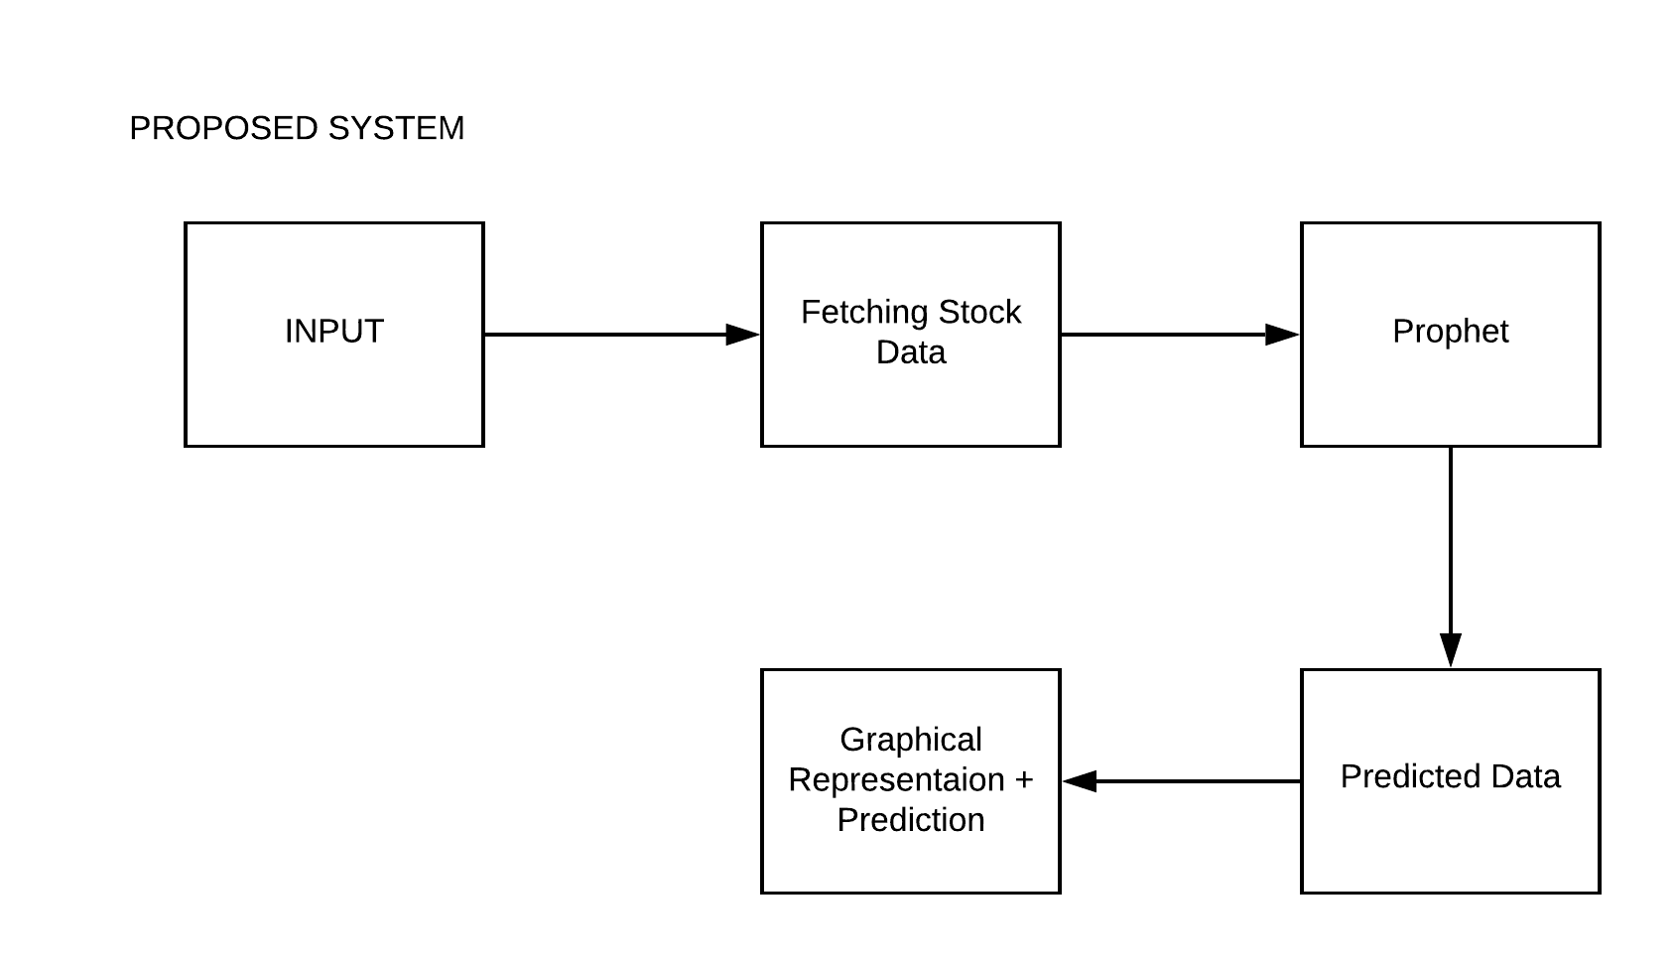
Proposed Methodology

Slide 6
INPUT : index name is acquired from the user through the front-end, using this user sends request to the API.
Stock data retrival : In this the stock data is retrieved from the yahoo finance website for the given period of time of the asked stock index. If the index name is wrong error is shown to re-enter.
Facebook Prophet:
Prophet is a procedure for forecasting time series data based on an additive model where non-linear trends are fit with yearly, weekly, and daily seasonality, plus holiday effects.
It works best with time series that have strong seasonal effects and several seasons of historical data.
The mathematical equation behind the Prophet model is defined as:
y(t)= g(t) + s(t) + h(t) + ε
g(t): piecewise linear or logistic growth curve for modeling non-periodic changes in time series
s(t): periodic changes (e.g. weekly/yearly seasonality)
h(t): effects of holidays (user provided) with irregular schedules
εt: error term accounts for any unusual changes not accommodated by the model

Slide 7
Predicted Data : this contains the predicted data or the forecated data which is given by the model, using this data we will be taking the decision on stocks.
Presentation :
Graphical Presentation : in this both the actual data of a particular stock and the forecasted data of the stock is represented in the form of graphs to the user.
Decision Made : using the predicted data a decision made by the system is shown on the screen, this can be:
BUY : for telling to buy a stock i.e the system expects user to make profit on this stock.
SELL/SHORT : the system is excepting a downfall of this stock, therefore the sell or short is shown.

Slide 8
Feasibility
Functional Requirement: Functional requirement are the functions or features that must be included in any system to satisfy the business needs and be acceptable to the users.
The system should be able to generate an approximate share price.
The system should collect accurate data from the STOCK website in consistent manner.
Non-functional Requirement: Non-functional requirement is a description of features, characteristics and attribute of the system as well as any constraints that may limit the boundaries of the proposed system.
Based on these the non-functional requirements are as follows:
The system should provide better accuracy.
The system should have simple interface for users to use
To perform efficiently in short amount of time.

Slide 9
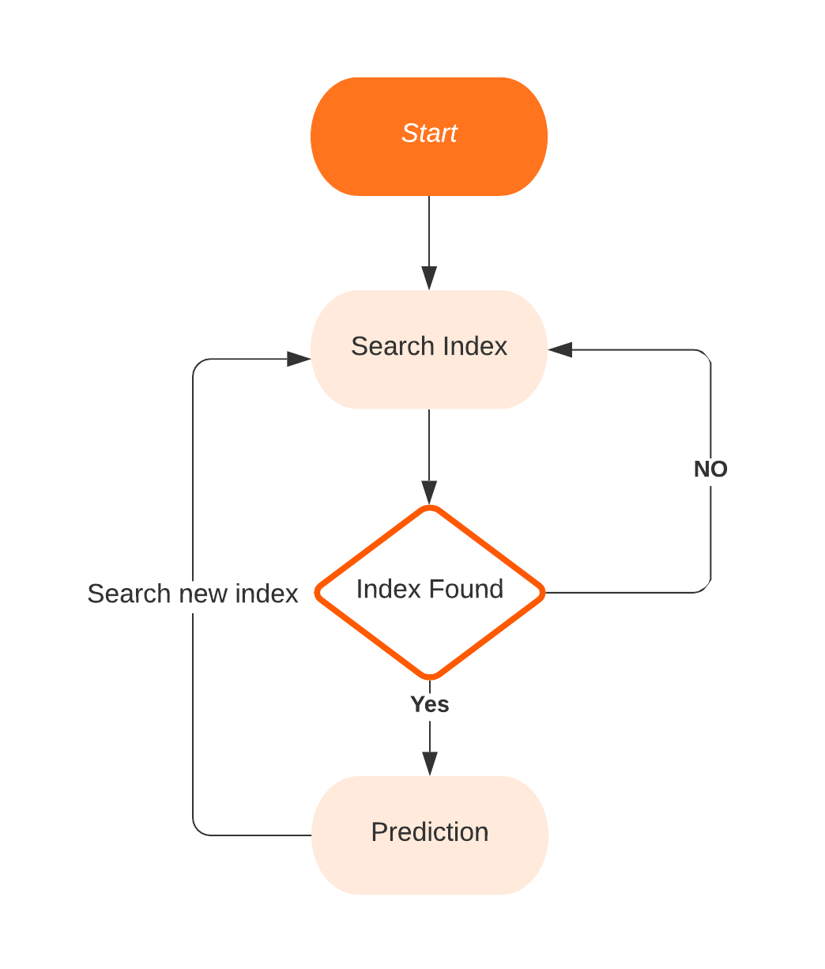
FLOW CHART

Slide 10
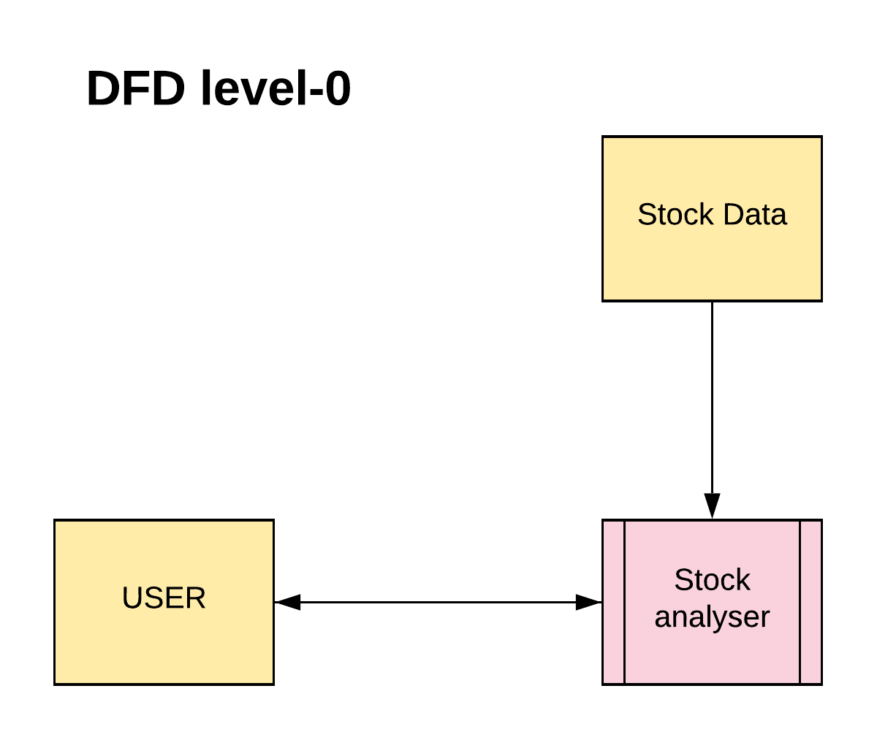
DATA FLOW
DIAGRAM

Slide 11
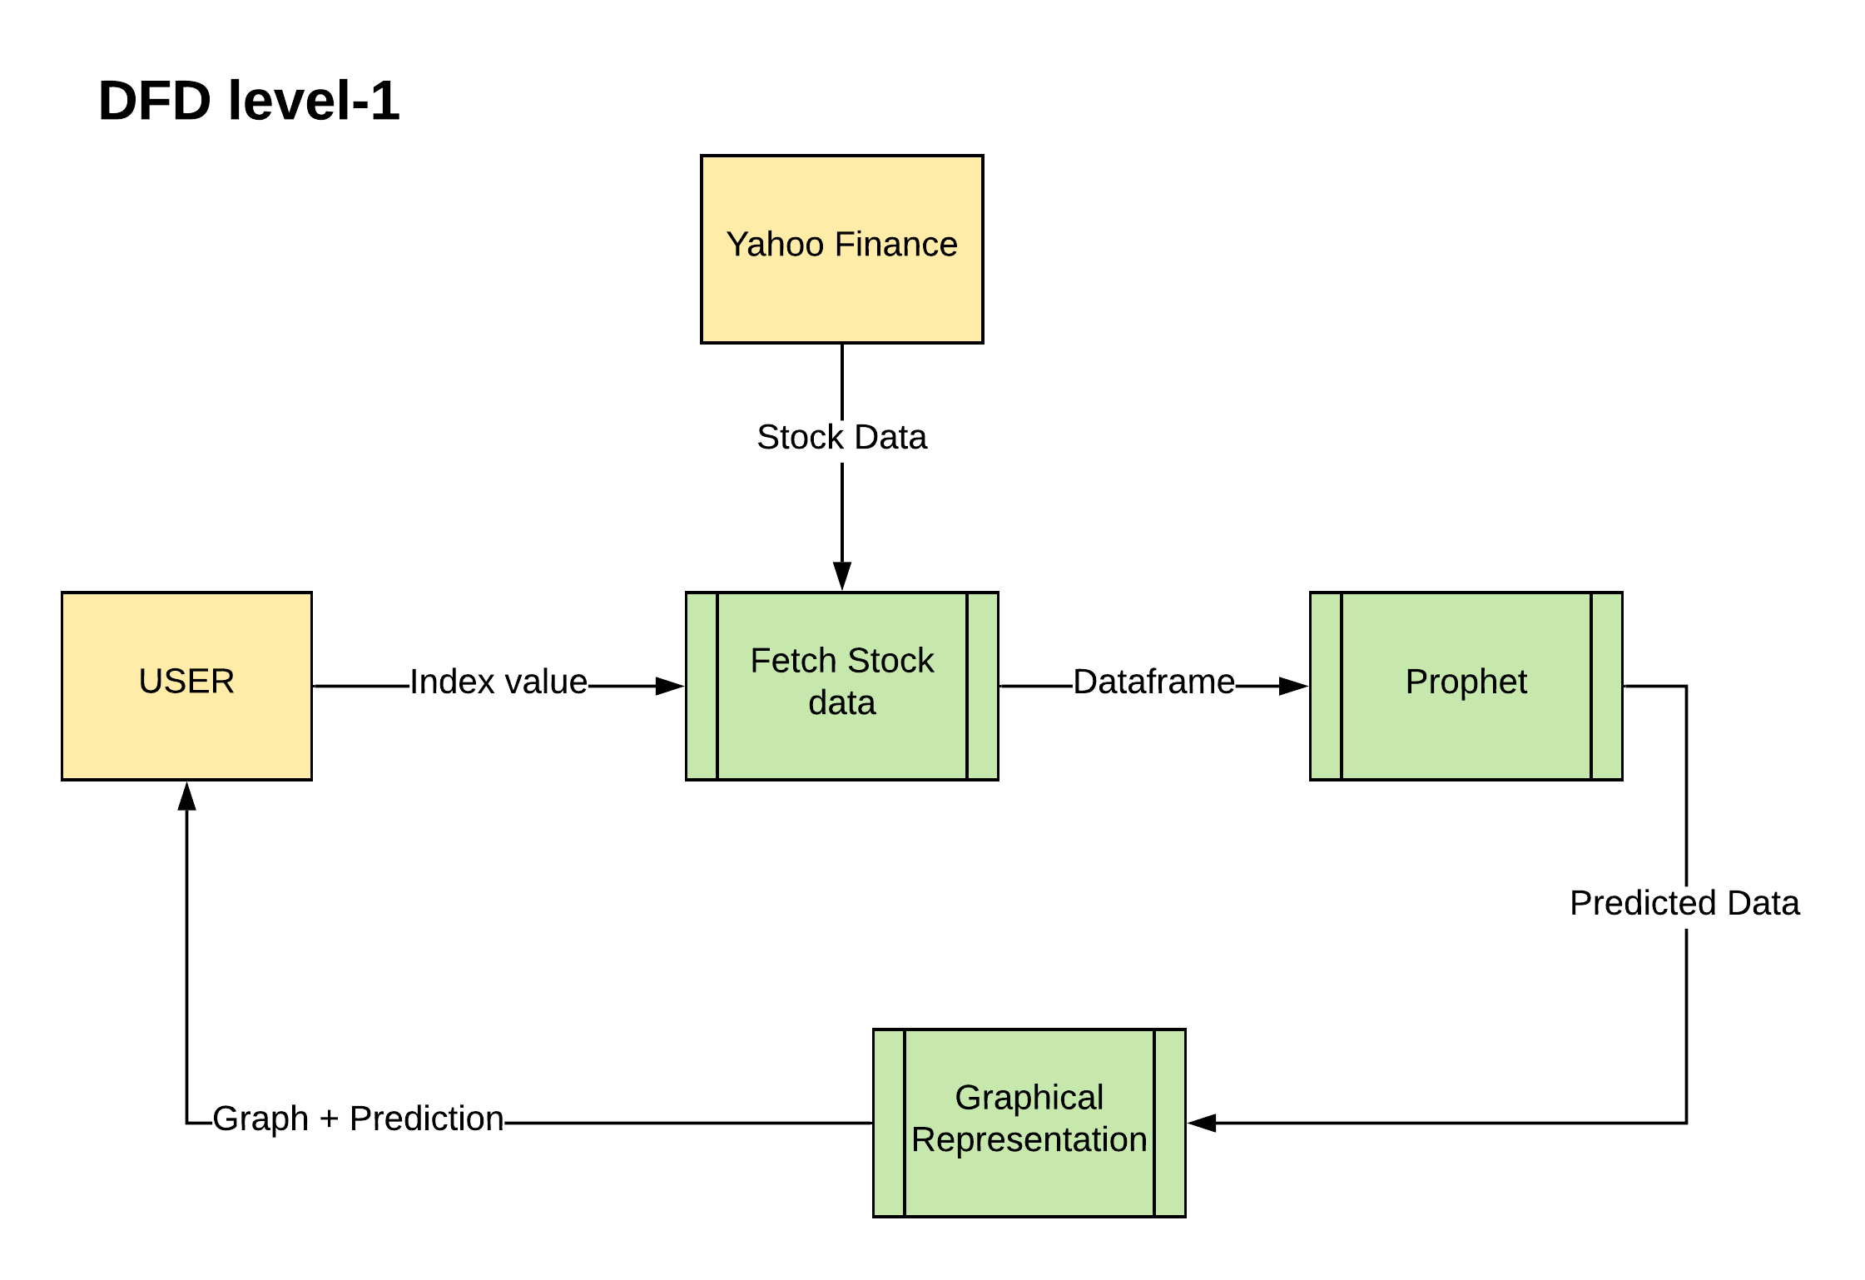

Slide 12
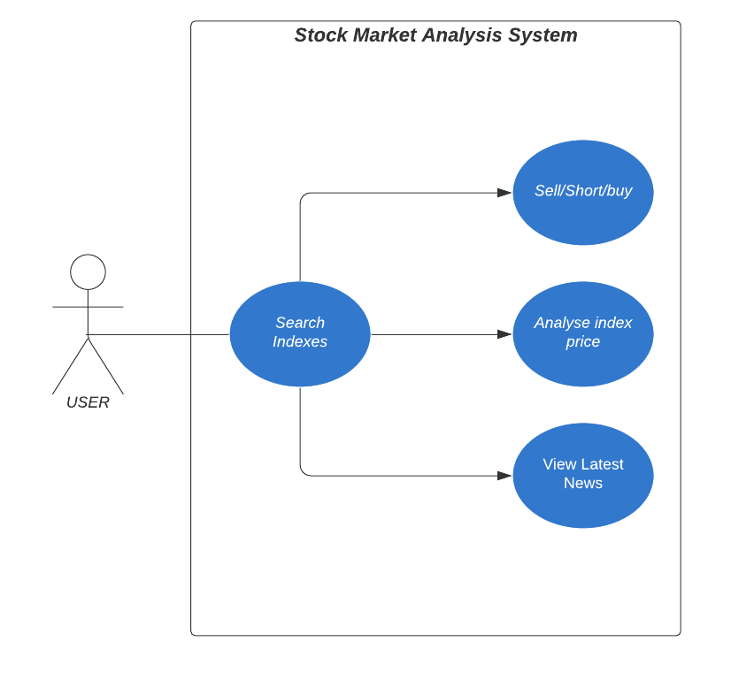
USER CASE
DIAGRAM

Slide 13
MODULES
Stock data retrival : In this the stock data is retrieved from the yahoo finance website for the given period of time of the asked stock index. If the index name is wrong error is shown to re-enter.
Prophet : in this module the facebook prophet model is trained with the stock data and using predict funtion of teh prophet model the forecasted data is preoduced.
Graphical Representation : in this module a graph is build according to the actual and the predicted data.
GUI : in this module graphical user interface is present.

Slide 14
Hardware Requirements:
RAM : 4 GB DDR3 RAM PROCESSOR: i3 3.2.1 GHZ & ABOVE HARD DISK SPACE : 10GB
Software Requirements:
OPERATING SYSTEM : UBUNTU 16.04 LTS & ABOVE / WINDOWS 7/8/10 LANGUAGE: PYTHON 3.8
ADDITIONAL: PANDAS, NUMPY,ANACONDA, Flask SKLEARN etc.

Slide 15







Tech Stack
Anaconda
HTML
Flask
Bootstrap
Facebook Prophet
DyGraph
Python

Slide 16
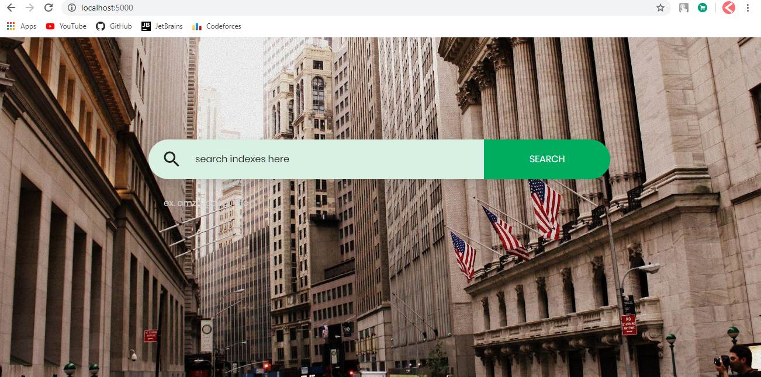
SNAPSHOTS

Slide 17
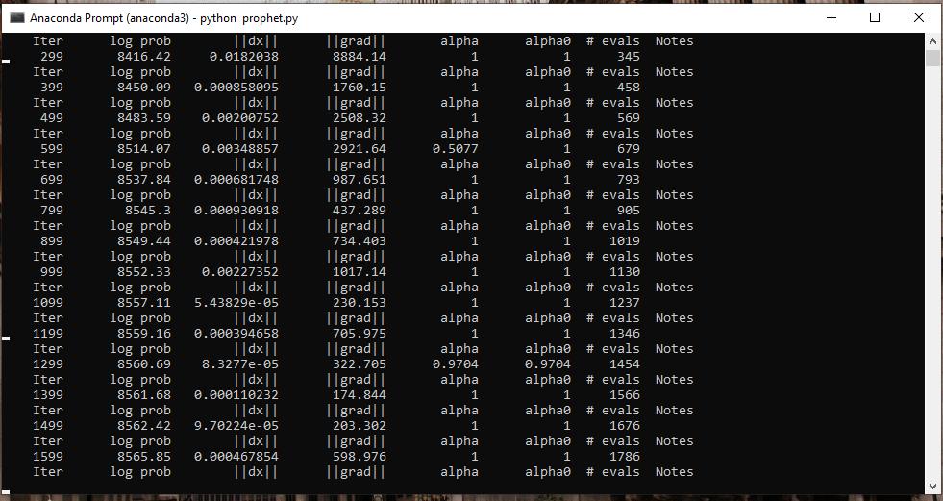

Slide 18
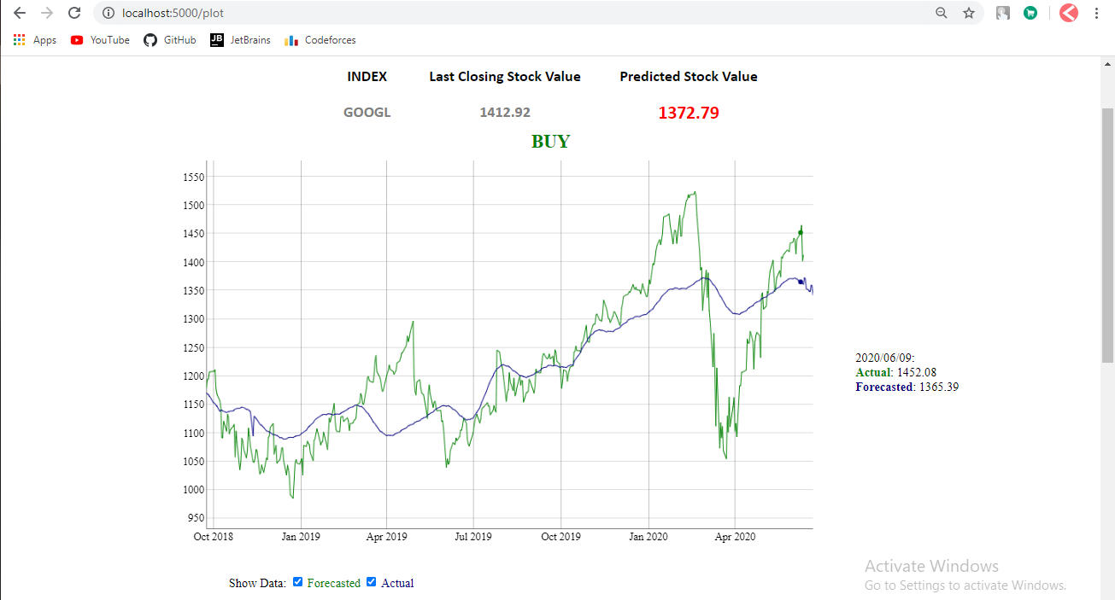

Slide 19
CONCLUSION
The task of stock market prediction, especially in the domain of trading, is still in the developing stage and far from complete.
The work division is currently done based on a per algorithmic implementation and testing.
Two of the most widely used methods, Fundamental Analysis and Technical Analysis showed little promise in the experiments carried out.
The only viable trading strategy for a casual investor is a passive buy and hold strategy in index funds.
We propose a couple of ideas which we feel are worth exploring in the future and may result in further improved performance.

Slide 20
FUTURE SCOPE
Speed of training model could be increased using STAN.
Comparison between two stocks feature.
Inclusion of real time tweets as a feature to increase accuracy.
Portfolio creation as per user could be made.
Intraday prediction.
Buy, short and sell option from within the system.

Slide 21
References
http://www.nasdaq.com/
https://in.finance.yahoo.com
https://www.google.com/finance
https://www.princeton.edu/~erp/ERParchives/archivepdfs/R7.pdf
http://cs229.stanford.edu/proj2013/DaiZhang-MachineLearningInStockPriceTrendForecasting.pdf
http://cs229.stanford.edu/proj2012/ShenJiangZhang-StockMarketForecastingusingMachineLearningAlgorithms.pdf
http://cs229.stanford.edu/proj2015/009_report.pdf
http://quant.caltech.edu/historical-stock-data.html

Slide 22
THANK YOU

