Slide 1

MACHINE LEARNING MODEL ON CREDIT CARD FRAUD DETECTION
Karan Dev Singh
3571

Slide 2
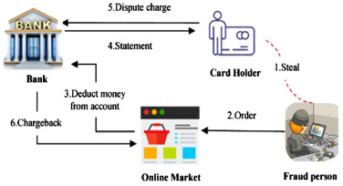
PROBLEM STATEMENT
Day by day as the number of transaction are increasing which gives the chances to fraudster's to make fraud transaction which leading to major losses to the bank.
The Objective of the project is to make a machine learning model which helps the service providers to figure out that which transaction is legists or which one is fraud.
Machine learning models have been developed and best model which is random tress forest is used to detect the and prevent the fraud.
A Cost benefit analysis has been made for more clear idea about the project.

Slide 3
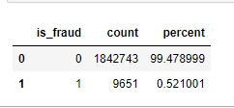
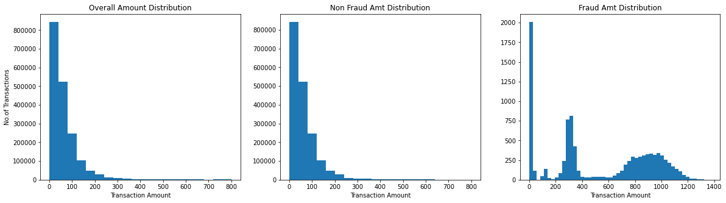
KEY FINDINGS
The result comes out that there are 0.5 fraudster's who target mostly at the amount range of 600-1200.

Slide 4
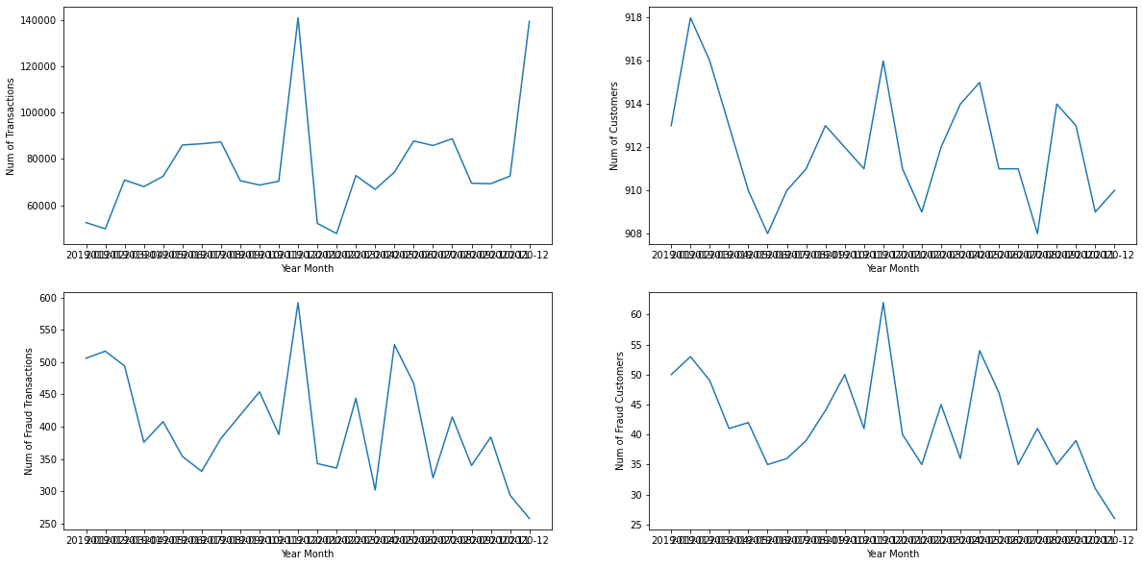
It shows the variation of no. of fraud transaction’s and actual transaction’s as well as number of actual and fraud customers year and month wise.

Slide 5
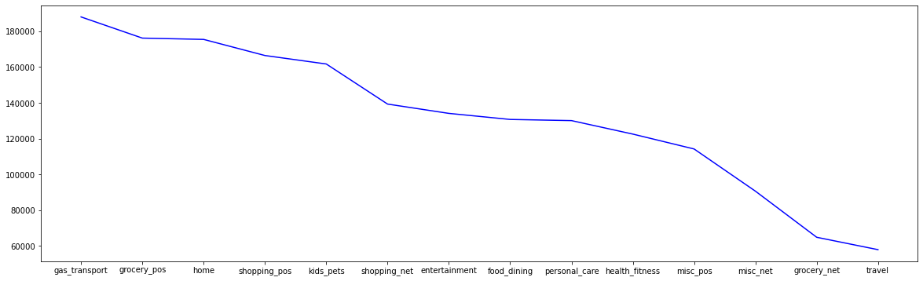
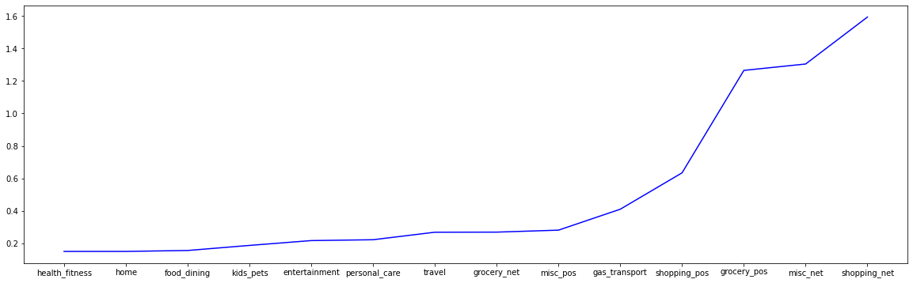
It display the which category have high chances of getting fraud transcation.

Slide 6
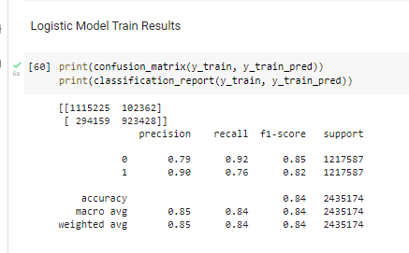
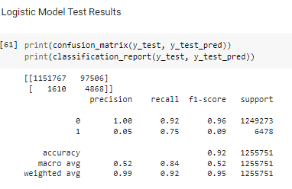
MACHINE LEARNING MODELS
For getting desired results three machine learning models are made.
Logistic Regression Model.
Decision Tree Model.
Random forest Model.
The best model which comes out is Random Forest Model.

Slide 7
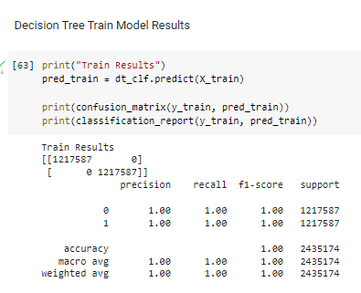
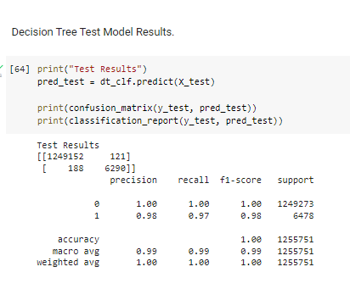
DECISION TREE MODEL

Slide 8
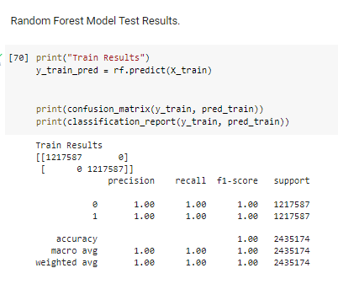
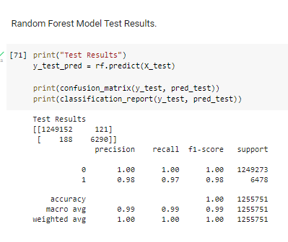
RANDOM TREE FOREST MODEL

Slide 9
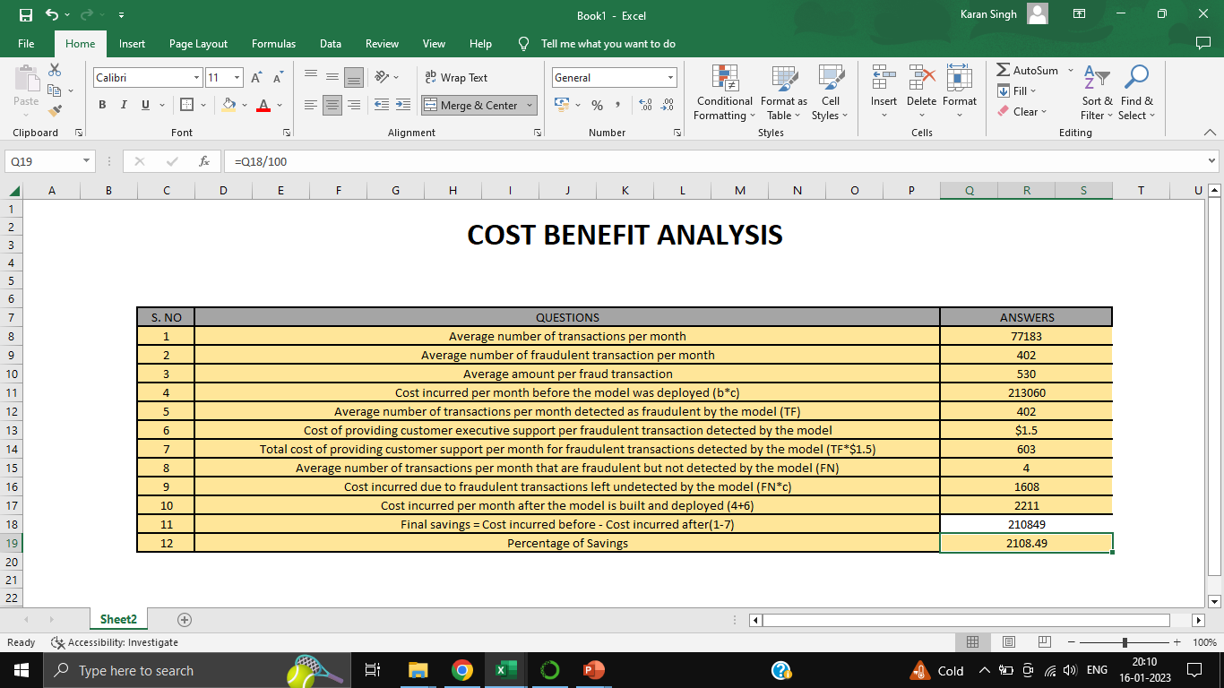
COST BENEFIT ANALYSIS

Slide 10
FLOW OF ANALYSIS
1. Data cleaning and data manipulation.
- Check and handle duplicate data.
- Check and handle NA values and missing values.
- Drop columns. If it contains large amount of missing values and not used for analysis.
- Imputation of the values.
2. EDA
- Univariate data analysis, values count, distribution of variable.
- Bivariate data analysis, correlation coefficients and pattern between the variable.
3. Feature Scaling and Creating Dummy Variable.
4. Handling historical data and performing sampling.
5. Building Model: Logistic regression, Decision Tree, Random forest Model used for the model making and prediction.
6. Validation of the model.

