Slide 1

Department of Information Technology
A.P. Shah Institute of Technology G.B.Road,Kasarvadavli, Thane(W), Mumbai-400615
UNIVERSITY OF MUMBAI
Academic Year 2020-2021

Slide 2
A Project Report on
IdClick: Identify Students Digitally
Submitted in partial fulfillment of the degree of Bachelor of Engineering(Sem-7)
in
INFORMATION TECHNOLOGY
By
Karan Thakkar(17104039) Gunasekar Naikar(17104055) Arun Pandey(17104020)
Under the Guidance of Ms. Rujata Chaudhari

Slide 3
1.Project Conception and Initiation

Slide 4
1.1 Abstract
Face recognition has been one of the most interesting and important research fields in the past two decades.
It is known to be reliable, effective, secure then why not use it for college as well.
In this project we will be developing a face recognition application which will give details about the students by capturing their face.
For our project, we will be implementing face recognition using reactjs and nodejs which are two most popular frameworks and also the faceapi.js which helps us in detection and recognition of face without actually training our own model with thousands of image.

Slide 5
1.2 Objectives
Platform for Teachers & College Staff:
Using IdClick Application for identifying student effortlessly can be very beneficial to indented user. A student will be free of registering themselves on gate when they forget their Id card.
Visitors from outside:
Consider a situation where an unknown person wants an entry into the institution he or she should be verifiable including their purpose of visit.
Authenticate student:
If we are able to provide the information to the concerned teacher and verify student identity it leads to informed decision making.

Slide 6
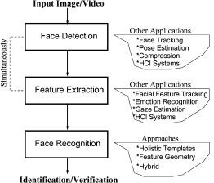
1.3 Literature Review
Authors W. ZHAO, R. CHELLAPPA, P. J. PHILLIPS, A. ROSENFELD have published a paper in 2003 ACM Computing Surveys, Vol. 35 entitled “Face Recognition: A Literature Survey”.
The authors in this have explained steps as shown in below image to detect and recognition faces from still image as well as from video.
●

Slide 7
1.4 Problem Definition
In college campus sometimes students enter without identifying themselves due to which security personnel faces the consequences.
Sometimes teachers or staff need to take action against other department students but they don’t know their proper details.
For this there must be proper and secured method to identify students and take actions accordingly.

Slide 8
1.5 Scope
Can be applied to identify students & register visitors in colleges.
Can be applied to send message to whatsapp.

Slide 9
1.6 Technology stack
Reactjs:
React is an open-source, front end, JavaScript library for building user interfaces or UI components. React can be used as a base in the development of single-page or mobile applications.
Nodejs:
Node.js is an open-source, cross-platform, back-end JavaScript runtime environment that runs on the V8 engine and executes JavaScript code outside a web browser.
Face-api.js:
JavaScript API for face detection and face recognition in the browser implemented on top of the tensorflow.js core API.
Twilio:
Twilio allows software developers to programmatically make and receive phone calls, send and receive text messages, and perform other communication functions using its web service APIs.

Slide 10
1.7 Benefits for environment & Society
Strengthens security measures:
Facial recognition also helps improve safety and security too.
Reduces the number of touchpoints:
Facial recognition requires fewer human resources than other types of security measures, such as fingerprinting.
Helps find missing people:
Law enforcement agencies use facial recognition to find missing people, and they've also used it to find missing children.
Reduction in cost:
With modern technology it has become easy to implement face recognition effectively & efficiently resulting in cost reduction rather than using big hardwares and senors altogether.

Slide 11
2. Project Design

Slide 12
2.1 Proposed System
For this project we have used the following models provided by face-api.js:-
Tiny Face Detector
Face Descriptor
Face Recognition Network
Back to our system. Once a face (or faces) detected, face detector model will return with bounding boxes of each face, telling us where the face is in the image.
The Face Recognition Network is another neural network (RestNet-34 like neural network, to be precise) return a Face Descriptor (feature vector contain 128 values) that we can use to compare and identify person in the image.

Slide 13









2.2 Design(Flow Of Modules)
Application
Photo Section
Upload Photo
Send Whatsapp Message
Recognise person
Add new person

Slide 14
2.3 Description Of Use Case
Use Case Name: | Photo Upload
Description: | Photo upload functionality to add/recognise person.
Actors: | Teachers, college staff
Pre-condition: | React & nodejs must be running in background.
Post-condition: | If new person after entering name and clicking upload button ‘saved data’ pop-up should appear. If person is already added after uploading photo person name should appear.

Slide 15
Use Case Name: | Sending message to whatsapp through twilio
Description: | With help of twilio we will be sending message to whatsapp.
Actors: | Teachers, college staff
Pre-condition: | Message receiver contact number should be already added.
Post-condition: | User should receive message on whatsapp successfully.

Slide 16
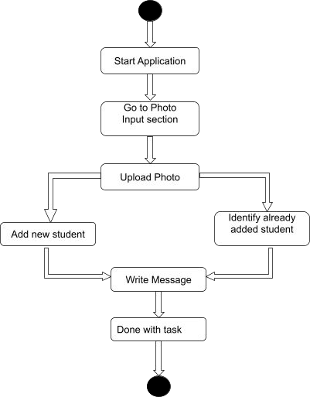
2.4 Activity diagram
As the above activity diagram depicts, firstly the user will launch the application, then he will go to input photo section on top left where user will be able to perform all operations, then user will upload a photo and if user wants to register new student they will enter name of student and click upload or if student is already registered name will be shown on the screen. Lastly if user wants to type and send any message so they can also do that message will be send through whatsapp.

Slide 17
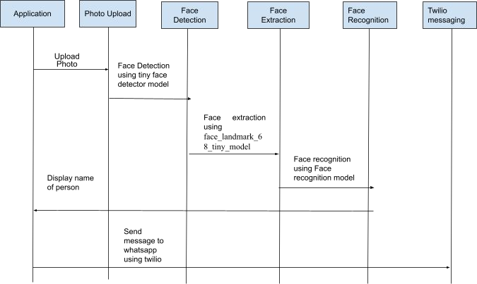
2.5 Sequence Diagram

Slide 18
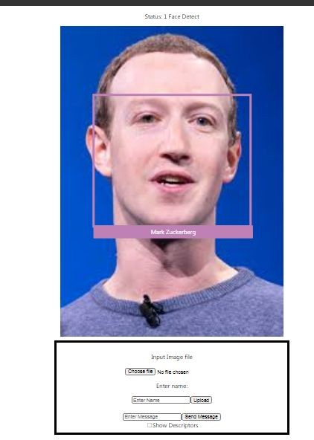
2.6 Module-1
Photo Input

Slide 19
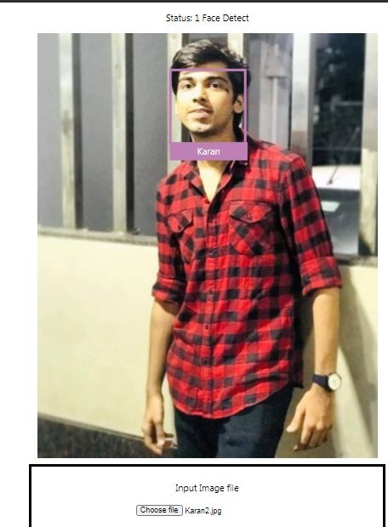
Module-2
Identify Newly Added User

Slide 20

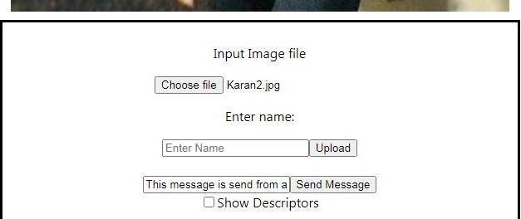
Module-3
Send Message To Whatsapp

Slide 21
2.7 References
Youtube channel: WebStylePress, Codevolution
Reactjs Ofﬁcial Documentation
Nodejs Ofﬁcial Documentation
towardsdatascience.com/facial-recognition

Slide 22
3. Conclusion and Future Scope

Slide 23
The App could detect and recognize Idol face quite accurately, but still have some error happen sometimes. This is due to the subject might not face directly to camera, their faces might tilt, or the photo was edited by some other apps.
As we all know that face recognition helps to identify person seamlessly so this
technology can be implemented anywhere where we want to identify person on a regular basis and make the process easy for authenticating the person. This places could be gyms, colleges, offices, Buildings, etc.

Slide 24
Thank You

