Slide 1

Student Recognition Application
Group No. 1
Karan Thakkar:17104039
Gunasekar Naikar:17104055
Arun Pandey:17104020
Project Guide: Rujata Chaudhari
Co-guide: Geetanjali Kalme

Slide 2
Abstract
A face recognition system is one of the biometric information processes, its applicability is easier
and working range is larger than others, i.e.; fingerprint, iris scanning, signature, etc. A face recognition system is designed, implemented and tested at AP SHAH INSTITUTE OF TECHNOLOGY, Information Technology Department.
In order to build our OpenCV face recognition pipeline, we’ll be applying deep learning in two key steps:
1. To apply face detection, which detects the presence and location of a face in an image, but does not identify it
2. To extract the 128-d feature vectors (called “embeddings”) that quantify each face in an image.

Slide 3
Introduction
Face recognition system is a complex image-processing problem in real world applications with complex effects of illumination, occlusion, and imaging condition on the live images. It is a combination of face detection and recognition techniques in image analyzes. Detection
application is used to find position of the faces in a given image. Recognition algorithm is used to classify given images with known structured properties, which are used commonly in most of the computer vision applications. Recognition applications use standard images, and detection algorithms detect the faces and extract face images which include eyes, eyebrows, nose, and mouth. That makes the algorithm more complicated than single detection or recognition algorithm. The first step for face recognition system is to acquire an image from a camera. Second step is face detection from the acquired image. As a third step, face recognition that takes the face images from output of detection part. Final step is person identity as a result of recognition part.

Slide 4
Objectives
In this project we aim to build a face recognition app to help teachers and other college staff to identify students just by taking a snap of student face. Specific objective of this project is:
1.To build a face recognition application
2.Research in the field of face recognition.
3.Provide accurate information based on student face.

Slide 5
Problem Definition
Identify students in college campus through an android app & display their accurate information(branch,year,class).

Slide 6
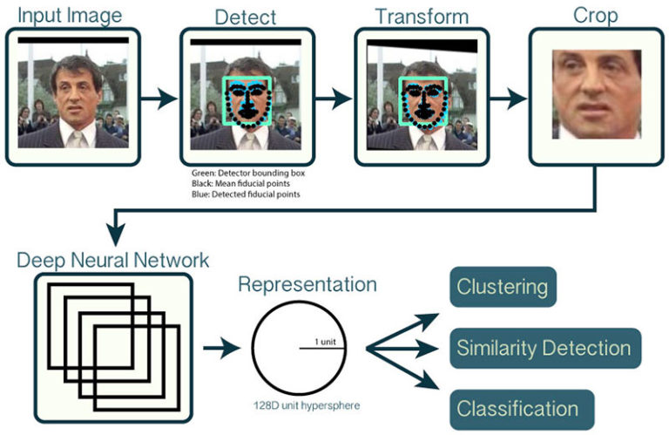
Proposed System Architecture/Working
How OpenCV’s face recognition works.

Slide 7
In order to build our OpenCV face recognition pipeline, we’ll be applying deep learning in two key steps:
1.To apply face detection, which detects the presence and location of a face in an image, but does not identify it
2.To extract the 128-d feature vectors (called “embeddings”) that quantify each face in an image

Slide 8
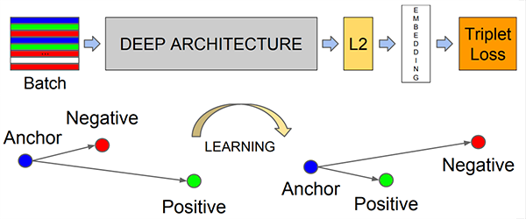
First, we input an image or video frame to our face recognition pipeline. Given the input image, we apply face detection to detect the location of a face in the image.
we pass the input face through our deep neural network:
In this manner, the network is able to learn to quantify faces and return highly robust and discriminating embeddings suitable for face recognition.

Slide 9
Technology Stack
1.libraries: extract_embeddings.py
Openface_nn4.small2.v1.t7
Train_model.py
Recognize.py
Recognize_video.py
2.Language: Python
3.Software: Android studio

Slide 10
Reference
https://www.pyimagesearch.com/2018/09/24/opencv-face-recognition/
https://www.pyimagesearch.com/2018/06/18/face-recognition-with-opencv-python-and-deep-learning/
https://www.researchgate.net/publication/262875649_Design_of_a_Face_Recognition_System

