Slide 1
Presentation on android os :
Anupriya karn

Slide 2
What is operating system(os)?
An operating system (OS) is a software system that manages computer hardware and software resources and provides common services for computer programs. It is the core software that runs on a computer or mobile device, and it manages everything from the allocation of memory and processing power to the interaction with input/output devices such as keyboards, mouse, and screens.
Some examples of popular operating systems include Microsoft Windows, macOS, Linux, Android, and iOS. The operating system serves as the intermediary between the computer hardware and software, and it provides a consistent and standardized platform for application developers to build upon. It also provides various services such as file management, security, networking, and device drivers.
The operating system is typically loaded into memory when the computer or device starts up, and it remains in memory until the computer or device is shut down. It is the foundation upon which all other software applications run, and it plays a critical role in the overall performance and stability of a computer or mobile device.

Slide 3
What is android?
Android is an operating system (OS) developed by Google primarily for use in mobile devices such as smartphones and tablets. It is based on the Linux kernel and is designed to be an open-source and flexible platform that allows developers to create a wide range of applications for the Android ecosystem. The first source code release happened as part of the initial release in 2007.
Android provides a graphical user interface for users to interact with their devices, including support for touchscreens, virtual keyboards, and other input methods. It also includes a wide range of built-in features such as a web browser, email client, and media player, as well as access to the Google Play Store, which offers millions of third-party applications that can be downloaded and installed.
Android has become one of the most popular mobile operating systems in the world, powering devices from many different manufacturers and used by billions of people. It has also expanded beyond mobile devices to other areas such as smart TVs, wearables, and even some cars.

Slide 4
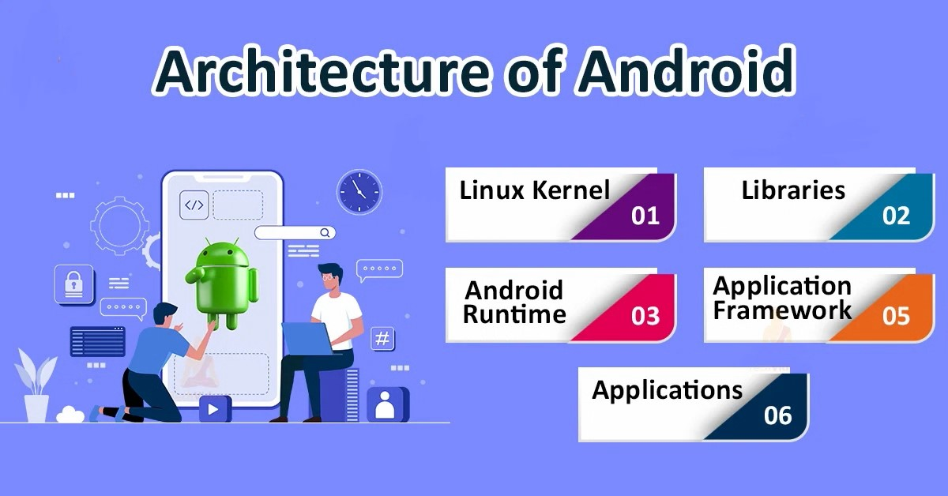

Slide 5
Key features of android :
Customizability: Android allows users to customize their devices in many ways, including changing the launcher, installing widgets, and using custom themes.
Google integration: Android is closely integrated with Google services, such as Google Search, Google Maps, and Google Assistant. This makes it easy to access and use these services on an Android device.
App ecosystem: Android has a large and diverse app ecosystem, with millions of apps available on the Google Play Store. This gives users a wide range of apps to choose from, including many free apps.
Voice assistants: Android devices support voice assistants such as Google Assistant, which allows users to interact with their devices using voice commands.

Slide 6
Advantages and disadvantages of android:
Advantages:
Disadvantages:
Open-source operating system.
Wide range of devices selection.
Customizable user interface.
Large number of app availability.
It also allows multi-tasking.
While Android has built-in security features, it is still a popular target for malware and other security threats
Fragmentation: Android is used on a wide range of devices from many different manufacturers, which can lead to fragmentation in terms of software updates and app compatibility.
Some apps may not be available on Android, or may not work as well as they do on other platforms, such as iOS.
Because Android allows for so much customization and multi-tasking, it can be more resource-intensive than other operating systems, which can lead to lower battery life.

Slide 7
How is android beneficial for society ?
Accessibility: Android provides a wide range of accessibility features that make it easier for people with disabilities to use their smartphones. This includes features like text-to-speech, closed captioning, and assistive touch, which enable people with visual, hearing, and physical impairments to use their phones more effectively.
Communication: Android provides various communication tools such as messaging, email, voice and video calling, and social media apps that help people to stay connected with their family and friends, regardless of their location.
Education: Android devices can be used as a powerful tool for education. Students can access educational apps and online resources, take notes, and participate in virtual classes or study groups.
Entertainment: Android offers various entertainment options such as music, movies, games, and other apps that can be used for leisure and relaxation. These apps can help people to reduce stress and increase their mental well-being.
Productivity: Android devices can also be used for business and productivity purposes, such as email, document editing, project management, and video conferencing. This can help people to be more productive, collaborate better, and work more efficiently.

Slide 8
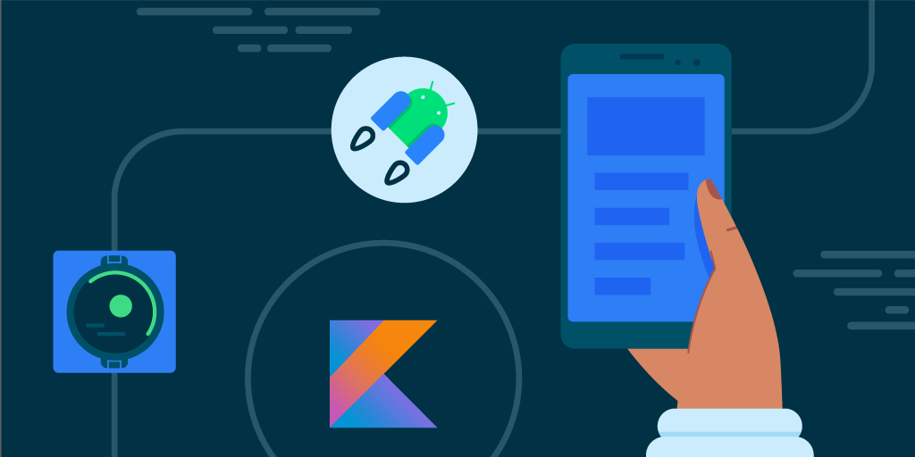
THAnK YOU

