Slide 1
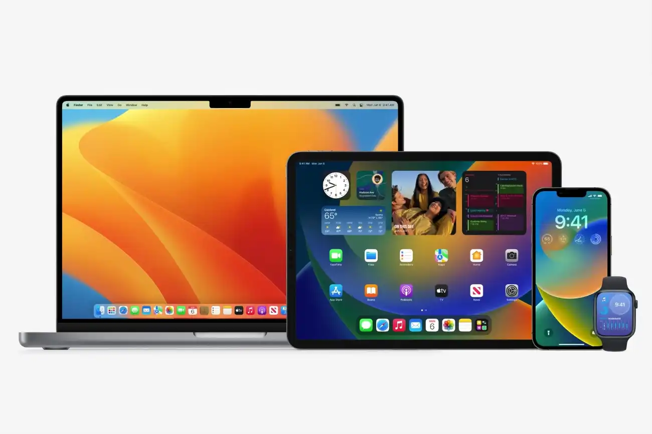
PRESENTATION ON iOS
BY: KARAN THAKUR

Slide 2

INTRODUCTION TO IOS:
iOS is a mobile operating system developed by Apple Inc. for its mobile devices, including the iPhone, iPad, and iPod Touch. It is the second most popular mobile operating system in the world, after Android. iOS is known for its user-friendly interface, smooth and fast performance, and seamless integration with other Apple devices. iOS was first released in 2007, and since then it has undergone many updates and improvements. It is currently in its 15th version, which was released in 2021. iOS provides a wide range of features and applications, including Siri (Apple's voice assistant), iMessage, FaceTime, Apple Pay, Health app, and many others.
One of the key features of iOS is its closed system, which means that only Apple-approved apps can be downloaded and installed on iOS devices. This provides a high level of security and helps to prevent malware and other security issues. Additionally, iOS devices are known for their durability and long-term software support, as Apple provides regular software updates for several years after the release of a new device.
In summary, iOS is a popular and user-friendly mobile operating system developed by Apple Inc. for its mobile devices. It provides a range of features and applications, and is known for its smooth performance, high level of security, and long-term software support.

Slide 3
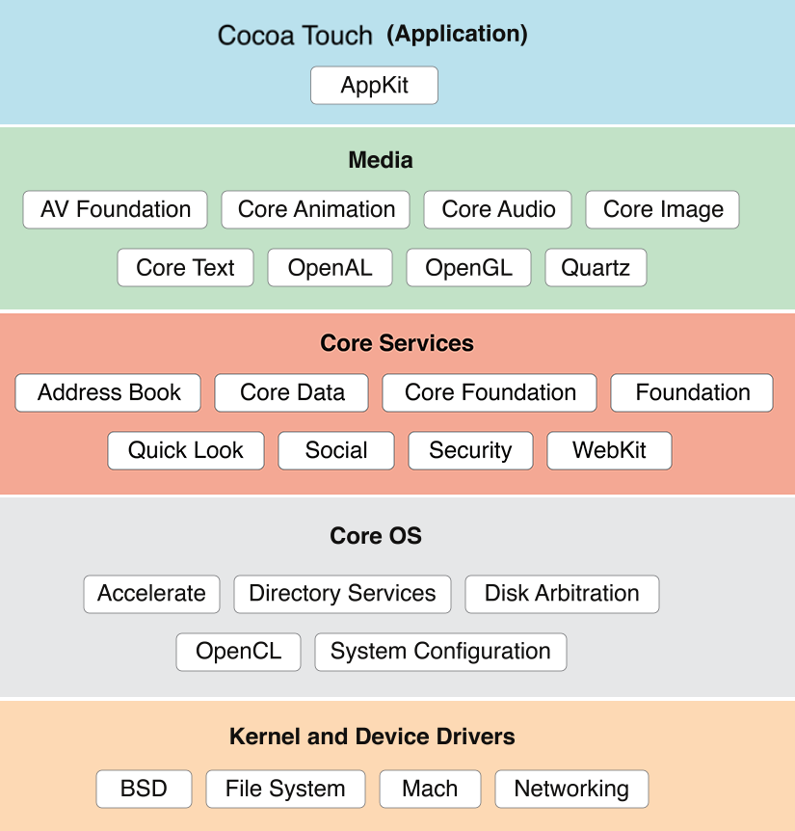
ARCHITECTURE OF iOS :

Slide 4
WORKING MECHANISM OF iOS :
Hardware: iOS is designed to work specifically with Apple's hardware, including the iPhone, iPad, and iPod Touch. Apple's hardware is known for its high-quality components, including its custom-designed processors and graphics cards, which work together to provide fast and efficient performance.
Kernel: The iOS kernel is the core component of the operating system, responsible for managing memory, running processes, and providing security features. The iOS kernel is built on a Unix-based foundation, which provides a stable and secure foundation for the operating system.
User interface: iOS provides a simple and intuitive user interface, with a range of design elements, including icons, menus, and gestures, that make it easy to navigate and use the operating system.
Applications: iOS includes a range of pre-installed applications, including Mail, Safari, and Messages, as well as access to the App Store, which provides a wide range of third-party applications that can be downloaded and installed on the device.
Security: iOS is known for its robust security features, including encrypted data storage, secure boot process, and regular software updates to address security vulnerabilities.

Slide 5
FEATURES OF iOS:
User-friendly interface: iOS is known for its clean, simple, and easy-to-use interface, which makes it easy for users to navigate and access various features and applications.
Siri: Siri is Apple's voice assistant, which allows users to use their voice to control their device, send messages, make calls, set reminders, and more.
App Store: The App Store provides access to over two million apps, including games, productivity apps, social media, entertainment, and more.
FaceTime: FaceTime is Apple's video calling app, which allows users to make high-quality video calls to other iOS and Mac devices.
Automatic software updates: iOS provides automatic software updates, which ensure that users have the latest security patches and feature updates without needing to manually download and install them.
High-performance: iOS is optimized for fast and smooth performance, providing quick response times and efficient battery life. Apple's custom-designed processors and software optimizations help to ensure a consistent and reliable user experience.

Slide 6
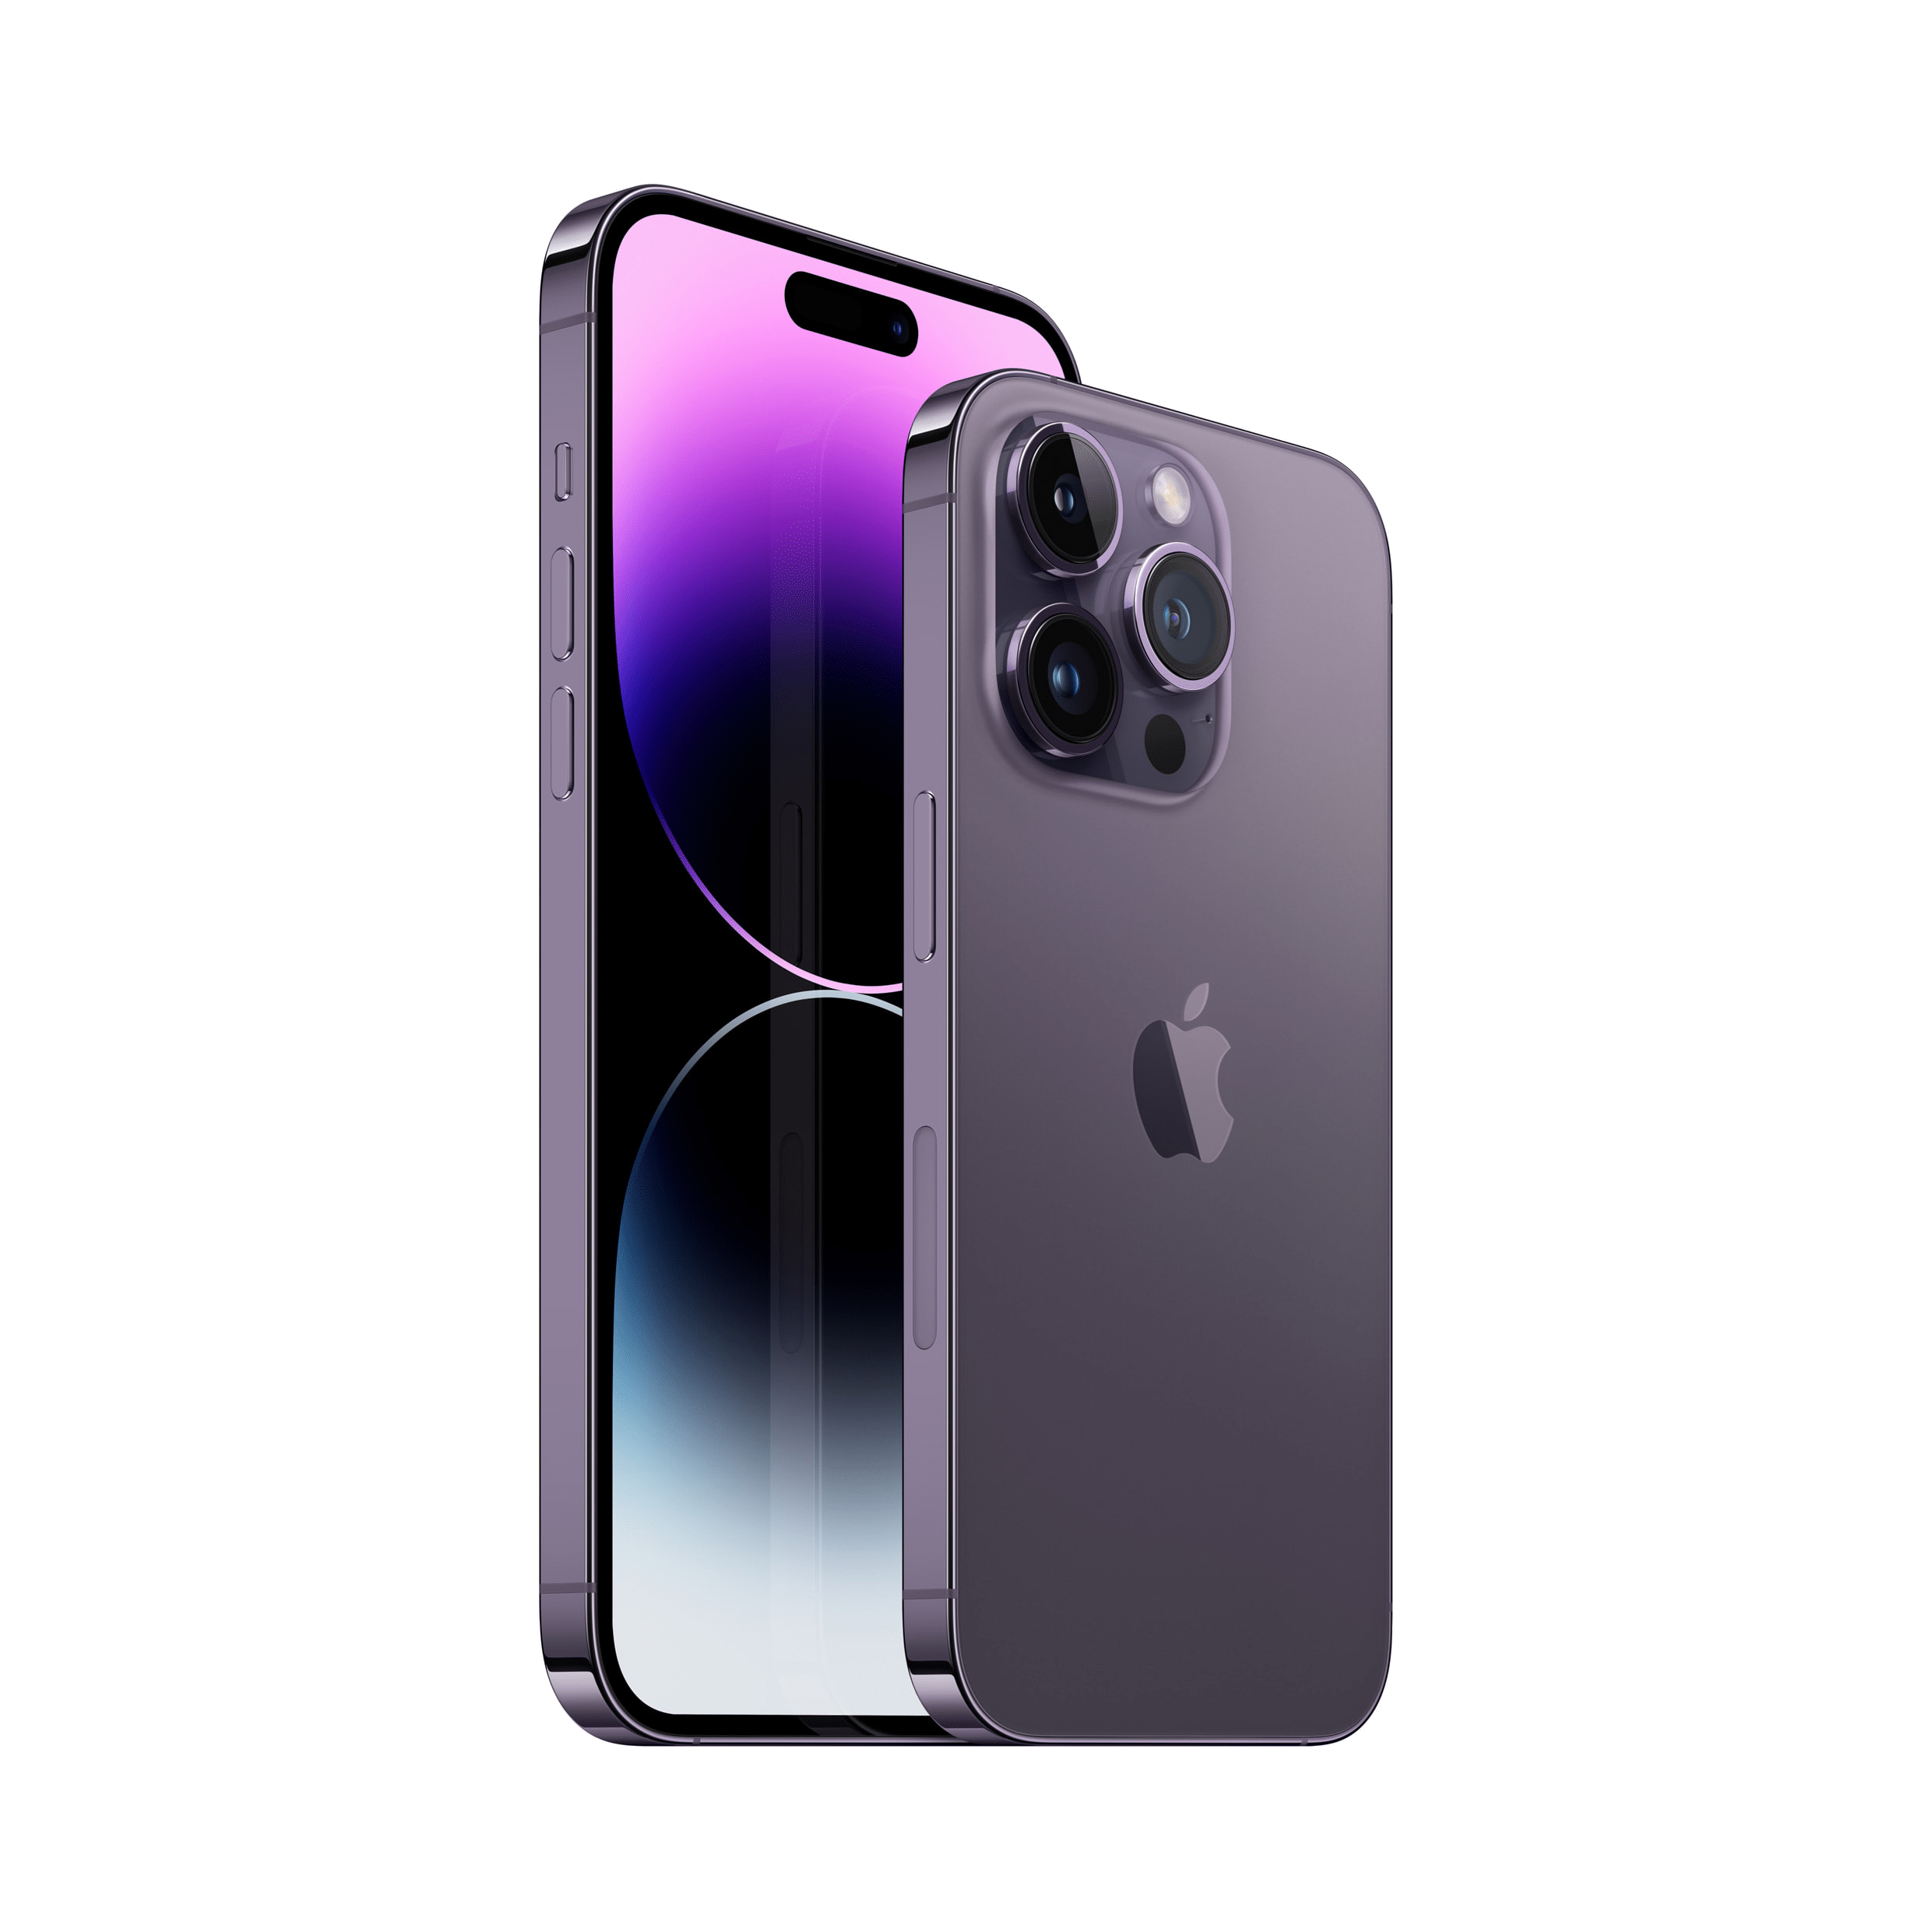
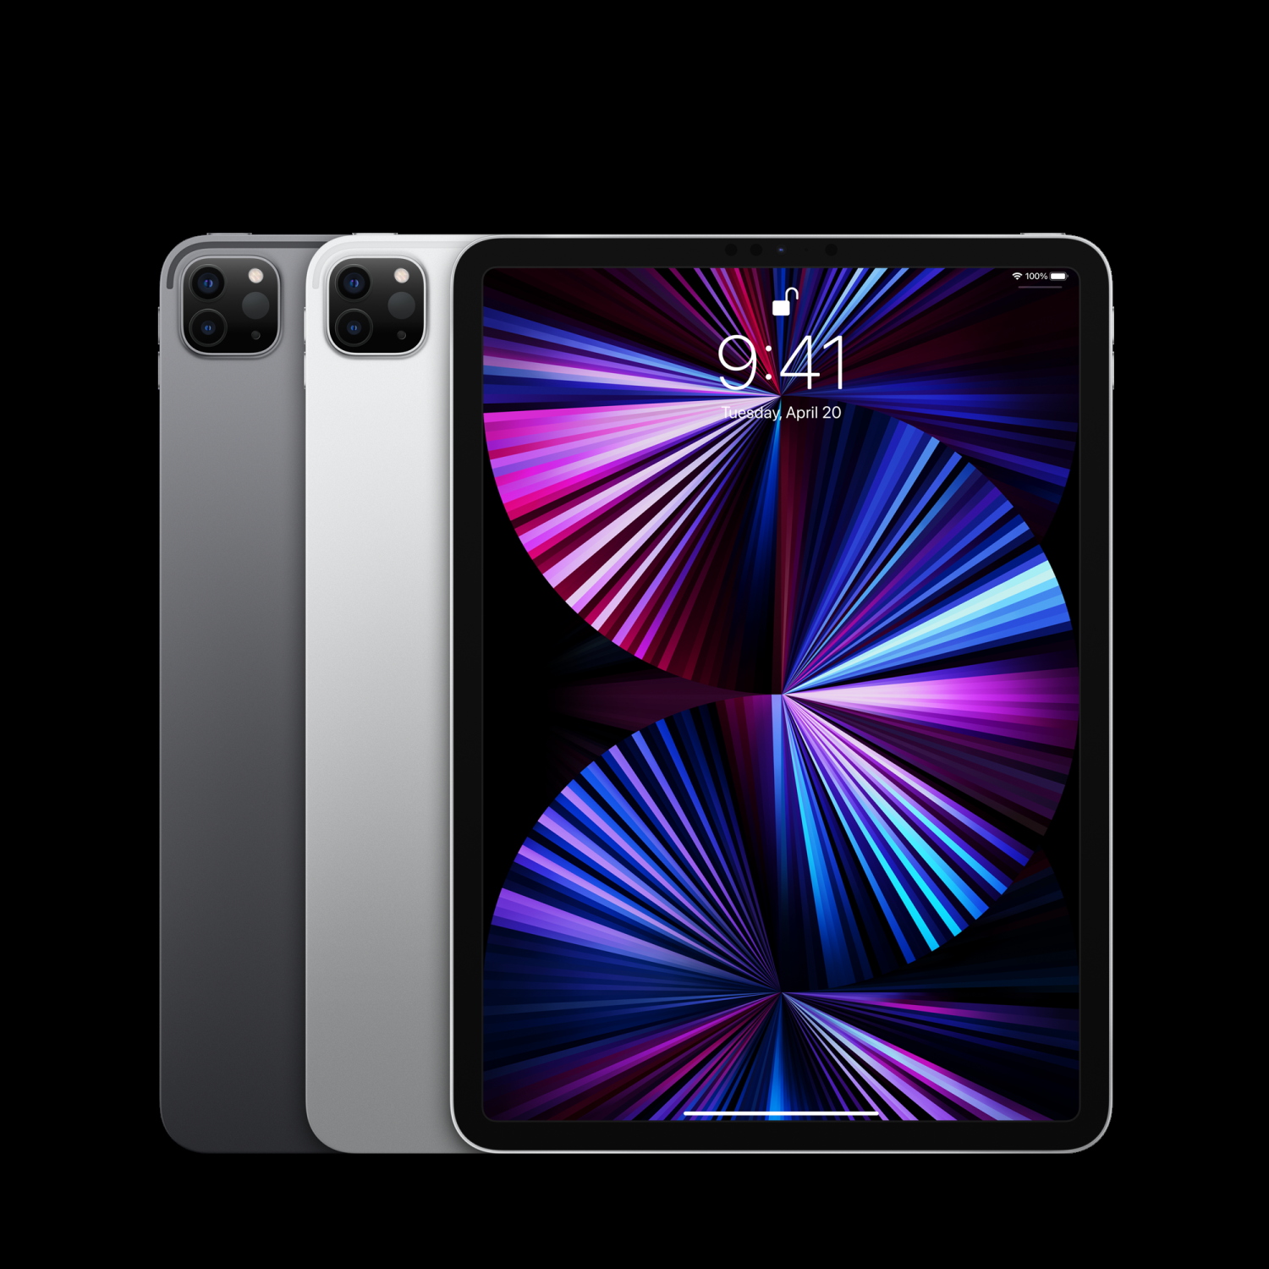
DEVICE THAT COMES WITH iOS :

Slide 7
ADVANTAGES OF iOS:
User experience: iOS is known for its intuitive and user-friendly interface, with a consistent design across all devices. Apple's strict design guidelines for third-party developers also ensure that apps are easy to use and have a consistent design.
App Store: The iOS App Store is the largest app store in the world, with millions of apps available for download. The App Store is curated by Apple, which helps to ensure that apps are high-quality and safe to use.
Security: iOS is known for its strong security features, including encrypted data storage, secure boot process, and regular software updates to address security vulnerabilities. This provides a high level of protection for user data and privacy.
Hardware and software integration: iOS is designed to work seamlessly with Apple's hardware, including the iPhone, iPad, and iPod Touch. This integration allows for a consistent and reliable user experience across all devices.

Slide 8
DISADVANTAGES OF iOS :
Closed system: iOS is a closed system, which means that users can only download and install apps from the App Store, and only those that have been approved by Apple. This can limit the ability to customize the device and use certain apps or services that are not available in the App Store.
Cost: Apple devices tend to be more expensive than many Android devices, which can make them less accessible to some users.
Limited device choice: iOS is only available on devices developed by Apple, which limits the range of devices available to users.
Customization: iOS devices have limited customization options compared to Android devices, with fewer options for changing the look and feel of the interface or adding features that are not provided by Apple.
Battery life: While iOS devices are known for their efficient performance, the battery life may not be as long as some Android devices.

Slide 9
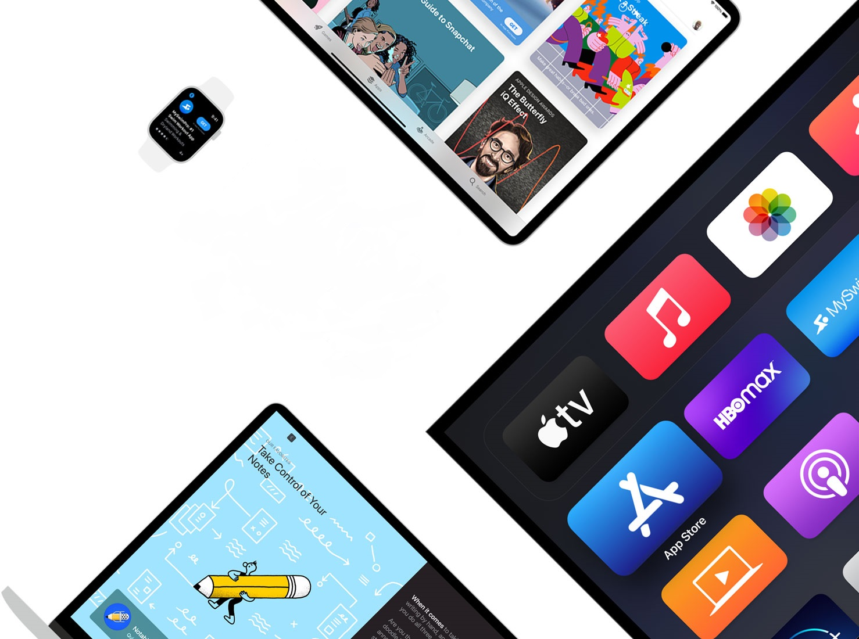
THANK YOU

