Slide 1


Household Power Consumption Time Series Data Analysis Using LSTM (CS441- Programming in Python)
Internal Guide: Prepared by:
Assi.Proff. Mohammed bohara Dhruvin Gohil (17dcs016)
KARAN ZAVERI (17DCS072)

Slide 2
Contents
Dataset
Libraries
Visualization
Methodology
Model
Experimental Result

Slide 3
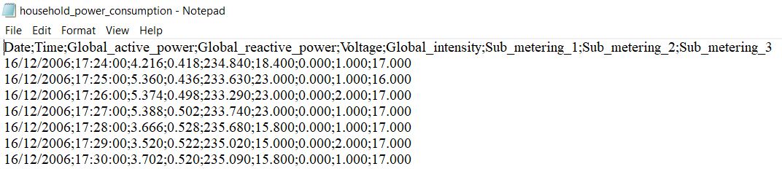
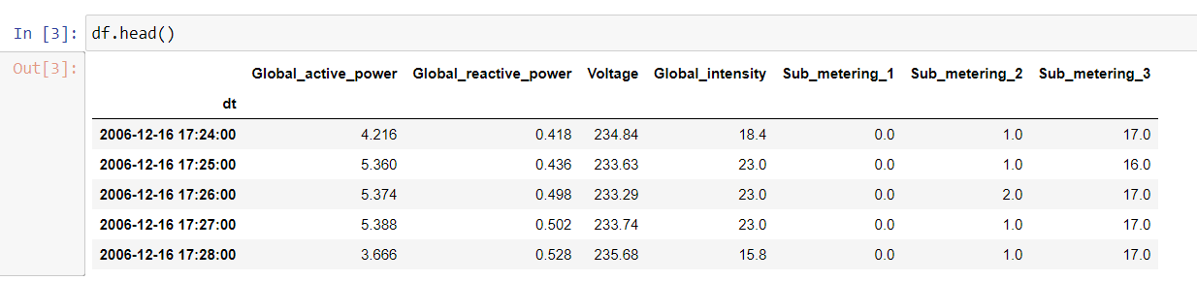
DATA SET

Slide 4
LIBRARIES
Keras
Allows for easy and fast prototyping (through user friendliness, modularity, and extensibility).
Supports both convolutional networks and recurrent networks, as well as combinations of the two.
Runs seamlessly on CPU and GPU.
Numpy
NumPy is the fundamental package for scientific computing with Python.
Pandas
library providing high-performance, easy-to-use data structures and data analysis tools for the Python programming language.
Scikit-Learn
It assumes a very basic working knowledge of machine learning practices (model fitting, predicting, cross-validation, etc.)

Slide 5
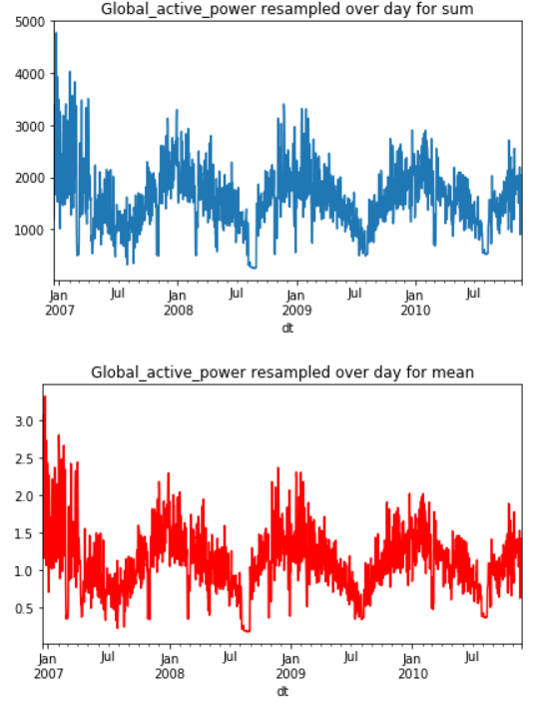
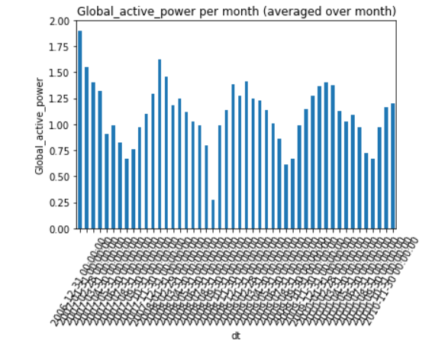
Visualization

Slide 6
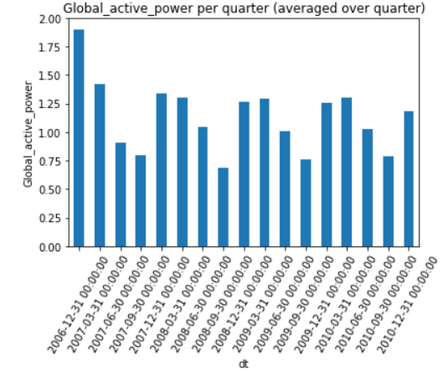
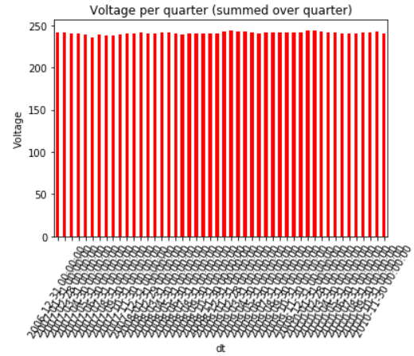

Slide 7
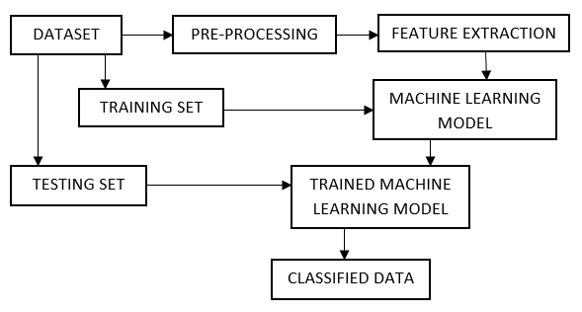
METHODOLOGY
Methodology / Structure of Model

Slide 8
MODEL ARCHITECTURE
LSTM with 100 neurons in the first visible layer
Dropout 20%
1 neuron in the output layer for predicting Global_active_power.
The input shape will be 1 time step with 7 features.
I use the Mean Absolute Error (MAE) loss function and the efficient Adam version of stochastic gradient descent.
The model will be fit for 20 training epochs with a batch size of 70.

Slide 9
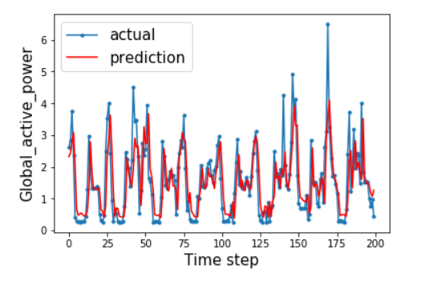
EXPERIMENTAL RESULTS

Slide 10
THANK YOU

