Slide 1
Advanced Database Topics
University of Windsor
Guided By: Dr. Kalyani Selvarajah

Slide 2
Sentiment Analysis of Twitter Data
Group No: 17
Group Members:
1) Bhavin Vaghasiya(110015301)
2) Karan Aggarwal (110015913)
3) Param Kewale (110021969)
4) Ravi Kanani(110013139)
5) Yug Rawal(110009769)

Slide 3
Introduction
Sentiment analysis is the automated process of analyzing text data and sorting it into sentiments positive, negative, or neutral. Using sentiment analysis tools to analyze opinions in Twitter data can help companies understand how people are talking about their brand.
We have used Hadoop framework to store the large Twitter data ( data/twitter posts related to bitcoin) and to perform analysis on it.
To perform analysis on the Data we have used AFINN Dictionary.

Slide 4
Existing Related Work
The various models which are being used in Sentimental Analysis of the Data are as follows: -
a) Bayes Sentiment Classifier:
b) Sentence-level Training and Classification
c) New Deep Learning Models

Slide 5
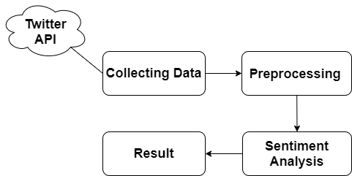
Flow Diagram

Slide 6
Tools and Technology
Flume
Apache Flume is a distributed, reliable, and available service for efficiently collecting, aggregating, and moving large amounts of streaming data into the Hadoop Distributed File System (HDFS).

Slide 7
Tools and Technology
Hive
A data warehouse infrastructure tool to process structured data in Hadoop.
Makes querying and analyzing easy.
Hive Query Language(HiveQL) is used for Analysis of data.

Slide 8
Tools and Technology
Hadoop
An open source software framework for distributed storage and large scale distributed processing of data-sets on clusters.
Uses MapReduce algorithm.
Could perform complete statistical analysis for a huge amounts of data.

Slide 9
Screenshots of the Working Model

Slide 10
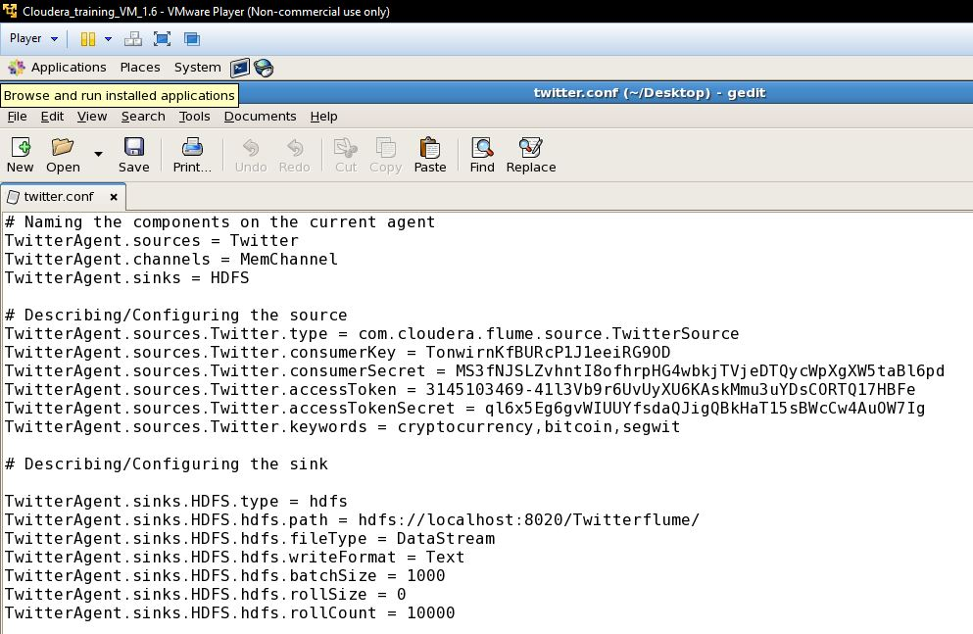
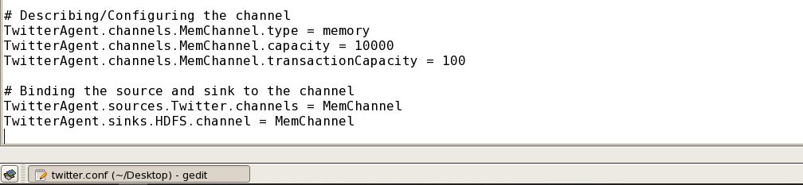
STEP 1:
Configuring Source, Sink and Channel Components of Apache Flume to Collect Tweets in Real Time.

Slide 11
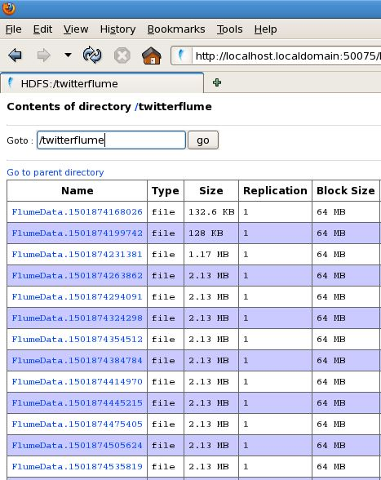
STEP 2:
Tweets Obtained in JSON format using Apache Flume

Slide 12
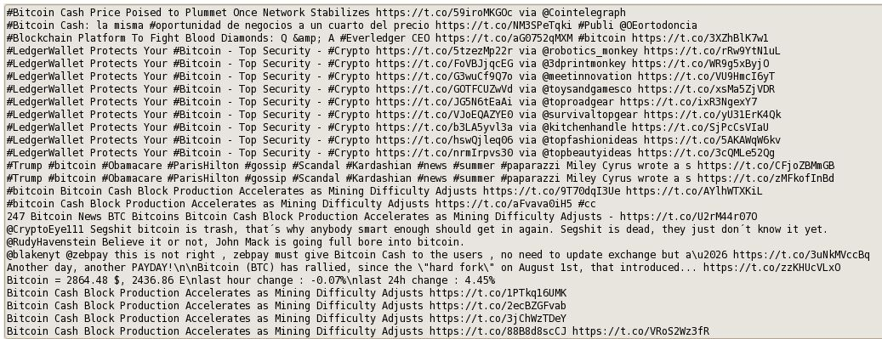
STEP 3: Using Mapper and Reducer for Transforming Tweets in text format

Slide 13
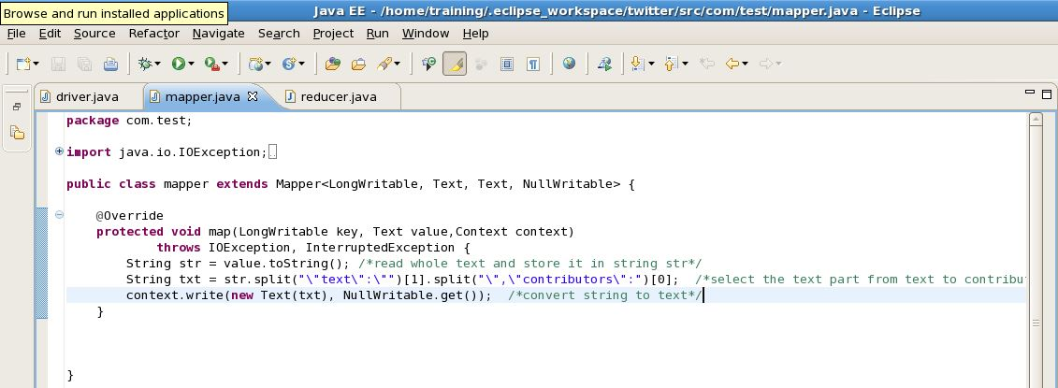
Mapper Class

Slide 14
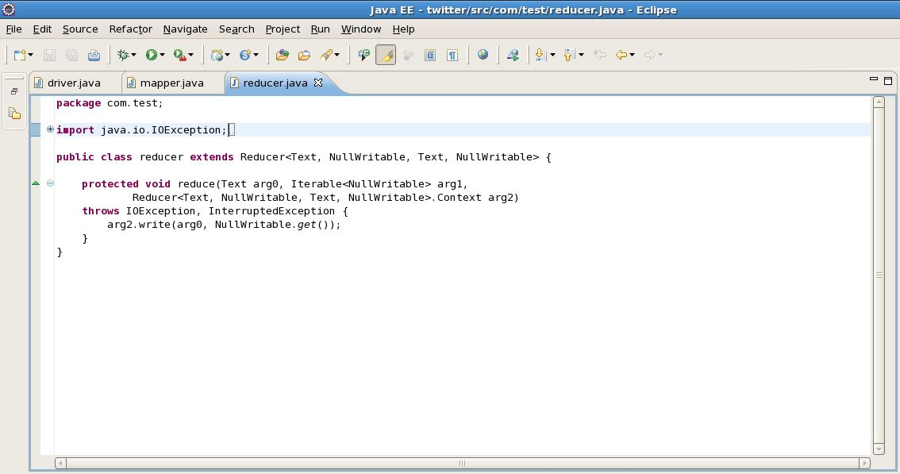
Reducer Class

Slide 15
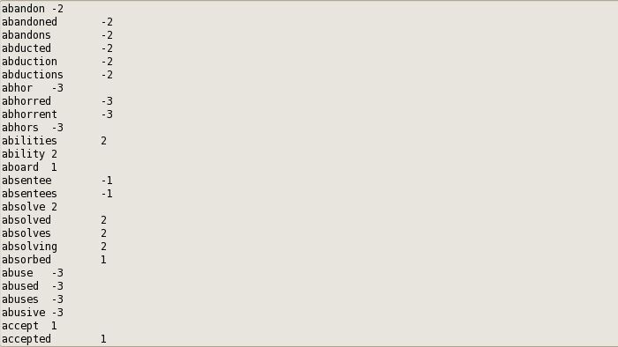
STEP 6:
Using AFINN Dictionary to analyze the sentiments of tweets.

Slide 16
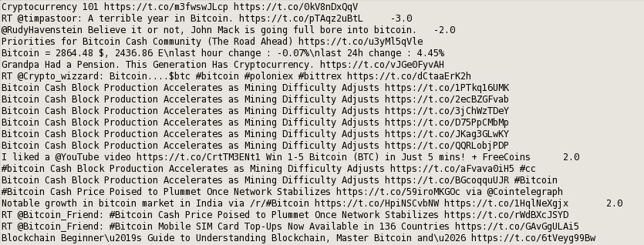
STEP 7: Output obtained after analyzing the sentiments of fetched tweets

Slide 17

ANY QUESTIONS?

