Slide 1

PREDICTING QUALITY OF WATER FOR SMART AQUACULTURE
by
KARANAM SAI MADHURI
(20001F0033)
Under the guidance of
Dr. P. RADHIKA RAJU M.Tech., Ph. D.
Assistant Professor (Ad-hoc)
DEPARTMENT OF COMPUTER SCIENCE AND ENGINEERING
JAWAHARLAL NEHRU TECHNOLOGICAL UNIVERSITY ANANTAPUR
COLLEGE OF ENGINEERING (Autonomous)
ANANTHAPURAMU
2022

Slide 2
CONTENTS
Introduction
Existing System
Disadvantages
Proposed System
Advantages
System Requirements
Block Diagram
Modules
Usecase Diagram
References

Slide 3
INTRODUCTION
Deep learning can be considered as a subset of machine learning.
Deep learning works with artificial neural networks, which are designed to imitate how humans think and learn.
In deep learning, a computer model learns to perform classification tasks directly from images, text and sound.
Deep learning models can achieve state-of-the-art accuracy, sometimes exceeding human-level performance.
Some of the Deep Learning Models are Convolutional Neural Networks, Recurrent Neural Networks, Long Short-Term Memory Networks and Multilayer Perceptrons.

Slide 4
EXISTING SYSTEM
Existing system is implemented by the Deep Learning (DL) models, Convolutional Neural Network (CNN) with the Long Short-Term Memory (LSTM) and Gated Recurrent Unit (GRU).
The process is implemented without removing unwanted data so this system is unable to predict the actual quality of water.
The techniques used in the existing system is not efficient for large amount of data.

Slide 5
DISADVANTAGES
Training time of the models is very high.
The existing system contains unwanted data so it is not efficient for large amount of data.

Slide 6
PROPOSED SYSTEM
The proposed system uses different deep and machine learning algorithms for predicting water quality for aquaculture.
To overcome the disadvantage of data duplicates here feature extraction techniques are used.
The proposed system uses the hybrid models such as CNN with LSTM, CNN with GRU.
Logistic Regression is performed on the result obtained by the CNN with LSTM and CNN with GRU.

Slide 7
ADVANTAGES
The process is implemented by removing unwanted data.
It is efficient for large amounts of data.

Slide 8
SYSTEM REQUIREMENTS
Software Requirements
Operating System : Windows 10
Language : Python
Front End : Anaconda Navigator – Spyder
Hardware Requirements
System : Pentium IV 2.4 GHz
Hard Disk : 200 GB
RAM : 4 GB

Slide 9
BLOCK DIAGRAM
Input Data
Water
Dataset
Checking Missing Values
Preprocessing
Data Splitting
CNN+LSTM
Test
CNN+GRU
Classification
Train
Logistic Regression
Performance
MAE
Water Quality
MSE
Prediction
RMSE
Visualization

Slide 10
MODULES
Data selection
Data Preprocessing
Data splitting
Classification
Performance Metrics
Prediction

Slide 11
DATA SELECTION
The input data was collected from dataset repository like UCI, github and kaggle
The dataset contains the information about the water such as ph, Hardness, Solids and so on. And it is fed into classification and regression algorithms.
Data pre-processing
Data pre-processing is the process of removing the unwanted data from the dataset.
In this process, the null values such as missing values and Nan values are replaced by 0 and data was cleaned of any abnormalities.
Encoding Categorical data: That categorical data is defined as variables with a finite set of label values.
Data Splitting
Data splitting is the act of partitioning available data into two portions.
One Portion of the data is used to develop a predictive model and the other to evaluate the model's performance.
Separating data into training and testing sets is an important part of evaluating data mining models.

Slide 12
Classification
In this process, different classification algorithms such as CNN+LSTM, CNN+GRU and logistic regression are used.
A CNN is a kind of network architecture for deep learning algorithms and is specifically used for image recognition and tasks that involve the processing of pixel data.
Long short-term memory (LSTM) is an artificial neural network used in the fields of artificial intelligence and deep learning. LSTM has feedback connections.
Performance Metrics
The Final Result will get generated based on the overall classification and prediction. The performance of this proposed approach is evaluated using some measures like,
Mean absolute error
Mean squared error
Root Mean squared error

Slide 13
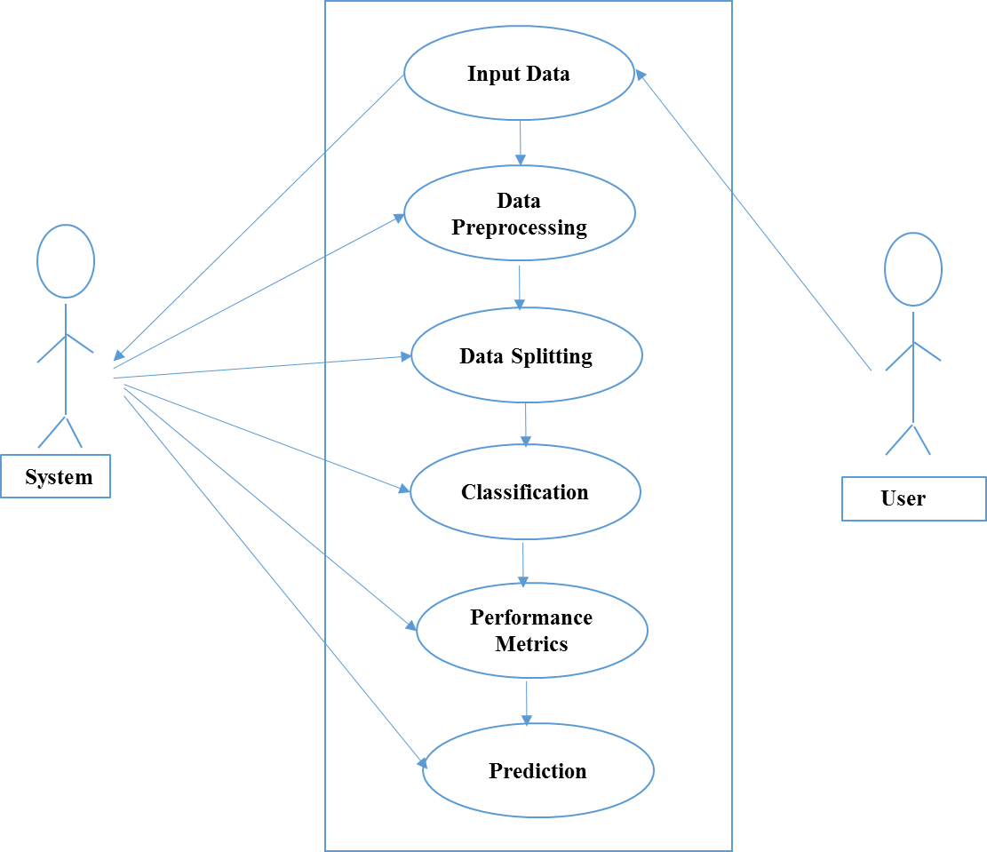
USECASE DIAGRAM

Slide 14

SCREENSHOTS
Home Page

Slide 15
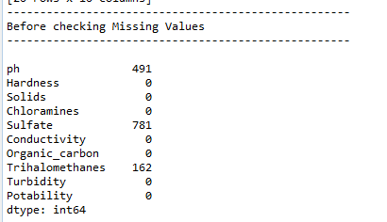
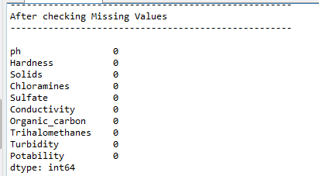
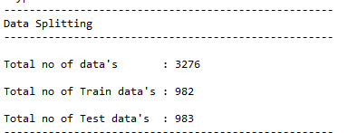
Preprocessing

Slide 16
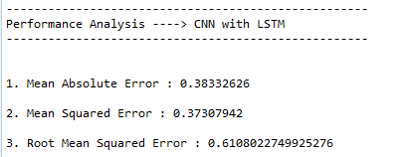
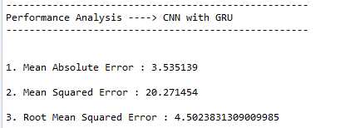
Performance Analysis

Slide 17
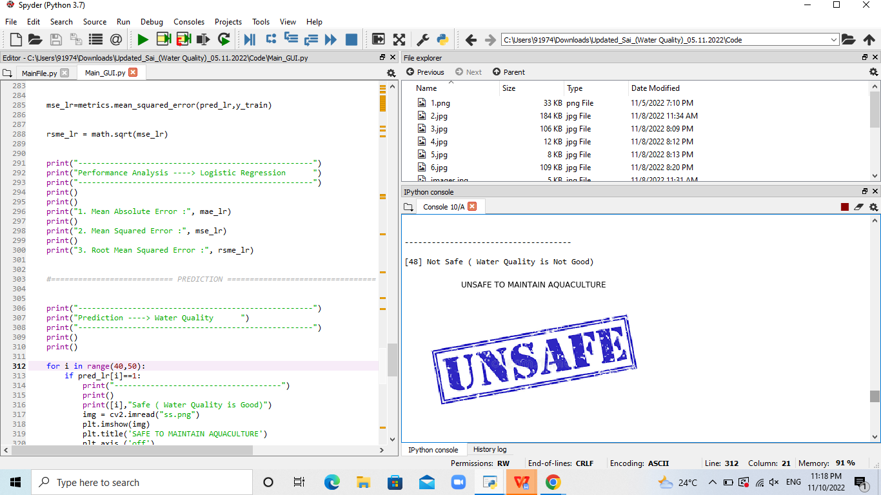
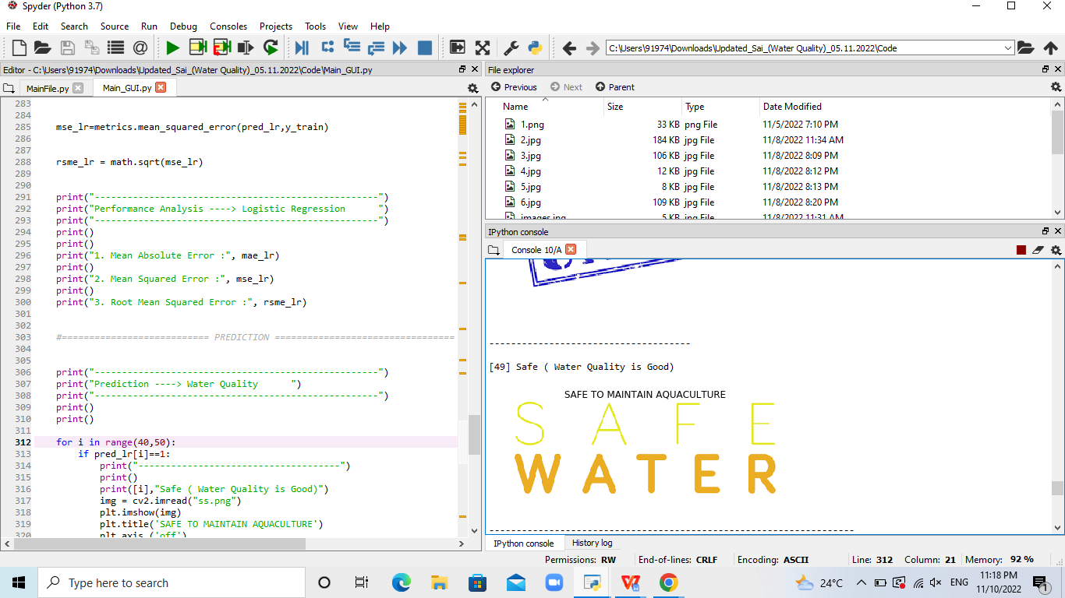
Prediction

Slide 18
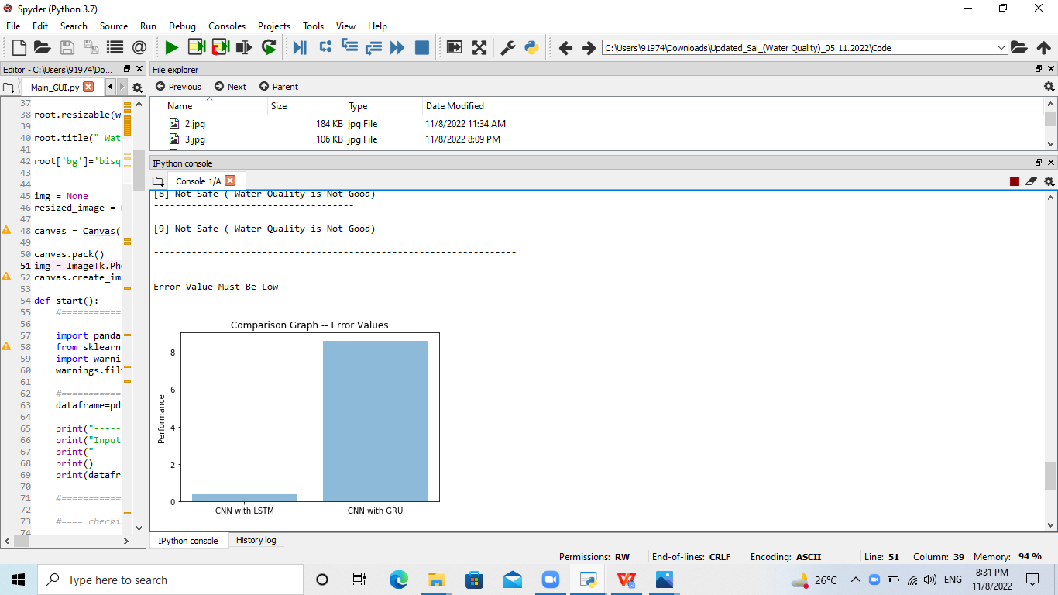
Accuracy

Slide 19
Conclusion
This project proposed a new method for predicting the quality of water based on the parameters by using deep learning based CNN, LSTM and GRU.
This system provides the prediction of water quality to maintain aquaculture and also provides accurate classification.

Slide 20
REFERENCES
“Water Quality Prediction for Smart Aquaculture Using Hybrid Deep Learning Models”, K. P. Rasheed Abdul Haq and V. P. Hari Govindhan, vol 10, June.2022.
S. S. Ahuja, ‘‘Monitoring water quality, pollution assessment, and remediation to assure sustainability,’’ in Monitoring Water Quality, S. Ahuja, Ed. Amsterdam, The Netherlands: Elsevier, 2013, pp. 1–18.
H. S. Ayele and M. Atlabachew, ‘‘Review of characterization, factors, impacts, and solutions of lake eutrophication: Lesson for lake tana, Ethiopia,’’ Environ. Sci. Pollut. Res., vol. 28, no. 12, pp. 14233–14252, Jan. 2021.
J. A. Martos-Sitcha, J. M. Mancera, P. Prunet, and L. J. Magnoni, ‘‘Editorial: Welfare and stressors in fish: Challenges facing aquaculture,’’ Frontiers Physiol., vol. 11, p. 162, Feb. 2020.

Slide 21
Thank You…

