Slide 1
Learn and document ways to identify web elements using Xpath and CSS Selectors
Introduction
When automating web applications using Selenium, one of the key tasks is identifying the web elements you want to interact with, such as buttons, text fields, and links. XPath and CSS Selectors are two powerful techniques for locating these elements. This report provides an overview of both methods, along with examples and explanations.
XPath (XML Path Language)
XPath is a language used for navigating through elements and attributes in an XML document. In web development, XPath is used to locate elements on a web page that is rendered in HTML, which is a subset of XML.
CSS Selectors (Cascading Style Sheets Selectors)
CSS Selectors are patterns used to select the elements you want to style in a webpage. In the context of Selenium, CSS Selectors are used to locate elements for automation.

Slide 2
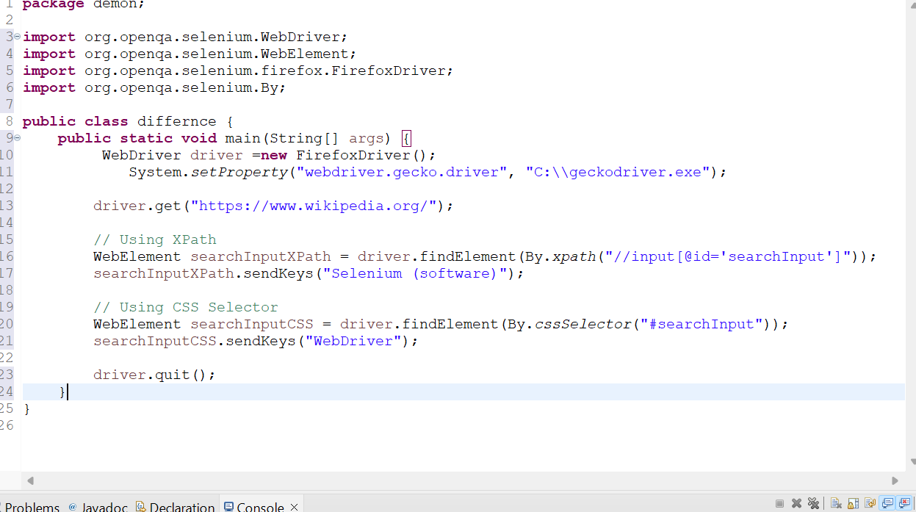

Slide 3
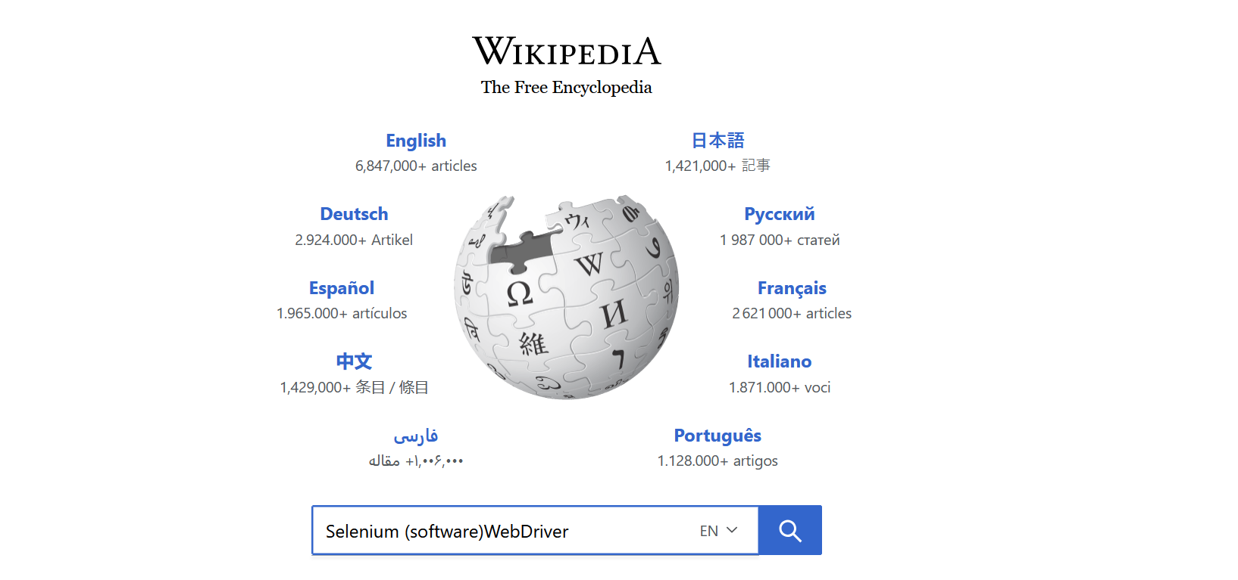

Slide 4
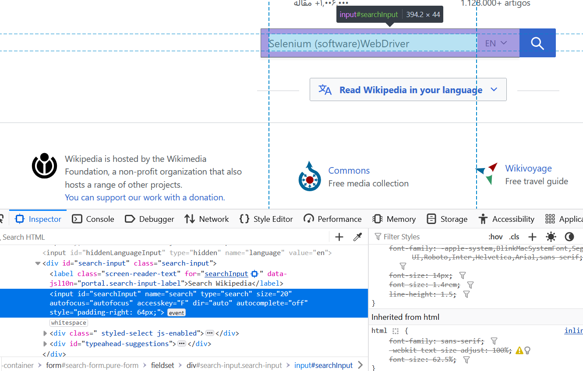

Slide 5
Download and configure Java WebDriver for Firefox and Chrome browsers.
Download WebDrivers
ChromeDriver:
Visit the ChromeDriver download page.
Download the version that matches your installed Chrome browser version.
Extract the downloaded file to a preferred location on your system.
GeckoDriver (Firefox):
Visit the GeckoDriver releases page.
Download the appropriate version for your operating system.
Extract the downloaded file to a preferred location on your system.

Slide 6
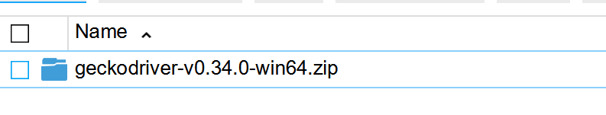
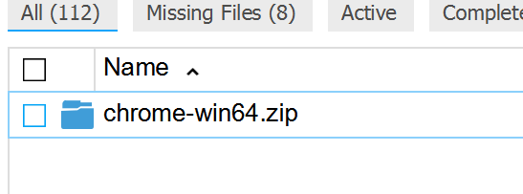
DOWNLOAD THEM

Slide 7
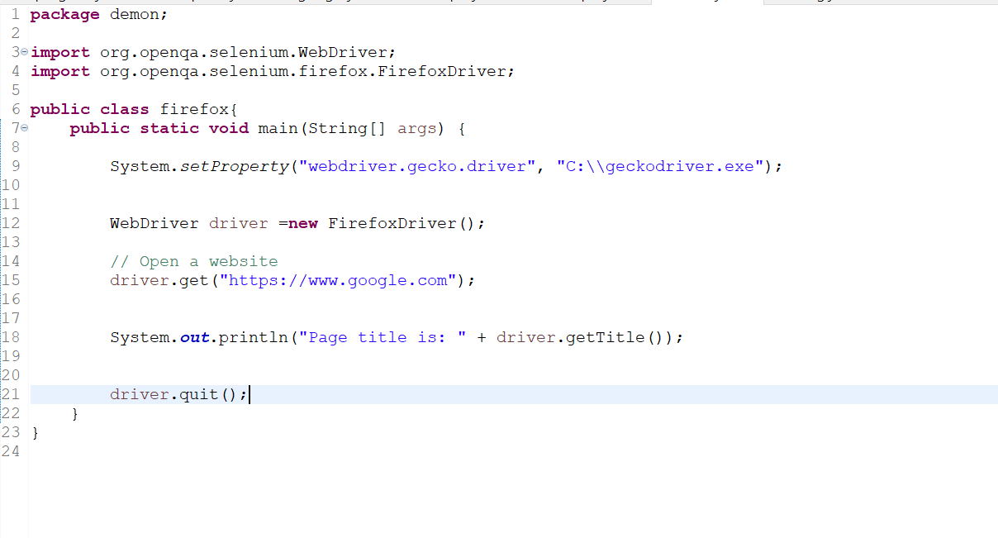
Firefox GekoDriver

Slide 8
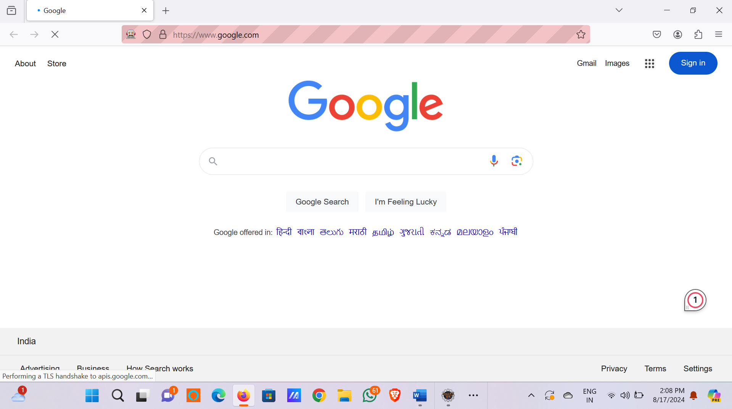

Slide 9
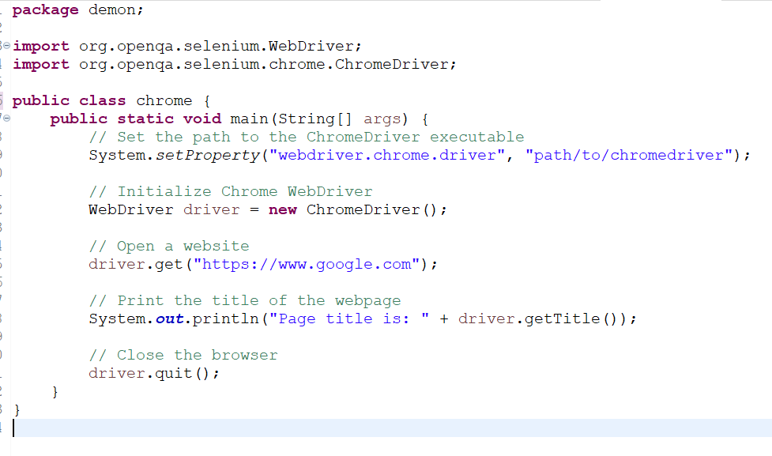
CHROME DRIVER

Slide 10
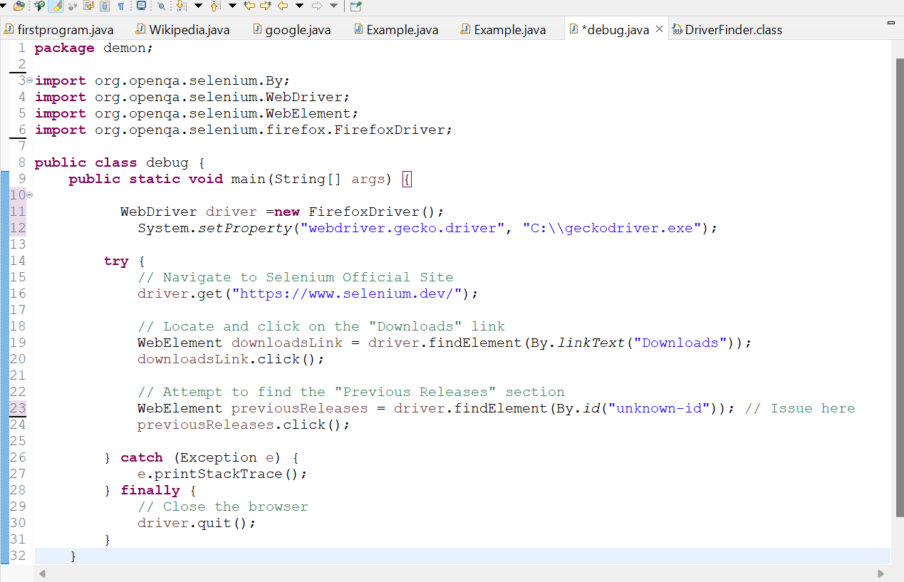
Debug a provided Selenium script that interacts with the Selenium official site to identify and fix issues. Sample Script with Issues ----

Slide 11
Issues and Debugging Issue 1: Incorrect Element Locator Problem: The script attempts to find the "Previous Releases" section using an incorrect ID ("unknown-id"). This ID doesn't exist on the page, which will cause a NoSuchElementException. Fix: Identify the correct ID or use a different locator strategy such as XPath or CSS Selector to find the element.
Issue 2: Missing Synchronization
Problem: The script may attempt to interact with elements before they are fully loaded, especially on a site like Selenium's which might load content dynamically. This can result in ElementNotInteractableException.
Fix: Implement explicit waits to ensure elements are interactable before performing actions on them.

Slide 12
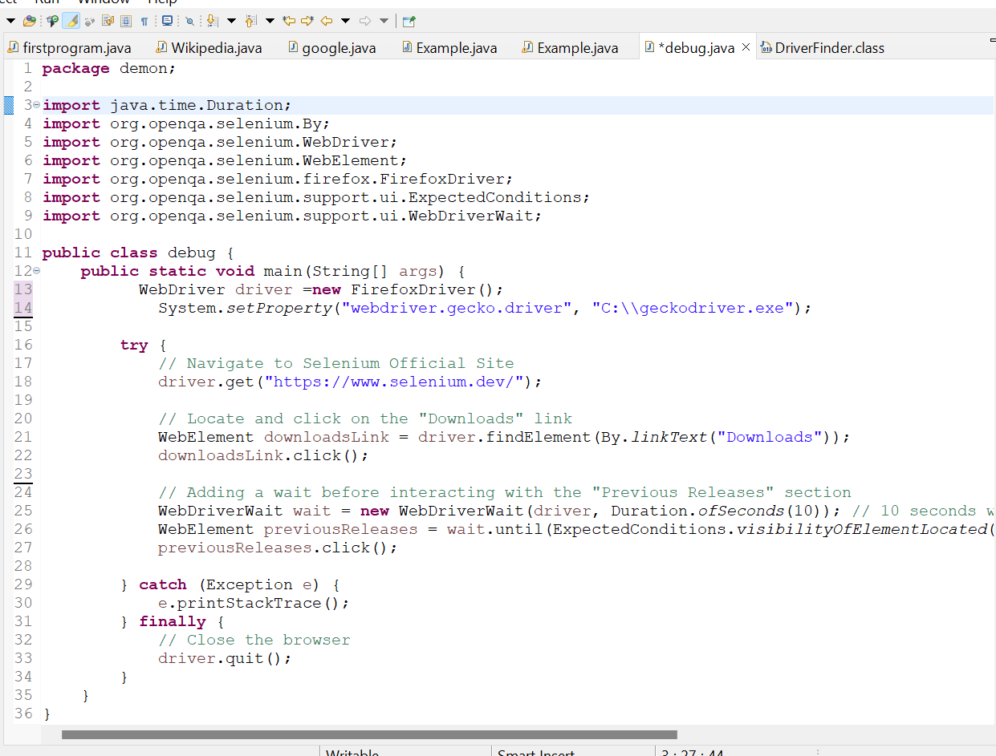
Debugged and Corrected Script

Slide 13
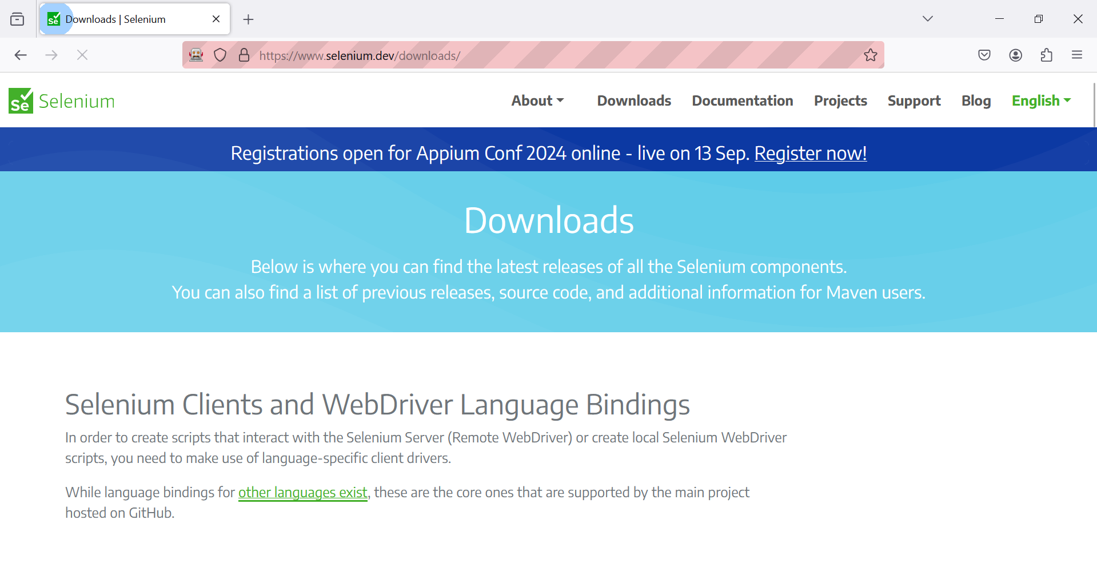
Explanation of Fixes:
Element Locator Correction:
The findElement method was trying to locate an element using an incorrect ID. The correct element was found using an XPath locator.
Synchronization with Explicit Wait:
Added an explicit wait using WebDriverWait to ensure that the element is visible and ready for interaction before clicking on it.

Slide 14
UNDERSTANDING PAGE OBJECT MODEL
The Page Object Model (POM) is a design pattern in Selenium that promotes the separation of test scripts from the web page structure. In POM, each web page in the application is represented by a corresponding page class in the code. This class contains the methods and locators for interacting with the elements on that page.
Key Characteristics of POM
Encapsulation of Page Elements:
Page elements are stored as variables (WebElements) within the page class.
Actions that can be performed on those elements are encapsulated in methods within the same class.
Separation of Concerns:
Test logic is separated from the page structure, making the code more modular and easier to manage.
Reusability:
Page classes can be reused across multiple test cases, reducing code duplication.

Slide 15
Benefits of Using POM Improved Code Maintenance: By isolating the page structure from the test logic, any changes in the UI can be managed in a single place (the page class) without affecting the test scripts. This significantly reduces maintenance efforts. Enhanced Code Readability: POM makes the test scripts more readable and understandable, as the interactions with web pages are abstracted into simple, descriptive methods. Increased Reusability: Since the page objects are modular, they can be reused across different test cases. This promotes the DRY (Don't Repeat Yourself) principle. Reduced Code Duplication: Common actions are defined in the page classes and can be reused, reducing redundancy and making the codebase cleaner. Simplified Test Case Creation: Test cases become simpler and more focused on business logic, as the details of interacting with the page elements are hidden behind the page object methods.
.

