Slide 1
POWER BI ASSIGNMENT
iVision Analytics
Cma acma cgma Karan bhanushali
Hero Vired – Batch 13

Slide 2
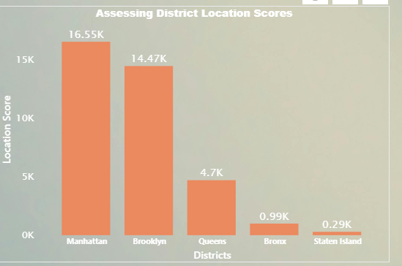
ASSESSING DISTRICT LOCATION SCORES
Assessing District Location Scores: The aim is to pinpoint the location in the district with the least favorable location scores.
The district with the least favorable location score is Staten Island. Only 290 people have voted in favor of Staten Island.

Slide 3
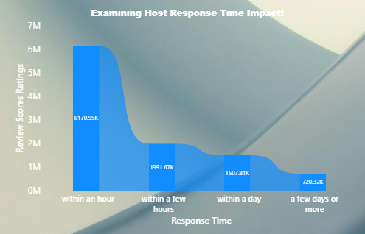
Examining Host Response Time Impact
Examining Host Response Time Impact: The goal is to delve into the relationship between host response times and the overall ratings of Airbnb listings providing valuable insights.
As per the inputs received Airbnb host are responding to the consumer at the earliest this helps to improve the Guest experience for the consumers.
On the other hand they also have a Competitive Advantage in the market which can attract more bookings which can also lead to Enhanced Ratings as well.
For the other areas where the response time is more than an hour airbnb can Implement strategies to monitor and improve response times, also Provide tools and resources to help hosts manage inquiries efficiently.

Slide 4
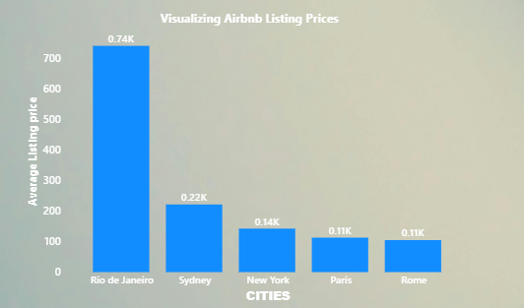
Visualizing Airbnb Listing Prices
Visualizing Airbnb Listing Prices: The objective is to create visual representations of Airbnb listing prices across different cities and summarize any noteworthy trends or variations.
The listing prices across various cities depends mostly on basic three basic points i.e.:
a) Regional Disparity
b) Seasonal Variations
c) Location & Amenities.
As per the data received the average listing price in Rio de Janerio is highest as compare to other cities. As the host may reside nearby famous locations.
The host of other cities can manage their prices according to various seasons which can attract more consumer.

Slide 5
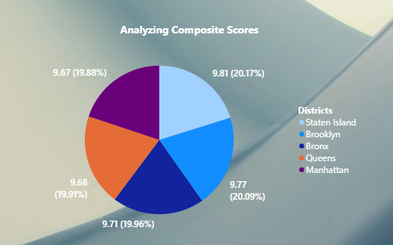
Analyzing Composite Scores
Analyzing Composite Scores: The task involves creating a composite score that integrates check-in experience and host communication for various districts with subsequent analysis and insights.
The host in District Staten Island have the highest composite score followed by Brooklyn, Bronx, Queens and Manhatten.
There are slight variations in all the district mentions above. This might differs on customer experience like effective host communication, ensuring smooth check-in process providing basic amenities and also other on demand services by consumers.

Slide 6
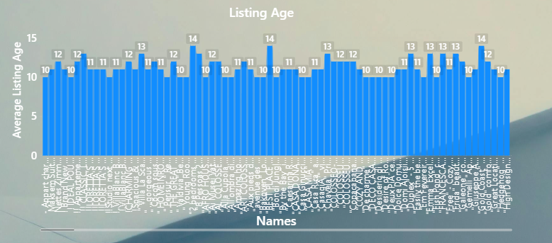
Listing Age and Host Tenure
Calculating Listing Age and Host Tenure: This objective entails computing the age of Airbnb listings and identifying hosts who have accumulated more than ten years of hosting expertise.
There are total 88,811 host who have accumulated more than 10 years of hosting expertise.

Slide 7
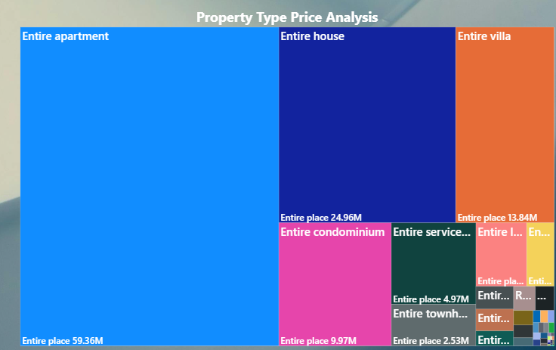
Property Type Price Analysis
Property Type Price Analysis: The task involves the creation of a visual tree map that displays average prices for various room and property types with specific attention given to the property type associated with the highest prices for entire places.
The Average price for the property type Entire Apartment for the Entire places is $59.36M followed by:
Entire house at $24.96M,
Entire Villa at $13.84M,
Entire Condominium at $9.97M and
Entire Service Apartments at $4.97M.

Slide 8
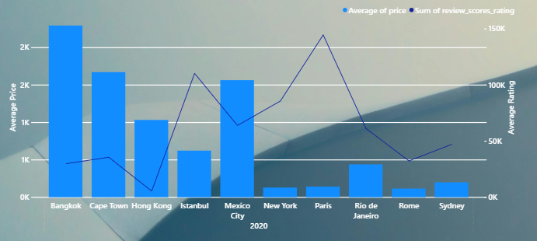
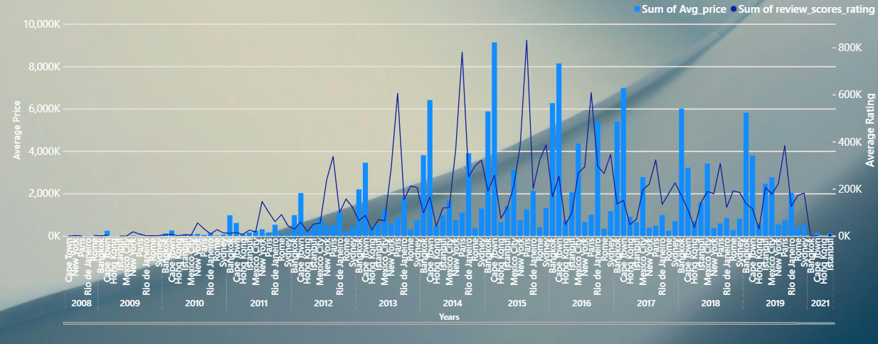
Crafting a Comprehensive City Insights Report
Crafting a Comprehensive City Insights Report: This objective entails the creation of a comprehensive report that presents listing prices, guest ratings, and visitor trends for multiple cities, with a particular focus on assessing changes in visitor trends in 2020 in contrast to earlier years.
In the year of pandemic i.e. 2020, the average price and rating for city line Rio de Janerio went down by almost 50% as compare to years 2014 and 2016.
For other cities also the average price have fall drastically as compared with the previous years.
The Average rating in the year 2020 also fall down as compare to the previous years.

Slide 9
THANK YOU
Cma acma cgma Karan bhanushali
Hero Vired – Batch 13

