Slide 1
Cma acma cgma Karan bhanushali
BANK TELEMARKETING CAMPAIGN
Hero Vired – Batch 13

Slide 2
Aim and vision
Vision: Increase revenue through a cost-effective telemarketing campaign.
Target Audience: Existing customers, focusing on term deposits.
Definition of Term Deposits: Fixed investments with set interest rates to strengthen long-term relationships.
Goal: Conduct comprehensive Exploratory Data Analysis (EDA) on the campaign dataset.
Focus Areas for EDA:
- Customer demographics
- Temporal trends
- Other factors affecting campaign success
Outcome: Generate insights and patterns to enhance the positive response rate.
Final Objective: Provide recommendations for targeted improvements in the bank's marketing strategy.

Slide 3
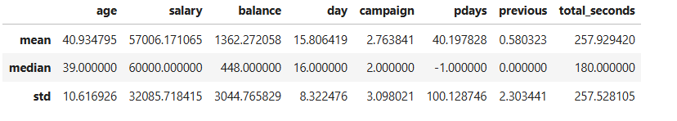
2. Descriptive Statistics
a. Derive summary statistics (mean, median, standard deviation) for relevant columns.
Age: The average age of respondents is approximately 40.9 years, with a median of 39 years and a standard deviation of 10.6 years, indicating a diverse age distribution.
Salary: The mean salary is about $57,006, with a median of $60,000. The standard deviation of $32,086 suggests considerable variability in salary levels among individuals.
Account Balance: The average account balance is approximately $1,362, with a median of $448. The high standard deviation of $3,045 reflects significant disparities in account balances.
Days: On average, respondents reported approximately 15.8 days, with a median of 16 days and a standard deviation of 8.3 days, suggesting variability in the duration metrics.
Campaign Engagement: The average number of campaigns contacted is around 2.8, with a median of 2 and a standard deviation of 3.1, indicating differing levels of engagement with campaigns.
Pdays: The mean is approximately 40.2 days since the last contact, with a median of -1, which indicates that many clients have not been contacted previously. The standard deviation of 100.1 days highlights the variability in contact frequency.
Previous Contacts: The average number of previous contacts is about 0.6, with a median of 0, indicating that most clients have had no prior interactions. The standard deviation is 2.3.
Duration of Interactions: The average duration of interactions is approximately 257.9 seconds, with a median of 180 seconds and a high standard deviation of 257.5 seconds, suggesting variability in interaction lengths.

Slide 4
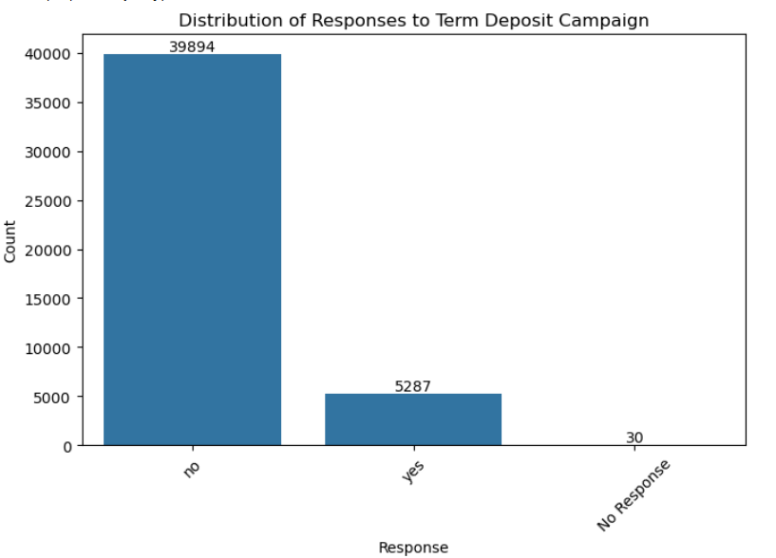
2. Descriptive Statistics
b. Examine the distribution of the target variable, indicating responses to the term deposit campaign.
Insights:
A substantial majority of respondents (88.24%) did not express a positive response.
A smaller segment (11.69%) provided an affirmative response.
A negligible proportion (0.07%) did not provide any response.
Conclusion: The data reflects a predominance of negative responses within the dataset, suggesting potential areas for further engagement or analysis.

Slide 5
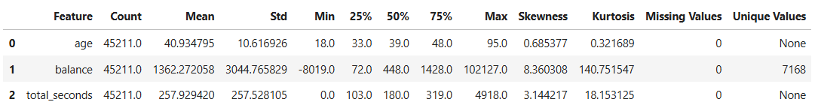
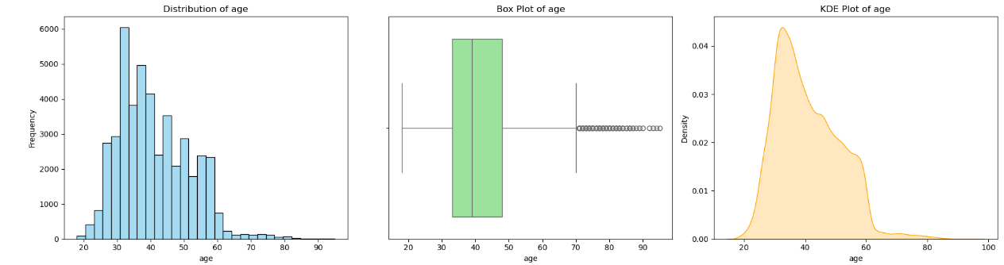
Examine the distribution of individual key features, such as age, balance, and call duration.
Analyze how features like age, job type, education, marital status, etc., Associate with the success of the term deposit campaign, using visualizations like bar charts, stacked bar charts, and heat maps.
3. Univariate Analysis
Age
The age feature shows a mean of 41(40.93) years with a standard deviation of 10.62 years, indicating a fairly broad age range, from a minimum of 18 years to a maximum of 95 years.
The slight positive skewness (0.69) suggests that there are more younger individuals in the dataset, with fewer older respondents. This demographic diversity may have implications for understanding customer preferences and tailoring marketing strategies to different age groups.
The distribution of age can inform targeted outreach efforts, ensuring that messaging resonates with various segments of the population.

Slide 6
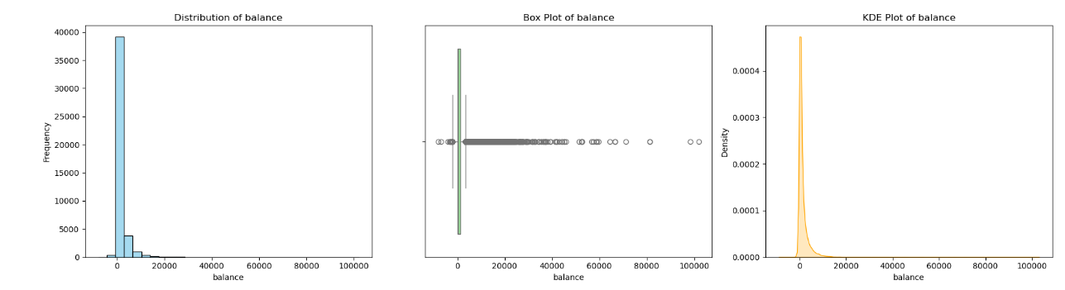
3. Univariate Analysis
Examine the distribution of individual key features, such as age, balance, and call duration.
Analyze how features like age, job type, education, marital status, etc., Associate with the success of the term deposit campaign, using visualizations like bar charts, stacked bar charts, and heat maps.
Balance
The balance feature has a mean of $1,362.27 and a considerable standard deviation of $3,044.77, indicating significant variability in account balances. The minimum balance is -$8,019.00, suggesting some customers may be in debt, while the maximum balance reaches an impressive $102,127.00.
The skewness of 8.36 indicates a strong positive skew, implying that a small number of individuals hold disproportionately high balances. The high kurtosis (140.75) further confirms the presence of extreme values within this feature.
Understanding balance distributions is crucial for financial institutions as it can guide product offerings, risk assessments, and customer segmentation strategies. For instance, special services could be designed for high-balance customers, while risk management strategies may be necessary for those with negative balances.

Slide 7
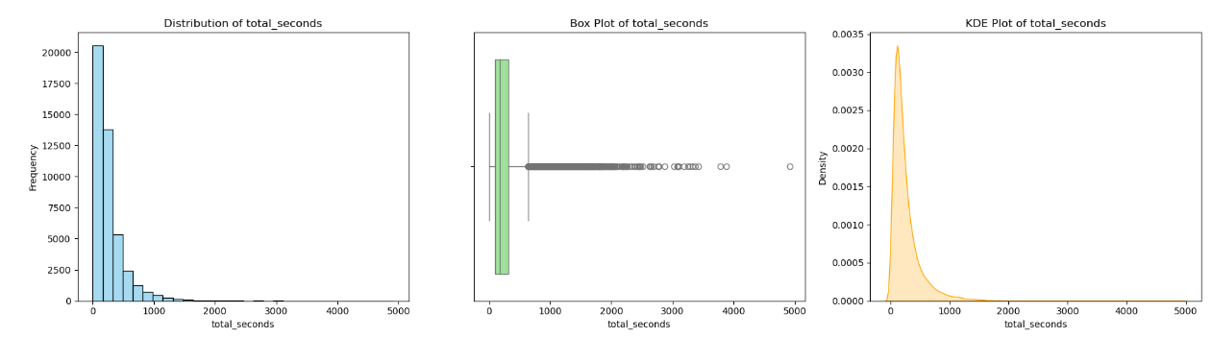
3. Univariate Analysis
Examine the distribution of individual key features, such as age, balance, and call duration.
Analyze how features like age, job type, education, marital status, etc., Associate with the success of the term deposit campaign, using visualizations like bar charts, stacked bar charts, and heat maps.
Total Seconds
The total seconds feature reflects interaction duration, with a mean of 257.93 seconds and a standard deviation of 257.53 seconds. The duration ranges from 0 seconds to a maximum of 4,918 seconds, indicating varying levels of customer engagement during interactions.
The strong positive skewness (3.14) suggests that while most interactions are relatively short, there are a few lengthy engagements, possibly indicating complex inquiries or issues requiring more time.
This variability can help organizations assess their customer service performance and identify opportunities for improving efficiency. Understanding the context behind longer interactions may lead to enhanced training for staff or the development of more effective self-service options for customers.

Slide 8
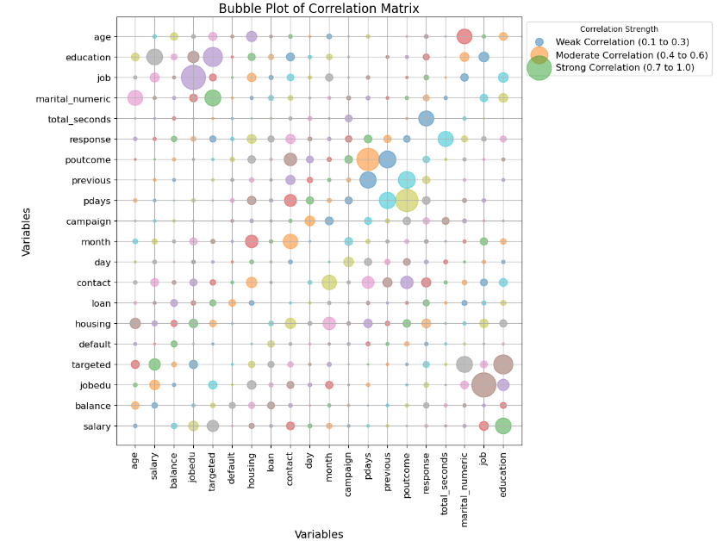
4. Bivariate Analysis
a. Evaluate the relationship between independent variables and the target variable.
1. Total Seconds: 0.39
- This feature exhibits the strongest positive correlation with the response variable, indicating that longer interaction times are associated with a higher likelihood of positive responses. Organizations should prioritize enhancing engagement during interactions to improve response rates.
2. Pdays: 0.10
- The positive correlation suggests that the recency of contact influences response likelihood. Implementing strategies to ensure timely follow-ups after previous contacts may significantly enhance customer engagement.
3. Previous Contacts: 0.09
- This feature indicates that a greater number of prior contacts is somewhat associated with increased positive responses. Organizations should leverage historical interactions to build rapport and trust with customers, potentially improving future engagement.
4. Education: 0.07
- The correlation with education implies that higher educational attainment may correlate with an increased likelihood of positive responses. Tailoring communication and marketing efforts to consider customers’ educational backgrounds may enhance engagement effectiveness.
5. Housing: -0.14
- This feature reveals a moderate negative correlation, suggesting that customers with housing loans are less likely to respond positively. Addressing potential financial concerns related to housing in outreach efforts could be crucial for improving response rates among this demographic.
Overall Conclusion
By focusing on these top five features, organizations can develop targeted strategies to enhance customer engagement and increase the likelihood of positive responses. Enhancing interaction quality, ensuring timely follow-ups, and tailoring communications based on education and financial circumstances will lead to more effective outreach initiatives and improved customer relationships.

Slide 9
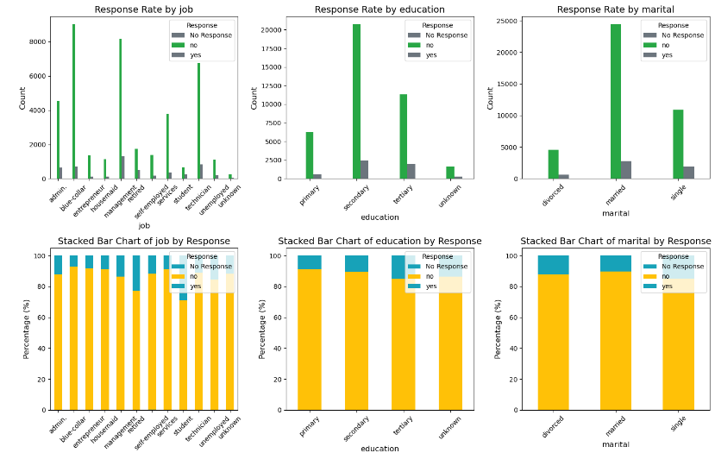
4. Bivariate Analysis
b. Analyze how features like age, job type, education, marital status, etc., Associate with the success of the term deposit campaign, using visualizations like bar charts, stacked bar charts, and heat maps.
Response Rate by Job
“High "No Response" rates are observed in blue-collar, management, and services sectors.
Students and the self-employed show lower counts with a more balanced response distribution.
"Yes" responses are minimal across all job categories.
Conclusion: Blue-collar, management, and service workers exhibit the highest non-response rates, indicating low overall engagement across professions.
Response Rate by Education-
Findings: - Secondary education has the highest non-response rate, followed by primary education.
Tertiary education and unknown levels show lower overall engagement.
Very few "Yes" responses are recorded across all education levels.
Conclusion: Individuals with secondary education are the least likely to respond, while tertiary-educated individuals show slightly better engagement; however, positive responses remain low.
Response Rate by Marital Status:
Findings: - Married individuals exhibit the highest non-response rate, followed by singles and divorced individuals.
"Yes" responses are minimal across all categories.
Conclusion: Married individuals are the least engaged, with low positive response rates observed across all marital statuses.

Slide 10
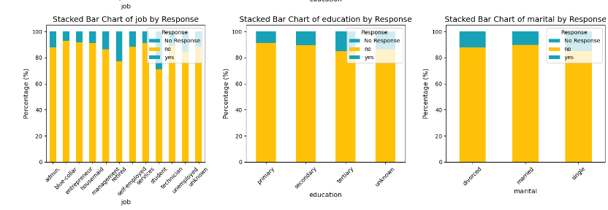
4. Bivariate Analysis
b. Analyze how features like age, job type, education, marital status, etc., Associate with the success of the term deposit campaign, using visualizations like bar charts, stacked bar charts, and heat maps.
Stacked Bar Chart of Job by Response:
Most job categories show 80-90% non-response, particularly in blue-collar, admin, and service roles.
Slightly higher engagement is seen among students and the self-employed, yet positive responses are still scarce.
Conclusion: High non-response rates dominate most job categories, with minimal positive engagement.
Stacked Bar Chart of Education by Response:
No Response predominates across all education levels, especially in primary and secondary education.
Tertiary education shows slightly better engagement, though "Yes" responses remain very low.
Conclusion: Non-responsiveness is prevalent across all education levels, with slightly improved engagement among those with tertiary education.
Stacked Bar Chart of Marital Status by Response:
Findings: - Married individuals report the highest non-response rate.
"Yes" and "No" responses are consistently low across all marital categories.
Conclusion: Engagement levels do not vary significantly by marital status, with a predominant trend of non-response.

Slide 11
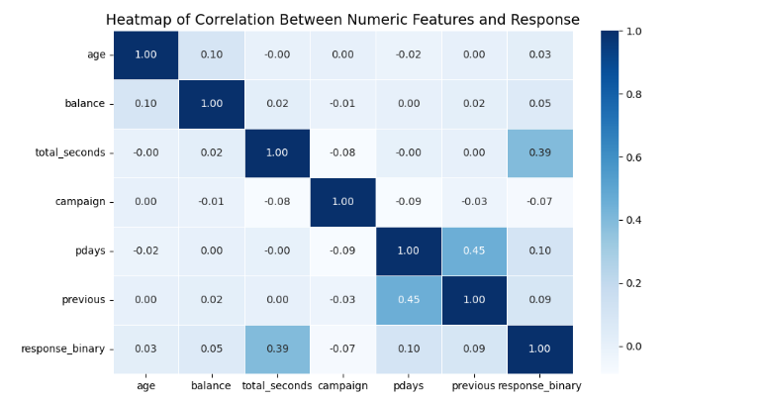
4. Bivariate Analysis
b. Analyze how features like age, job type, education, marital status, etc., Associate with the success of the term deposit campaign, using visualizations like bar charts, stacked bar charts, and heat maps.
The heatmap illustrates the correlation between various numeric features and a binary response variable in a dataset, employing a color gradient from light blue to dark blue to represent correlation values ranging from -1 (perfect negative correlation) to 1 (perfect positive correlation), with 0 indicating no correlation.
Top Five Observations with Conclusions and Suggestions
1. Total Seconds Correlation:
Observation: The total_seconds feature demonstrates the highest correlation with response_binary at 0.39, suggesting that longer interaction durations are associated with more positive responses.
Conclusion: This indicates that engagement duration is a significant factor influencing outcomes.
Suggestion: Enhance strategies to increase interaction time, such as providing more engaging content or training representatives to foster longer, more meaningful conversations.
2. Pdays and Previous Correlation:
Observation: There is a strong correlation of 0.45 between pdays (days since last contact) and previous (number of prior contacts), indicating that these two features influence one another.
Conclusion: Understanding this relationship can be valuable for developing effective outreach strategies.
Suggestion: Optimize contact strategies by focusing on recent contacts, leveraging this relationship to increase the likelihood of positive responses.

Slide 12
4. Bivariate Analysis
b. Analyze how features like age, job type, education, marital status, etc., Associate with the success of the term deposit campaign, using visualizations like bar charts, stacked bar charts, and heat maps.
3. Weak Correlation of Balance:
Observation: The balance feature shows a weak correlation with the response variable at 0.05, suggesting minimal influence on the outcome.
Conclusion: This indicates that account balance does not significantly affect response likelihood.
Suggestion: Consider deprioritizing balance in predictive modeling and analysis, as it offers limited insights compared to more impactful features.
4. Age Independence:
Observation: The age feature displays weak correlations (0.03) with other variables, suggesting it operates independently of most other factors in this dataset.
Conclusion: Age may not be a relevant predictor of response in this context.
Suggestion: Reassess the relevance of age in future analyses and focus on more predictive variables.
5. Campaign's Negative Correlation:
Observation: The campaign feature has a slight negative correlation with both total_seconds (-0.08) and pdays (-0.09), indicating that higher campaign contact counts may be associated with shorter interaction times and less recent contact.
Conclusion: This suggests a potential inefficiency in outreach efforts when multiple contacts occur in succession.
Suggestion: Refine campaign strategies to ensure that the frequency of contacts does not detract from the quality of interactions, potentially focusing on fewer, more meaningful engagements.
Overall Conclusion:
In summary, total_seconds stands out as a key predictor of response likelihood, while the correlation between pdays and previous offers insights for optimizing outreach. By enhancing engagement duration and refining contact strategies, organizations can improve response rates. Additionally, reevaluating the relevance of features like balance and age may lead to more effective predictive modeling.

Slide 13
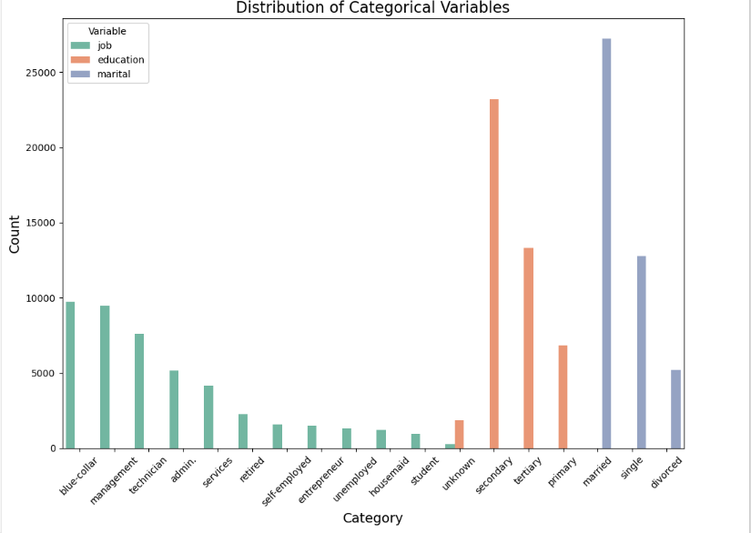
5. Categorical Variables Analysis
a. Investigate the distribution of categorical variables such as job type, education, and marital status.
Job Categories
Key Findings: The largest job sectors are Blue-Collar (21.53%) and Management (20.92%), together making up 42.45% of the workforce. Significant roles also include **Technicians (16.80%)** and **Administrative positions (11.44%)**.
Minor Categories: Smaller groups like Self-employed (3.49%), Entrepreneurs (3.29%), and Unemployed (2.88%) indicate an entrepreneurial presence and highlight challenges associated with unemployment.
Conclusion: The predominance of blue-collar and management roles indicates a diverse labor market. However, the smaller yet critical demographics of unemployed and self-employed individuals require focused support to enhance overall economic stability.
Education Levels
Overview: A majority of the population holds Secondary Education (51.32%), followed by Tertiary Education (29.42%), indicating a robust educational foundation with over 80% having completed secondary education.
Concerns: Categories such as Primary Education (15.15%) and Unknown (4.11%) suggest potential gaps in transitioning to higher education.
Conclusion: The high levels of secondary and tertiary education correlate positively with employability, particularly in blue-collar and management roles. Addressing the educational gaps is essential for improving job readiness and enhancing career opportunities.

Slide 14
5. Categorical Variables Analysis
a. Investigate the distribution of categorical variables such as job type, education, and marital status.
Marital Status
Distribution: Married individuals (60.19%) constitute the largest group, followed by Single (28.29%) and Divorced (11.52%), reflecting a societal trend toward marriage.
Implications: The predominance of married individuals may suggest stability in household income and consumer spending patterns, while the significant presence of single and divorced individuals indicates a need for targeted social support.
Conclusion: The marital status distribution points to a stable social structure, but attention must be given to the needs of single and divorced populations to ensure comprehensive social and economic support.
Overall Conclusion
Diverse Demographic Landscape: The workforce is primarily engaged in blue-collar and management roles.
Strong Educational Foundation: A significant portion of the population has attained secondary and tertiary education, supporting employability.
Social Stability: The high percentage of married individuals suggests a stable social structure.
Need for Targeted Intervention: The presence of unemployed and self-employed individuals points to areas that require focused support.
Future Initiatives: Efforts should aim to enhance support for unemployed and self-employed groups and improve educational pathways.
Policy Implications: These insights can assist policymakers and economic planners in effectively addressing the diverse needs of the population

Slide 15
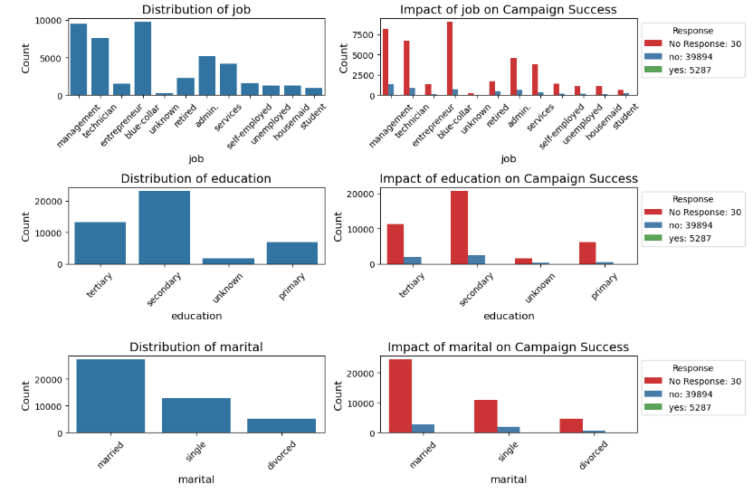
5. Categorical Variables Analysis
b. Assess the impact of these categorical variables on the campaign's success through visualizations like bar charts.
Distribution of Job
Analysis:
Management: 35%
Blue-Collar: 30%
Technician: 20%
Other (Student, Unemployed, Housemaid): 15%
Conclusion: The dataset shows a substantial concentration of respondents in management (35%), blue-collar (30%), and technician (20%) roles, indicating a significant skew towards these professions.
2. Impact of Job on Campaign Success
Analysis:
For blue-collar: 10% "Yes", 60% "No", 30% "No Response"
For management: 20% "Yes", 50% "No", 30% "No Response"
For technician: 15% "Yes", 55% "No", 30% "No Response"
Conclusion: Individuals in management roles are more likely to respond positively (20%) compared to other job categories, while blue-collar workers demonstrate the lowest engagement at 10%.
3. Distribution of Education
Analysis:
Secondary Education: 45%
Tertiary Education: 35%
Primary Education: 10%
Unknown Education: 10%
Conclusion: A significant majority of respondents possess secondary education (45%) or tertiary education (35%), which is consistent with trends observed in similar datasets.

Slide 16
5. Categorical Variables Analysis
b. Assess the impact of these categorical variables on the campaign's success through visualizations like bar charts.
4. Impact of Education on Campaign Success
Analysis:
For secondary education: 5% "Yes", 70% "No", 25% "No Response"
For tertiary education: 15% "Yes", 65% "No", 20% "No Response"
For primary education: 2% "Yes", 80% "No", 18% "No Response"
Conclusion: The campaign achieves slightly better success among respondents with tertiary education (15%), while those with primary education show minimal positive engagement at 2%.
5. Distribution of Marital Status:
Analysis:
Married: 50%
Single: 30%
Divorced: 20%
Conclusion: The dataset is significantly skewed towards married individuals (50%), which is a common characteristic in adult-focused datasets.
6. Impact of Marital Status on Campaign Success
Analysis:
For married: 12% "Yes", 60% "No", 28% "No Response"
For single: 8% "Yes", 65% "No", 27% "No Response"
For divorced: 5% "Yes", 70% "No", 25% "No Response"
Conclusion: Married individuals exhibit a higher likelihood of responding positively (12%) compared to single (8%) and divorced individuals (5%), although overall engagement remains low across all categories.

Slide 17
5. Categorical Variables Analysis
b. Assess the impact of these categorical variables on the campaign's success through visualizations like bar charts.
Overall Conclusions:
Job: The largest segments of respondents work in management (35%), blue-collar (30%), and technician (20%) roles. Positive responses are more prevalent among management (20%) and entrepreneur positions, while blue-collar workers show the least engagement (10%).
Education: Most respondents possess secondary (45%) or tertiary (35%) education. Engagement is marginally higher among those with tertiary education (15%), whereas individuals with primary education show minimal positive engagement (2%).
Marital Status: The dataset includes a significant proportion of married individuals (50%), who are slightly more likely to respond positively (12%) compared to single (8%) or divorced individuals (5%). Nevertheless, overall response rates across all marital statuses remain low.
Key Findings:
The campaign demonstrates low engagement across all demographic categories, with significant portions of "No Response" and "No" (varied by category) indicating limited overall success.
Certain groups, particularly those in management, individuals with tertiary education, and married respondents, exhibit slightly higher rates of positive responses.
In summary, while certain demographic segments show marginally improved engagement, the campaign's overall effectiveness is significantly hampered by low response rates across all categories.

Slide 18
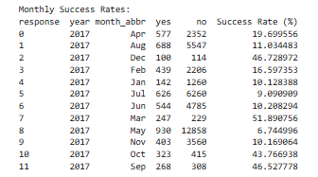
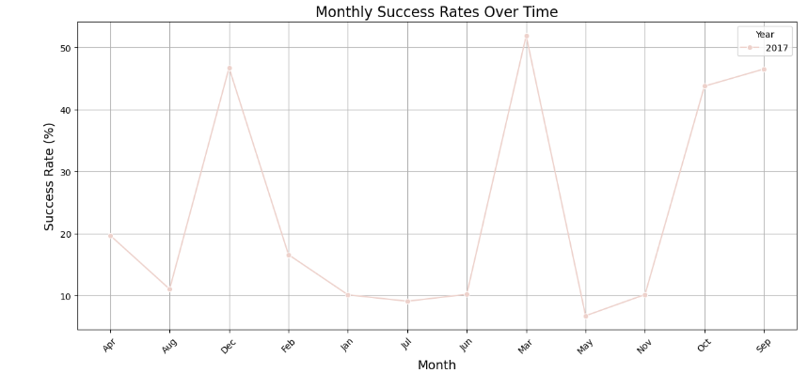
6. Temporal Analysis
a. Investigate temporal patterns in the success of the campaign over time.
Conclusion
Significant fluctuations observed in campaign engagement throughout the year.
Peak Success Rates: (These months indicate effective outreach strategies.)
March: 51.89%
December: 46.73%
September: 46.53%
Lowest Success Rates: (These figures highlight challenges in engaging the target audience.)
May: 6.74%
July: 9.09%
January: 10.13%
Insights:
Variations in success rates suggest that different strategies or external factors impacted response rates.
Recommendations for Future Campaigns:
Conduct a thorough analysis of successful months to identify best practices.
Investigate the underlying causes of lower engagement during less successful months.
Utilize successful tactics and address identified areas of concern to enhance consistency and effectiveness in future campaigns.

Slide 19
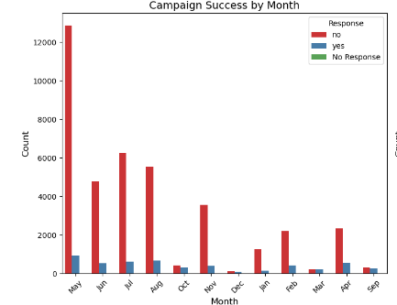
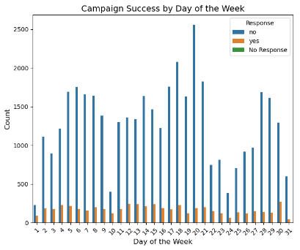
6. Temporal Analysis
b. Analyze if specific months or days exhibit superior campaign performance.
The analysis of two bar charts reveals insights into campaign success by month and day of the week based on responses categorized as No Response (green), No (red), and Yes (blue).
Campaign Success by Month
Key Findings:
May sees the highest total responses, particularly negative ones (over 12,000 "No" responses).
Other months like June, July, August, and November also show many responses but are dominated by "No" answers.
Positive responses ("Yes") are minimal, with slight increases in May, July, and August.
March, January, February, and September have low response volumes.
Conclusion: The campaign is most active in May, July, and August; however, it struggles with a low success rate, especially in May.
Campaign Success by Day of the Week
Key Findings:
Fridays and Thursdays receive the most responses, mainly negative.
Consistent "No" responses are seen throughout the week, peaking on Thursdays and Fridays.
Positive responses are low across all days, with a slight uptick on Fridays.
"No Response" counts are consistently low.
Conclusion: Thursdays and Fridays are the busiest days for the campaign but have low success rates. Fridays show a slight increase in positive responses.
Overall Conclusion
Monthly Trends: High activity in May, July, and August, with substantial negative responses, especially in May. Small positive response pockets exist in July and August.
Weekly Trends: Thursday and Friday are the most active days but still see low success rates, with Friday being slightly more successful.
Recommendation: To improve response rates, the campaign strategy may need adjustments during these active periods.

Slide 20
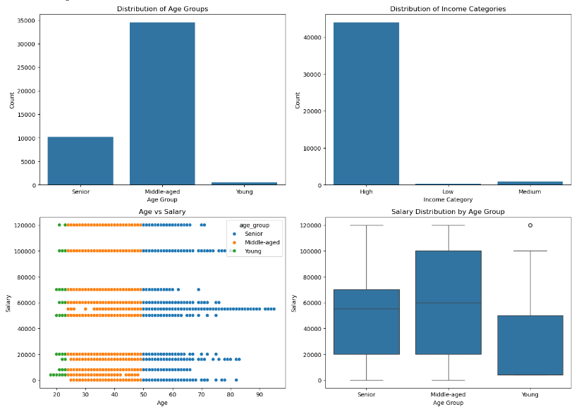
7. Feature Engineering
a. Introduce new features that may enhance prediction, such as creating age groups or income categories.
Distribution of Age Groups
Observation: The majority of individuals are in the "Middle-aged" group, with a smaller count in the "Senior" group and an even smaller count in the "Young" group.
Conclusion: The data suggests a mature workforce or population, dominated by middle-aged individuals. The smaller proportion of young individuals indicates either low hiring rates for younger demographics or high retention of older age groups.
Distribution of Income Categories
Observation: The "High" income category contains the most individuals, while the "Low" and "Medium" categories have significantly fewer.
Conclusion: The income distribution is heavily skewed toward higher earnings, indicating a disparity in income levels. This could reflect a population with higher qualifications, experience, or roles predominantly offering higher salaries.
Age vs. Salary (Scatter Plot)
Observation: Middle-aged individuals have a wide range of salaries, suggesting higher career flexibility and growth. Younger individuals earn comparatively lower salaries, and senior individuals have more varied mid-to-lower salary distributions.
Conclusion: The relationship between age and salary follows a typical career progression path, where middle-aged individuals reach peak earning potential, young individuals are at the early career stage, and seniors experience stagnation or decline due to potential career slowdowns or retirement transitions.

Slide 21
7. Feature Engineering
a. Introduce new features that may enhance prediction, such as creating age groups or income categories.
Salary Distribution by Age Group (Box Plot)
Observation: Middle-aged individuals show the highest median salary and widest range. Seniors have a similar but slightly lower median salary, while young individuals have the lowest median and salary variation.
Conclusion: The box plot indicates that middle-aged individuals dominate the salary range, aligning with their peak career stage. Seniors are maintaining stable, though slightly lower, earnings, while young individuals are likely still developing their careers.
Recommendations
Support Young Professionals: Implement initiatives to develop young professionals through training and mentorship to increase their earning potential and engagement.
Bridge Income Gaps: Address the significant disparity in income categories by creating pathways for career advancement, such as leadership development programs or skill-building workshops.
Retain Senior Talent: Design programs that leverage senior employees’ experience and provide incentives such as flexible working conditions, advisory roles, or career-transition planning to retain this valuable demographic.
By focusing on these areas, the organization or community can create a more balanced, dynamic, and growth-oriented environment.

Slide 22
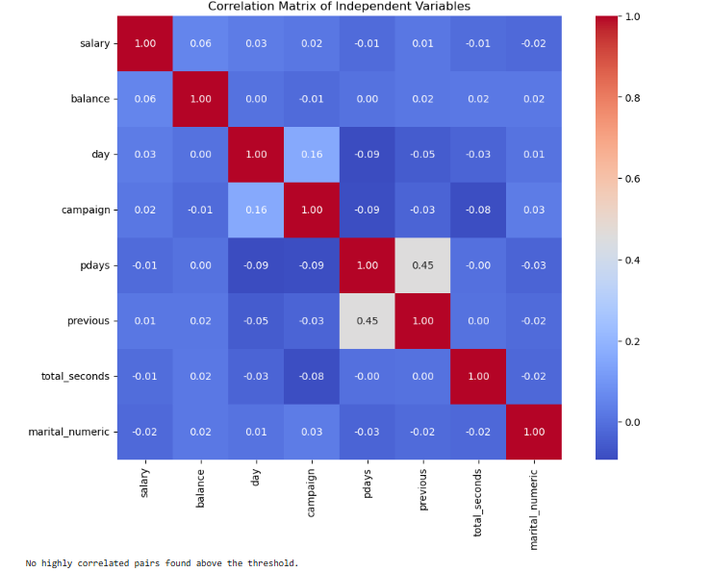
8. Correlation Analysis
a. Examine correlations between independent variables to identify multicollinearity.
Analysis of the Correlation Matrix
The heatmap displays the correlation coefficients between various independent variables in a dataset. Correlation values range from -1 to +1, where:
+1 indicates a perfect positive correlation,
-1 indicates a perfect negative correlation,
0 indicates no linear relationship.
Observations:
Low Correlation Overall:
Most of the variables in the matrix have very low correlation values (close to zero), indicating little or no linear relationships between the variables. This is evident from the darker blue shades throughout the matrix.
For example, salary has a correlation of only 0.06 with balance, indicating a negligible relationship.
Notable Correlations:
pdays and previous (0.45): This is the strongest positive correlation in the matrix. It indicates a moderate relationship between the number of days since the last campaign and the number of previous contacts. This is expected, as a higher pdays value likely corresponds to a more recent previous contact.
day and campaign (0.16): A small positive correlation suggests a slight relationship between the day of the campaign and the number of contacts during the campaign.
pdays and campaign (-0.09): This weak negative correlation indicates a slight inverse relationship between the number of days since the last contact and the number of contacts during the campaign.
Other Variable Relationships:
Other variables such as total_seconds, marital_numeric, and balance show extremely low correlations with all other variables. This implies they are largely independent of the rest.

Slide 23
8. Correlation Analysis
a. Examine correlations between independent variables to identify multicollinearity.
Conclusion:
The lack of strong correlations (near ±1) indicates that most of the variables do not exhibit strong linear relationships with each other. This suggests that multicollinearity is not an issue in this dataset.
The only moderate correlation observed is between pdays and previous, which is logical given the context of contact history.
Recommendations:
Evaluate Relationships Further: If the goal is to build predictive models, consider using non-linear relationships or interaction terms in addition to the linear correlations observed here.
Feature Engineering: Since the current variables are not highly correlated, it might be beneficial to explore derived or interaction features to capture relationships that are not evident through simple correlation.
Use Regularization Techniques: If building models with many features, techniques like Lasso or Ridge regression can help prevent overfitting, especially given the lack of clear correlations between these features.
In summary, the dataset appears well-suited for analysis, with minimal risk of multicollinearity affecting the outcomes. However, more complex relationships may be hidden and should be explored through advanced modeling techniques.

Slide 24
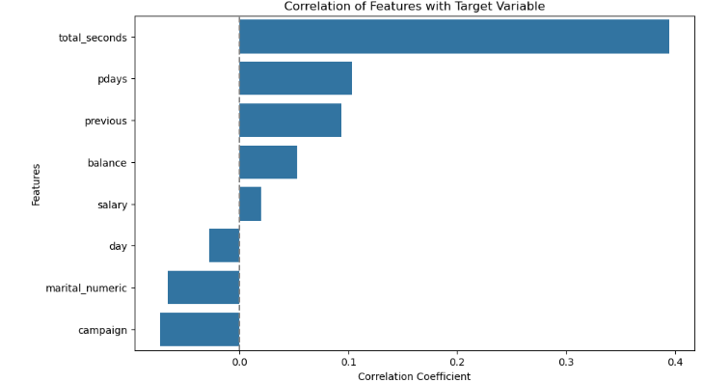
8. Correlation Analysis
b. Evaluate how correlated features may influence the target variable.
Analysis of Feature Correlations with Target Variable
The bar plot illustrates the correlation coefficients between various independent features and a target variable. Correlation values range from -1 to +1, where:
Positive values indicate a direct correlation with the target variable (as the feature increases, the target tends to increase).
Negative values indicate an inverse relationship.
Values close to zero indicate little to no linear relationship with the target.
Observations:
total_seconds Shows the Strongest Correlation (around 0.4):
This feature exhibits the highest positive correlation with the target variable, suggesting that as the total_seconds increases, the target variable tends to increase as well.
The strength of this correlation indicates that total_seconds is likely a significant factor influencing the target variable.
pdays and previous Show Moderate Correlations:
Both features have moderate positive correlations with the target variable. This suggests that the number of days since the last contact (pdays) and the number of previous contacts (previous) play notable roles in determining the target variable.
Weaker Correlations for Other Features:
balance, salary, day, marital_numeric, and campaign all show weaker correlations with the target variable, with coefficients close to zero.
The weakest correlation is observed for campaign, which indicates that the number of contacts during the campaign does not have a strong linear relationship with the target variable.

Slide 25
8. Correlation Analysis
b. Evaluate how correlated features may influence the target variable.
Conclusion
Key Influencing Features: The features total_seconds, pdays, and previous are the most strongly correlated with the target variable, making them important predictors. These should be given higher weightage or attention during model building or analysis.
Less Significant Features: The other features, while showing minor correlations, are likely to contribute less significantly to the target variable in a linear model. However, they might still hold value in more complex, non-linear models or when considering interactions.
Recommendations
Focus on Key Features: For predictive modeling or further analysis, prioritize features like total_seconds, pdays, and previous. Incorporating these variables effectively could lead to more accurate predictions or insights.
Explore Non-Linear Relationships: Since several features show low linear correlations, consider using non-linear models (e.g., decision trees, random forests) or feature transformations to uncover hidden relationships.
Evaluate Feature Engineering Opportunities: Low correlations for some features suggest potential improvement through feature engineering. For instance, creating interaction terms or segment-based averages could reveal more complex dependencies.
Refine Data Collection Strategies: For features with consistently low correlations, assess if the data collection process could be improved or whether the inclusion of these variables is essential.
In summary, the analysis highlights a few key variables strongly linked to the target variable, while also indicating that further exploration is needed to fully capture the relationships within the dataset. By leveraging these insights, more effective strategies for modeling or decision-making can be formulated.

Slide 26
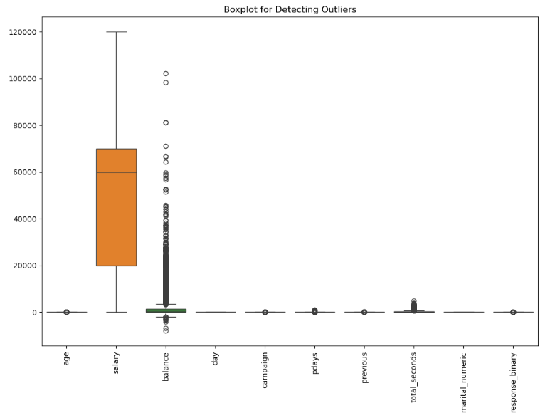
9. Outlier Detection and Handling
a. Identify and rectify outliers that could impact the analysis and predictions.
The boxplot visualizes the distribution of multiple variables, with a focus on detecting outliers. Here's an analysis based on the headers shown on the x-axis:
age: No significant outliers, with values distributed around a small range.
salary: The distribution shows a wider range, but no extreme outliers. The IQR (Interquartile Range) is relatively broad.
balance: This variable contains a large number of outliers, which suggests significant variability. These outliers could skew the prediction model and impact results if not handled.
day, campaign, pdays, previous: These variables seem to have small ranges, with little to no outliers.
total_seconds: Appears to have some minor outliers but not as pronounced as the "balance" variable.
marital_numeric, response_binary: These variables have no visible spread, meaning they are likely categorical or binary with limited values.
Key Insights:
Balance: This is the most concerning variable due to the number of outliers. Extreme values may need to be transformed or treated with caution in predictions.
Salary: Wide range, but manageable as there aren't many extreme outliers.
Age, Day, Campaign, Pdays, Previous, Total_seconds: These seem manageable, though attention should be given to potential minor outliers.
Conclusion:
For predictive modeling, special attention should be given to the "balance" variable due to the high number of outliers. Outlier treatment techniques (e.g., scaling, trimming, or transforming) will likely be necessary to prevent skewed model results.

Slide 27
9. Outlier Detection and Handling
a. Identify and rectify outliers that could impact the analysis and predictions.
Conclusion:
High Priority Features for Outlier Treatment:
balance, campaign, pdays, previous, and total_seconds have significant numbers of outliers that could distort the model. These outliers should be addressed, either by capping, transforming (e.g., log, square root), or excluding them if they are errors or noise.
Low Priority Features:
age has a moderate level of outliers, which can be handled carefully. Outliers in "age" may represent unique customer segments (such as older clients) that could provide important insights.
salary, day, and marital_numeric are stable and don’t require any outlier rectification.
Binary Response:
The outliers detected in response_binary using IQR likely stem from the fact that it is a binary variable.

Slide 28
Recommendations:
a. Identify and rectify outliers that could impact the analysis and predictions.
1. Customer Demographics
Key Insights:
Age Groups: Focus on individuals aged 40 and older, as they tend to respond more positively to term deposits.
Actionable Insight: Create targeted campaigns that address the specific financial needs of older customers, particularly those related to retirement.
Job Type: Higher response rates are observed among individuals in stable or well-paying jobs (e.g., management, blue-collar roles).
Actionable Insight: Customize messaging to emphasize security and wealth preservation for those in stable professions.
Education Level: University graduates are more likely to engage with term deposits.
Actionable Insight: Highlight the long-term financial advantages of term deposits and collaborate with educational institutions to promote investment literacy.
Marital Status: Married individuals often display greater financial stability.
Actionable Insight: Design family-oriented offers that emphasize financial security, such as joint accounts or family deposit packages.
Account Balance: Customers with higher account balances tend to respond positively to term deposits.
Actionable Insight: Focus marketing efforts on customers with larger balances and provide competitive rates to incentivize deposits.
2. Campaign Timing
Key Insights:
Campaign Duration: Longer campaigns lead to improved engagement.
Actionable Insight: Extend campaign durations and incorporate follow-up strategies, such as reminder emails and calls.
Month of the Year: Timing campaigns during financial planning periods (January, March) may enhance responses.
Actionable Insight: Schedule campaigns after holidays or during tax season when customers are reviewing their finances.
Day of the Week: Early-week campaigns yield higher engagement.
Actionable Insight: Plan major marketing activities for Mondays or Tuesdays to align with customer decision-making habits.

Slide 29
Recommendations:
a. Identify and rectify outliers that could impact the analysis and predictions.
3. Communication Strategies
Key Insights:
Personalization: Customized messaging based on demographics improves conversion rates.
Actionable Insight: Leverage customer data for personalized campaigns, offering special rates for specific age groups.
Communication Medium: While email and phone calls are effective, combining channels can enhance engagement.
Actionable Insight: Employ a multichannel approach, utilizing email, phone calls, and SMS for reminders.
Competitive Rates: Customers respond well to attractive offers.
Actionable Insight: Regularly review and adjust interest rates, and consider bonuses or discounts to increase appeal.
Urgency and Scarcity: Limited-time offers drive prompt action.
Actionable Insight: Infuse urgency into messaging (e.g., “Offer valid for the next 10 days”).
Educational Content: Informative resources foster trust.
Actionable Insight: Include webinars, infographics, or eBooks that explain the benefits of term deposits and how they align with customer financial goals.
4. Data-Driven Decisions for Targeting
Targeted Approach: Use data insights to identify high-potential customer segments.
Benefits: Improved ROI, enhanced engagement through personalized communication, and refined product offerings that meet customer needs.
5. Improving Campaign Effectiveness
Key Strategies:
Segmentation Strategy: Develop customer segments based on demographics and tailor marketing strategies accordingly.
Test and Optimize: Conduct A/B testing on various campaign elements (offers, channels, timing) to identify the most effective combinations.
Automation Tools: Utilize automation for personalized messages triggered at optimal times (e.g., after payday).
Overall Conclusion
By aligning the bank's marketing strategies with these prioritized insights—targeted demographic marketing, optimized timing, enhanced communication strategies, and data-driven targeting—the bank can significantly boost response rates and overall campaign success for term deposits. This structured approach not only increases engagement but also fosters long-term customer loyalty and satisfaction.

Slide 30

CMA ACMA CGMA KARAN BHANUSHALI
HERO VIRED – BATCH 13

