Slide 1
SQL ASSIGNMENT
U.S. Food and Drug Administration
Cma acma cgma Karan bhanushali
Hero Vired – Batch 13

Slide 2
Task 01
1. Determine the number of drugs approved each year and provide insights into the yearly trends.
Answer: From 1955 to 1996 only one drug only one drug is approved in a single year from 1997 the trend has changed drastically from 124 drugs in 1997 to 2288 in 2016 as and when the drugs are required they have been approved.
2. Identify the top three years that got the highest and lowest approvals, in descending and ascending order, respectively.
Answer: The top three years in ascending orders are 1955, 1955 and 1996 in descending orders are 2015, 2012 and 2011.
3. Explore approval trends over the years based on sponsors.
Answer: COREPHARMA has the highest number of approval i.e. 10 followed by PARKEDALE with 5 approvals KING PHARMS, LEDERLE with 4 each.
4. Rank sponsors based on the total number of approvals they received each year between 1939 and 1960.
Answer: Based on the approvals between 1939 and 1960 LEDERLE with 13 approvals and KING PHARMS with 11, 10 and 9 approvals tops the list.

Slide 3
Task 02
1. Group products based on MarketingStatus. Provide meaningful insights into the segmentation patterns.
Answer: According to the MarketingStatus there are 18344 products who are with the status 1 followed by 14209 products with status 2, 1231 products with status 3 and 681 products with status 4.
2. Calculate the total number of applications for each MarketingStatus year-wise after the year 2010.
Answer: Below is the number of application for each MarketingStatus year-wise after the year 2010.
ProductMktStatus | 2011 | 2012 | 2013 | 2014 | 2015 | 2016 | Grand Total
1 | 4373 | 4419 | 6654 | 6637 | 5941 | 4626 | 32650
2 | 129 | 202 | 224 | 253 | 246 | 218 | 1272
3 | 778 | 659 | 1009 | 773 | 743 | 462 | 4424
4 | 91 | 149 | 111 | 137 | 222 | 292 | 1002
Grand Total | 5371 | 5429 | 7998 | 7800 | 7152 | 5598 | 39348

Slide 4
Task 02
3. Identify the top MarketingStatus with the maximum number of applications and analyze its trend over time.
Answer: There are 139424 applications with MarketingStatus as 1 followed by 98532 with MarketingStatus as 2, 5246 with MarketingStatus as 3 and 1367 with MarketingStatus as 4.
Trend over Time: After 1952 the Number of applications are in the increasing order only from 18 application in 1952 to 4626 applications in 2016.

Slide 5
Task 03
1. Categorize Products by dosage form and analyze their distribution.
Answer: TABLET;ORAL have topped in the Product by dosage categories with 13942 no. of products followed by
INJECTABLE;INJECTION with 6173 no. of products.
2. Calculate the total number of approvals for each dosage form and identify the most successful forms.
Answer: The most successful forms of dosage is 10MG with 6141 approvals followed by 5547 approvals of 100MG and 5541 approvals of 50MG.
3. Investigate yearly trends related to successful forms.
Answer: Since 1978 INJECTABLES;INJECTION have shown a significant growth.

Slide 6
Task 04
1. Analyze drug approvals based on the therapeutic evaluation code (TE_Code).
Answer: Based on the therapeutic evaluation code (TE_Code) 24410 drugs are approved.
2. Determine the therapeutic evaluation code (TE_Code) with the highest number of Approvals in each year.
Answer: The Highest number of Approvals has came in the year 2002 with 1005 approvals followed by the year 1996 with 992 and year 1985 with 974 approvals.

Slide 7
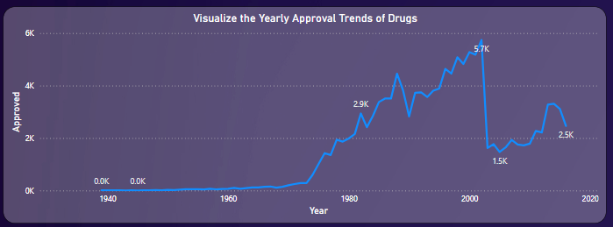
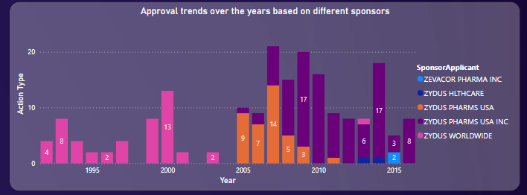
POWER BI
1. Visualize the yearly approval trends of drugs. Highlight any significant patterns and/or fluctuations, if any.
Answer: There is an increasing trend in the approval of the drugs from the year 1982 with 2.9K approvals which peaked in the year 2002 with 5.7K approvals which further declined to 2.5K approvals in 2016.
2. Explore approval trends over the years based on different sponsors. Uncover patterns and changes in approval rates among sponsors.
Answer: ZYDUS PHARMS USA INC has got the highest number of approvals. The change in the approval rate among the sponsors moved from ZYDUS WORLDWIDE to ZYDUS PHARMS USA INC from the year 2005.

Slide 8
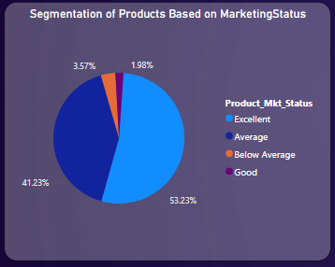
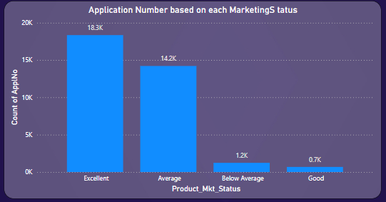
POWER BI
3. Visualize the segmentation of products based on MarketingStatus.
Answer: ProductMktStatus with Excellent status i.e. with 1 covers 52.23% of market share followed by Average with 41.23%, Below Average by 3.57% and Good with 1.98%
4. Show the total number of applications for each MarketingStatus. Enable users to filter by years and MarketingStatus for detailed analysis.
Answer: Applications with MarketingStatus as Excellent tops with 18.3k applications followed by Average with 14.2k, Below Average with 1.2k and 0.7k with Good MarketingStatus

Slide 9
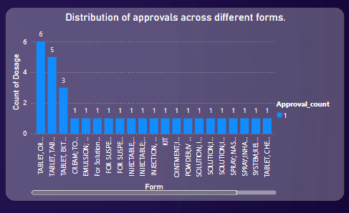
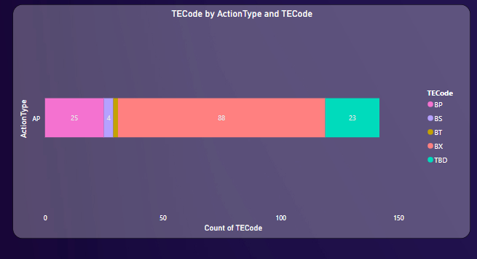
POWER BI
5. Analyze the grouping of drugs by dosage form. Visualize the distribution of approvals across different forms. Identify the most successful dosage form.
Answer: The most successful dosage form is TABLET ,ORAL.
6. Visualize drug approvals based on therapeutic classes. Identify classes with the highest number of approvals.
Answer: The highest number of approved drug based on therapeutic classes is drug BX with 88 approvals.

Slide 10
Thank You
Cma acma cgma Karan bhanushali
Hero Vired – Batch 13

