Slide 1
MSC.IT Data Management and visual insights
Sem-3

Slide 2
< // Student Counselling Mind // >
Group leader – Priyanshu Jani (202126940033)
Team members :-
Karandeep Singh Sarna(202126940109)
Nitin Parmar (202126940071)
Nouman Mansuri( 202126940049)

Slide 3



Planning
Identification of website-This is a Counselling Website, this website is mainly for student who recently completed their studies in high school and entering to their graduation and higher studies, and for those who wants counselling for their further studies.
Purpose – The purpose of making this website is to provide a best counselling and to provide better advise to those students who doesn’t know what to do after high school and in which field they were having a bright future according to their interest, by this we will show correct direction to them according to their will.
Another purpose for this is to clear all doubts, difficulties regarding to their higher studies, Graduation. Many students are capable to built there bright future also they have good academics but Because of the lack of guidance and not having proper knowledge they were not able to do so,So like these we built these websites for all students who want correct career counselling .

Slide 4
Feasibility

Slide 5

Web pages
The Web pages in this website are as follows:
Home page
Registration page
Login Page
Information page
Sign up page
About page
Contact us page

Slide 6

Counselling Mind

Slide 7
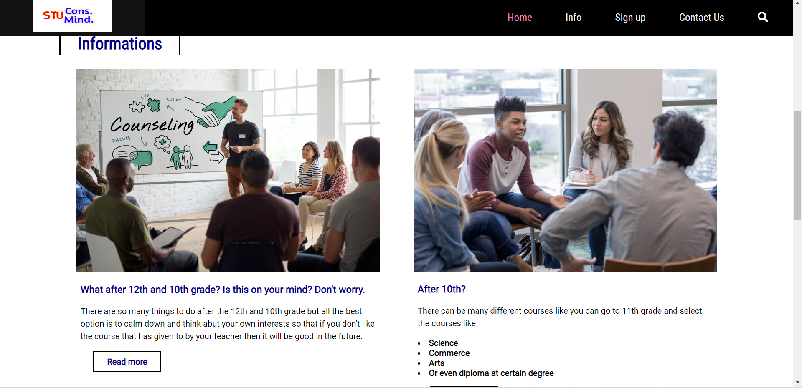

Slide 8
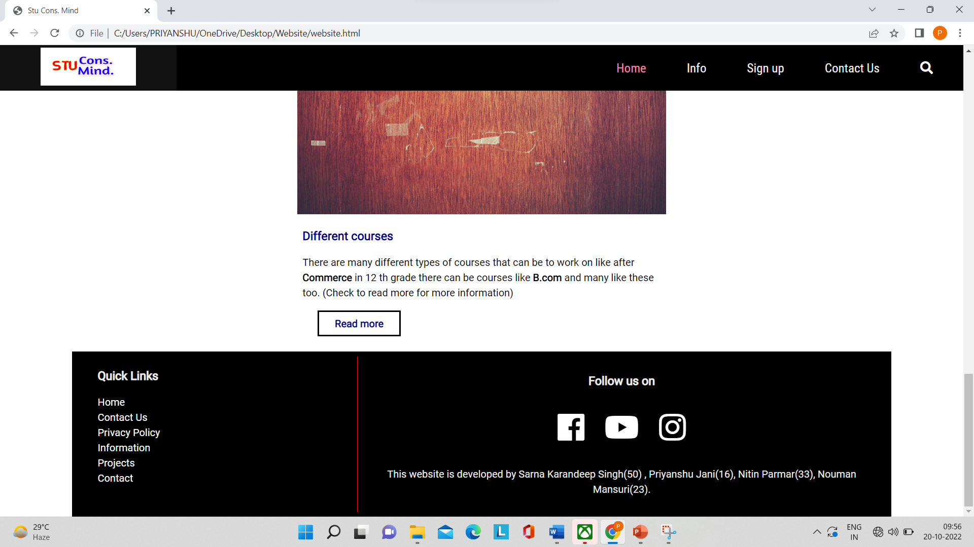

Slide 9
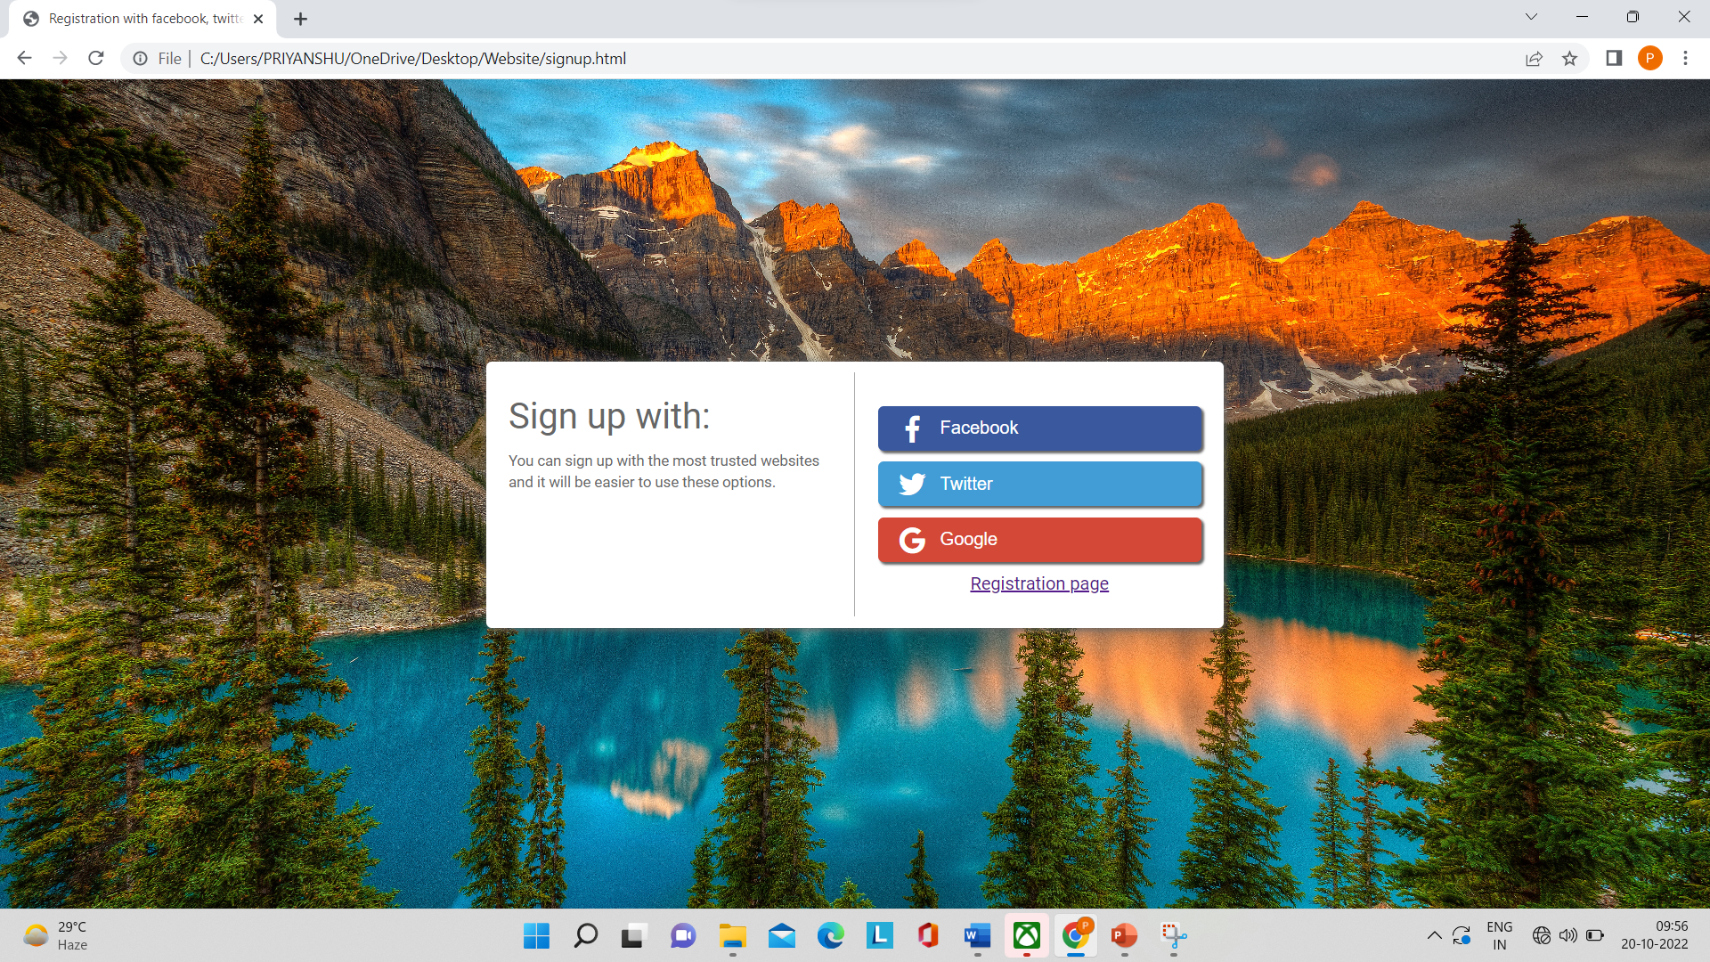

Slide 10
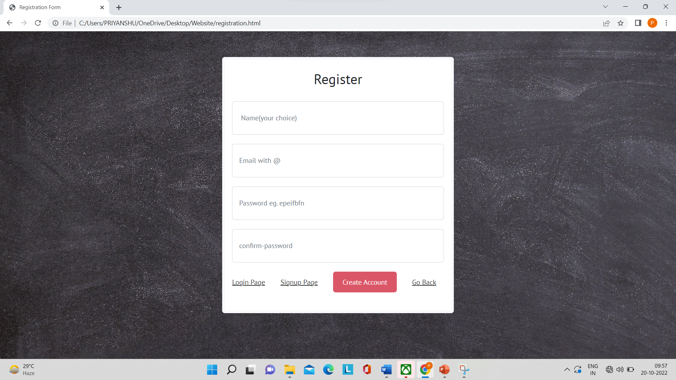

Slide 11
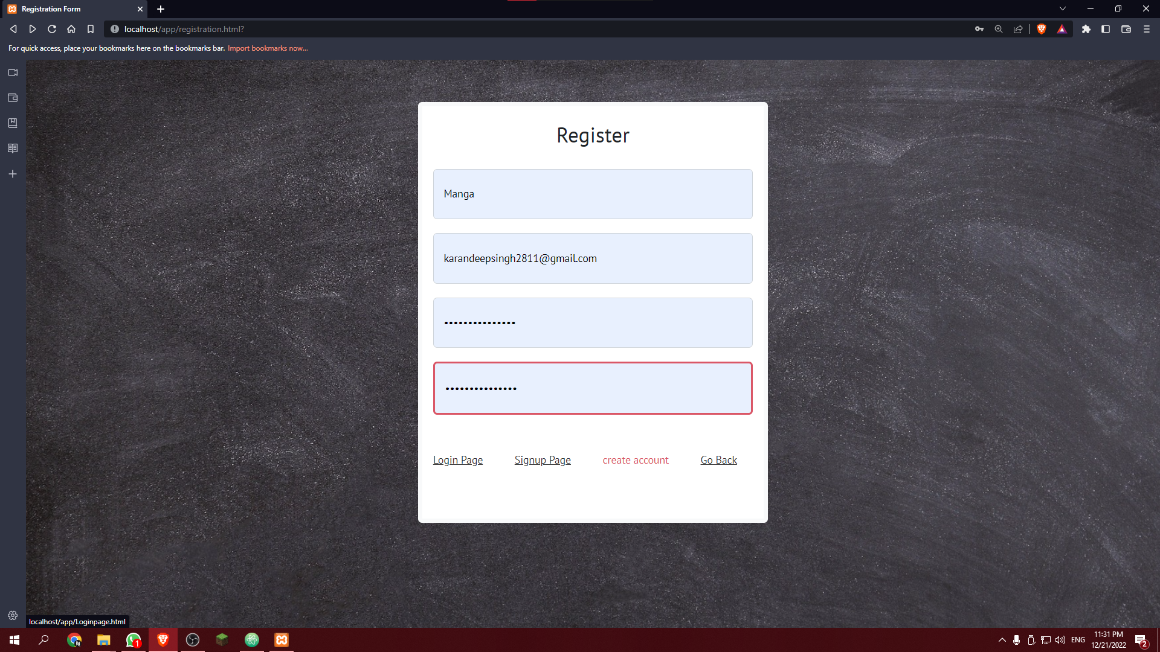

Slide 12
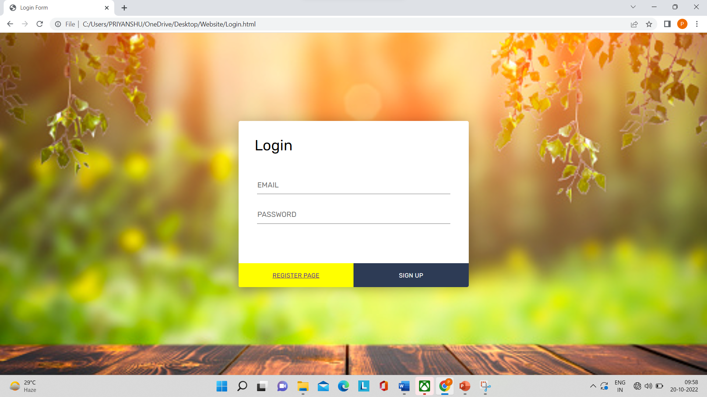

Slide 13
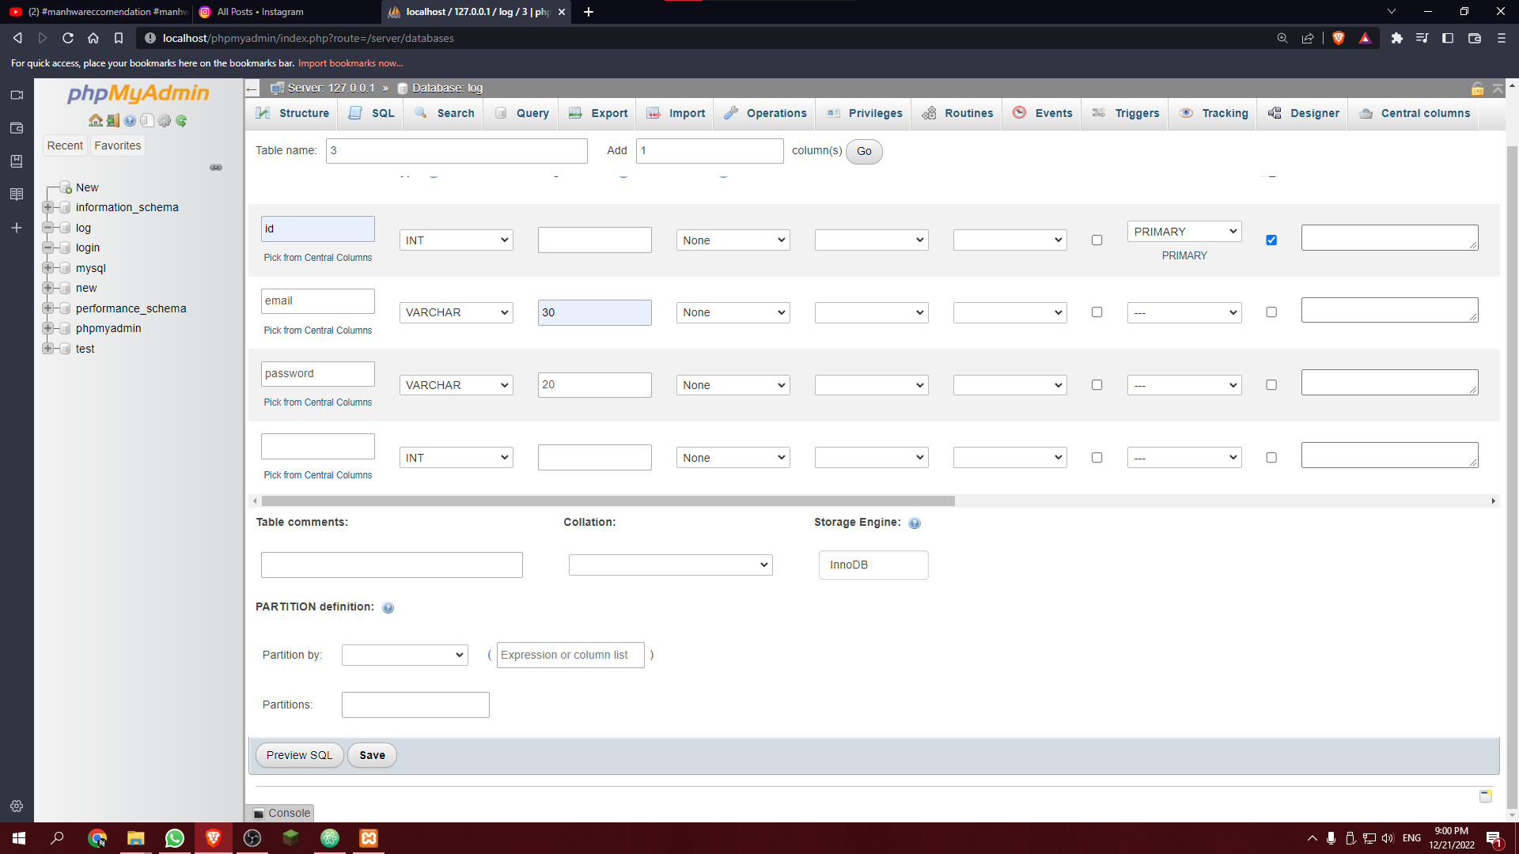

Slide 14
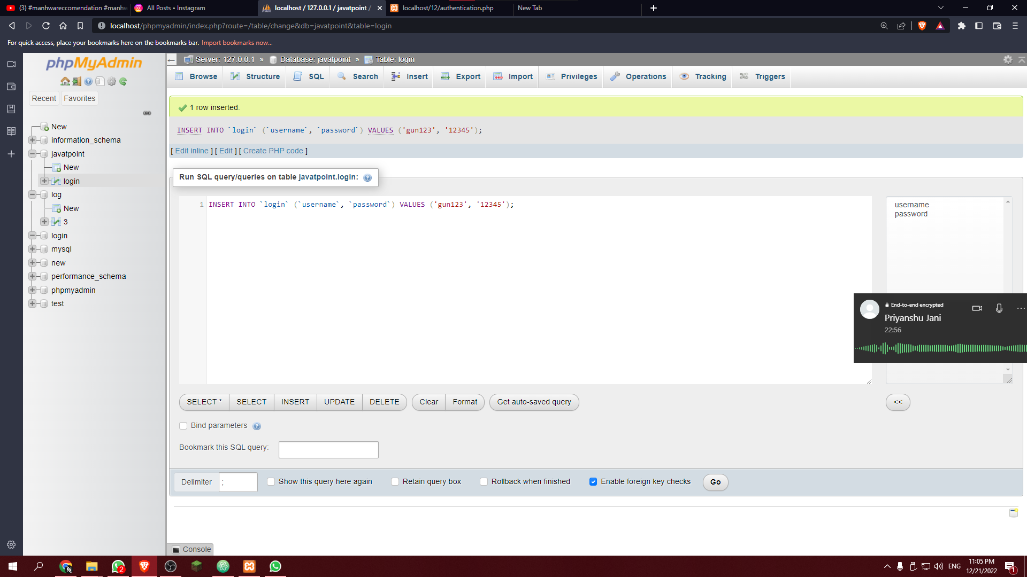

Slide 15
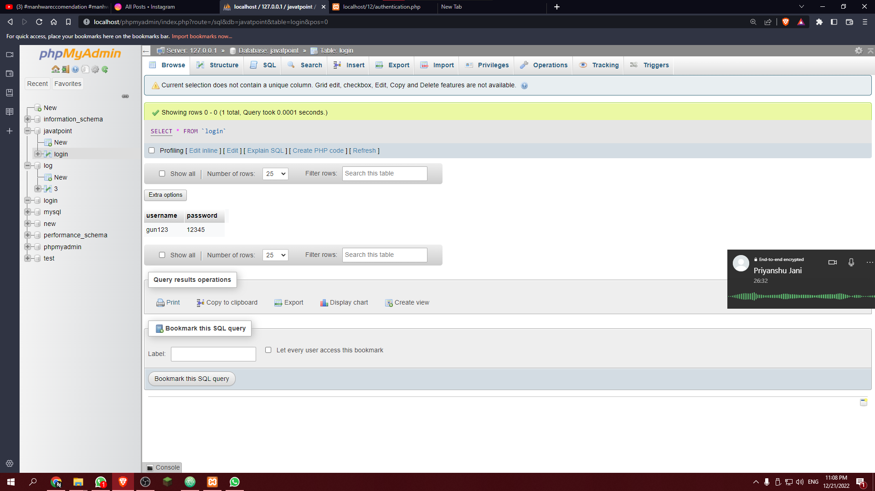

Slide 16
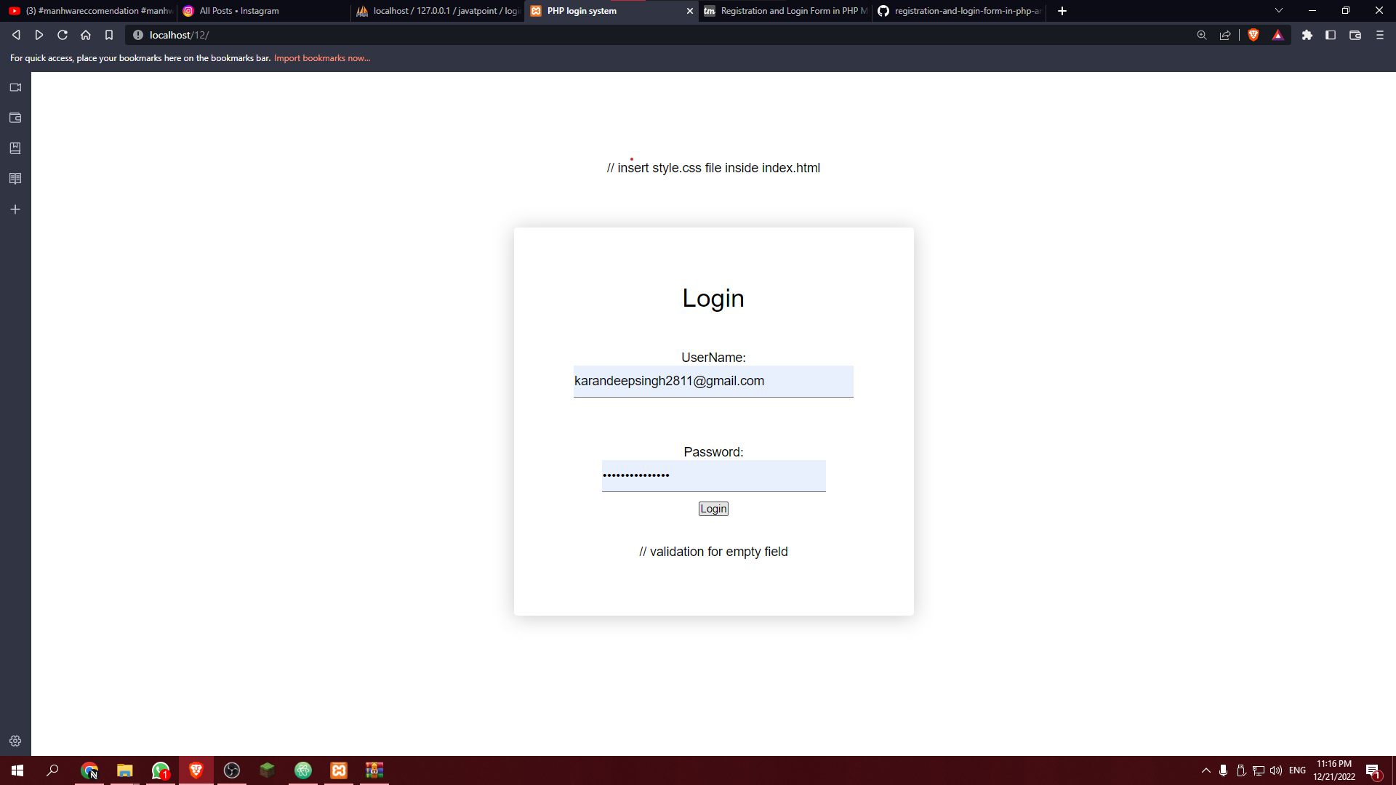

Slide 17
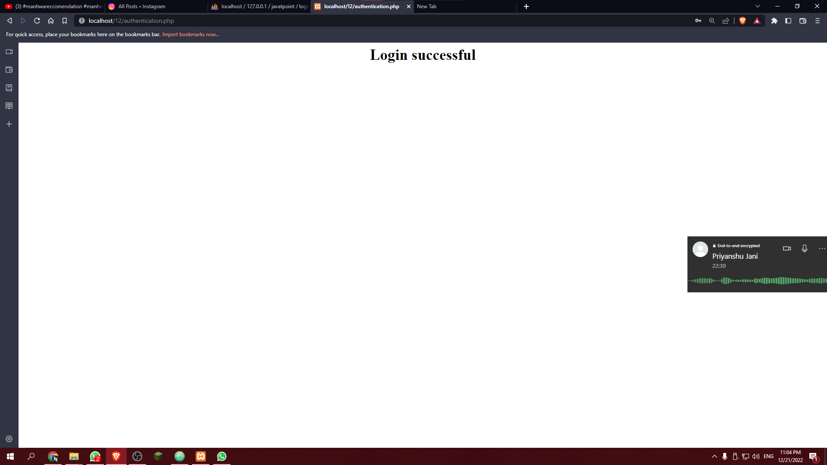

Slide 18
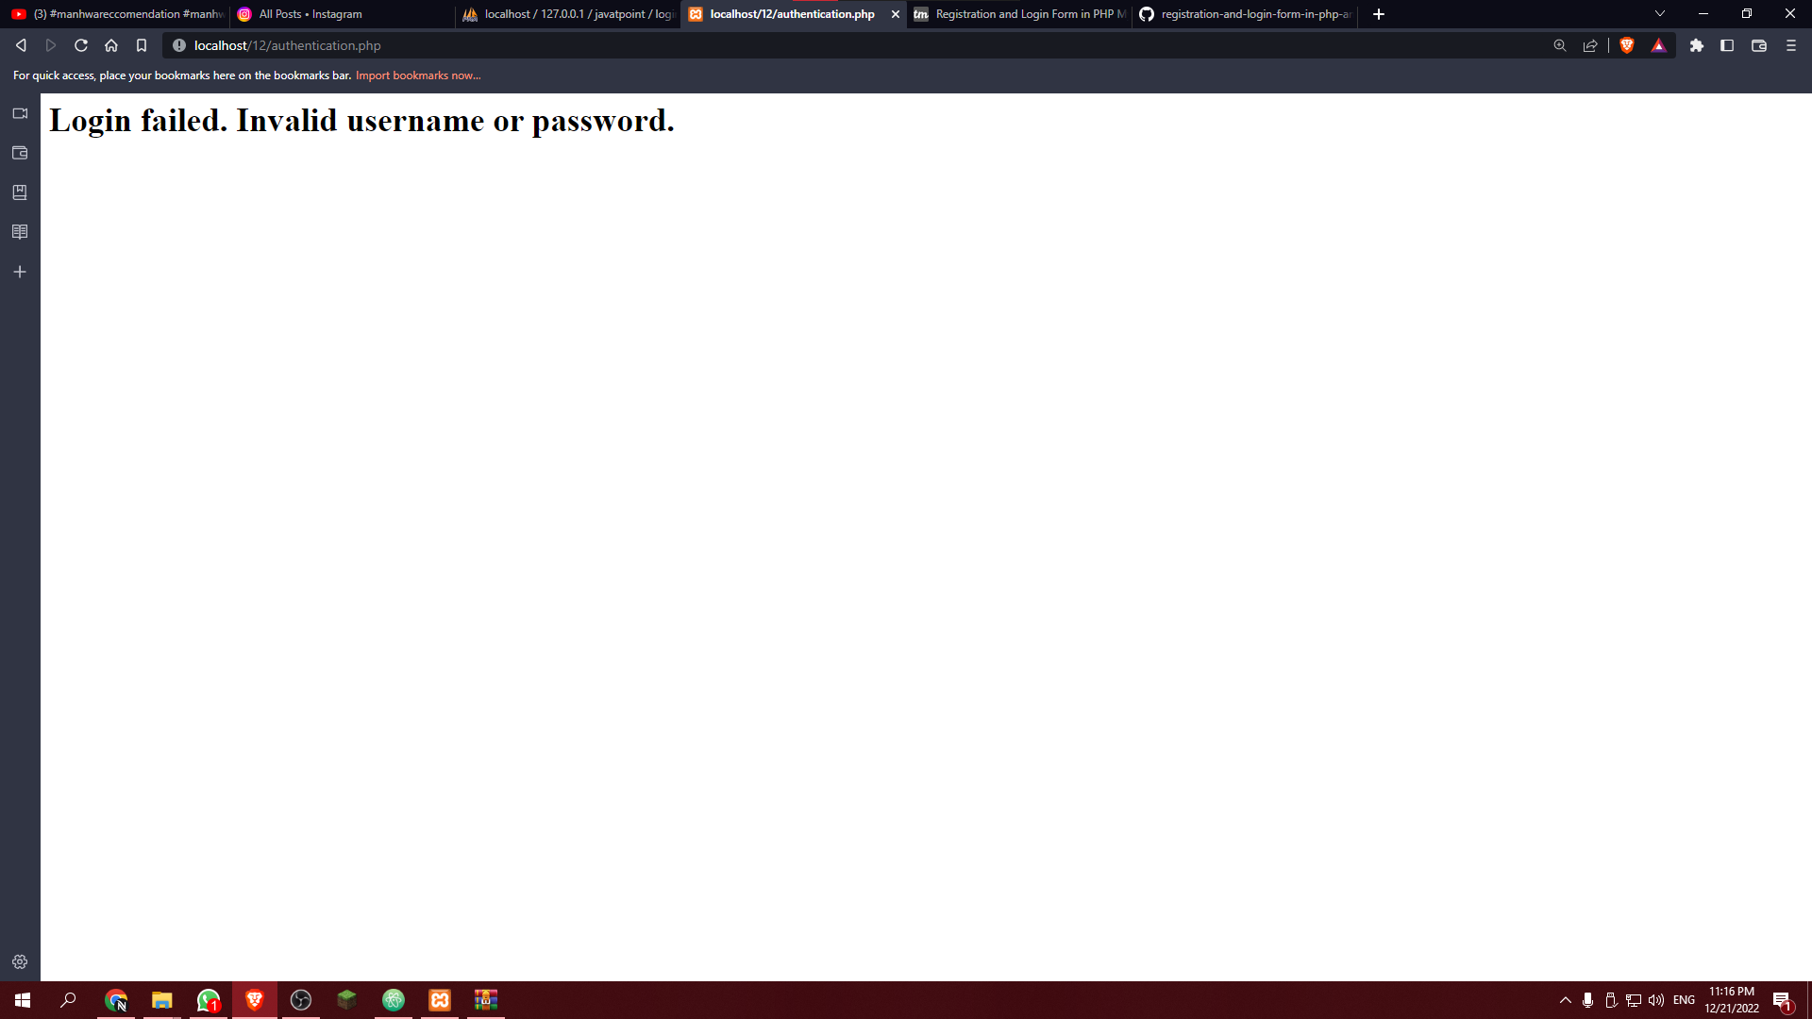

Slide 19
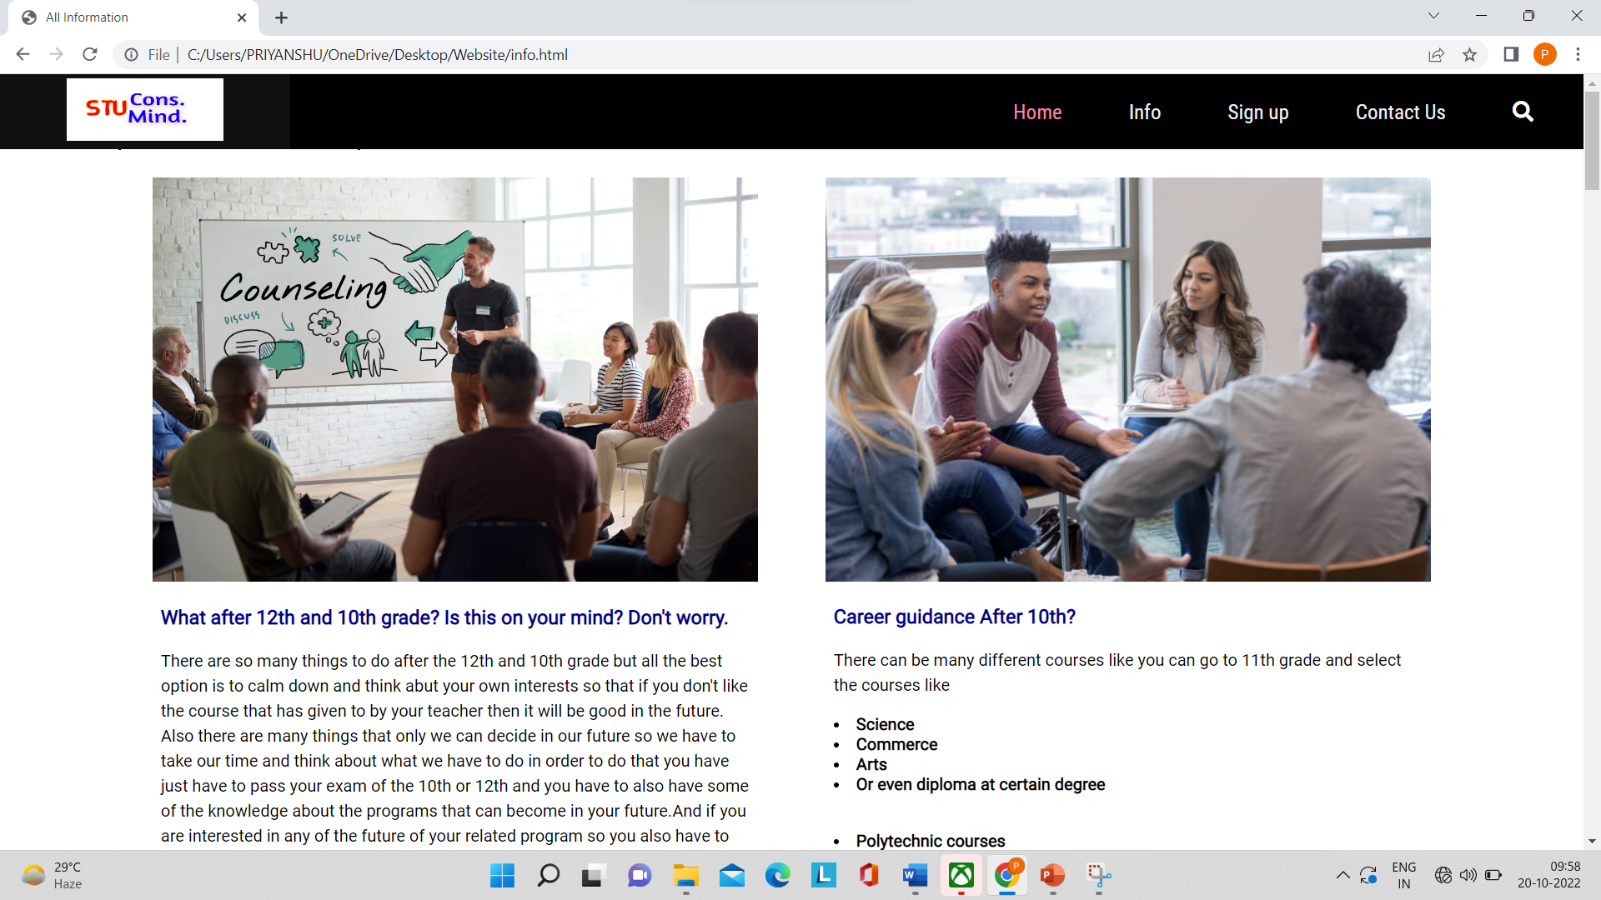
Information page

Slide 20
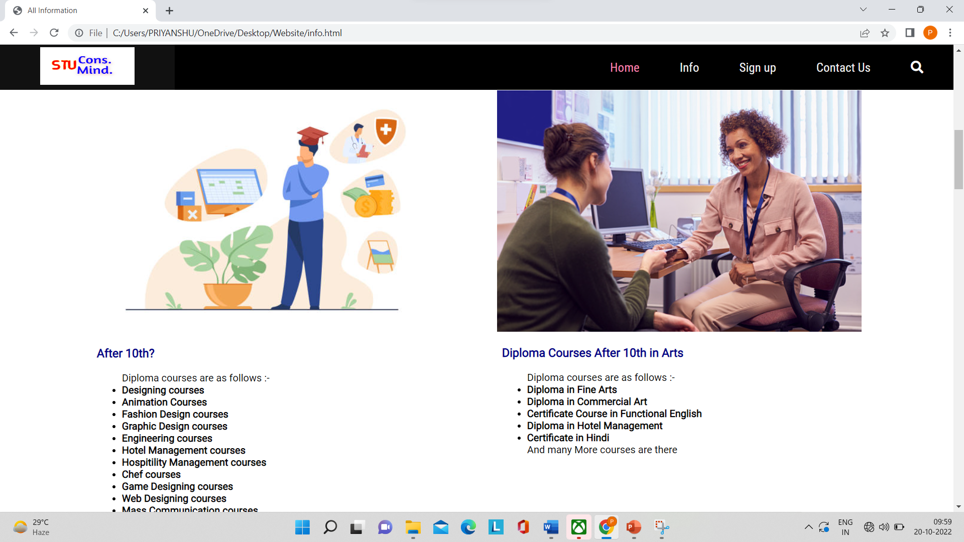

Slide 21
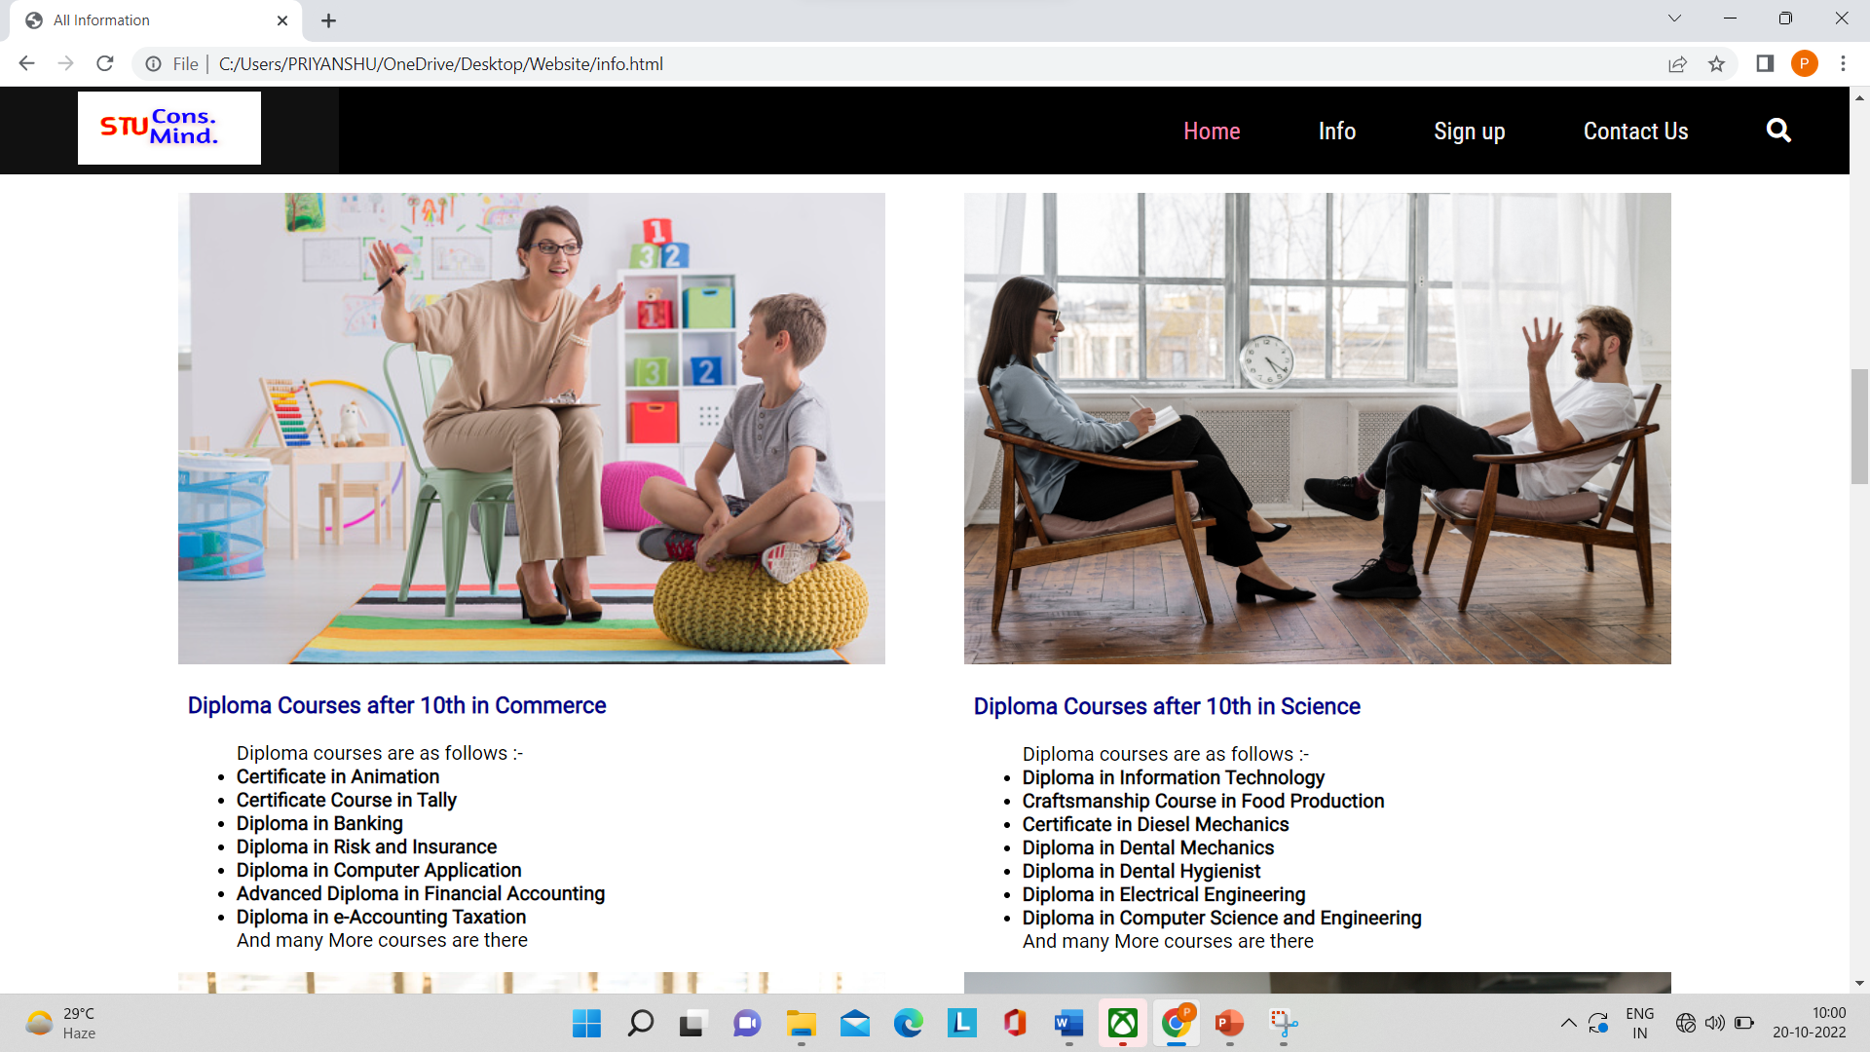

Slide 22
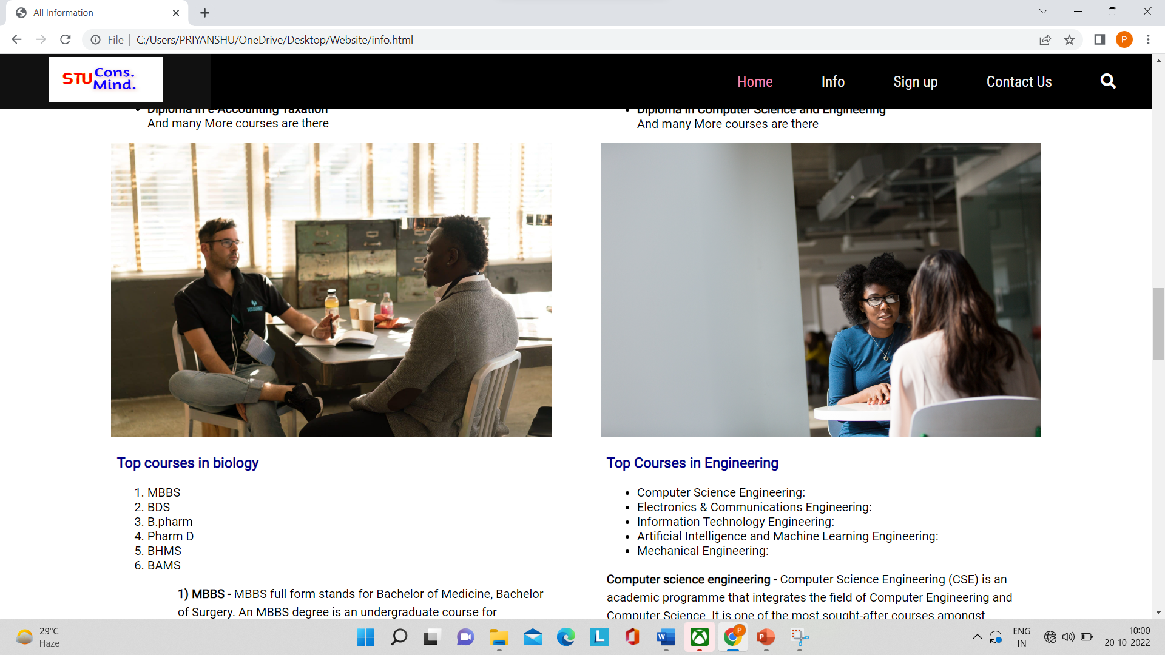

Slide 23
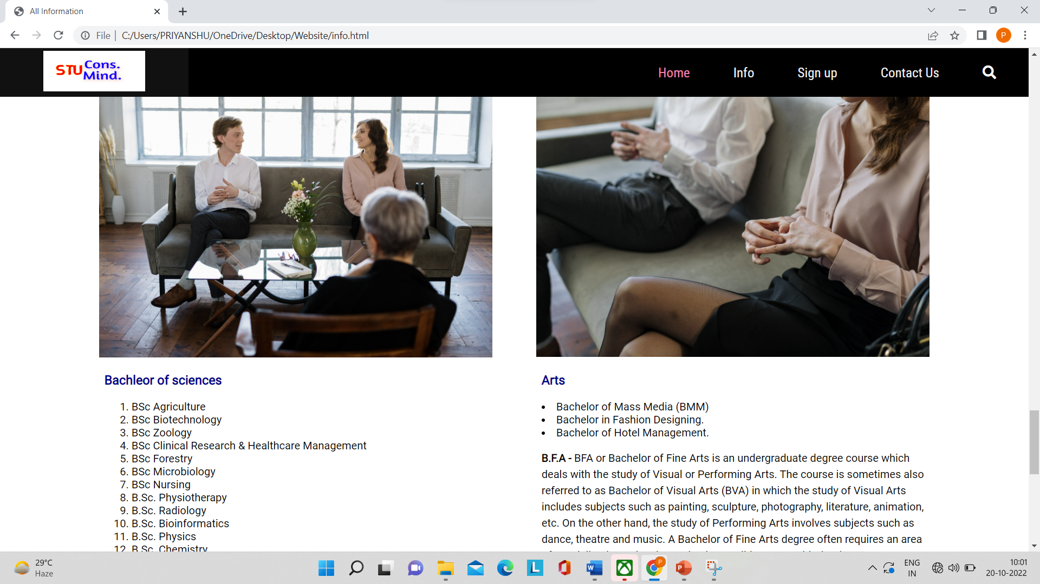

Slide 24
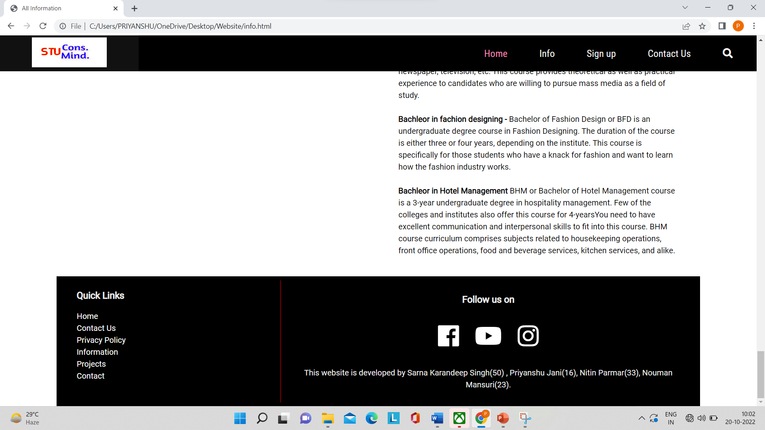

Slide 25
Thank you

