Slide 1

Yahoo Troll Question Detection
Team Karandeepak
Karanjit (IMT202003)
Netradeepak (IMT2020014)

Slide 2
Early Preprocessing steps (Round-1)
Converting text to lower case
Remove brackets
Remove punctuations
Remove words containing numbers

Slide 3

Extra Preprocessing Steps (Round-2)
Punctuation
Get rid of additional punctuations
Lines
Removing "\n" escape sequenes
URL
Remove hyperlink URLs
HTML
Remove HTML tags

Slide 4
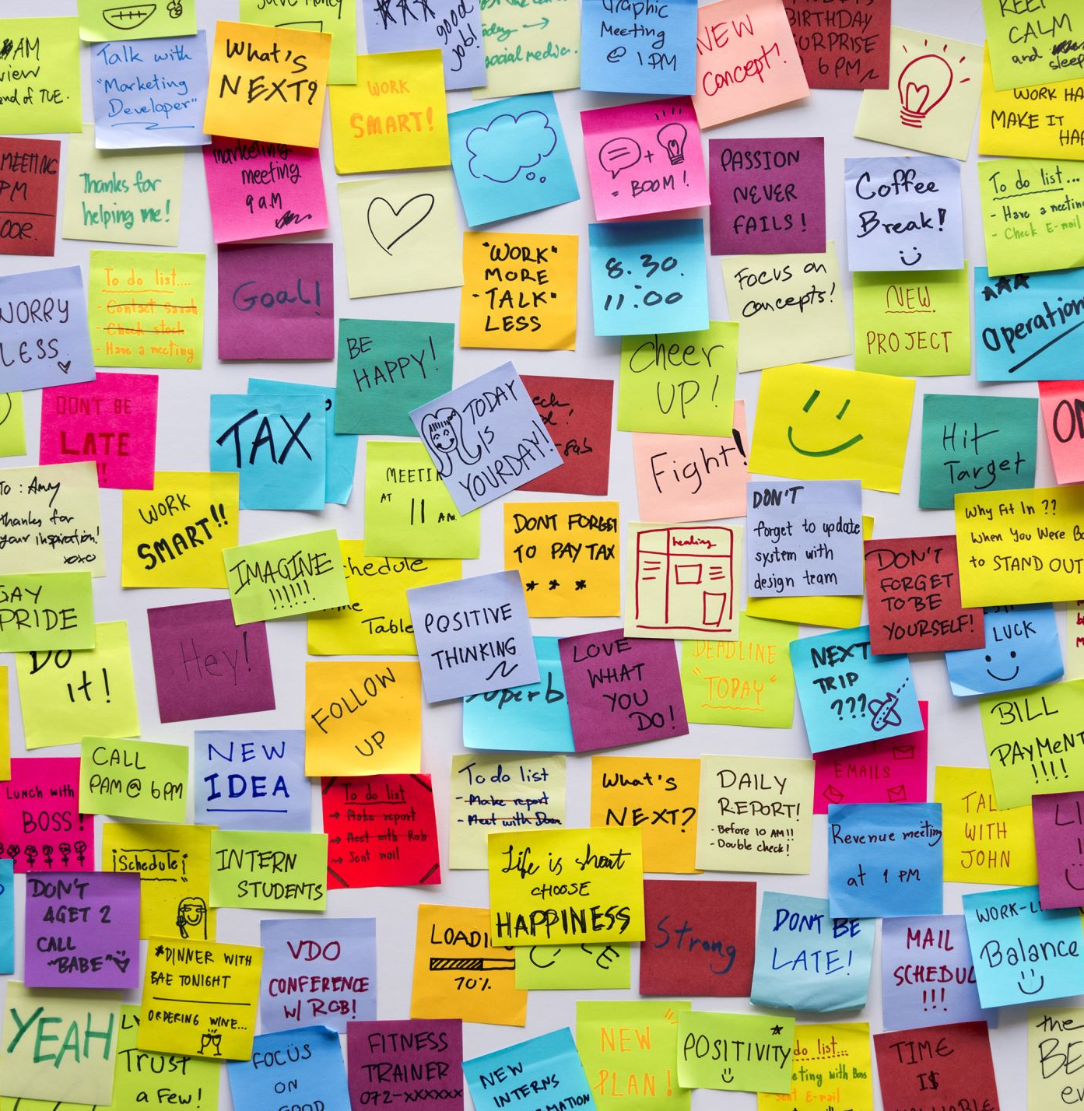
Tokenization
This technique breaks down a given sentence into a list of words which can be then processed upon independently making stuff like the upcoming lemmatization and stop word removal easy.

Slide 5
Stop Words Removal
Some words tend to amass a large percentage of the sentence but contain little to no important information regarding the question at hand. This process removes them

Slide 6
Vectorization
As text strings are hard to use, the strings are converted to numbers using the TF-IDF vectorizer

Slide 7

Lemmatization
This process converts words having the similar root meaning into the same root. For example, "go, went, gone" all will be converted to "go"

Slide 8

Current Model Used
Multinomial Naïve Bayes
Uses the bayes classifier with independent gaussian curves

