Slide 1
Secure Data Hiding in Images Using Steganography
CAPSTONE PROJECT
Presented By:
Student Name : Karan Dhondiba Koli
College Name & Department : G H Raisoni College Of Engineering and Management Pune (CSE-Cybersecurity)

Slide 2
OUTLINE
Problem Statement
Technology used
Wow factor
End users
Result
Conclusion
Git-hub Link
Future scope

Slide 3
Problem Statement
Keeping sensitive information safe is a big challenge today. Regular encryption methods can attract attention, but steganography hides data inside images, making it nearly invisible. This project focuses on securely hiding text in images while keeping the image looking the same.

Slide 4
Technology used
Programming Language: Python
Libraries:
Pillow (PIL) → For image processing
NumPy → For handling image pixel data
Algorithm: Least Significant Bit (LSB) Steganography
Platform: Works on Windows, Linux, and macOS
Development Environment: VS Code / Jupyter Notebook

Slide 5
Wow factors
Hides messages inside images without making them look different.
Uses Least Significant Bit (LSB) technique for efficient data hiding.
Adds encryption before hiding the text for extra security.
Simple user-friendly interface to encode and decode messages easily.

Slide 6
End users
People who want to send secret messages securely.
Cybersecurity professionals.
Journalists and activists who need privacy.
Government agencies for secure communication.

Slide 7
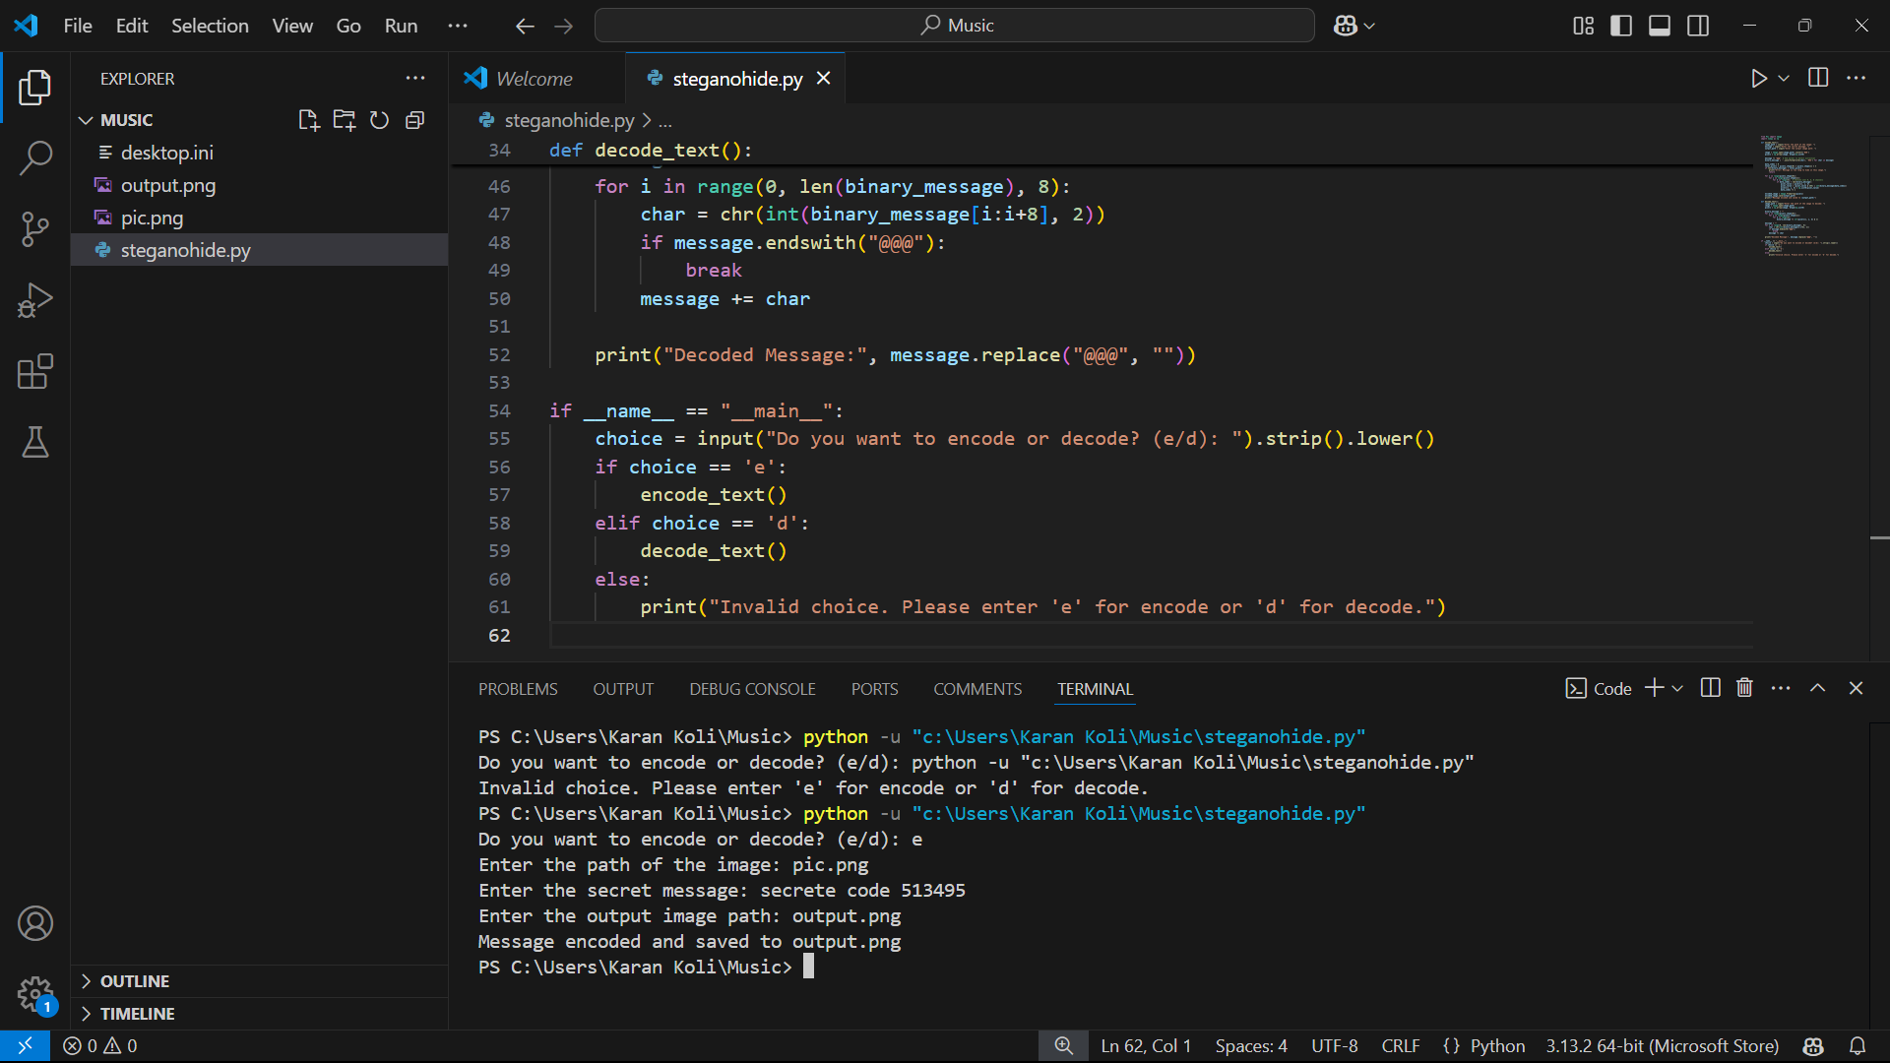
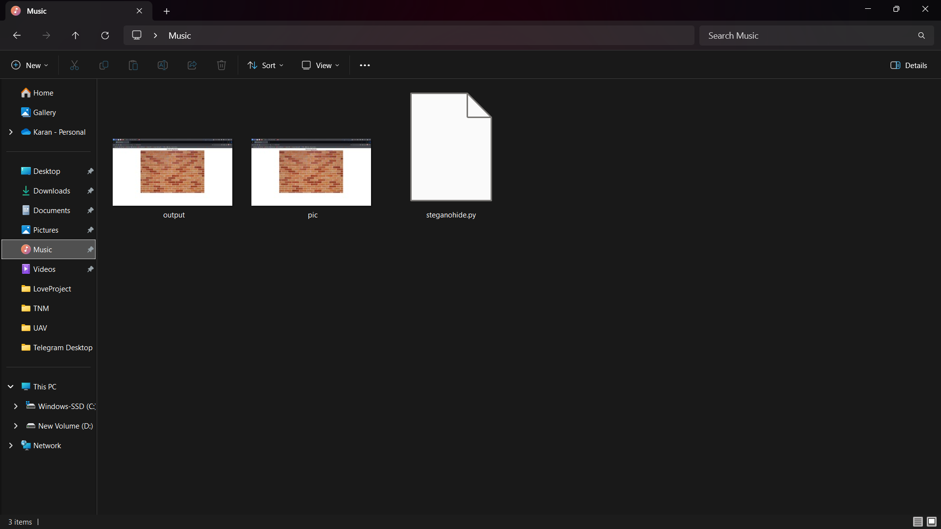
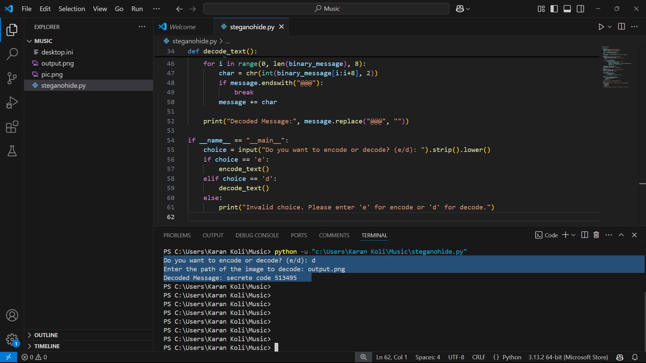
Results
Encode:
Decode:

Slide 8
Conclusion
This project provides a smart way to send secret messages by hiding them inside images. Since the image looks normal, no one will suspect it contains hidden information. By combining encryption with steganography, it adds an extra layer of security.

Slide 9
GitHub Link
https://github.com/Karankoli17/Steganography-Project

Slide 10
Future scope
Hiding data in videos or audio instead of just images.
Making the hidden data more secure against detection.
Using AI to improve data hiding techniques.

Slide 11
THANK YOU

