Slide 1
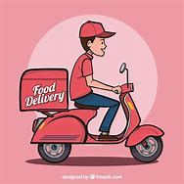
WELCOME
TO
FOOD DELIVERY APP
Presented by GANESHA GROUP ASHISH KUMAR KARAN KUMAR AMAN KUMAR

Slide 2
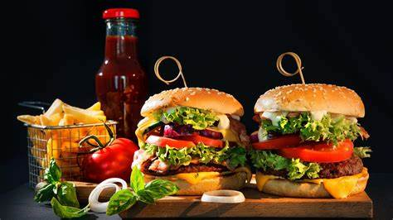
Customer order specification system. . An employees goes to the restaurant and the pickup food order by customer. . An employees hang the food in drone and fly. . Drone can reach areas very fast that are difficult or impossible for delivery boys .

Slide 3
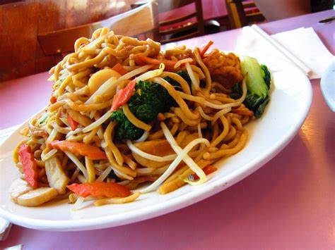
MODULES ~
THE PROCESS CONSISTS OF A CUSTOMER CHOSSING THE RESTURANT OF THEIR CHOICE,SCANNING THE MENU ITEM,CHOSSING FOR PICK-UP OR DELIVERY

Slide 4
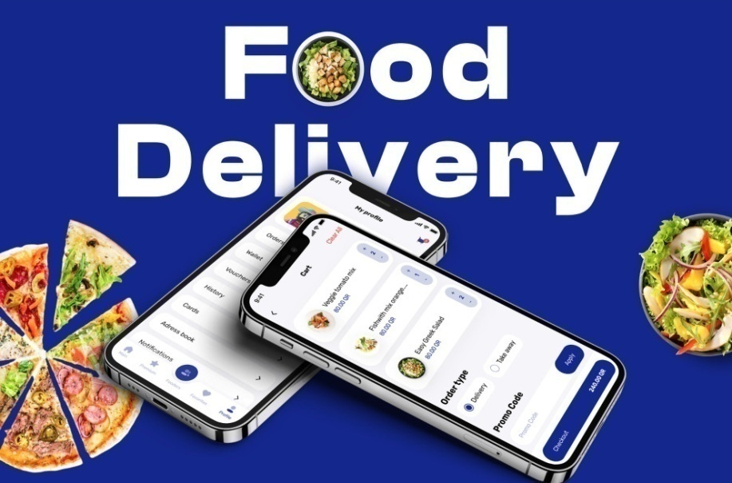
Developing a fast food order system to promote a greater count of food lovers to splurge into the field of restaurant. It integrates the benefits of an ordering food with the technology, minus the commuting will usher in the immense flexibility and an the existing manual platform structures, with the perfect blend of synchronous and asynchronous interaction. It provides a means of collaborative E-ordering for the customer.

Slide 5
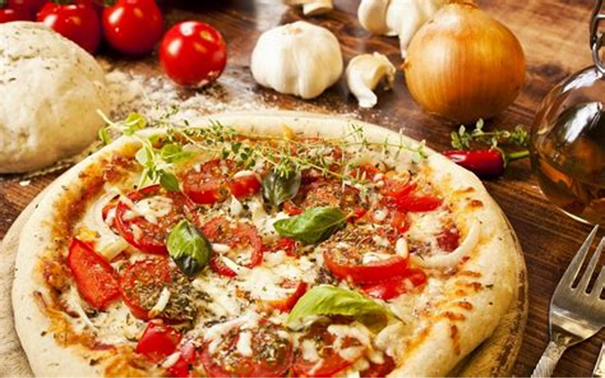

SCOPE AND PURPOSE
To manage the online fast food ordering anywhere. It helps to customer to book products from anywhere Also make payment on delivery. It helps to book desired products at their perfect time.
.

Slide 6
PROPOSED SYSTEM
The proposed system ensure the complete freedom for users, where user at his own system can login to this website and can book his product. Our proposed system allows only registered users to book the products ,view booking and cancel their booking as per their need.
In this proposal the entire work is done on online. Here customer can send their queries and suggestions through a feedback form.

Slide 7
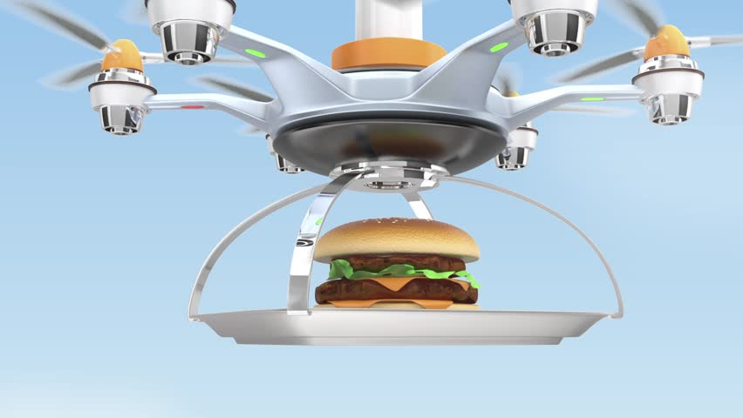
DRONE DELIVERY SYSTEMssssssss
SYSTEM
A delivery drone is an unmanned aerial vehicle [UAV] used to transport packages that include medical supplies, food,or other goods.

Slide 8
Drone given their accuracy ,environment-friendly operations’ shorter delivery time’ and lower operational cost than traditional delivery boys.

Slide 9
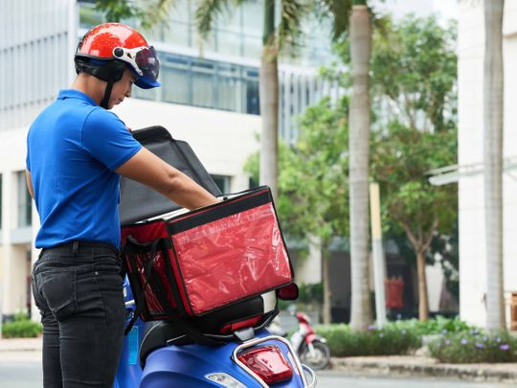
A Delivery boy responssibilites ; accepting and recording payment for delivered packages.

Slide 10
THANK YOU

