Slide 1
CS240C
Spring 2018
http://cs.binghamton.edu/~iwobi/CS240C

Slide 2
week 1 - Introduction
Goals
Understand course organization, requirements and expectations
Overview of course
Introduction to c++
Functions
Streams

Slide 3
Course home page
http://cs.binghamton.edu/~iwobi/CS240C
Textbook
Cplusplus.com
Listserv
Grading
Work load expectation
Academic honesty

Slide 4
Assignment from zybook
Before 11:30 on Thursday (Jan. 18) complete exercises from:
Ch. 1 to 5
Ch. 7 (sections 1 and 2)
Completion of sections not marked optional will count towards grade
Optional sections cover material that has been covered before
It is assumed that you know this material

Slide 5
Data structures plus algorithms == ???????

Slide 6
Containers
A container is a collection of like elements/items (data structure)
How are elements related to each other?
What are the basic container operations (algorithms)?
How are the elements stored in memory (implementation)?
How do we measure the efficiency of container operations?

Slide 7
How are elements related to each other?
Linear
Hierarchical
Graph
membership

Slide 8
How are elements related to each other?
Linear
Hierarchical
Graph
membership

Slide 9
What are the basic container operations (algorithms)?
Add an element
By position
By value
Remove an element
By position
By value
Retrieve an element
By position
By value

Slide 10
How are the elements stored in memory?
Contiguous storage (array)
Non-continuous storage (linked)
combination

Slide 11
How are the elements stored in memory?
Contiguous storage (array)
Non-continuous storage (linked)
combination

Slide 12
How do we measure the efficiency of container operations?

Slide 13
What are the building blocks of a program?

Slide 14
Functions and classes
C program made up of functions
Java program made up of classes
C++ program made up of functions and classes

Slide 15
Where do functions and classes come from?

Slide 16
functions and classes can come from
Part of the language (built in)
A library
C++ standard library
Other libraries
Programmer defined

Slide 17
A function is a black box
caller
behavior

Slide 18
How does a function communicate with its caller?

Slide 19
C++ parameter passing
By value (type param-name)
Parameter is a copy of the argument
Argument cannot be changed
By reference (type & param-name)
Parameter is a reference to the argument
Changing parameter changes the argument
By const reference (const type & param-name)
Parameter is a reference to the argument
Compiler will not allow change to a parameter
Used to prevent copy of argument being made
Return can be by value or by reference

Slide 20
caller
A1
A2
v1
v2
called (A1, A2)
called (P1, P2)
P1
P2
v1

Slide 21
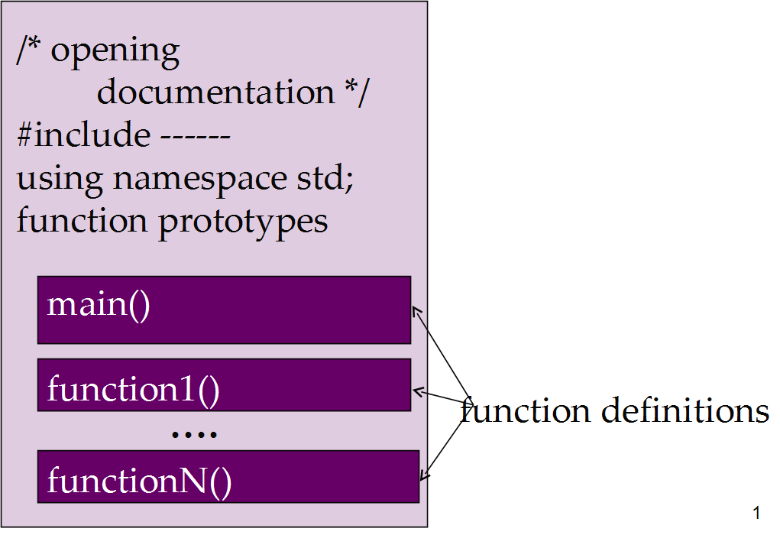
C++ program organization

Slide 22
Function prototypes
return-type function-name(parameter-list);
// input: describe input parameters
// output: describe value(s) returned
// side effects: describe external I/O (if any)
Prototype describes what, not how

Slide 23
What are side effects?

Slide 24
Side effects
External input
Keyboard
File
External output
terminal
File
Global variables
Defined at file level (not inside a function or class)
Do not use

Slide 25
Assignment from zybook
Before 11:30 on Tuesday (Jan. 23)
Complete exercises from:
Ch. 6
Ch. 7 (sections 3 to 8)
Do zylabs found in Ch.29 (sections 1 and 2)

Slide 26
Some differences (java and C++)
No stand alone functions in java
Details for defining a class
Java has automatic Garbage collection
C++ objects are values, java objects are references
Direct vs indirect addressing
Java is interpreted; C++ is compiled

Slide 27
Value vs reference
If a variable/object is a value
Name of the variable/object represents the memory location of the value
Direct addressing
If a variable/object is a reference
Name of the variable/object represents the memory location which contains the memory location of the value
Indirect addressing

Slide 28
Java C++
string name = “C++”;
string name = new string (“java”);
name
name
C++
JAVA

Slide 29
What happens?
String Name2 = name;
String Name2 = name;
Name
Name
“C++”
“JAVA”

Slide 30
What happens?
String Name2 = name;
String Name2 = name;
Name name2
Name name2
“C++”
“C++”
“JAVA”

Slide 31
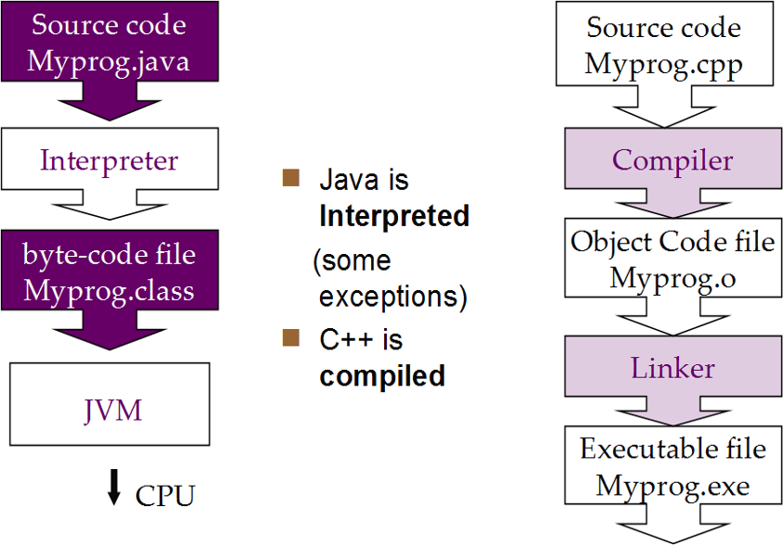
Compiled vs interpreted languages

Slide 32
C++ Compiler used in cs240c
Gcc
Available on all cs lab machines
Can access remotely
All programs written for CS240C must compile and run using GCC on the CS lab machines

Slide 33
Some differences (C and C++)
I/O
Parameter passing
Strings
Templates
classes

Slide 34
C++ uses streams for I/O
A stream is a sequence of characters
An Input stream can come from the keyboard (terminal)
Text files can also be used as input streams
Programs produce output streams that can be sent to:
THE Screen (terminal)
A text file

Slide 35
Programs using terminal I/O
Need to #include <iostream>
Iostream is a header file from the C++ standard library
Defines objects that can be used for I/O
Cout
cin

Slide 36
Using cout
Cout is an object of type(class) ostream
Is connected to the stream of characters being sent to the terminal at run-time
Insertion operator (<<) sends character representation of values to the output stream
Ex: Cout << value1 << “ “ << value2 << endl;
Formatting of output can be controlled by manipulators

Slide 37
Using cin
Cin is an object of type(class) istream
Is connected to the stream of characters entered at the keyboard at run-time
Extraction operator (>>) reads a sequence of non white space characters from the input stream and assigns a value (of the needed type) to a variable
Ex: cin >> myInt >> mystring;
What happens if the characters extracted are “34abc”?

