Slide 1
What remains
Topics
C++ standard template library (Stl)
Graphs
Sorting
Assignments
Ass. 6 (BST) – due April 16
Ass. 7 (stl set) – due april 23
Ass. 8 (graph) – due may 7
Final exam
Mon. May 14, 12:50 to 2:50 in UU 206

Slide 2
Exam 2
Question 3 - comparing space needed for n items
Vector - O(capacity)
capacity may be > n
Linked list - O(n)
Question 6 - void print_in_reverse(node* p){ if(p == nullptr) return; print_in_reverse(p->next); cout << p-data; }
Question 11 – for array in which items are stored in order of key
Add(item) – O(n)
Remove(item) – O(n)
Retrieve(key) – o(log₂ n)

Slide 3
Some Assignment 5 issues
Use names specified in assignment
Lower case m for file names
Upper case m for class name
Add method should not add (or replace) element if there is already an element with that key
Should map.cpp do any terminal output?
Test with goal of finding errors!
what are the problems with implementing the copy constructor by calling the add method?

Slide 4
Two problems
The copy and original have separate nodes, but share the memory allocated for the value part of the elements in the original
what is the big O?

Slide 5
standard template library (STL)
Most programs need to store a collection of like elements
Most programming languages now have types (classes) that programmers can use
Java: collection classes
Python: list and map
C++ added the standard template library in 1998
Stl was updated in 2011 and 2014

Slide 6
Before class on Thursday zybooks ch.22 – sections 1, 4 and 5

Slide 7
Stl components
Containers iterators algorithms

Slide 8
Some Stl container classes
Sequence containers
Vector
List
Forward_list - added in 2011
Container adapters
Stack
Queue
PRIORITy_queue
Associative containers
Map
Set
Unordered associative containers
Unordered_map - added in 2011
Unordered_set - added in 2011

Slide 9
Stl containers
Are templates for creating a class
Ex: vector<t>
vector<int> numbers;
vector<string> words;
Vector<itemTopurchase> cart;

Slide 10
Compare to use of typedef
Who decides on type of element to be stored in the container?
User or implementer?
When is executable code (a .o file) created?
Can a program make use of multiple containers holding different types?
Yes or no

Slide 11
Compare to use of typedef
Who decides on type of element to be stored in the container?
template class – User
Typedef – implementer (writer of .h file)
When is executable code (a .o file) created?
Typedef – when the .cpp file is compiled
Template class – when the file in which the class is used is compiled
Can a program make use of multiple containers holding different types?
Template class – Yes
Typedef - no

Slide 12
How to make our own class a template class see zybooks ch.18 (sec 1 and 2)

Slide 13
// file Stack.h
#ifndef _STACK_
#define _STACK_
template<class ItemType>
class Stack
public:
Stack();
bool isEmpty() const;
bool push(const ItemType& newEntry);
bool pop();
ItemType peek() const;
private:
;
#include "Stack.cpp"
#endif;
WHY?

Slide 14
// file: Stack.cpp
#include "Stack.h"
template<class ItemType>
Stack<ItemType>::Stack() {
}
template<class ItemType>
bool Stack<ItemType>::push(const ItemType& newEntry) {
}
template<class ItemType>
bool Stack<ItemType>::isEmpty() const {
}
template<class ItemType>
bool Stack<ItemType>::pop(){
}
template<class ItemType>
ItemType Stack<ItemType>::peek() const{
}

Slide 15
iterators
An iterator is an object that provides access to an element in a container
Provide same functionality as array indices and linked list node pointers
All sequence and associative classes have these two methods:
C.begin() - returns an iterator to the first element in the container
C.end() - Returns an iterator referring to the past-the-end element
Many stl container methods return an iterator
Ex: find

Slide 16
iterators
Iterator objects have at least the following 3 methods
Iter++ // iter now gives access to the “next” element
*iter // the value of the element accessed by iter
== and !== // do two iterators access the same element?
challenge - Using the begin and end methods and the iterator methods above write a loop that traverses a vector and displays each element

Slide 17
vector<string> words; // add strings to words
auto iter = words.begin();
for (iter = words.begin(); iter != words.end(); iter++) { cout << *iter << endl; }
vector<string> words; // add strings to words
auto iter = words.begin();
while (iter != words.end(){ cout << *iter << endl;
iter++; }

Slide 18
Range-based for statement
Shorthand version of for loop using iterators
For ( item : container) statement
Can be used with any stl container which has a begin() and an end() method

Slide 19
Two examples
vector<string> words; // add strings to words
for (auto word : words) { cout << word << endl; }
vector<int> numbers; // add integers to numbers
for (auto &num : numbers) {
num = num * 2;
}
size of a container cannot be changed using a range for statement

Slide 20
Stl Associative containers
Elements ordered by key
Map associative array; hold key-value pair
Set container in which the key is the value
Multimap map in which a key can appear multiple times
Multiset set in which a key can appear multiple times
Unordered collections
Unordered_map map organized by a hash function
Unordered_set set organized by a hash function
Unordered_multimap unordered map in which a key can appear multiple times
Unordered_multiset unordered set in which a key can appear multiple times

Slide 21
set<T> methods
map<K, T> methods
Big 3
Begin()
End()
Empty(), size(), clear()
Insert(T), emplace(T)
Erase(T)
Count(T) - returns 0 or 1
Find(T) - returns an iterator
Big 3
Begin()
End()
Empty(), size(), clear()
Insert(k, t), emplace(k, t)
Erase(k)
Count(k) - returns 0 or 1
Find(k) - returns an iterator
At(k) or [k]

Slide 22
Using at(k) or [k] with a map
K is mapped to (associated with) a value
Can use a map key in the same way we use an array index
My_array[i] = T; // assigns t to the I’th position in my_array
My_map[k] = t; // makes t the value associated with k or adds new element
My_map.at(k) = t; // makes t the value associated with k (throws exception if k not found)
t = my_array[i]; // t is assigned the value at position i
T = my_Map[k]; // t is assigned the value associated with k
t = my_map.at(k); // t is assigned the value associated with k (throws exception if k not found)

Slide 23
Two questions
How are the stl set<t> and map<t> classes implemented?
What is the big o of the insert, emplace, erase, find, count, at and [ ] methods?

Slide 24
Two questions
How are the stl set<t> and map<t> classes implemented?
Balanced binary search tree
What is the big o of the insert, emplace, erase, find and count methods?
Logarithmic in size - O(log₂ n)

Slide 25
Unordered_set<t> and Unordered_ map<k, t>
Are implemented using a form of hash table
Have same methods as set<t> and Map<K, t>
big O (from cplusplus.com)
Average case: constant - O(1)
Worst case: linear in container size - O(n)
Can use default hash function and table size provided or provide your own

Slide 26
Assignment 7
Will compare the performance of the set<T> and unordered_set<t>
Be prepared to ask questions next Tuesday

Slide 27
graphs
What is a graph?
Interface for a graph adt
Data structures for implementing a graph
Comparing use of space and time
Traversing a graph
Foundation for many graph algorithms

Slide 28
By next Tuesday’s class zybooks chapter 23 sections 1, 2, 3, 6

Slide 29
A graph is a collection of items having a many to many relationship

Slide 30
examples
computer networks
airline route maps
road map
pert charts
social networks

Slide 31
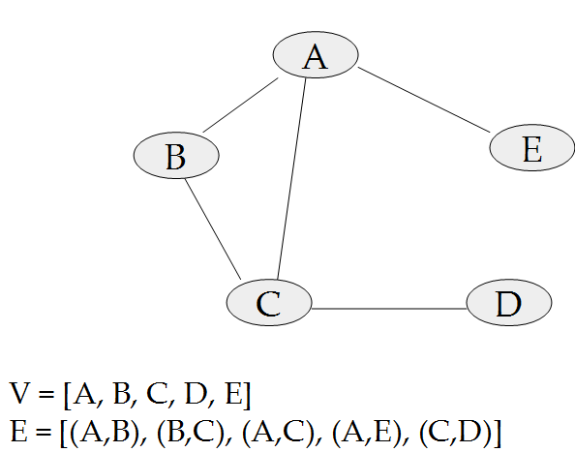
Graphs have vertices and edges

Slide 32
Some Graph variations
undirected graph (graph)
edges are bidirectional
directed graph (digraph)
edges go in one direction only
edges may be weighted or unweighted

Slide 33
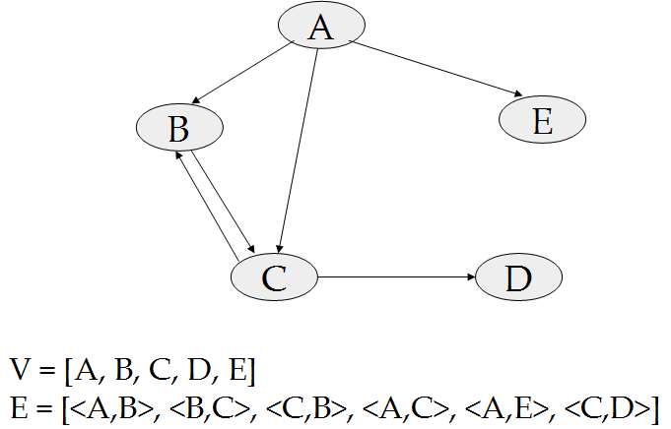
An unweighted digraph

Slide 34
graph Interface
Add_Vertex(v) – add a vertex to the graph
Add_Edge(v1, v2) - add an edge to the graph
isVertex(v) – is v a vertex in the graph?
Is_Edge(v1, v2) – is there an edge from v1 to v2 in the graph?
Remove_Vertex(v) – remove v from the graph
Remove_Edge(v1, v2) – remove an edge from the graph

Slide 35
Data structures for implementing a graph
A Graph consists of vertices and edges
Vertices have unique identifiers (often strings)
City name
Computer id
name
Edges are made up of 2 vertices
Undirected edge - (v1, v2)
Directed edge - <v1, v2>
Look first at storing the vertices

Slide 36
Storing the vertices
for the graph user vertices are identifiers (strings)
Graph implementations are based on dealing with vertices as numbers
Vertices are stored in a vector
the number of a vertex is the index at which it is stored
Vertex table
0
1
2
3
4
A
B
C
D
E

Slide 37
Using the vertex table
most graph operations start by looking up the number associated with a vertex
Int vnum = getvnum(vname);
What is the big O?
Also need the reverse operation
String vname = getvname(vnum);
What is the big(O)?

Slide 38
vertexTable
A D C B E
0 1 2 3 4
int vnum = getvnum(vname); O(n)
string vname = getvname(vnum); O(1)

Slide 39
How many edges does a graph with v vertices have?

Slide 40
Storing the edges
A graph has between 0 and v² edges
Adjacency matrix
based on storing information about all possible edges
Adjacency lists
based on storing information about only the existing edges

Slide 41

Storing the edges of a graph

Slide 42
Vertex table
0
1
2
3
4
A
B
C
D
E
0
1
2
3
4
0 1 2 3 4
0
1
2
3
4
0
1
2
3
4
Adjacency list
Adjacency matrix

Slide 43
Vertex table
0
1
2
3
4
A
B
C
D
E
0
1
2
3
4
0 1 2 3 4
0
1
2
3
4
1
2
4
0
1
2
3
4
0 | 1 | 1 | 0 | 1
1 | 0 | 1 | 0 | 0
1 | 1 | 0 | 1 | 0
0 | 0 | 1 | 0 | 0
1 | 0 | 0 | 0 | 0
0
2
0
1
3
2
0
Adjacency list
Adjacency matrix

