Slide 1
Assignment 7 questions?

Slide 2
This assignment will be graded based on the following criteria:
5 pts correctly submitted to MyCourses
10 pts compiles correctly using g++ on the CS lab machines
10 pts creating the set of known spammers
10 pts determining good and bad IP addresses
10 pts removing addresses from the set of known spammers
10 pts handling of the input files
15 pts functional decomposition
10 pts style standards
10 pts hierarchy chart (do not include calls to set or unordered_set methods)
10 pts performance table

Slide 3
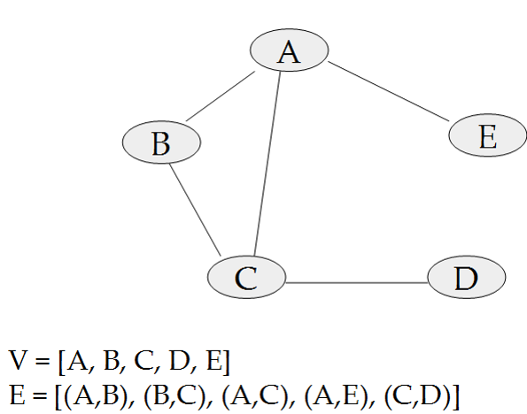
Vertex table
0
1
2
3
4
A
B
C
D
E
0
1
2
3
4
0 1 2 3 4
0
1
2
3
4
1
2
4
0
1
2
3
4
0 | 1 | 1 | 0 | 1
1 | 0 | 1 | 0 | 0
1 | 1 | 0 | 1 | 0
0 | 0 | 1 | 0 | 0
1 | 0 | 0 | 0 | 0
0
2
0
1
3
2
0
Adjacency list
Adjacency matrix

Slide 4
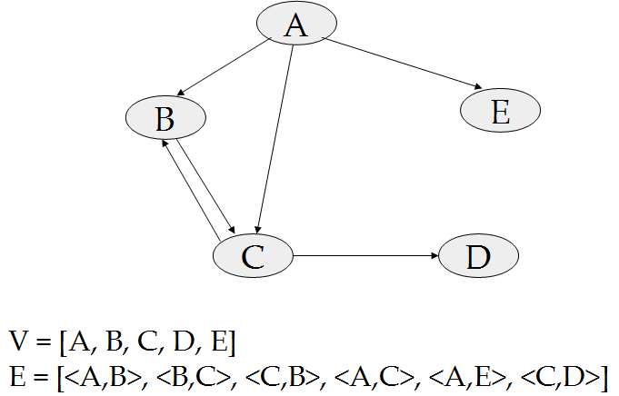
Storing the edges of a digraph

Slide 5
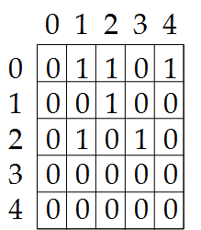
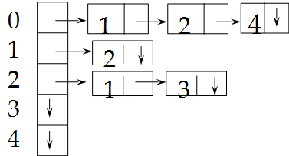
0 A
1 B
2 C
3 D
4 E

Slide 6
0 A
1 B
2 C
3 D
4 E
Which vertices are adjacent to (successors of) A?
Which vertices are adjacent from (predecessors of) A?

Slide 7
Comparing adjacency matrix and adjacency lists
Given that a graph has v vertices and e edges
How much memory space is needed?
What is the efficiency of
Add an edge from v1 to v2?
Is there an edge from v1 to v2?
How many vertices are adjacent to v1?
How many vertices are adjacent from v1?

Slide 8
Memory space comparison
Adjacency matrix
Adjacency lists
Graph
Digraph

Slide 9
Memory space comparison
Adjacency matrix
O(v²)
Adjacency lists
Graph
V + 2E or O(V + E)
Digraph
V + E or O(V +E )
Most graphs are sparse

Slide 10
Efficiency of digraph operations
Add an edge from v1 to v2
Adjacency matrix
Adjacency lists
Is there an edge from v1 to v2
Adjacency matrix
Adjacency lists
How many vertices are adjacent to v1
Adjacency matrix
Adjacency lists
How many vertices are adjacent from v1
Adjacency matrix
Adjacency lists
Do not include finding the vertex numbers.
Use V for number of vertices, E for number of edges and e for number of vertices on an adjacency list

Slide 11
Efficiency of digraph operations
Add an edge from v1 to v2
Adjacency matrix O(1)
Adjacency lists O(1) or O(e) (to prevent duplicates)
Is there an edge from v1 to v2
Adjacency matrix o(1)
Adjacency lists O(e)
How many vertices are adjacent to v1
Adjacency matrix o(v)
Adjacency lists o(1) - assuming adjacency list knows its own size
How many vertices are adjacent from v1
Adjacency matrix o(v)
Adjacency lists O(V + e)

Slide 12
By Thursday April 19 zybooks ch. 23 sec. 4 and 5

Slide 13
Traversing a graph
where to start?
visit order?
how to prevent multiple visits?
will all vertices be visited?

Slide 14
Traversing a graph
where to start?
have to specify starting vertex (can be any)
visit order?
depth first – get far away from start vertex as quickly as possible
breadth first – visit immediate neighbors first
how to prevent multiple visits?
Need a visited list
will all vertices be visited?
only if the graph is connected

Slide 15
Do a depth first traversal starting at ny
NY
ATL
DC
LA
CHI
BOS

