Slide 1
Miscellaneous items
Everyone completed lab2 with 3 points
files submitted to My courses must
Use naming convention given: assignment_lastname_firstname_tar.gz
Contain no .o or executable files
Can tar and zip with one command
Tar –cvzf assignment_lastname_firstname_tar.gz dir_Name
To change your CS Lab password go to
Sysadmin.cs.Binghamton.edu
to compile using c++11
Zybooks environment uses C++ by default
Cs lab environment does not
Use: g++ -std=c++11 -----.cpp

Slide 2
Questions about lab or assignment ???

Slide 3
Before Thursday’s class do zybook exercises chapter 10 (.8 through .15) Chapter 11

Slide 4
What are the 3 cornerstones of OOP?

Slide 5
Cornerstones of oop
Inheritance
Polymorphism
Encapsulation - main focus in CS240

Slide 6
encapsulation
A stringstream object encapsulates a string
A vector<t> object encapsulates an array
A function encapsulates ?????
abc

Slide 7
A function encapsulates an algorithm
algorithm

Slide 8
A class encapsulates data that can be accessed only through operations (methods)
operations
operations
data
data

Slide 9
Cs240 focuses on containers of like items
will use classes for
The type of items to be stored in a container
The container
List
Map
Graph

Slide 10
Some differences between java classes and c++ classes
A java class is defined and implemented in a single file
A c++ class is defined in one file and implemented in another file
Java objects are references
C++ objects are values
A c++ class can have methods that are overloaded operators
Ex: MyObject == yourobject
Ex: cout << myobject << endl;

Slide 11
The box class
An object of the box class holds a single type of item
A jewelry box
A book box
A bait box
A junk box
What can be done to/with a box?
Create a box
Find out the type of item stored in a box
Set the type of item stored in a box
Add an item to the box
Remove an item from the box
How many items in the box?

Slide 12
public class Box {
private String itemType;
private int numItems;
public Box( ) {
itemType = “unknown”;
numItems = 0;
}
public Box (String theType) {
itemType = theType;
numItems = 0;
}
public setItemType (String theType) {
itemType = the Type;
}
public String getItemType ( ) {
return itemType;
}
public void addItem (){
numItems = numItems + 1;
}
public void removeItem (){
numItems = numItems - 1;
}
public int howManyItems(){
return numItems;
}
}
The Java Box class

Slide 13
Syntax of C++ class statement
class MyClass
{
public:
//protypes for constructors //prototypes for operations (methods) accessible to user private: //data members needed to store value of an instance
//prototypes for operations not accessible to user
};
C++ class definition goes in a .h file
C++ class implementation goes in a .cpp file

Slide 14
// box.h
#include <string>;
class Box {
public:
Box ();
// default constructor
Box (std::string theType);
// constructor
void setItemType (std::string theType);
// set type of item to theType
std:string getItemType ( ) const;
// return type of item
void addItem();
// add an item to the box
void removeItem();
// remove an item from the box
int howManyItems() const;
// return number of items in the box
private:
std::string itemType;
int numItems;
};
C++ definition of
the Box class

Slide 15
// file box.cpp
#include “box.h”
Box::Box() {
itemType = “unknown”;
numItems = 0;
}
Box::Box(std::string theType) {
itemType = theType;
numItems = 0;
}
void Box::setItemType (std::string theType) {
itemType = theType;
}
std::string Box::getItemType ( ) const {
return itemType;
}
void addItem() {
numItems ++;
}
void removeItem() {
numItems --;
}
int howManyItems() const {
return numItems;
}
C++ implementation
of the Box class

Slide 16
Declaring class instances (objects)
Java - objects are references
Box myBox = new Box();
Box myBox = new Box(“books”);
C++ - objects are values
Box mybox ();
Box mybox (“books”);
Box* myboxptr = new box(“books”); (coming later)

Slide 17
Using the box class
First write a program whose purpose is test the box class to be sure that its methods provide the expected behavior
Test program needs to
#include “box.h”
Declare instances of type box
Invoke all methods of the box class

Slide 18
Code is now spread over 3 files
box.h - defines the class interface
box.cpp - implements the class
boxtester.cpp - program to test the behavior of the box class
Both box.cpp and boxtester.cpp #include box.h
Attempt to define a class twice results in a compiler error

Slide 19
preventing redefinition
// box.h
#ifndef _BOX_
#define _BOX_
#include <string>;
class Box
{
…………
};
#endif

Slide 20
HOW DO WE CREATE AN EXECUTABLE FILE?
box.cpp
boxtester.cpp
#include “box.h”
#include “box.h”
compile
link
box.o
boxtester.o
executable file

Slide 21
The UNIX make program
use to manage multifile projects
Keeps track of changes made in source files
Make looks for its instructions in a file named makefile (all lower case)
A Makefile contains
Comment lines – start with #
Dependency lines followed by action lines
An example:
box.o: box.cpp box.h <- a dependency line g++ -c std=c++11 box.cpp <- an action line
Action line must start with a tab!

Slide 22
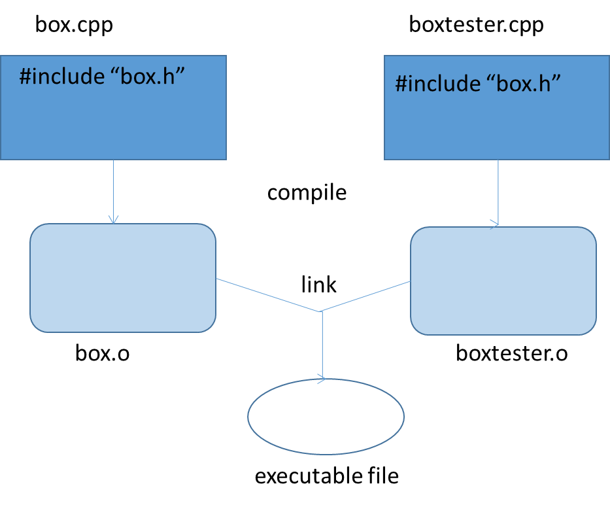
A makefile
boxProgram.exe: box.o boxtester.o
g++ box.o boxtester.o -o boxProgram.exe
box.o: box.cpp box.h
g++ -c -std=c++11 box.cpp
boxtester.o: boxtester.cpp box.h
g++ -c -cstd=c++11 boxtester.cpp

Slide 23
Benefits of make
Don’t have to type individual commands
Will only recompile the files that have been changed since the last time make was executed
Done by checking time stamps
Has many other uses

Slide 24
A useful addition
boxProgram.exe: box.o boxtester.o
g++ box.o boxtester.o -o boxProgram.exe
box.o: box.cpp box.h
g++ -c -std=c++11 box.cpp
boxtester.o: boxtester.cpp box.h
g++ -c -cstd=c++11 boxtester.cpp
clean:
rm *.o *.exe

Slide 25
Future submissions to mycourses must include
All .h and .cpp files needed to build the executable program
A makefile with commands needed to build the executable program
Any input files needed to run the program
Nothing else
No .o files
No executable files

Slide 26
Another example
Abstract view of a fraction object
What operations are needed?
What data members are needed?
2 / 5

Slide 27
A partial header file
#ifndef _FRACTION_
#define _FRACTION_
class Fraction{
public:
Fraction():
// creates a Fraction with the value 1/1
Fraction(int initNumerator, int initDenominator)
// creates a Fraction with the value initNumerator / initDenominator
// precondition: initDenominator != 0
int getDenominator()const;
// returns the denominator
int getNumerator()const;
// returns the numerator
double getFloatValue()const;
// returns fraction’s float value
private:
int num;
int denom;
};
#endif

Slide 28
Some additions to fraction class
Doing arithmetic with fractions
F3 = f1 + f2;
Sending a fraction to an output stream using insertion operator
Cout << myfraction;
Myoutputfile << myfraction;
Keeping fractions in simplified form
1/2 not 2/4

Slide 29
Overloading the + operator
Fraction operator+ (const Fraction & rhsOperand) const;
// returns the result of adding this Fraction to rhsOperand
in fraction.h
Fraction Fraction::operator+ (const Fraction & rhsOperand) const (
int sumNum = (num * rhsOperand.denom) + (denom * rhsOperand.num);
int sumDenom = denom * rhsOperand.denom;
return Fraction(sumNum, sumDenom);
}
in fraction.cpp

Slide 30
Overloading <<
Cannot be defined as a method – why?
Fraction object would have to be the left hand operand
myFraction << cout instead of cout << myFraction
Define it as a friend function
a Friend function has access to private data members
Prototype must be defined in the class definition (.h file)

Slide 31
friend ostream& operator<< (ostream & out, const Fraction & f);
// sends the value of f to out
in fraction.h
ostream & operator<< (ostream & out, const Fraction & f) {
out << f.num << “/” << f.denom;
return out;
}
in fraction.cpp
cout << myFraction
myOutPutFile << myFraction
in program that uses Fraction class

Slide 32
Fractions should be kept in simplest form
How is a fraction simplified?
Whose job is this?

Slide 33
Fractions should be kept in simplest form
How is a fraction simplified?
Divide numerator and denominator by their greatest common factor
Whose job is this?
Best done when a fraction is being created

Slide 34
Fraction::Fraction (int initNumerator, int initDenominator) {
assert (initDenominaotr != 0);
int gcf = greatestCommonFactor (initNumerator, initDenominator);
num = initNumerator / gcf;
denom = initDenominator / gcf;
}
What is greatestCommonFactor?

