Slide 1
Miscellaneous items
Lab
Assignment 1
functional decomposition
Testing
Submitting test cases

Slide 2
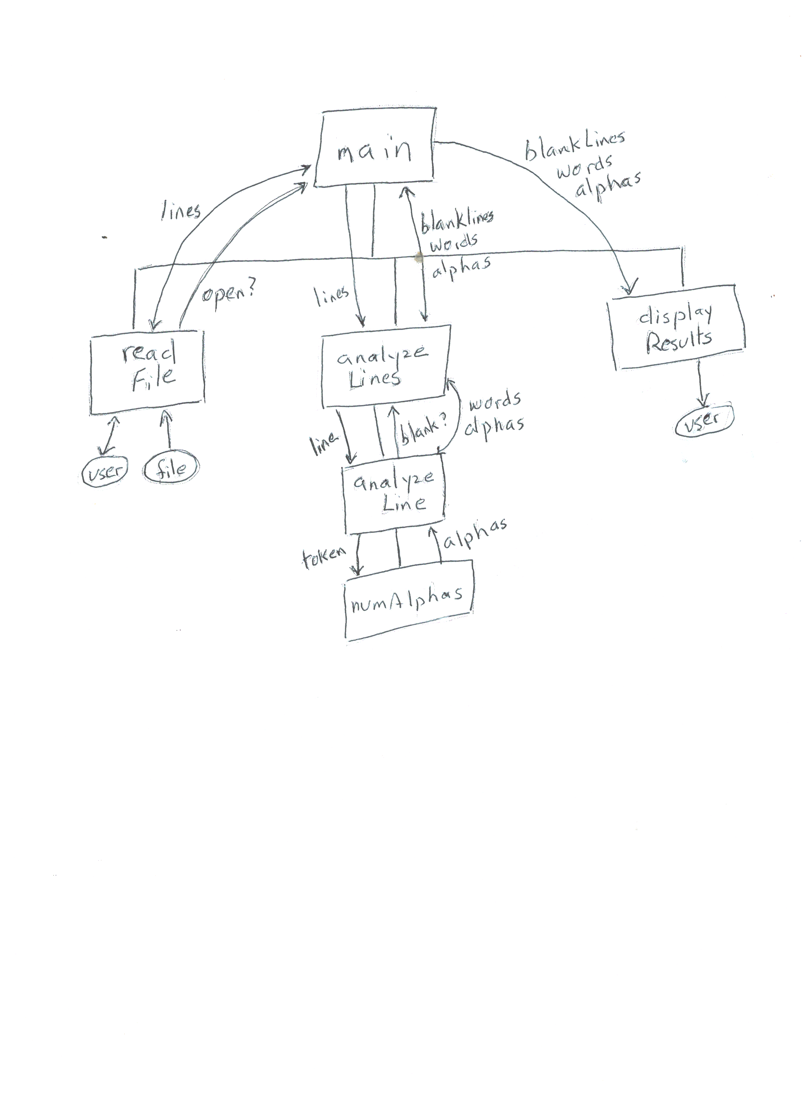

Slide 3
Arraylist.h
#ifndef array_List_
#define array_List_
#include "ListInterface.h“
const int CAPACITY = 10;
class ArrayList : public ListInterface {
public:
ArrayList();
bool isEmpty() const;
int getLength() const;
bool insert(int newPos, const ItemType & newEntry);
bool remove(int pos);
ItemType retrieve(int position) const;
bool append(const ItemType & newEntry);
private:
ItemType array[CAPACITY];
int size;
};
#endif

Slide 4
an ArrayList object
array
size
CAPACITY
10

Slide 5
Arraylist.cpp
Implement
Constructor
Isempty
Getlength
Implement
Append
implement
Retrieve
How to handle the precondition?
Implement
Insert
remove

Slide 6
Arraylist.cpp constructor, isEmpty, getlength
#include “ArrayList.h“
ArrayList::ArrayList(){
size = 0;
}
bool ArrayList::isEmpty() const{
return size == 0;
}
int ArrayList::getLength() const{
return size;
}

Slide 7
Implement append
bool append (const ItemType & newEntry);
//input: element to be added at end of the list
//output: if entry was appended return true; else return false

Slide 8
Arraylist.cpp append
bool ArrayList:: append(const ItemType & newEntry){
if(size >= CAPACITY)
return false;
array[size] = newEntry;
size++;
return true;
}

Slide 9
Arraylist.cpp retrieve
ItemType ArrayList::retrieve(int position){
return array[position - 1];
}
What is missing?

Slide 10
Dealing with preconditions
#include <cassert>
Contains the function assert
assert(some_Boolean_condition);
if condition is true
execution continues
If condition is false
program execution stops and error message displayed
Assert(position >= 1 and position <= getLength())
Caller of a method that has a precondition is responsible for meeting it

Slide 11
Arraylist.cpp retrieve – with assert
ItemType ArrayList:: retrieve(int position){
assert(position > 0 and position <= size);
return array[position - 1];
}

Slide 12
Insert and remove
Check to see if position for insertion or removal is valid
If yes
For insertion – shift items upward in array to make room for newitem
For deletion – shift items downward in array to fill in the gap
Increment or decrement size

Slide 13
Assignment 2
Assignment 1 was decomposed using functions
Assignment 2 will be decomposed using functions and classes
classes
Itemtopurchase
Linkedlist – inherits from listinterface (is-a)
Shoppingcart
Has-a linkedlist to hold items purchased
Program decomposed using functions
Manages contents of a shopping cart

Slide 14
ListInterface
ShoppingCart
is-a
has-a
has-a
program
LinkedList
has many
ItemToPurchase

Slide 15
Before thurday’s class
do zybook exercises
ch 12 (.1 through .7)
Note: list operations are value oriented, rather than position oriented
read assignment 2
write expected output from test1.txt
this will be collected in class

Slide 16
linkedlist.h
#ifndef linked_List_
#define linked_List_
#include "ListInterface.h“ //no need for CAPACITY
class LinkedList : public ListInterface {
public:
LinkedList();
bool isEmpty() const;
int getLength() const;
bool insert(int newPos, const ItemType & newEntry);
bool remove(int pos);
ItemType retrieve(int position) const;
bool append(const ItemType & newEntry);
private:
};
#endif

Slide 17
A linked list
head
element
element
element
a node
a node
a node
Elements are stored in nodes that are in non-contiguous memory locations
Nodes are linked together using pointers
A C++ programmer has to allocate and free space for nodes

Slide 18
pointers
Variables of type pointer have a value which is a memory address
Example: string* spointer ;
spointer is of type pointer to a string
String mystring = “CS240C”;
Spointer = &mystring;

Slide 19
Do not mistake the pointing finger for the moon
SPOINTER
MYSTRING
CS240C
cout >> SPOINTER >> endl;
cout >> MYSTRING >> endl;
cout >> *SPOINTER >> endl;

Slide 20
the new and delete operators
New allocates (at run time) memory space to store a value of some type and returns the address of that block of memory
Myclass* ptr = new myclass(-----);
Delete frees up the block of memory a pointer points to
Delete ptr;
Ptr = nullptr;
Nullptr is a c++ 11 keyword
Every new needs a delete
PTR
PTR

