Slide 1

Big Data Analytics Project Proposal
Topic - Social Health
Team - EcoStats
Karan Sheth, Wing Au, Liting Chiang

Slide 2
Table of Contents
Introduction
Background
Methodology
Potential
Results
Takeaway

Slide 3
Introduction
Aim: How do different factors affect the social health of people?
Focus -
Evaluate and analyze different factors that affect social Health such as Presence of Healthcare, Education, alcoholism, drug use, mortality, and overall life satisfaction
How confidence and trust of people on the country system and policy affect their happiness
How alcohol/drug consumption affects the living condition of people
Economic Stability relates to social life of people

Slide 4
Background: Why do we care?
Social health, life expectancy, income, and life satisfaction are all intricately related
Existing research has shown that increased life satisfaction and overall happiness have lead to longer life expectancies
A 2013 German study¹ found that life satisfaction is a powerful risk-factor for later mortality and is more predictive of mortality than a host of other variables
A similar result was produced in a 2020 longitudinal study² performed in the US that found life expectancies at age 18 could be nearly 9 years longer for individuals with high life satisfaction
Understanding the socio-economic conditions that can contribute to higher life satisfaction and happiness can inform better public policy decisions
For example, higher education levels have been linked to increased life satisfaction³
Every ten percent annual income rise increases an individual’s happiness by a similar percentage irrespective of the amount of money they earn each year.¹⁰
A 2018 survey by Purdue University that used Gallup World Poll data, found out that with a yearly financial gain of 95000 USD, people can experience satisfaction in life.¹⁰

Slide 5
Methods Proposed
Social Factor
Healthcare
Social Factor
Education
Social Factor
Life Satisfaction
Social Factor
Alcoholism, Drug abuse
Social Factor
Mortality
Data Pipeline Preprocessing
( Spark )
Cluster #1
Based on Social Health of Countries
Feature Engineering
( Dimensionality Reduction )
Feature Assessment
( Similarity Search, Clustering)
Cluster #2
Prediction
( Machine Learning/ Distributed TensorFlow )
Cluster #3

Slide 6
Methodology
Dataset Formation
Combining datasets related to various social factors
Data Cleaning & Preprocessing
Feature Selection
Handling null values & outliers
Exploratory Data Analysis
Similarity Search
Form clusters of countries based on social Factors
Predictive Modeling
Predicting life satisfaction based on social conditions of the country

Slide 7
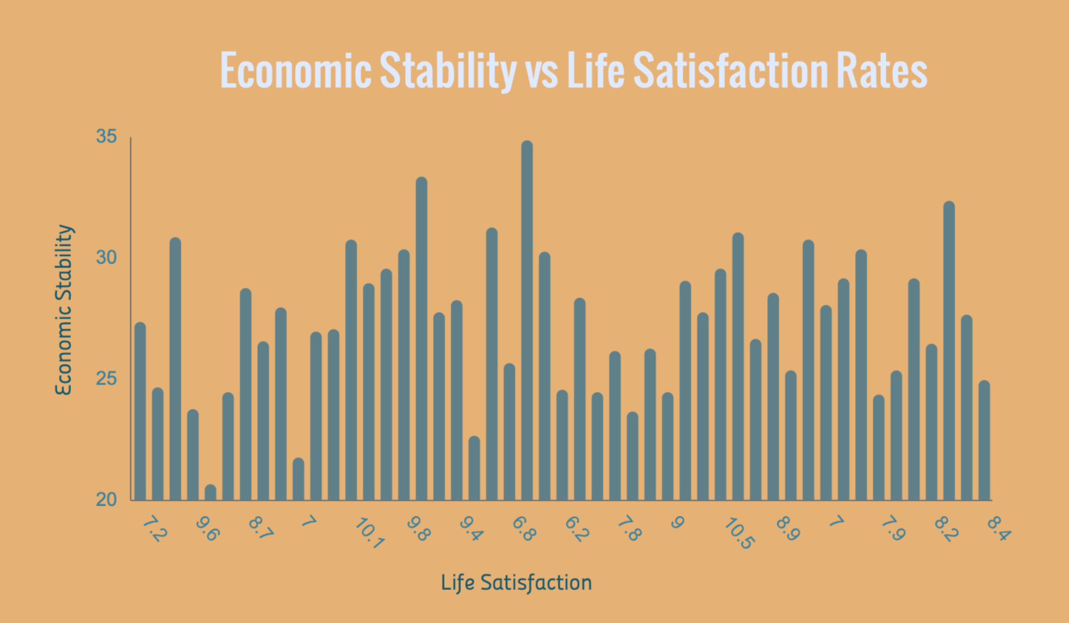
Potential Results

Slide 8
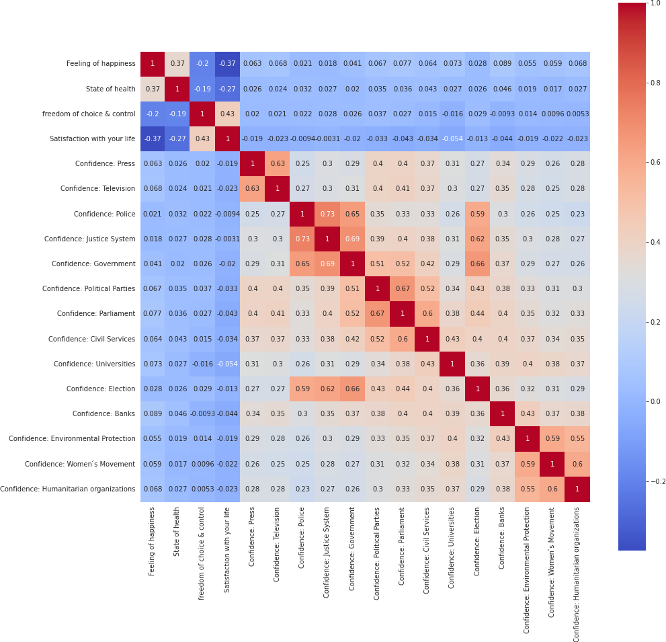
Potential Results

Slide 9
Takeaways
Forming clusters of the countries based on social factors can help countries understand where they can improve
Predicting life satisfaction & happiness of people
Identifying primary factors that countries can focus on to improve social health

Slide 10
Team Work
Data Collection - Karan, Wing, Liting
Data Cleaning - Wing, Karan
Feature Extraction Liting, Wing
Dimensionality Reduction Liting
Machine Learning/TensorFlow Karan
Similarity Search Wing, Liting
Model Evaluation Karan

Slide 11
Sources
Guven, Cahit, and Rudy Saloumidis. "Life satisfaction and longevity: longitudinal evidence from the German socio-economic panel." German economic review 15.4 (2014): 453-472.
Lee, Hyunjung, and Gopal K Singh. “Inequalities in Life Expectancy and All-Cause Mortality in the United States by Levels of Happiness and Life Satisfaction: A Longitudinal Study.” International journal of MCH and AIDS vol. 9,3 (2020): 305-315. doi:10.21106/ijma.392
Zhang, Wei et al. “The educational, racial and gender crossovers in life satisfaction: Findings from the longitudinal Health and Retirement Study.” Archives of gerontology and geriatrics vol. 73 (2017): 60-68. doi:10.1016/j.archger.2017.07.014
https://www.kaggle.com/datasets/jeromeblanchet/fannie-mae-freddie-mac-public-use-database
https://www.bls.gov/developers/api_signature_v2.htm
https://ourworldindata.org/happiness-and-life-satisfaction
https://ourworldindata.org/literacy#:~:text=While%20only%2012%25%20of%20the,1960%20to%2086%25%20in%202015.
https://inequality.stanford.edu/research
https://www.kaggle.com/datasets/cdc/mortality
https://www.renolon.com/can-money-buy-happiness-statistics/

Slide 12

Thank You!
Team - EcoStats
Karan Sheth
Wing Au
Liting Chiang

