Slide 1
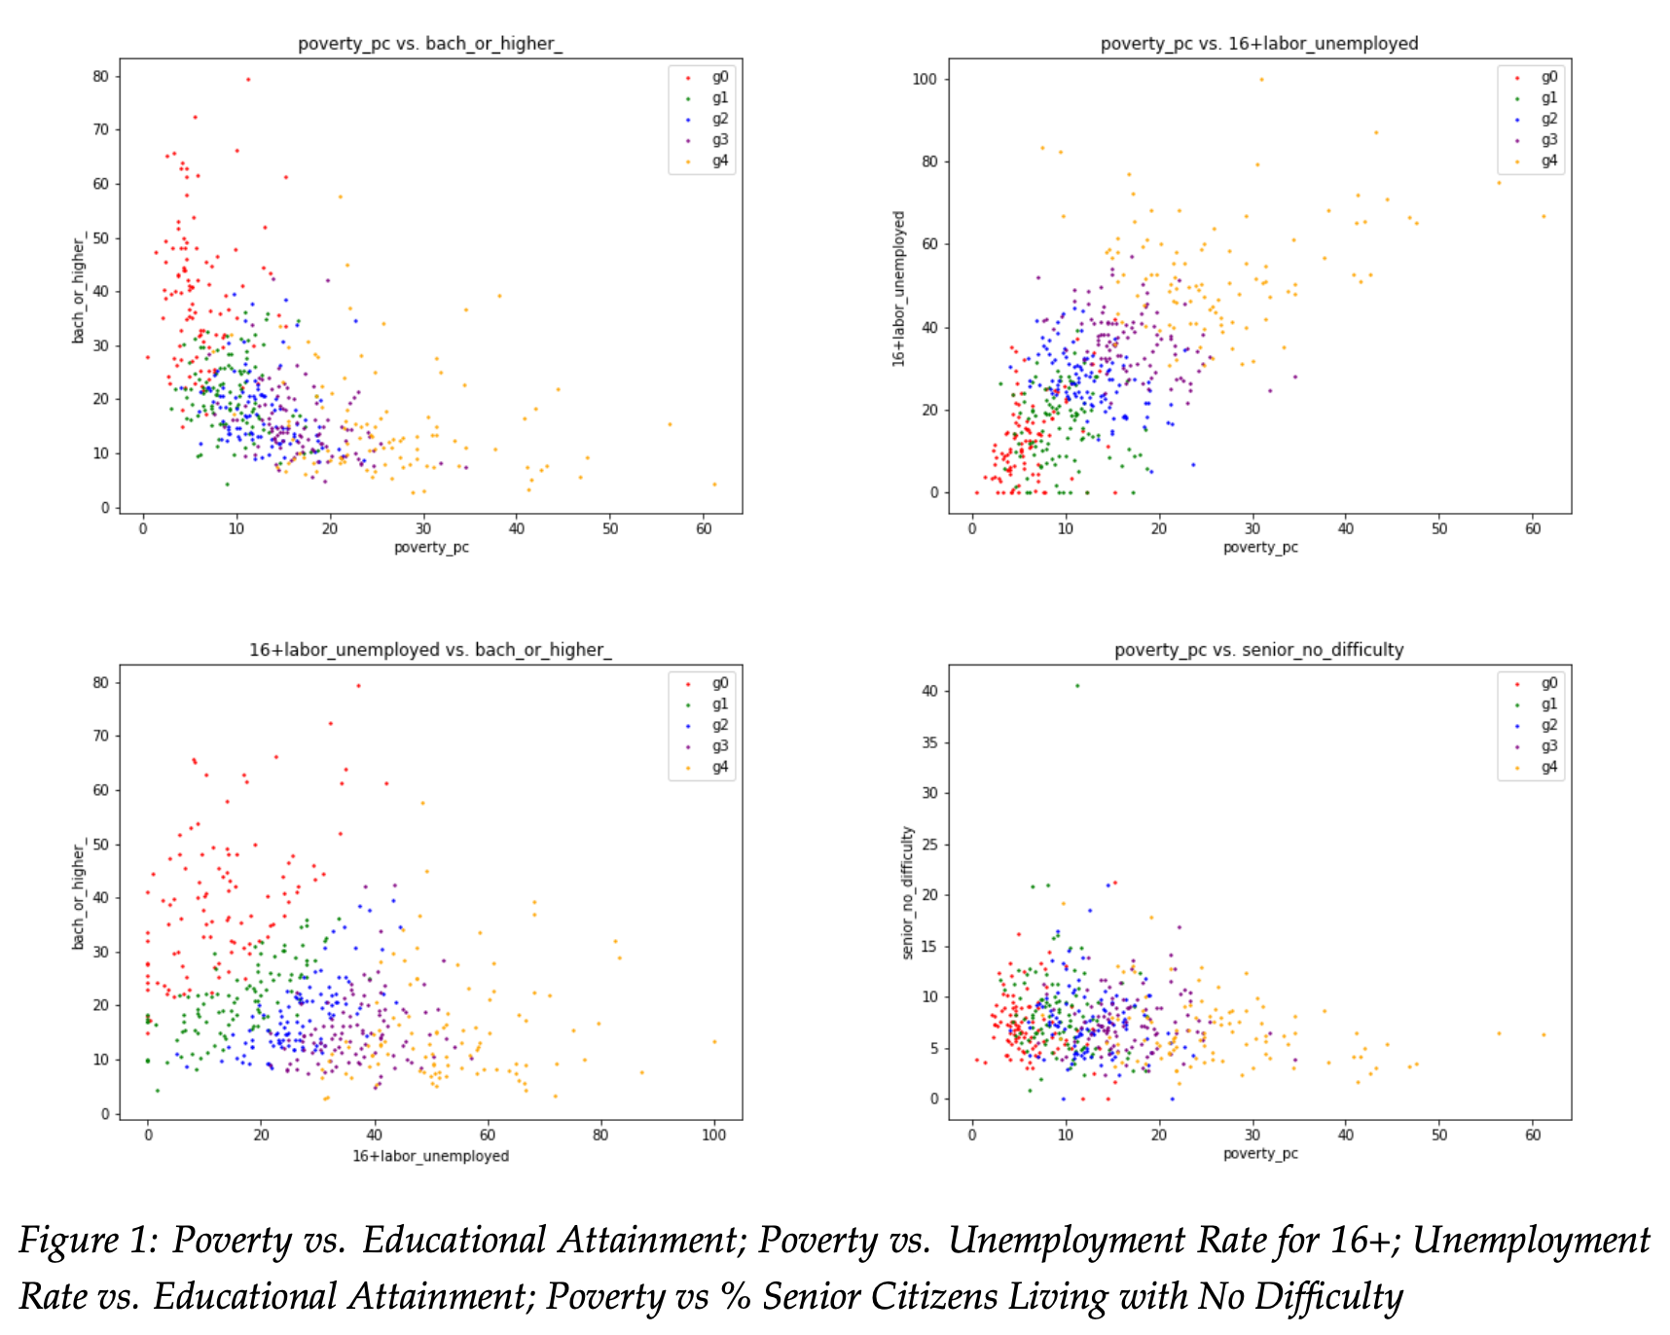
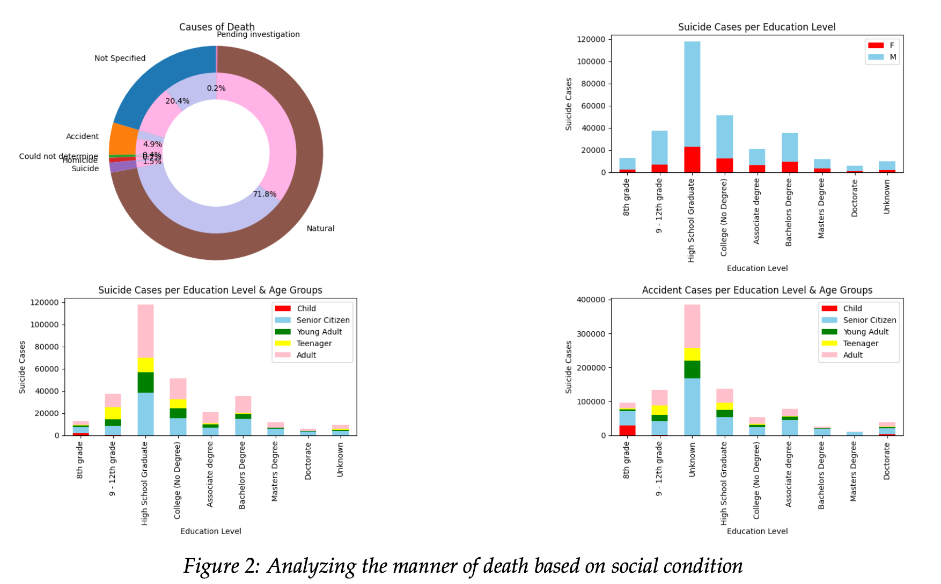
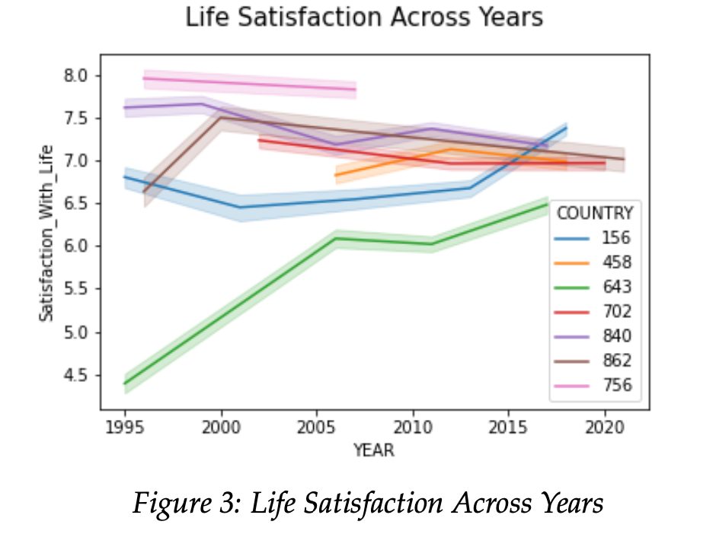
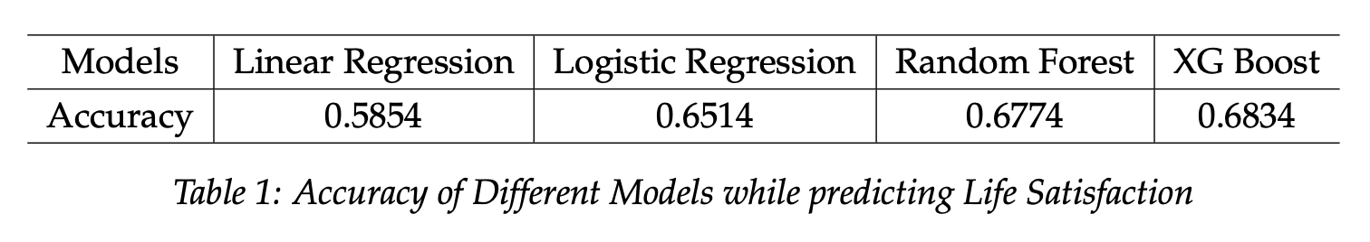
Analyzing Social Health Factors
Team EcoStats
Karan Sheth, Liting Chiang, Wing Au,
Introduction
The goal of this project was to investigate the various relationships between the multiple factors that make up social health.
This project explores various data sets related to economic well-being including poverty rates, mortality rates, educational attainment, and social factors (e.g., trust in religion, faith in politics, etc.).
Since social health is such a broad topic, big data frameworks are useful for aggregating data from multiple sources and performing fine-grained analysis
Results
Clustering Analysis on U.S. County Economic Data
Introduction
How many transformer dimensions are required for your task?
Background
Existing research has shown that increased life satisfaction and overall happiness have lead to longer life expectancy. [1], [2]
Higher education levels have been linked to increased life satisfaction [3].
Increased income has been linked to higher life satisfaction [4].
Understanding the socio-economic conditions that can contribute to higher life satisfaction and happiness can inform better public policy decisions
Clustering Analysis on U.S. County Economic Data
Data
U.S. Census Bureau Data (6.5 GB)
Educational Attainment, Poverty, Income, Senior Citizen Living Conditions, Age by Zip Code
CDC U.S. Mortality Data (5.5 GB)
Manner of Death, gender, education, location of death
World Values Survey Data (2 GB)
Questions about their family, neighborhood, values, beliefs in political systems, confidence and faith in various procedures, and so on. (396041 rows and 55 columns)
.
B) U.S. CDC Mortality Rate Breakdown
C) Predicting Life Satisfaction Via Social Factors
Conclusion
An important factor to reducing overall poverty is expanding educational opportunities, as higher educational attainment was linked to lower poverty and unemployment rates
The high proportion of suicide cases among those with only high school degrees warrants suggests greater need for supporting economically weaker areas in the United States, in particular adult men
Tracking citizens’ social features can be a useful tool in predicting life satisfaction.
Methodologies
Clustering Analysis based on U.S. Census Data
Data Preprocessing and Feature Engineering (Spark)
Clustering by Similarity Search and Euclidean distance
Understanding Cause of Death in United States
Extracted key features from the data to understand how a person's social background influences the causes of death, particularly accidents and suicide.
Predicting Life Satisfaction of country based on Social Factors
Employing large-scale machine learning to forecast people’s life satisfaction depend-ing on their socio-economic circumstances.
References
[1] C. Guven and R. Saloumidis, “Life satisfaction and longevity: longitudinal evidence from the german socio-economic panel,” German economic review, vol. 15, no. 4, pp. 453–472, 2014.
[2] H. Lee and G. K. Singh, “Inequalities in life expectancy and all-cause mortality in the united states by levels of happiness and life satisfaction: A longitudinal study,” International Journal of Maternal and Child Health and AIDS, vol. 9, no. 3, p. 305, 2020.
[3] W. Zhang, K. L. Braun, and Y. Y. Wu, “The educational, racial and gender crossovers in life satisfaction: Findings from the longitudinal health and retirement study,” Archives of gerontology and geriatrics, vol. 73, pp. 60–68, 2017.
[4] J. M., “29 eye-opening can money buy happiness statistics in 2021,” 2022.
[5] “Us census bureau: https://www.census.gov/.”
[6] CDC, “Centers for disease control and prevention: https://www.kaggle.com/datasets/cdc/mortality?datase 2016.
[7] I. R., “World values survey: All rounds - country-pooled: https://www.worldvaluessurvey.org/wvscontents.jsp,” 2021.
Notes:
You can add your presentation notes here. This presentation template for research posters is fully editable so text, graphics and content can be updated to fit your own research needs.
Download more poster presentation templates from FPPT.com

