Slide 1
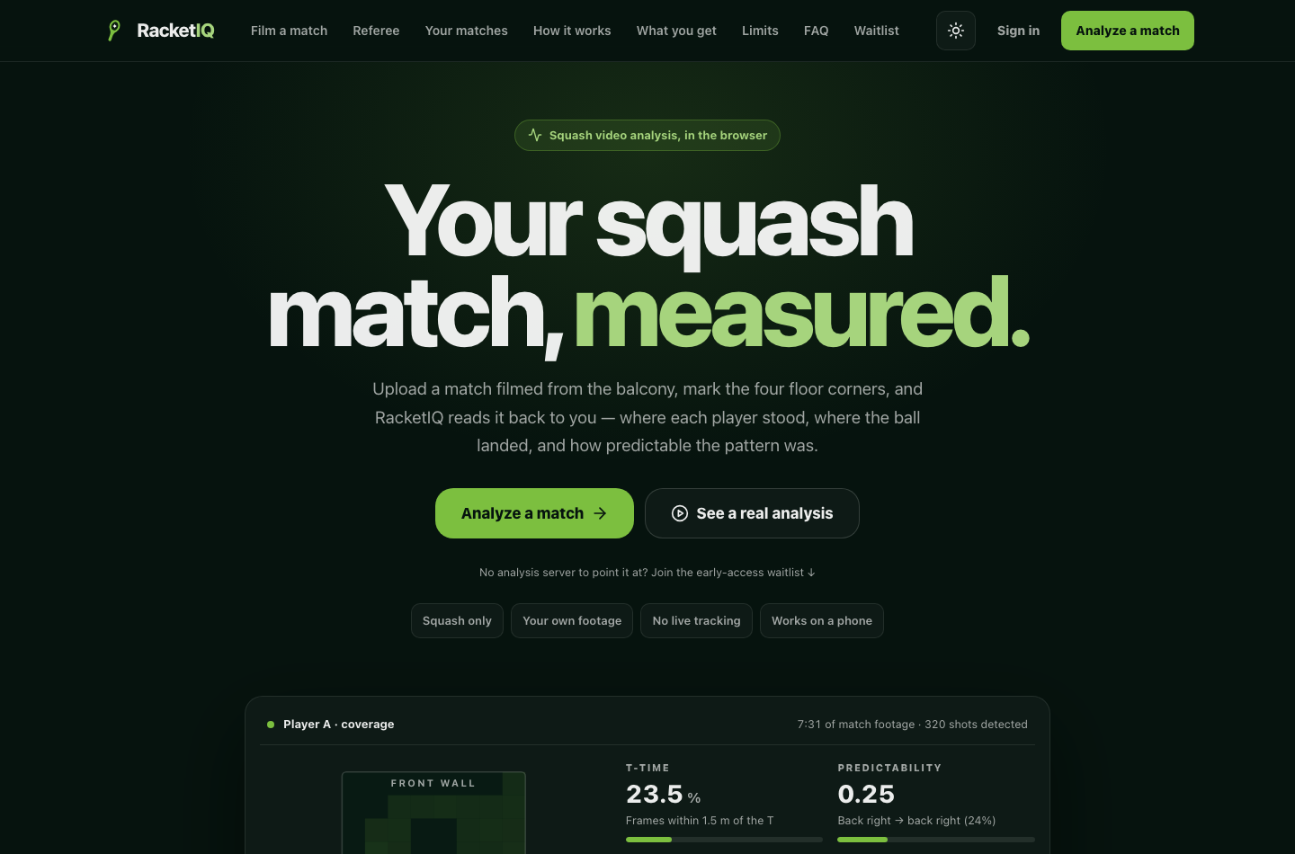
WEEK IN REVIEW · 15 – 21 AUGUST 2026
RacketIQ
Seven days from a merged scaffold to a squash analysis product that is live on the web, submitted to Apple for review, and measured against hand-labelled ground truth rather than claimed.
racketiq.tech — apex and www, both serving over TLS. Captured from the shipped bundle.
89
48K
728
7
commits merged to main
lines added — TS, Python, Swift
tests green before every merge
days, scaffold to live product
RacketIQ · weekly build report
01
Notes:
Week of 15-21 Aug 2026. 89 commits, ~48K lines added across TypeScript, Python and Swift, 728 tests green. Three surfaces live: the web app at racketiq.tech, iOS v1.0.0 submitted for App Store review (expedited request in), and the analysis API behind TLS on Azure.

Slide 2
THE CONTEXT · WHAT CAME BEFORE
Before this: daybot
daybot is an AI dropshipping storefront platform — a FastAPI backend, a merchant web dashboard, buyer storefronts, and one Expo codebase that ships to both app stores.
BUILT FROM SCRATCH
0 → App Store
live worldwide, in about one week
Deliberately on pause — not dead. daybot is paused so every hour this week could go into RacketIQ — the pause is a bet on focus, not a retreat.
The daybot iOS app went from an empty folder to live on the App Store worldwide in roughly a week — through one rejection and a five-lens submission audit.
CARRIED FORWARD
736
~86K
The pinned Expo SDK 57 matrix already proven under App Review, the App Store runbook, and the credential hygiene — RacketIQ started this week on rails daybot paid for.
commits on the platform
lines of Python + TypeScript
118
2
API routes on the main router
stores — iOS shipped, Android prepared
02
Notes:
Context slide: daybot, the previous product, is an AI dropshipping storefront platform. Its iOS app went from empty folder to live on the App Store worldwide in about one week, through one rejection. 736 commits, ~86K lines, 118 API routes, Play submission prepared. Now deliberately paused - RacketIQ inherits its proven build/review infrastructure.

Slide 3
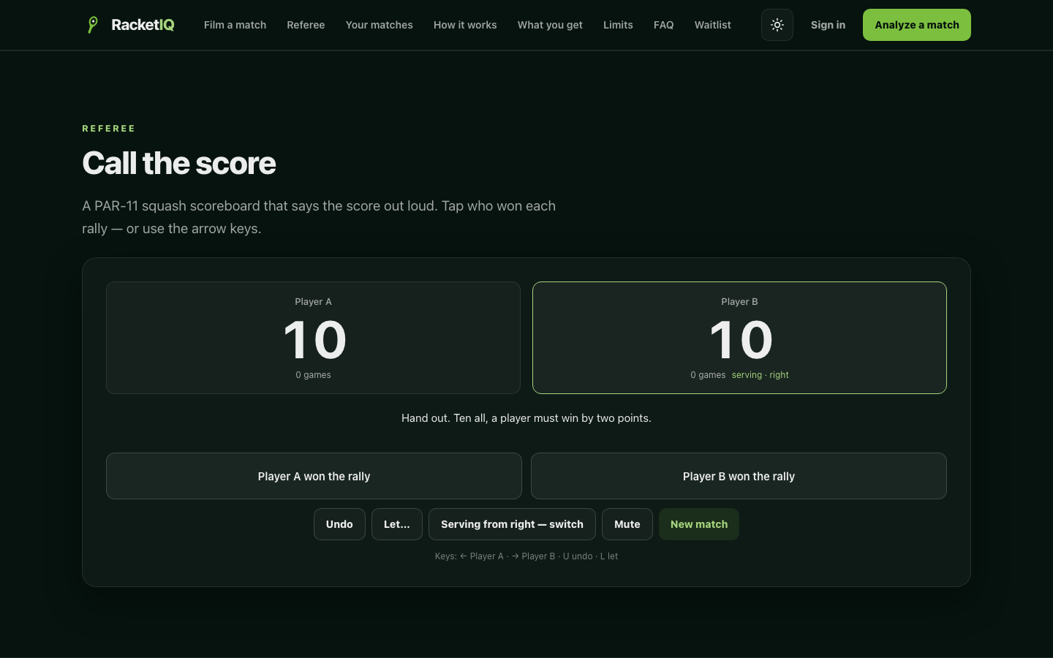
What the app does now
Five surfaces shipped this week — all of them running on real club footage, not demo data.
Match analysis
Shot placement, coverage heatmaps, T-time and a predictability score, with a pose skeleton and a shot type on every strike.
Referee
Watches the court live, proposes the rally winner with a plain-English reason, and always asks before it touches the score.
Score keeper
A PAR-11 board that calls the score out loud in squash convention, handles let / stroke / no-let, and undoes cleanly.
Score a video
The same rally engine run over an already-analysed match in a single pass — autopilot is opt-in and every call is correctable.
Film, store, sign in
Record on a phone or a laptop, matches survive a reload, and accounts plus the paywall now gate both clients.
The referee calling a real tie-break: “Hand out. Ten all, a player must win by two points.”
03
Notes:
Five product surfaces: analysis, live referee, score keeper, video scoring, and the capture/account layer. The referee never scores silently - every rally end is a question.

Slide 4
Accuracy: hand-labelled first, then measured
None of these are vendor numbers. Ground truth was labelled by hand before the code was written, and every figure below is what the shipped engine scored against it.
PLAYER IDENTITY
46.4% → 2.1% mislabelled
379 samples across three matches. Appearance re-ID on a torso patch replaced position-only tracking; 59 identity flips became 13.
SHOT DETECTION
41.1% → 71.0% precision
Recall held at 86.4%, F1 0.557 → 0.779. The false positives were real strikes — from the neighbouring courts.
RALLY WINNER
72.7% oracle ceiling
Measured, not assumed. At that ceiling a silent auto-confirm is worse than no referee, so the app proposes and always asks.
Ball tracking: measured, then not built. The detector landed 44.1% of visible frames within 5 px — real, and statistically significant. But a bounce needs about six consecutive positions to fit, and across 84 frames of live play there was exactly one such run. The limit is the camera, not the algorithm, so nothing shipped.
04
Notes:
Player identity: 46.4% -> 2.1% mislabelled over 379 samples. Shot detection: 41.1% -> 71.0% precision with recall unchanged at 86.4%. Rally-winner heuristic tops out at 72.7% (oracle), which is why the referee always asks. Ball tracking was killed by its own eval.

Slide 5
The stack underneath it
One data contract (analysis.json, schema v2) shared by four layers that ship independently.
CLIENTS
iOS — Expo SDK 57, React Native 0.86, React 19, expo-router, Zustand. Web — Vite, React 18, Tailwind, framer-motion. The web referee imports the phone's own rules modules through an @app/* alias, so the scoreline cannot diverge between platforms.
ON DEVICE
A Swift native module: AVCaptureSession → Vision pose → a streaming audio-onset detector → a rally engine that emits rally-started / strike / rally-ended with a proposed winner, a confidence, and a plain-English reason. 4.9K lines, ported from the Python spec.
ANALYSIS SERVICE
Python: RTMPose via rtmlib on CPU ONNX, OpenCV with ORB/RANSAC drift compensation so a bumped camera still maps to the same court, a homography fitted from the floor lines, librosa spectral-flux onsets, and a Flask job server in Docker.
PLATFORM & INFRA
Supabase for auth, RLS and the event store. Stripe Checkout server-side only; RevenueCat on iOS. Azure Container Instances behind a Caddy TLS sidecar, and Azure Static Web Apps with an Azure DNS alias record holding the apex.
05
Notes:
Four layers: Expo/React clients sharing rule modules, a Swift on-device engine, a Python CPU vision service, and the Supabase/Stripe/Azure platform. The shared analysis.json schema v2 is the contract between them.

Slide 6
Traction: what is live, and what is in the pipe
Nobody has paid yet. This week built every surface that can carry the first user who does — and put the app in Apple's queue.
WEB
iOS
PRICING
racketiq.tech
Submitted
$9.99 / month
Apex and www, both on TLS, live since 21 Aug. The apex needed an Azure DNS alias record — the registrar supports neither ALIAS nor CNAME flattening.
v1.0.0 (build 29) submitted for App Store review, expedited request in. Signing, entitlements and permission strings verified from inside the IPA.
or $79.99 a year, after three free analyses. Stripe on the web, RevenueCat on iOS, both resolving to one entitlement.
Waitlist live
Admin metrics
Club pipeline
Run cost
On the landing page, writing to an insert-only Supabase table.
Users, signups, events, purchases and revenue behind basic auth.
Intro with the Dixie club head on 19 Aug; a Milton community session priced the app at $50.
The analysis server currently runs at roughly CAD $7 a day.
The honest gap. No revenue, and the first club match still has not been filmed. What changed this week is that nothing technical stands between us and that pilot — the site serves, the build installs, the paywall charges, and the analysis runs on someone else's footage.
06
Notes:
Be straight about this in the room: zero paying users. What exists is the full distribution surface - live site, TestFlight build, waitlist, billing, admin metrics - plus two club conversations and a $50 willingness-to-pay signal from Milton.

Slide 7
WHAT THE SUBMISSION CARRIES
MILESTONE · APP STORE
Signed for distribution — verified from inside the IPA, not the build log
Submitted to Apple for review
Sign in with Apple entitlement and all four permission strings present
Subscriptions submitted together with the app, as a first-time IAP requires
RacketIQ 1.0 is in Apple's queue — and the expedited-review request is already in.
Honest metadata — the listing claims only what the shipped build does
In-app account deletion and real legal pages — no placeholder links
v1.0.0 · build 29
com.racquetai.app
Expedited review requested
THE ONE WATCH ITEM
Build 29's photo-library purpose string is Expo's generic default — a known 5.1.1 risk. The corrected build is ready and goes up the moment the EAS quota resets on 1 September.
07
Notes:
Milestone: v1.0.0 build 29 submitted for App Store review with an expedited-review request already in. The submission was verified from inside the IPA. One watch item: the generic photo-library purpose string (5.1.1 risk); the corrected build is ready for the Sep 1 quota reset.

Slide 8
How it was built
Four rules did most of the work — and one of them killed a feature.
Label first, build second
A feature may fail its gate
72 hand-labelled shot moments, 379 identity samples, rally outcomes across three matches. The ground truth existed before the code that gets measured against it, so no number in this deck is self-graded.
Ball tracking ran as a feasibility study, not a build. The numbers did not earn it, so nothing was written. Killing it midweek is what paid for the rest of the week.
Two engines, one spec
Never two copies of a rule
The Swift port was checked frame-by-frame against the Python tracker across 9,707 association decisions, with zero mismatches. The port is a port, not a second opinion.
The web referee imports squash.ts and announce.ts straight from the phone. Only the genuinely platform-bound pieces — speech and storage — are allowed to fork.
89
561
33K
10K
4.9K
commits
files changed
TypeScript
Python
Swift
08
Notes:
The method is the differentiator: measure before building, allow a feature to fail its gate, keep one spec across two languages, and never let a rule exist twice.

Slide 9
Next
Ordered by what unblocks the first paying user.
The submission is in and the expedite request is filed. Answer App Review the hour they write, and have the corrected photo-string build ready the moment the EAS quota resets on 1 September.
01
LAND REVIEW
Rotate the Stripe and Supabase keys out of sandbox, turn on the signed Stripe webhook, fix Apple sign-in on the web (native iOS only today), and re-enable email confirmation before launch.
02
HARDEN
Film one club box-league match end to end and analyse it — the first proof outside archive footage — then work the waitlist and the Dixie conversation off the back of it.
03
PROVE
Raise last-striker attribution: 72.7% is the ceiling on the referee today, and everything the referee claims is capped by it. Ball tracking stays shelved until the camera changes.
04
SHARPEN
09
Notes:
Land the review, harden, prove, sharpen. The single hard external dependency is the EAS iOS build quota resetting on 1 September.

