Slide 1
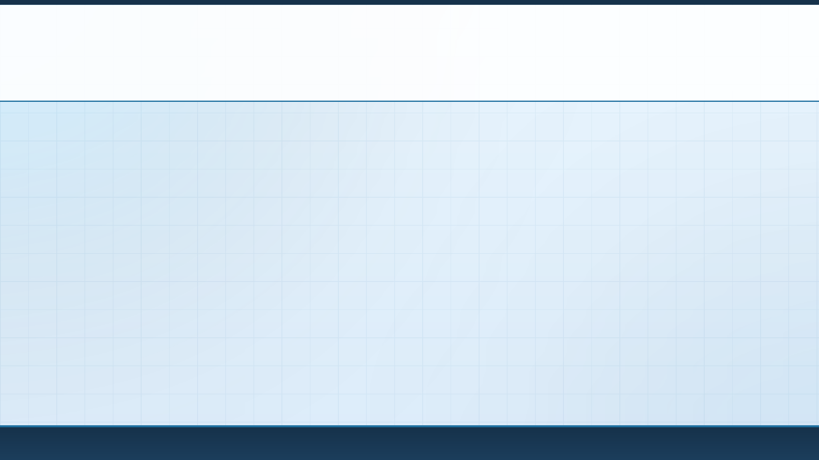




IDEA SUBMISSION
AI-POWERED CYBER INVESTIGATION & DIGITAL FORENSICS HACKATHON
Problem Statement ID
PS-01 — Building an AI-Powered Indigenous Digital Forensics Investigation Framework
Theme
AI-Powered Cyber Investigation, Incident Response & Digital Forensics Technologies
Team Name (registered on portal)
Team SUTRA-Trace
Team: Team SUTRA-Trace
Idea Submission · Where Every Trace Connects
01

Slide 2

02
TEAM DETAILS
A team may have up to 4 members. Fill in only the cards you need and delete the rest.
01
TEAM LEADER
SECTOR A · VAULT
02
MEMBER
SECTOR B · TRIAGE
Full Name
[Team Leader Name]
Full Name
[Member 2 Name]
Branch / Year
CSE / Cyber Security
Branch / Year
AI & Machine Learning
Email
[Email]
Email
[Email]
Phone
[Phone]
Phone
[Phone]
03
MEMBER (if applicable)
SECTOR C · GRAPH
04
MEMBER (if applicable)
SECTOR D/E · LEGAL/UI
Full Name
[Member 3 Name]
Full Name
[Member 4 Name]
Branch / Year
Data Science / Financial Engineering
Branch / Year
Cyber Law & Forensic Analytics
Email
[Email]
Email
[Email]
Phone
[Phone]
Phone
[Phone]
Team: Team SUTRA-Trace
Idea Submission · Where Every Trace Connects
02

Slide 3

03
IDEA TITLE
WHAT TO COVER
PROPOSED SOLUTION — describe your idea / solution / prototype
AI finds the lead. Byte offsets prove it in court.
Detailed explanation of the proposed solution
How it addresses the problem
Innovation and uniqueness of the solution
THE PROBLEM
THE SOLUTION
WHY IT'S UNIQUE
CRISIS AT THE FRONTLINE
3-STAGE SMART FORENSICS
CUSTODY BRIDGE, 3 CASES
₹15L–₹25L per seat a year for foreign black-box suites
14–21 day backlog per 4 TB dump; fails Sec. 45 BSA scrutiny
No Sec. 63 BSA or Sec. 105/106 BNSS support since July 2024
Blind to Digital Arrest deepfakes, F2FS RATs, UPI→USDT
Acquire: $MFT, $UsnJrnl, SQLite WAL, F2FS, VBS RAM in <3 min
Analyse: 7-bit INT8 triage at >99% recall, symbolic check to <0.5% FPR
Report: 1-click Sec. 63 BSA PDF/A-1b + FINnet 2.0 STR XML
(A) Victim device: owner signs Part A
(B) Seized device: primary evidence, Sec. 57 Expl. 5 BSA; I.O. signs workstation Part A
(C) Bank / TSP: Sec. 94 BNSS summons
Part B = raw hex offsets, checkable with dd / b3sum
→ leads ≠ court proof
>99%
neural triage recall
<0.5%
false positives after symbolic check
100%
findings pinned to raw byte offsets
<3 min
Phase-1 volatile triage
BEFORE 14–21 days manual carving → NOW <3-min Phase-1 triage → OUTPUT Sec. 63 BSA dossier
BRIDGE neural recall + deterministic byte-offset proof = one engine
Team: Team SUTRA-Trace
Idea Submission · Where Every Trace Connects
03

Slide 4
04
TECHNICAL APPROACH
WHAT TO COVER
YOUR TECHNICAL APPROACH — diagrams and screenshots welcome
Four engines turn raw silicon into verifiable leads.
Technologies to be used (e.g. programming languages, frameworks, hardware)
Methodology and process for implementation (flow charts / images / working prototype)
01
INGESTION
→
02
NEURAL TRIAGE
→
03
T-PKG GRAPH
→
04
LEGAL DOSSIER
eBPF · VBS RAM · F2FS · 1-PPS
deepfake · RingRTC · APK · DeFi
harmonic GRU + PCST (next)
Sec. 63 BSA · BNSS (next)
PILLAR 1 · RUST / GO / eBPF
PILLAR 2 · PYTHON / ONNX INT8
KERNEL INGESTION VAULT
MULTI-MODAL NEURAL TRIAGE
eBPF write/TRIM blocker: NVMe 0x09 TRIM + APST=0; SCSI 0x2A / 0x42 UNMAP
VBS/HVCI-safe Win 11 RAM: SysDbg 37 dump, BitLocker FVEK, TPM2_Quote
Android 14+ F2FS carver: gc_urgent=0, CP1/CP2 diff, orphan 0xF2F5 inodes
Integrity: SIMD BLAKE3 Merkle + piecewise valid-extent SHA-256
Deepfake physiology: jaw→forehead PTT lag 12–45 ms; shaders show ≈ 0 ms
Windkessel + VAE: dicrotic ratio 0.15–0.48; KL-VAE lattice spike > 2.45
WhatsApp RingRTC carver: srflx IP:port → Sec. 94 BNSS IPDR notice
SecBERT LOLBins + polyglot lattice for JPEG+ZIP+DEX chimeras
→ 0 bytes written to evidence
→ ranked leads at >99% recall
STACK
Rust
Go
Wasmtime
eBPF
PyTorch
ONNX INT8
Q16.16 LUT
BLAKE3
Streamlit
HARDWARE
16 GB CPU-only LEA laptop
NavIC / GPS 1-PPS receiver
Faraday seizure bags
Team: Team SUTRA-Trace
Idea Submission · Where Every Trace Connects
04

Slide 5
04
TECHNICAL APPROACH (contd.)
WHAT TO COVER
YOUR TECHNICAL APPROACH — diagrams and screenshots welcome
From seizure seal to court certificate, in one cockpit.
Technologies to be used (e.g. programming languages, frameworks, hardware)
Methodology and process for implementation (flow charts / images / working prototype)
01 INGEST
02 TRIAGE
03 CORRELATE
04 REVIEW
05 DOSSIER
Write-blocked image + seizure video
INT8 deepfake, VoIP, APK, LOLBin scans
T-PKG graph + PCST storyline
Analyst + 14-point exculpatory check
Sec. 63 BSA PDF/A-1b + FINnet XML
→ R_case root
→ ranked leads
→ attack graph
→ audit ledger
→ court + FIU
PILLAR 3 · T-PKG
PILLAR 4 · BSA 2023
WORKING PROTOTYPE
PROVENANCE GRAPH
LEGAL DOSSIER
CYBER COCKPIT, LIVE
32-byte CSR arena: 4M edges in 128 MB; graph RAM < 210 MB
Harmonic time: [cos | sin | ln(1+|Δt|)] stops sleeper aliasing
Deterministic PCST: ties broken by disk offset → bit-identical graphs
Money trail: UPI RRN → EVM/TRON USDT bridge affinity
Byte-offset pinning: device, offset, length, proof per finding
Sec. 63 BSA Part A + B auto-filled; Sec. 39 BSA / 79A IT Act tracks
Sec. 105 BNSS video: 50 Hz ENF hum, Δφ < 0.08 rad flags splices
Sec. 106 BNSS seals: 3-point optical PUF Faraday ledger
Q1
R_case root + ENF gauge
Q2
PTT 0.2 ms → FAKE
Q3
25-node PCST graph
Q4
Export Sec. 63 + STR XML
sector_a_vault · sector_b_triage · sector_c_graph · sector_d_legal · sector_e_dashboard · main.py
Golden benchmark: < 2 s end-to-end
share.gemini.google/VGvgu3LxFA4E
→ same graph every run
→ Sec. 63 BSA PDF/A-1b
Team: Team SUTRA-Trace
Idea Submission · Where Every Trace Connects
05

Slide 6
05
FEASIBILITY AND VIABILITY
WHAT TO COVER
YOUR FEASIBILITY ANALYSIS
Runs on a 16 GB police laptop. No GPU, no cloud.
Analysis of the feasibility of the idea
Potential challenges and risks
Strategies for overcoming these challenges
16 GB
7-bit
0 B
<210 MB
standard LEA laptop, zero GPU
INT8 weights, no CPU overflow
written to evidence
graph RAM, 4M+ edges
TECHNICAL
OPERATIONAL
ECONOMIC
BOUNDED, BIT-EXACT
FITS THE CYBER CELL
ZERO LICENCE, LONG LIFE
4 MB mmap ring per thread + MADV_DONTNEED
Sparse-extent skip; E01 / AFF4 via 16 MB ring
Bit-exact: 255·63·2 = 32,130 fits int16
Thermal cap: max 4 threads
100% air-gapped, zero cloud egress
ISO/IEC 27037 acquisition workflow
Interoperable: Autopsy, FTK, Wireshark
NavIC 1-PPS + RFC 3161 time anchors
₹0 licensing vs ₹15L–₹25L per seat
₹150–₹250 Cr saved yearly, 1,000+ districts
5+ year life for existing 16 GB PCs
No 450 W GPU servers to buy
16 GB LAPTOP MEMORY BUDGET (MB) · ACTIVE ≈ 422 MB
>97%
of 16,384 MB left for OS + acquisition
I/O rings 16
E01 ring 16
CSR edges 128
WL sketches 82
INT8 ONNX 180
Team: Team SUTRA-Trace
Idea Submission · Where Every Trace Connects
06

Slide 7
05
FEASIBILITY AND VIABILITY (contd.)
WHAT TO COVER
YOUR FEASIBILITY ANALYSIS
Built to survive anti-forensics and cross-examination.
Analysis of the feasibility of the idea
Potential challenges and risks
Strategies for overcoming these challenges
RISK 1 · ANTI-FORENSICS
RISK 2 · TECHNICAL
TIMESTOMPING & VSS WIPING
SUPERNODES & PARSER BOMBS
→ STRATEGY: 5-invariant timestamp matrix
→ STRATEGY: CamFlow split + Wasmtime sandbox
$MFT LSN @0x08 + $SI USN @0x28 must rise with time
100-ns tick entropy: t mod 10^7 = 0 exposes SetMace
$UsnJrnl + raw VSS carve split copies from backdates
64 MB zero-syscall sandbox, 50M fuel cap, 64:1 breaker
Brent's cycle guard: MaxDepth ≤ 65,536
Inverse log-degree gating splits svchost-type hubs
RISK 3 · MEDIA DECAY
RISK 4 · LEGAL
FLASH DEGRADES BEFORE TRIAL
SEC. 45 BSA TROJAN DEFENCE
→ STRATEGY: Piecewise valid-extent SHA-256
→ STRATEGY: Exculpatory ledger + salted Merkle
Bad sectors isolated (0xDEADBEEF) in a signed manifest
Dual hashes: linear + piecewise over healthy bitmask M
eBPF write-block keeps the image intact in the malkhana
14-point intrusion checklist: RDP, AnyDesk, SSH, rootkits
pruned_telemetry_audit.parquet keeps pruned edges
DPDP-safe annexes: salted BLAKE3; clone intact (Sec. 230)
ADVERSARIAL SURVIVAL 100% cyclic-trap neutralisation · 0-byte image mutation · 100% BSA 2023 admissibility
Team: Team SUTRA-Trace
Idea Submission · Where Every Trace Connects
07

Slide 8
06
IMPACT AND BENEFITS
WHAT TO COVER
YOUR IMPACT AND BENEFITS
Faster triage, safer convictions, zero foreign licences.
Potential impact on the target audience
Benefits of the solution (social, economic, environmental, etc.)
I4C & MHA PRIORITY THREATS Digital Arrest deepfakes · UPI mule chains · sideloaded Android RATs
LAW ENFORCEMENT
JUDICIARY
ATMANIRBHAR BHARAT
<15 min
100%
₹150–250 Cr
triage, down from 14–21 days
events hash-linked to evidence
saved yearly, 1,000+ districts
<3-min Phase-1 capture
One cockpit replaces 5+ tools
Sec. 63 BSA certificate automated
No black-box AI to attack
₹15L–₹25L per seat avoided
FINnet 2.0 XML golden-hour freezes
Capability | Foreign suites | SUTRA-Trace
Annual cost per seat | ₹15,00,000 – ₹25,00,000 | ₹0 · indigenous
Sec. 63 BSA certificate | None · drafted by hand | Automated, 3 scenarios
Sec. 105/106 BNSS chain | Absent | ENF hum + optical PUF seals
Indian money trails | Blind to UPI / NPCI RRNs | UPI RRN + DeFi + FINnet 2.0
Court reproducibility | Black-box scores | dd / sha256 / b3sum offsets
SOCIAL
victim relief, PII-safe
ECONOMIC
₹150+ Cr public savings
GREEN
5+ yr PC life, no GPUs
Team: Team SUTRA-Trace
Idea Submission · Where Every Trace Connects
08

Slide 9
07
RESEARCH AND REFERENCES
WHAT TO COVER
YOUR RESEARCH AND REFERENCES
Every claim traces to a statute, paper or dataset.
Details / links of the reference and research work
STATUTORY
NFSU
STATUTES & PRECEDENTS
NFSU SCHOLARSHIP (P. H. RUGHANI)
[S1] BSA 2023, Sec. 39(1)–(2), 45, 57 (Expl. 5), 63
[S2] BNSS 2023, Sec. 94, 105, 106, 230 · IT Act Sec. 79A
[S3] DPDP 2023 s.17 · PMLA s.17(1A), Rule 8 · ISO/IEC 27037
[S4] Arjun Panditrao Khotkar v. Kailash Gorantyal, (2020) 7 SCC 1
[S5] Gopalkrishnan @ Dileep v. State of Kerala, (2019) 9 SCC 166
[S6] State of H.P. v. Jai Lal, (1999) 7 SCC 280
[S7] K.S. Puttaswamy v. Union of India, (2017) 10 SCC 1
[N1] Gogia, S. & Rughani, P. H. (2023). SynFO, NFSU Gandhinagar
[N2] Rughani, P. H. et al. FSAGen & PAREX file-system validation
[N3] Rughani, P. H. Smart Acquisition, Analysis & Reporting
LITERATURE
DATASETS
TIER-1 PROVENANCE & DEEPFAKE
BENCHMARKS & BLUEPRINT
[L1] Cheng et al. KAIROS, IEEE S&P 2023
[L2] Rossi et al. TGN, 2020 · Han et al. UNICORN, NDSS 2020
[L3] Pasquier et al. CamFlow, 2017 · Zeng et al. SHADEWATCHER, 2022
[L4] Wang et al. POS rPPG, 2017 · Wang et al. DIRE, ICCV 2023
[D1] DARPA TC Engagement 3 / 5 (CADETS, THEIA, TRACE)
[D2] NIST CFReDS & CFTT
[D3] CCCS-CIC-AndMal-2020 · CSE-CIC-IDS2018
[B1] Live architecture blueprint:
share.gemini.google/VGvgu3LxFA4E
SUTRA-Trace: where every fragmented trace connects with cryptographic certainty.
Team: Team SUTRA-Trace
Idea Submission · Where Every Trace Connects
09

