Slide 1
Cursus web development
Dag 1

Slide 2
Introductie
3-daagse cursus basic web development
2 dagen front-end
1 dag back-end
Vandaag
Version Control – GIT
MVC Patroon
Javascript & jQuery

Slide 3
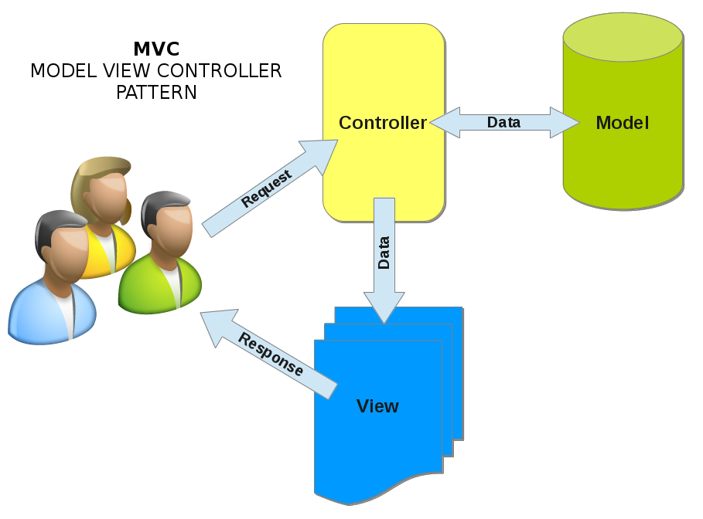
MVC Patroon

