Slide 1
Data Visualization
IT Elective 4

Slide 2
Data Visualization Best Practices
Now that you have a grip on what is data visualization, what it’s used for, and the types of charts, infographics and graphs you can make, let's arm you with important best practices.
These will help make sure your data visualization is on point and error-free.

Slide 3
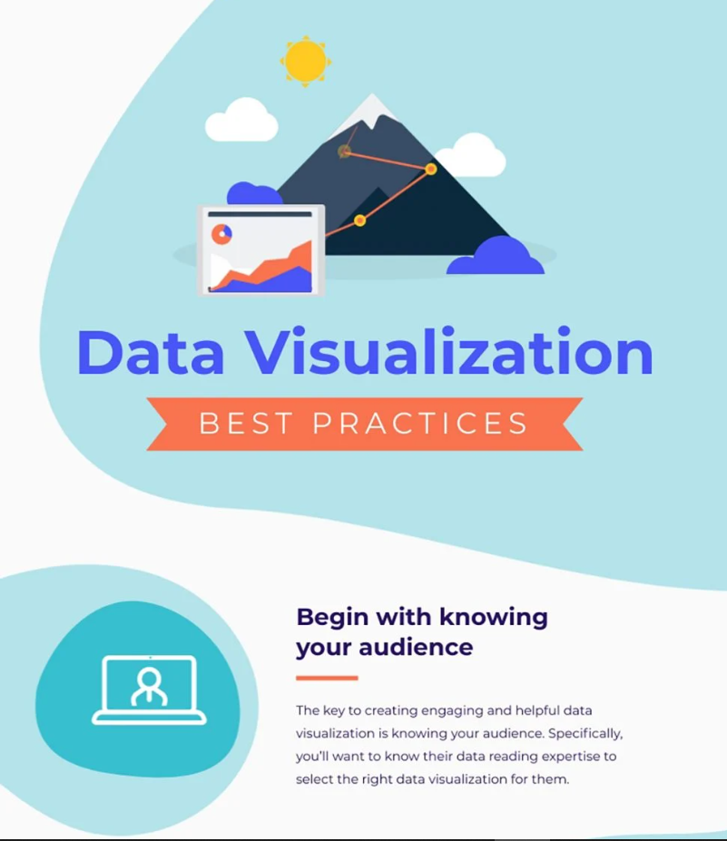
1. Begin with knowing your audience.
The key to creating engaging and helpful data visualization is knowing your audience. You’ll want to know their data reading expertise to select the right data visualization for them.
For instance, a student in a business school can better understand line graphs than a high schooler.
Similarly, not everyone understands spider charts. But if you put one in front of a human resource department, the team would read them just right.

Slide 4
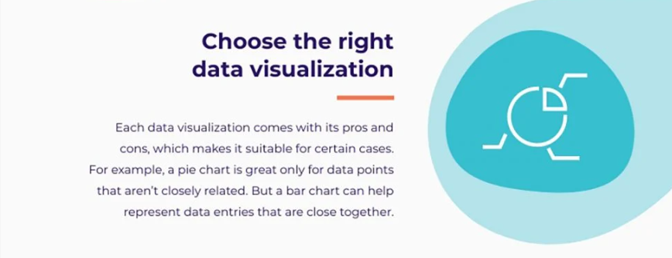
2. Choose the right data visualization.
Each data visualization comes with its pros and cons, which makes it suitable for certain cases.
For example, a pie chart is great only for data points that aren’t closely related. But a bar chart can help represent data entries that are close together.
Similarly, a comparison infographic is great for drawing comparisons between 2-3 concepts.
If you want to compare parts of a whole against other points, you’ll find that a stacked bar chart does this job well with its segmented bars representing parts of a whole.

Slide 5
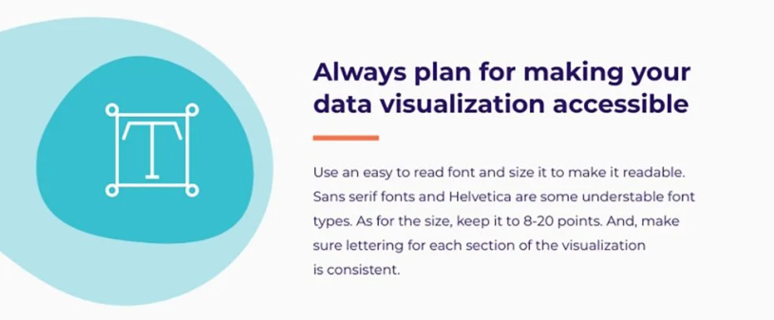
Use an easy-to-read font and size it to make it readable. Sans serif fonts and Helvetica are some understandable font types. As for the size, keep it to 8-20 points. And, make sure lettering for each section of the visualization is consistent.
Select colors that are easy on the eye. Use a tool like Coolors to create color palettes based on colors that go with each other.
Make your visualization accessible for color blind people. Some ways to do so include using patterns to show contrast and using clearly contrasting colors in your charts. Blue and purple, green and brown, blue and grey and green and grey are some color combinations that color blind folks can’t make out.
3. Always plan for making your data visualization accessible.
This is so that your audience can understand your visualization.
Some ways you can make designs understandable are:

Slide 6
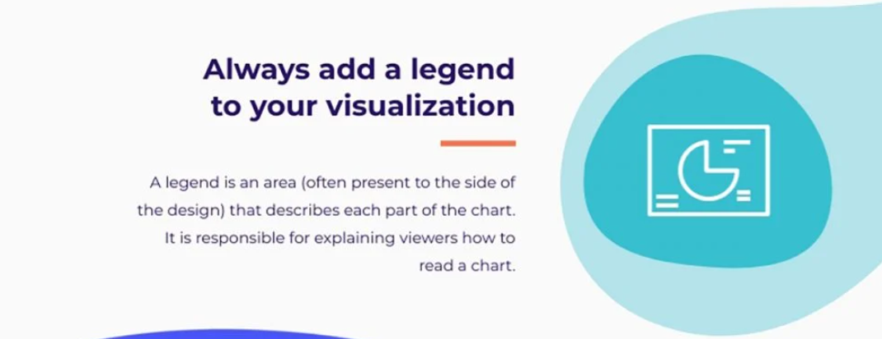
4. Always add a legend to your visualization.
Whether it’s a chart or a graph that you’re using, you’ll need to add a legend to the side. A legend is an area, often present on the side, that describes each part of the chart.
But what does it help with? A legend is chiefly responsible for explaining to viewers how to read a chart.
Suppose you’ve used different colors in the visualization. To tell which color represents what, use the legend to explain which color stands for what.
Look at the legend in this design to get a better idea.

Slide 7
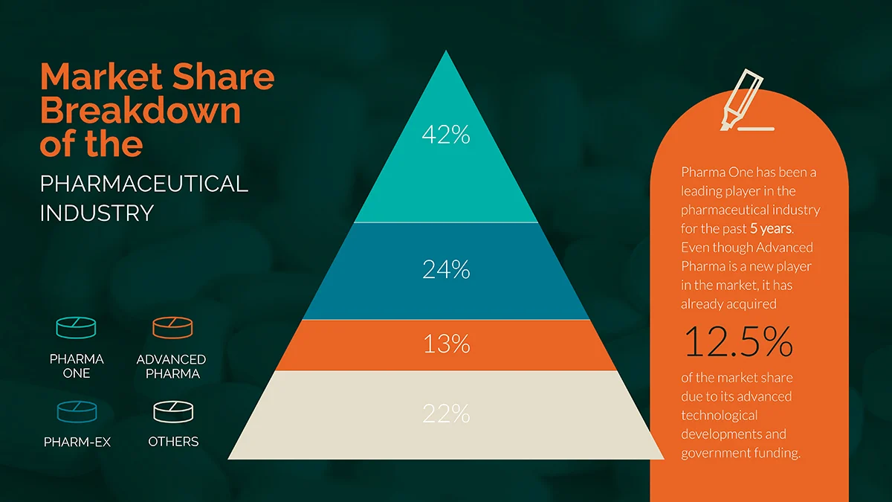

Slide 8
5. Use the right data visualization tools.
It’s also helpful to use a data visualization tool that meets your needs and is easy to use as well.
If you’re looking to make visually appealing infographics in PowerPoint, for example, you’ll have a hard time since it can help you with simple charts and graphs only.

Slide 9
Quiz
__________ is the key to creating engaging and helpful data visualizations by determining the level of understanding of the viewers.
A __________ should always be added to a chart or graph to explain what different visual elements represent.
Fonts such as Helvetica and other __________ fonts are recommended to improve readability in data visualizations.
A __________ chart is ideal when you want to represent parts of a whole using segmented bars.
Tools like __________ can help you build color palettes with combinations that are visually appealing and accessible.
Notes:
1. Knowing your audience
2. Legend
3. Sans serif
4. Stacked bar
5. Coolors

Slide 10
Quiz
Which of the following is an important first step in creating a data visualization?
A. Choosing the color scheme
B. Knowing your audience
C. Adding animations
D. Using a legend
Notes:
Correct Answer: B

Slide 11
Quiz
Why is it not advisable to use pie charts for closely related data points?
A. They are hard to color
B. They are better for text
C. They don’t clearly show comparisons
D. They are outdated
Notes:
Correct Answer: C

Slide 12
Quiz
What makes a data visualization accessible for color-blind viewers?
A. Using only red and green colors
B. Adding background music
C. Using patterns and high-contrast color combinations
D. Minimizing use of fonts
Notes:
Correct Answer: C

Slide 13
Quiz
What does a legend in a chart primarily do?
A. Makes the chart more colorful
B. Compares the data with other charts
C. Explains what each color or symbol in the chart represents
D. Shows the source of data
Notes:
Correct Answer: C

Slide 14
Quiz
Which of the following font types is recommended for better readability in visualizations?
A. Cursive
B. Gothic
C. Sans serif
D. Comic Sans
Notes:
Correct Answer: C

Slide 15
Thank you! ☺

