Slide 1
Data Visualization
IT Elective 4

Slide 2
Data Visualization
Data visualization is a fancy term for making graphs and charts to showcase your data and help make it easy (and visually appealing) to interpret that data.
Neptune
Mars
90%
It is the farthest planet from the Sun
Despite being red, Mars is a cold place

Slide 3
What is Data Visualization?
By way of a formal definition, data visualization is the graphical representation of data so that it’s easy to comprehend, analyze and present.
Data visualization is a lot more fun than the overwhelming vibes that the technical-sounding term gives off.
Marketers, scientists, teachers, and everyone in between uses them. In fact, even healthcare professionals have come to rely on data visualizations like infographics to make complicated topics easy to digest.
This infographic on COVID-19 is a prime example.

Slide 4
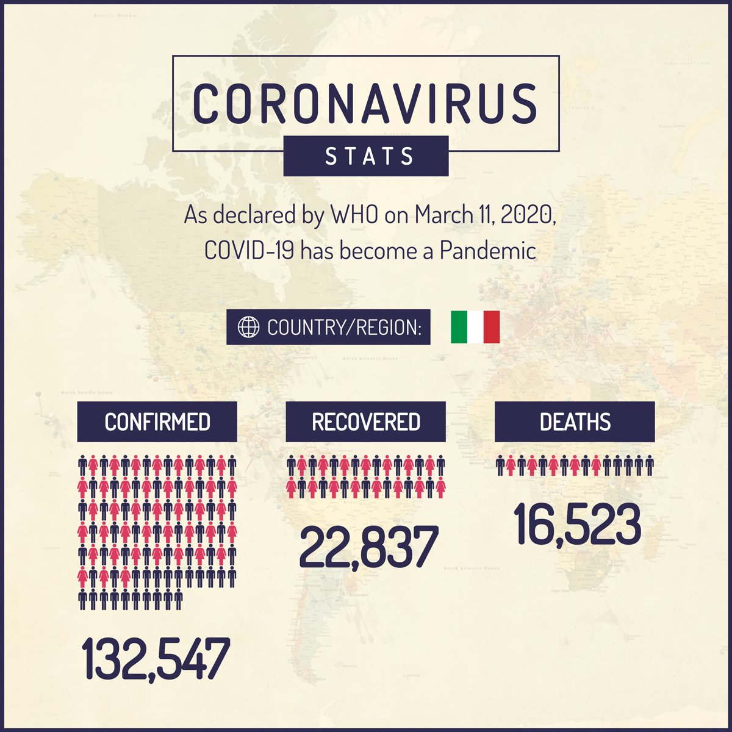

Slide 5
Why is Data Visualization Important?
1. Data visualization makes data easy to digest.
This, in turn, makes data engaging.
Think of it, really.
Would anyone believe if you told them about a trend you identified from all the data you’ve gathered? A handful of people might believe you.
But your finding won’t find a wider audience unless you put it into an easy-to-understand visualization as Hootsuite did with all the data they gathered over the year.

Slide 6
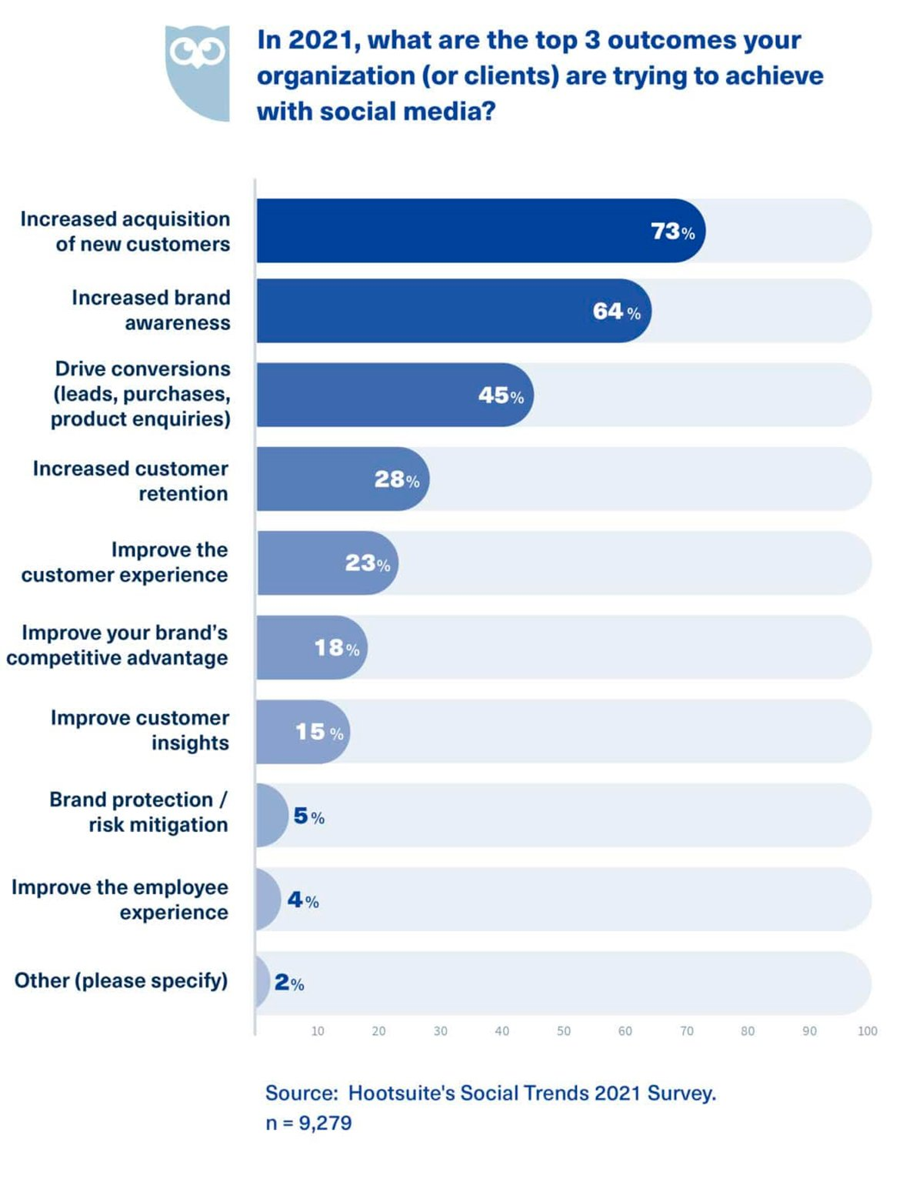

Slide 7
Why is Data Visualization Important?
2. It helps identify patterns within a given set.
Data has stories to tell as patterns, correlations, and trends emerge from it.
You might sniff a vital pattern or two in a data pile. But you can only make complete sense of it if you plot it into a graph or chart.
On top of that, data visualization helps you prove your point. Identified a trend? Great. Let the visualization like the one below do the talking for you.

Slide 8
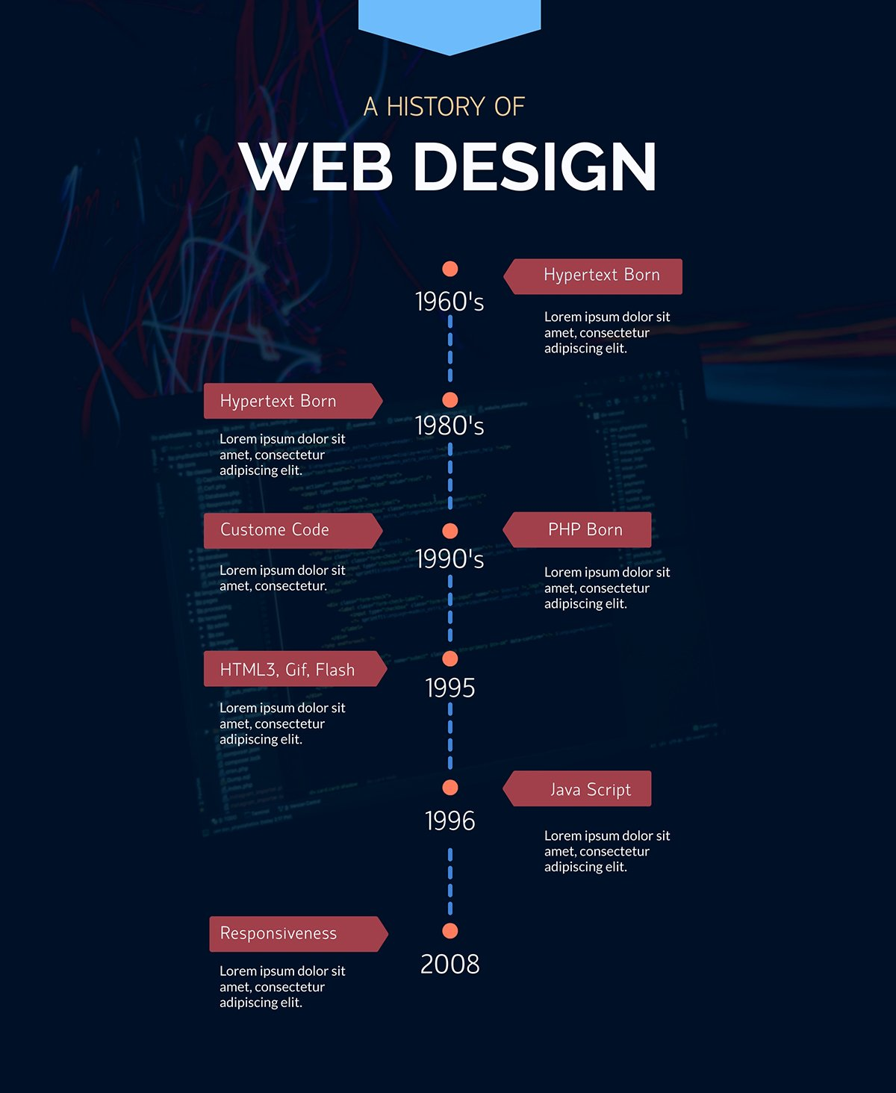

Slide 9
Why is Data Visualization Important?
3. It helps narrate a wider story.
This could be a story that you find within piles of data over time. Or, it could be complex information that’s not easy to explain with only text.
Either way, data visualization can help as it brings illustrations, widgets, and text together into visually appealing and easy-to-digest charts, graphs and infographics.
For a new freelancer, for instance, this infographic on how to take the perfect headshot is a useful way to deliver important information in a digestible and engaging format.

Slide 10
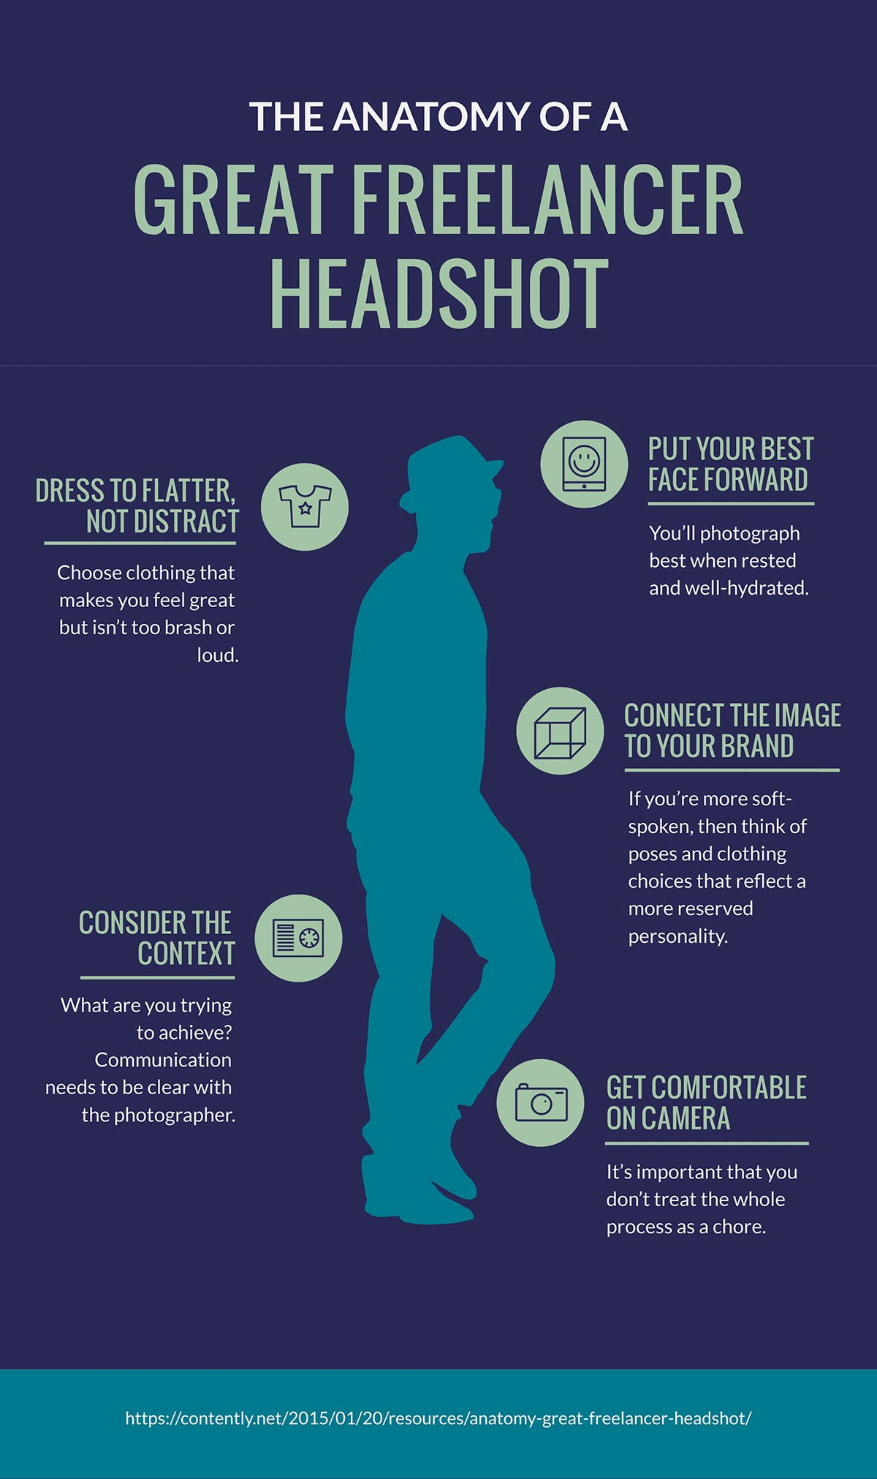

Slide 11
Why is Data Visualization Important?
4. It makes data more memorable.
In addition to all the analysis and storytelling, capturing important data points in visuals is an effective way to teach it. After all, the visual nature makes it easy for people to understand.
By extension, this makes it easy to recall all the data — giving it an extended life.
This visualization, Where The Wild Things Grow, is a good example of what we’re getting at. It’s an attractive chart showing where bioluminescence is present on Australia’s southeastern coast.

Slide 12
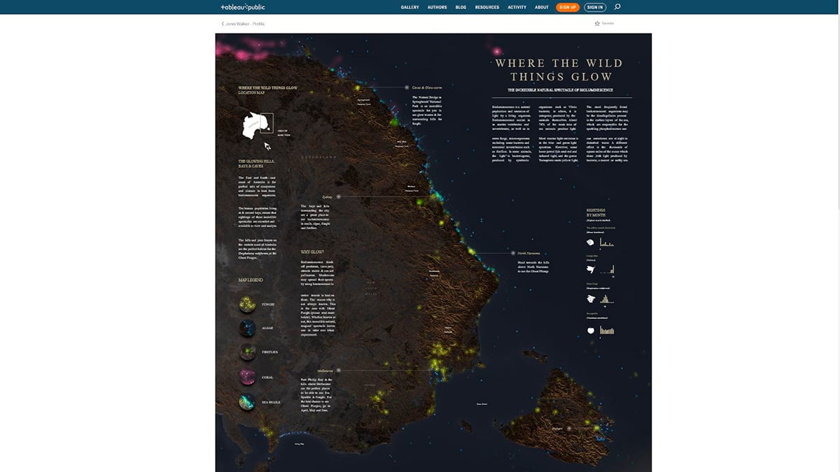

Slide 13
Thank you! ☺

Slide 14
QUIZ
The graphical representation of data so that it’s easy to comprehend, analyze and present.
2-5. List the four reasons why Data Visualization is Important.
6-8. List at least three group of individuals that rely on data visualization.
9. Which of these is a benefit of using data visualization to analyze data over several years?
Identifying frequency
Planning schedules
Predicting patterns
Evaluating risk
Notes:
1.

Slide 15
QUIZ
10. What does data visualization help you pinpoint by providing a visual view of all the data?
Frequency
Relationships
Value
Risk

