Slide 1




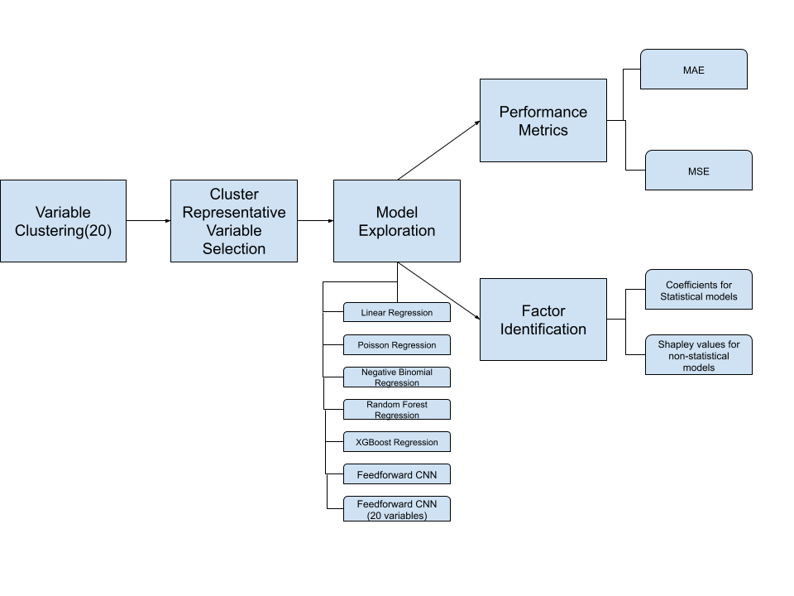
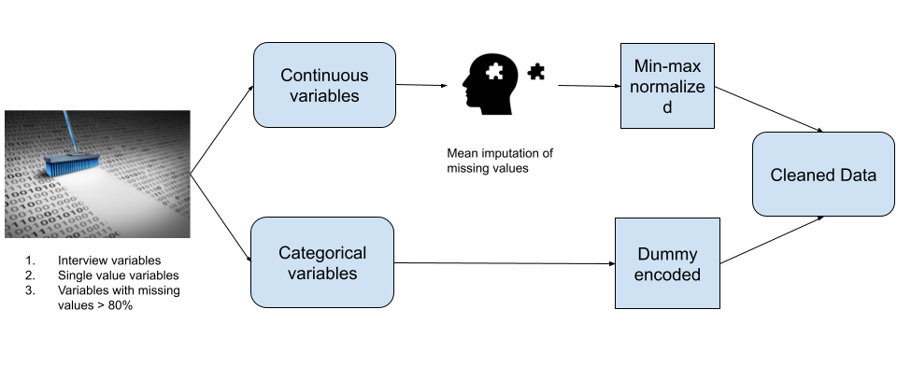

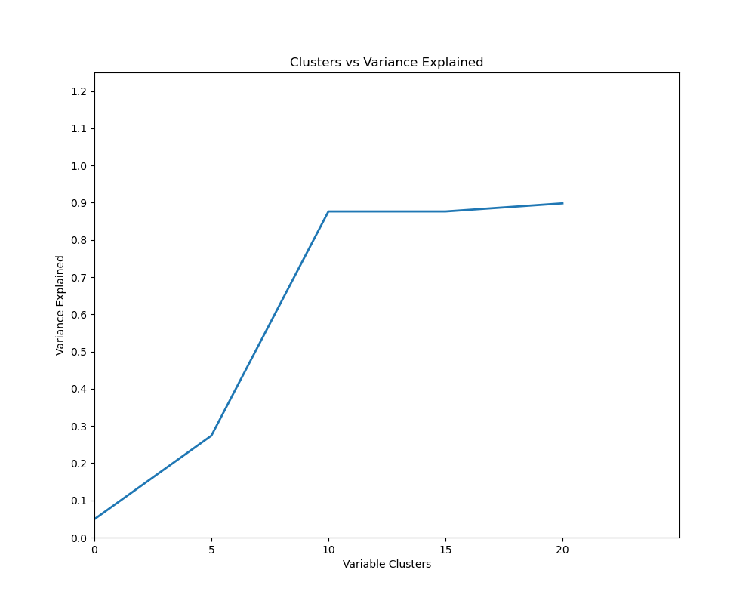
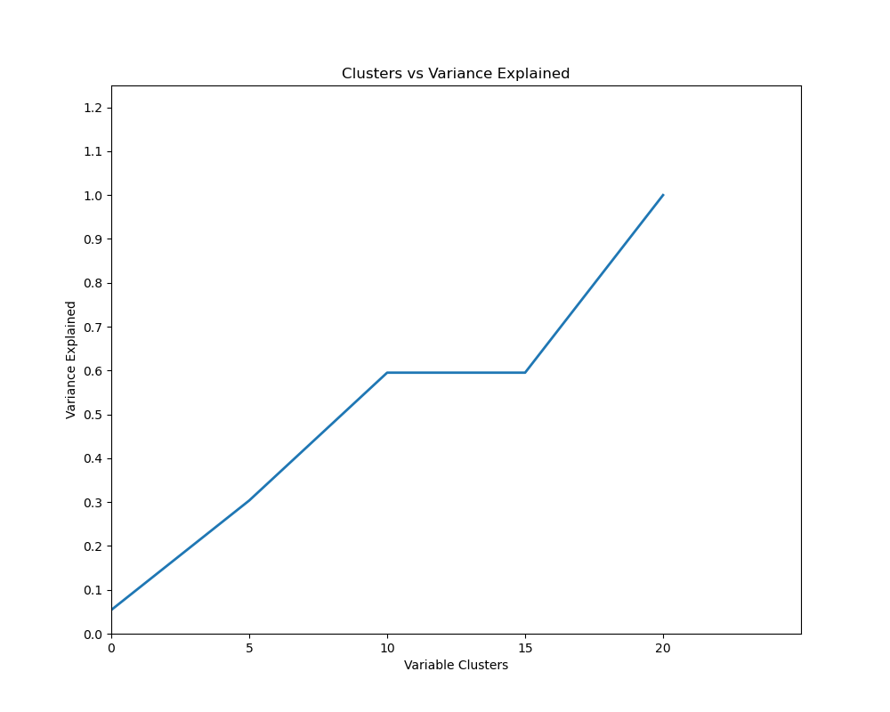

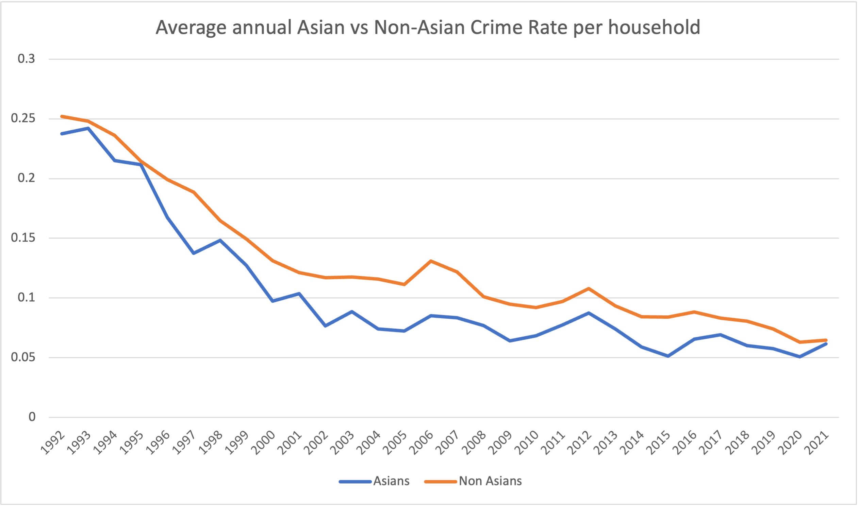
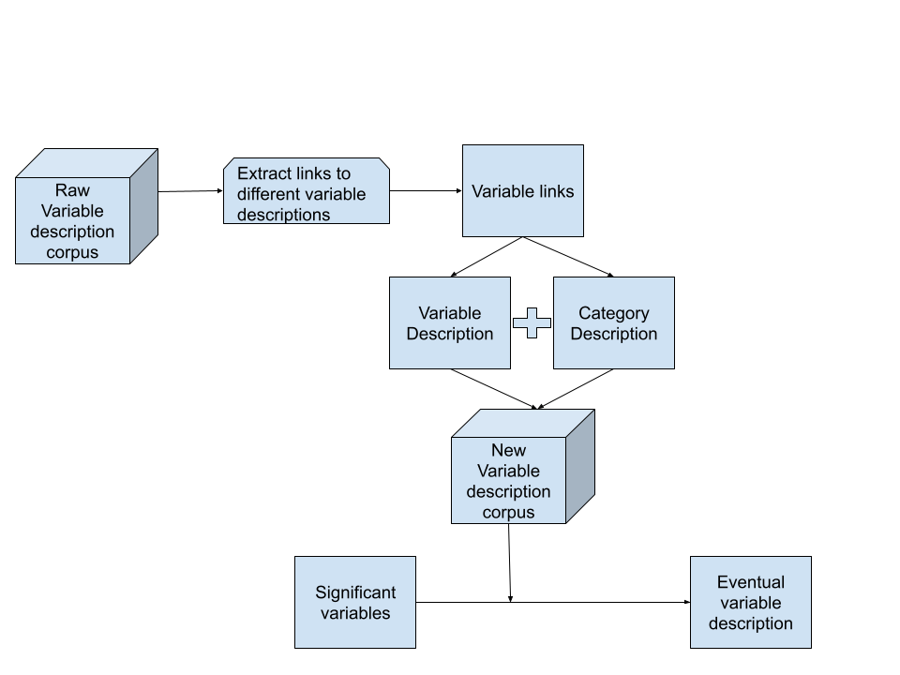
Have the key factors associated with crimes against Asians and Non-Asians changed in the US before and after COVID?
JITENDRA SAI KOTA, Dr. Sherry Ni (include contact)
KEY FACTORS
In 2019 (Before COVID):
For Non-Asians:
+ MSA, not city/ not MSA
+ phone in office
- Income in $40,000 to $49,999
- Non-permanent house unit
For Asians:
+ Income in $20,000 to $24,999
+ Non-permanent house unit
- Income in $75,000 to $99,999
In 2021 (After COVID):
For Non-Asians:
+ Mobile house unit/ hotel
- phone in office
- Not MSA
- Student quarters
For Asians:
+ Mobile house unit
- Less that 100000 people in the area.
- Living in rooming house
LinkedIn URL
INTRODUCTION
METHODOLOGY
COVID-19 amplifies hate crimes against Asians.
Not all Asian-targeted crimes stem from hate.
Limited analysis on Asian crime trends.
Statistical and Machine Learning models employed.
Unraveling factors unique to Asian crime rates.
Investigating pre and post-pandemic influences.
DATASET
Comprehensive crime data.
Includes victim demographics.
Dependent variable: incidents per
household.
4. Provides nuanced insights.
5. Enables longitudinal analysis.
6. Enhances understanding of crime
dynamics.
VARIANCE PROPORTION GRAPHS
POST Model Evaluation Web scraping
Most of the variables used in modeling are categorical in nature.
Knowing the variable description and its category description is crucial in gaining complete knowledge about the factors.
Need to create a new Variable description corpus to describe the dummy coded variables.
DISCUSSION on MODELS
MOTIVATION
Linear Regression struggled due to count-based data.
Poisson better but outmatched by ML models (RF, XG Boost).
CNN (20 variables) outperformed RF, XG Boost; NB excelled among 20-variable models.
Comparing CNN (all variables) to NB may be biased.
Non-Asians 2021
Asians 2021
EXPERIMENTAL ANALYSIS
 | Poisson (MSE,MAE) | Negative Binomial (MSE,MAE) | CNN (MSE,MAE) | CNN (MSE,MAE)(20) | Random Forest (MSE,MAE) | XG Boost Regressor (MSE,MAE)
NON-ASIAN (2019) | 0.232, 0.258 | 0.108, 0.127 | 0.099, 0.115 | 0.108, 0.130 | 0.109, 0.127 | 0.109, 0.127
ASIAN (2019) | 0.073, 0.104 | 0.072, 0.103 | 0.071, 0.109 | 0.131, 0.290 | 0.075, 0.104 | 0.076, 0.104
NON-ASIAN (2021) | 0.284, 0.312 | 0.097, 0.116 | 0.082, 0.096 | 0.097, 0.121 | 0.098, 0.116 | 0.098, 0.116
ASIAN (2021) | 0.507, 0.524 | 0.078, 0.109 | 0.077, 0.119 | 0.217, 0.425 | 0.080, 0.110 | 0.080, 0.110
CONCLUSION
This study shows that irrespective of the dataset size, traditional statistical models can still be applied efficiently to certain problems in a more effective way than the Machine Learning Models.
Also, they make for better explainability, because with SHAP values, one can only talk about the negative and positive impacts, but quantifying them with respect to the actual values is much harder.

