Slide 1






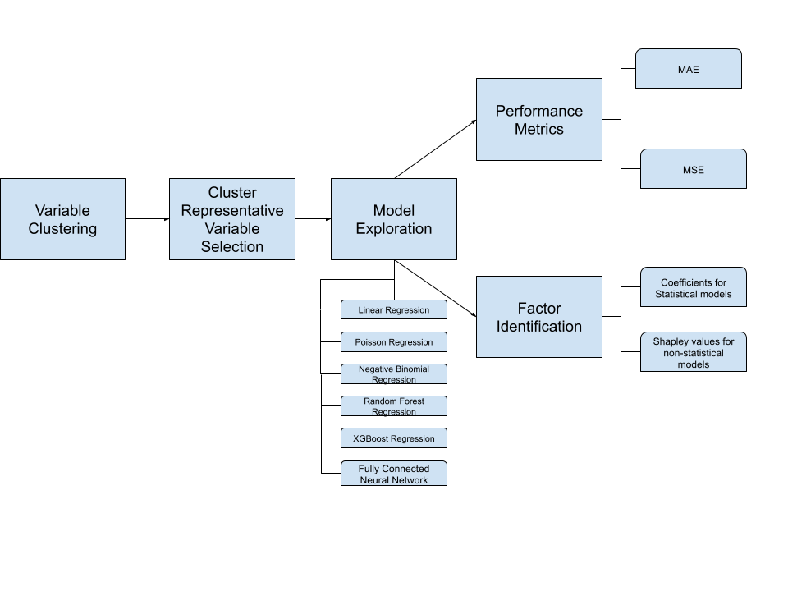
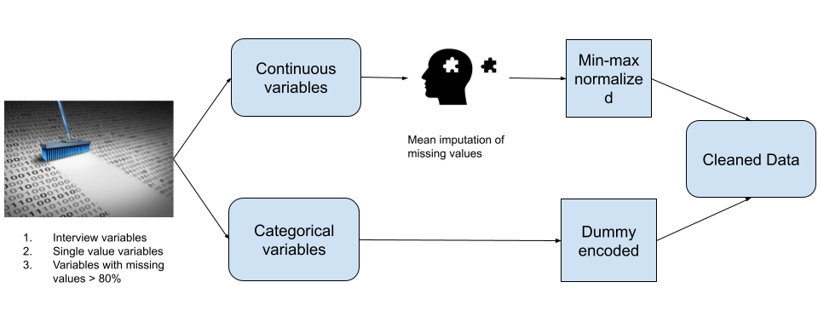

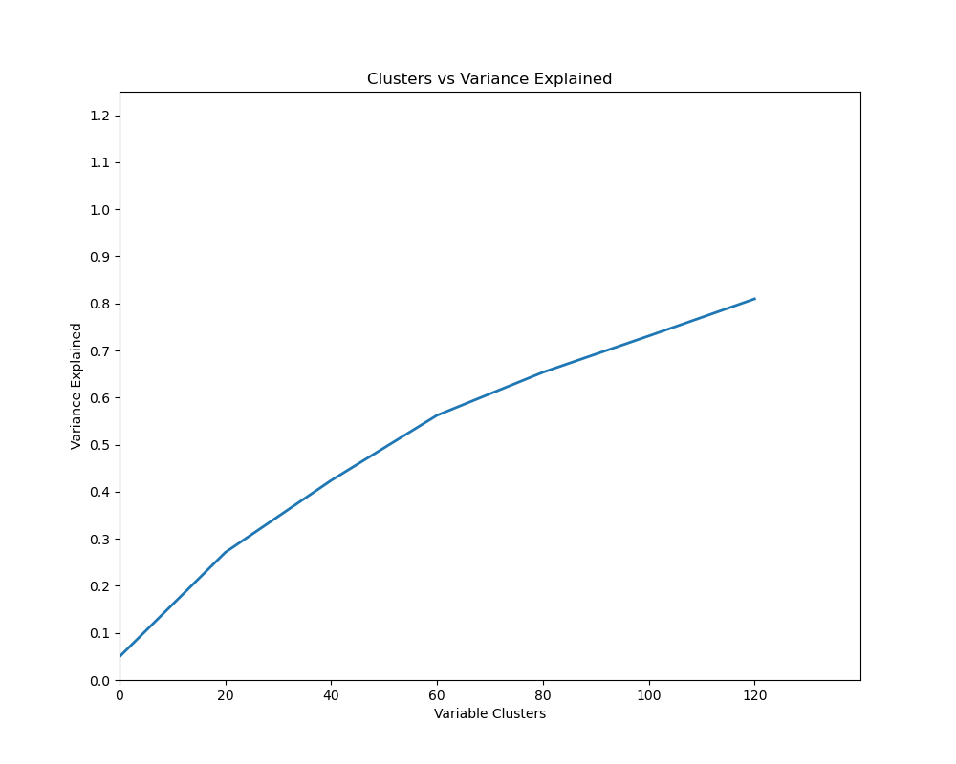


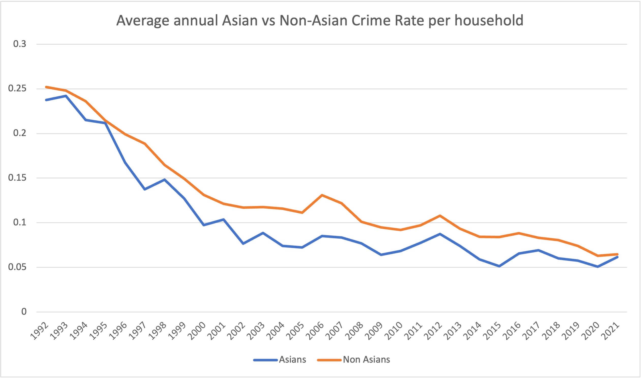
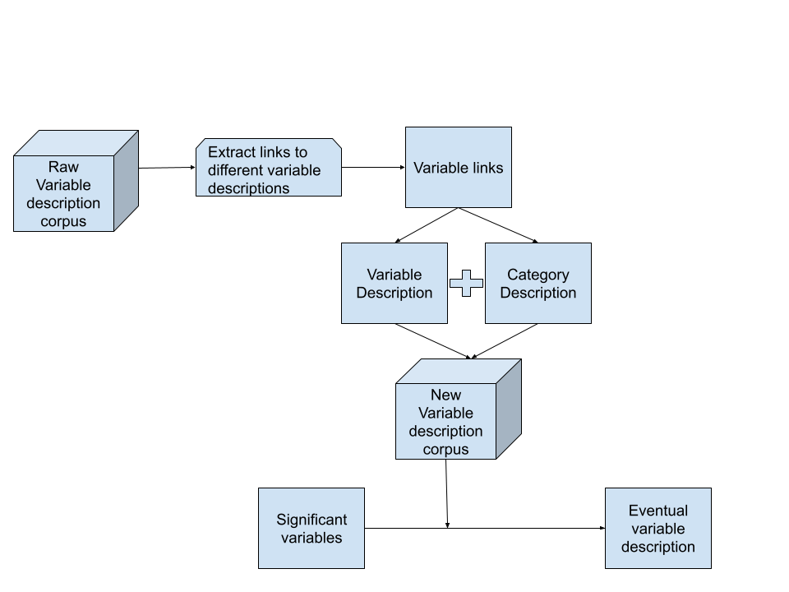
Have the key factors associated with crimes against Asians and Non-Asians changed in the US before and after COVID?
KEY FACTORS FOR LOW CRIMES
In 2021 (Before COVID):
For Non-Asians:
+ Household income range: 150,000 – 199,999
- Household income range: 25,000 – 29,999
- Western US
For Asians:
- Household income range: 100,000 – 149,999
- Household income range: 20,000 – 24,999
In 2019 (After COVID):
For Non-Asians:
+ Housing units in structure - Two
- Housing units in structure – Five to Ten
+ Household income range: 7,500 – 9,999
- Housing units in structure - Two
- Not a Metropolitan area.
- Place size : between 2.5 million to 5 million
For Asians:
- Southern US
- Place size – 250,000 – 499,999
Jitendra Sai Kota
(Ph.D. Student)
Dr. Sherry Ni
(Advisor)
Jitendra’s
LinkedIn URL
Poster download
INTRODUCTION
METHODOLOGY
COVID-19 amplifies hate crimes against Asians.
Not all Asian-targeted crimes stem from hate.
Limited analysis on Asian crime trends.
Statistical and Machine Learning models employed.
Unraveling factors unique to Asian crime rates.
Investigating pre- and post-pandemic influences.
DATASET
Comprehensive crime data.
Includes victim demographics.
Dependent variable: incidents per household.
Provides nuanced insights.
Enables longitudinal analysis.
Enhances understanding of crime dynamics.
VARIANCE PROPORTION GRAPHS
POST MODEL-EVALUATION WEB SCRAPING
Most of the variables used in modeling are categorical in nature.
Knowing the variable description and its category description is crucial in gaining complete knowledge about the factors.
Need to create a new variable description corpus to describe the dummy coded variables.
DISCUSSION ON MODELS
MOTIVATION
Linear Regression struggled due to count-based data.
Poisson better but outmatched by ML models (RF, XG Boost).
FCNN outperformed all the algorithms.
Negative Binomial showed performance on par with FCNN.
Non-Asians 2021
Asians 2021
EXPERIMENTAL ANALYSIS
 | Poisson (MSE,MAE) | Negative Binomial (MSE,MAE) | FCNN (MSE,MAE) | Random Forest (MSE,MAE) | XG Boost Regressor (MSE,MAE)
NON-ASIAN (2019) | 0.119, 0.137 | 0.104, 0.118 | 0.100, 0.116 | 0.124, 0.127 | 0.106, 0.117
ASIAN (2019) | 0.083, 0.110 | 0.075, 0.097 | 0.072, 0.101 | 0.088 0.108 | 0.097, 0.112
NON-ASIAN (2021) | 0.105, 0.124 | 0.091, 0.103 | 0.088, 0.102 | 0.112, 0.112 | 0.092, 0.103
ASIAN (2021) | 0.082, 0.108 | 0.082, 0.102 | 0.078, 0.108 | 0.087, 0.108 | 0.080, 0.110
CONCLUSION
Traditional statistical models can still be more effective and on par with Machine Learning Models.
Statistical models can also provide greater clarity in their explanations, compared to Machine Learning models.

