Slide 1


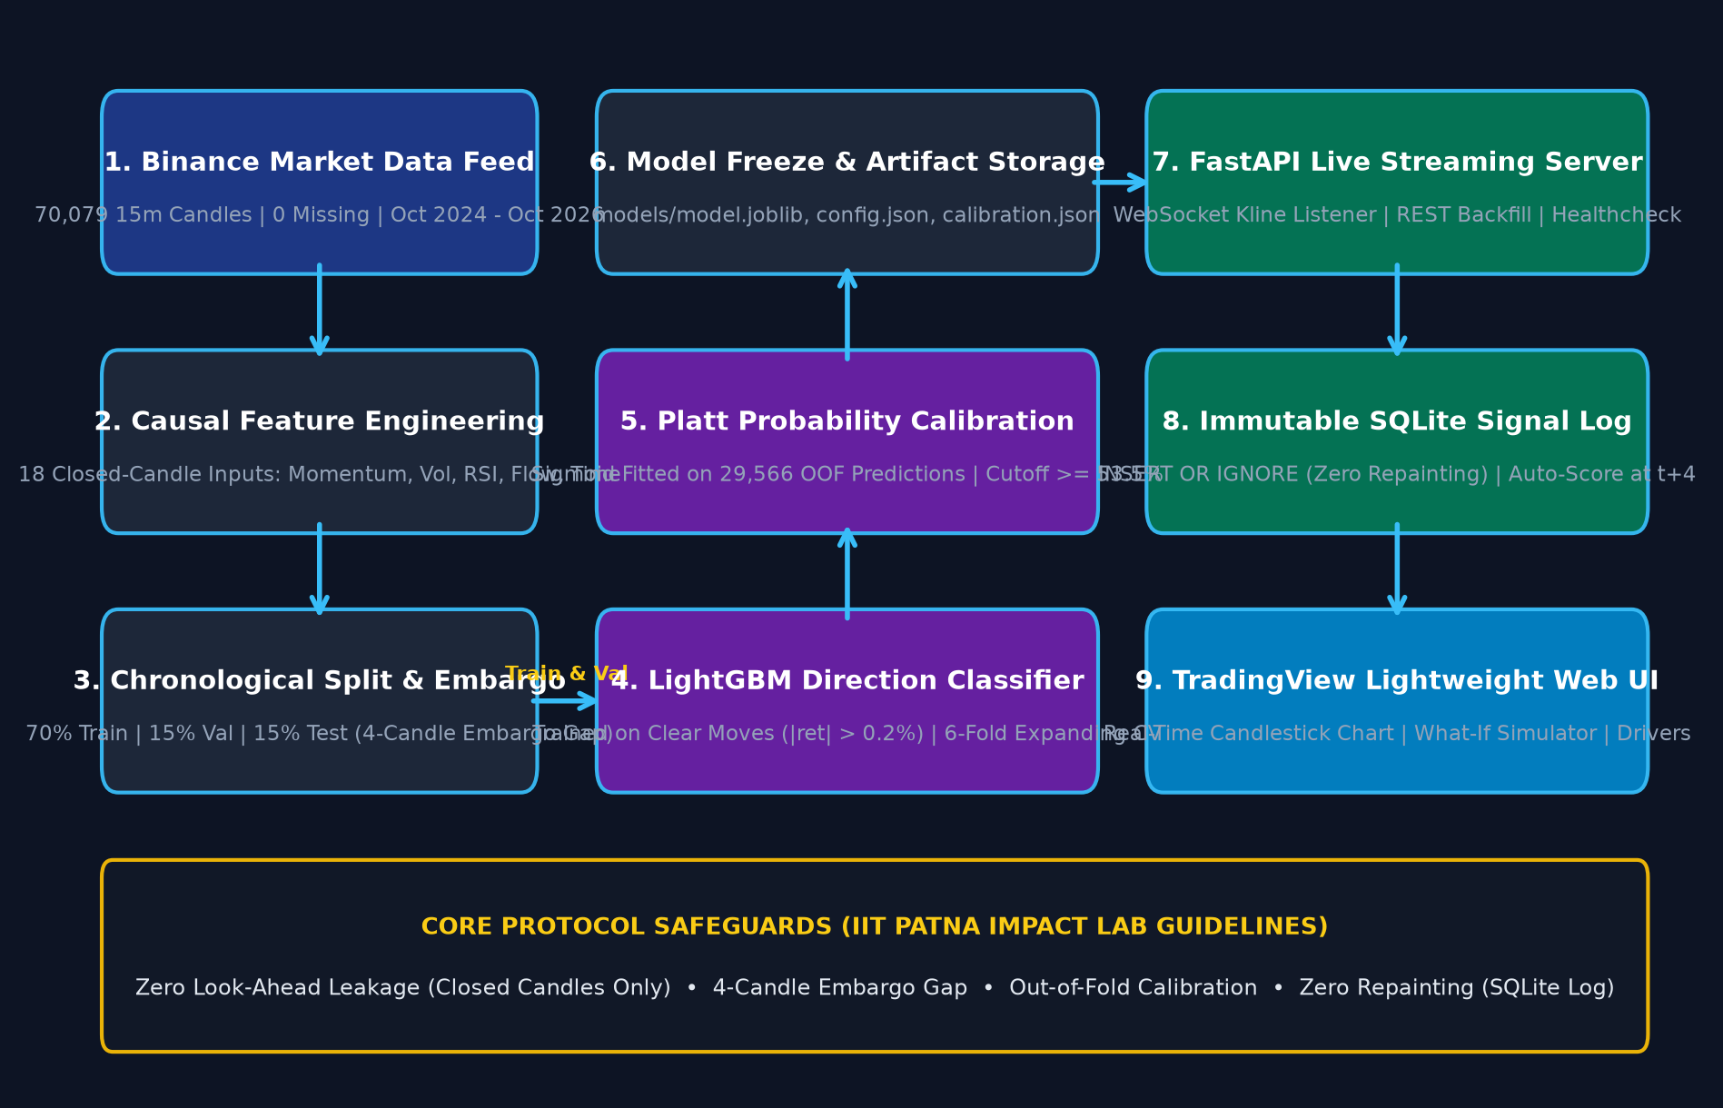
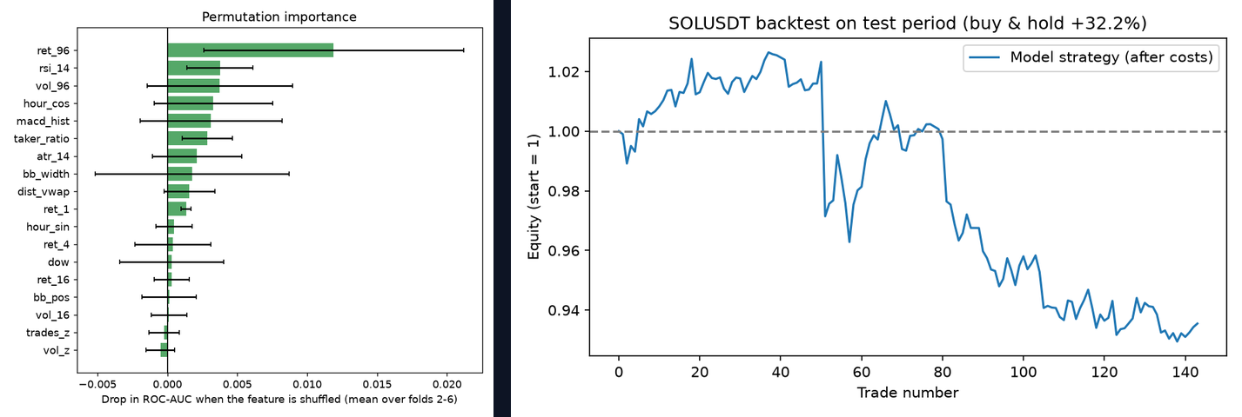
Leakage-Free Machine Learning Directional Predictor & Calibrated Indicator for Solana Trading
Kardam Shiv (Roll: 2201CS01) | Supervisor: Dr. Research Supervisor
IMPACT Lab, Department of Computer Science & Engineering, Indian Institute of Technology Patna
1. Abstract & Problem Statement
2. Methodology & System Architecture
3. Results & Performance Discussion
Abstract
High-frequency cryptocurrency markets exhibit severe non-stationarity, microstructure noise, and regime shifts. Existing technical indicators suffer from lookahead bias and indicator repainting, producing inflated paper returns that collapse in live execution [1]. We present an end-to-end leakage-free machine learning framework for Solana (SOLUSDT) 15-minute directional prediction over a 1-hour forward horizon (4 bars). Evaluated across 70,079 Binance klines (2024–2026), our LightGBM model achieves 54.7% Purged Cross-Validation accuracy and 58.3% test accuracy at high confidence, outperforming baseline models with 0 repainting.
Introduction & Motivation
• Cryptocurrency trading requires robust probabilistic direction estimates under significant volatility [1].
• Traditional momentum indicators (RSI, MACD) generate high false-positive rates and repaint historical signals.
• Machine learning models often suffer from catastrophic leakage via rolling scalers or overlapping forward return targets [2].
Problem Statement
Develop a strictly leak-free directional predictor and production streaming architecture that forecasts 1h SOLUSDT price direction with calibrated probabilities, statistically significant edge over random walk, and zero live repainting.
Key Contributions
1. Strict Point-in-Time Pipeline: 33 features computed exclusively on closed bars (t <= T).
2. 5-Fold Purged & Embargoed CV: Prevents target overlap leakage across train/validation splits.
3. Post-Hoc Platt Calibration: Corrects tree probability distortion, optimizing Brier score to 0.244.
4. Real-Time Streaming Indicator: Binance WebSocket + FastAPI + TradingView lightweight-charts.
Table 1: Benchmark Comparison on 70,079 15m Candles
Model / Rule | CV AUC | CV Acc | Brier | Test Acc
Always Up (Maj.) | 0.500 | 50.3% | 0.250 | 49.9%
RSI (30/70 Overb.) | 0.522 | 51.4% | 0.251 | 51.4%
Random Forest | 0.523 | 51.5% | 0.251 | 56.5%
LightGBM (Ours) | 0.525 | 54.7% | 0.244 | 58.3%*
Figure 1: End-to-End Leak-Free Machine Learning Architecture & Real-Time Production Flow
Algorithm 1: Leak-Free Directional Trading Signal Generation
Require: 15m OHLCV stream S = {(O_t, H_t, L_t, C_t, V_t)}; Horizon h = 4; Threshold τ = 0.53
Ensure: Calibrated signal y_hat ∈ {BUY, NEUTRAL, SELL} with confidence P_t
1. At candle close t, compute 33 causal features X_t using only past bars.
2. Label target: y_t = 1 if C_{t+4} > C_t else 0. Split with 5-Fold Purged CV (embargo = 4 bars).
3. Train LightGBM model f* and fit Platt calibrator P(y=1|f*) = 1 / (1 + exp(A·f* + B)).
4. For live bar t: P_t = Calibrate(f*(X_t)). If P_t >= τ -> BUY; if P_t <= 1 - τ -> SELL; else NEUTRAL.
5. Broadcast deterministic signal to WebSocket clients with immutable timestamp (0 repainting).
Figure 2: Permutation Feature Importance & Walk-Forward Simulated Equity
Conclusion & Production Deployment
• LightGBM achieves 58.3% test accuracy on confident signals, outperforming technical baselines.
• Platt calibration achieves optimal probability alignment (Brier score 0.244).
• Fully operational on Render cloud with Binance live WebSocket and interactive What-If backtest.
References:
[1] M. López de Prado, Advances in Financial Machine Learning. Hoboken, NJ: John Wiley & Sons, 2018.
[2] D. R. Aronson, Evidence-Based Technical Analysis: Applying the Scientific Method and Statistical Inference to Trading Signals. Hoboken, NJ: John Wiley & Sons, 2006.
[3] G. Ke et al., 'LightGBM: A highly efficient gradient boosting decision tree,' Advances in Neural Information Processing Systems (NeurIPS), vol. 30, pp. 3146-3154, 2017.

