Slide 1
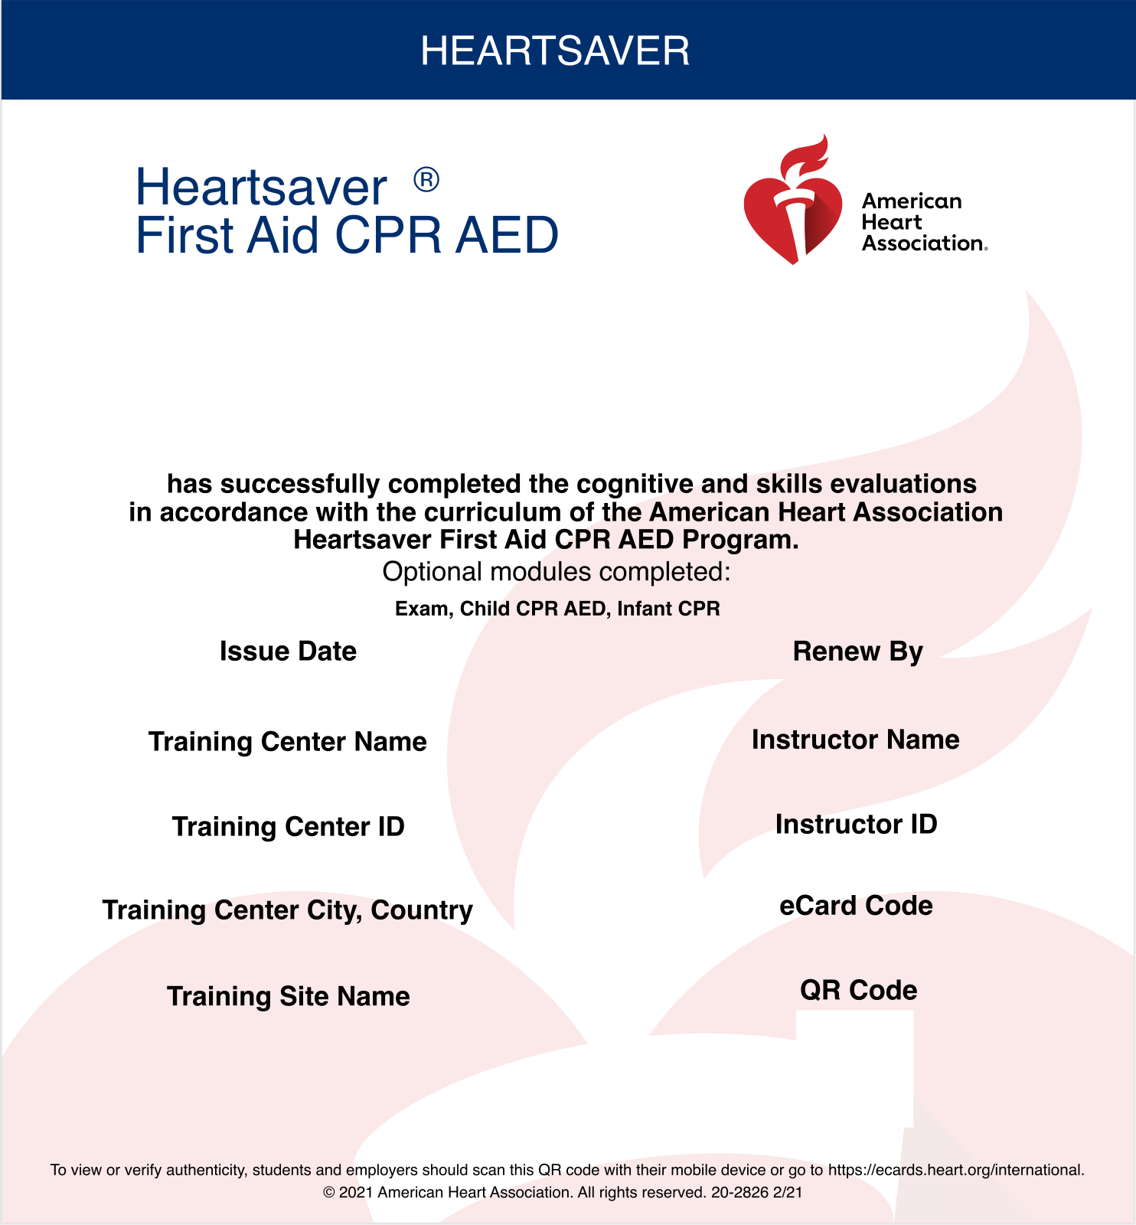
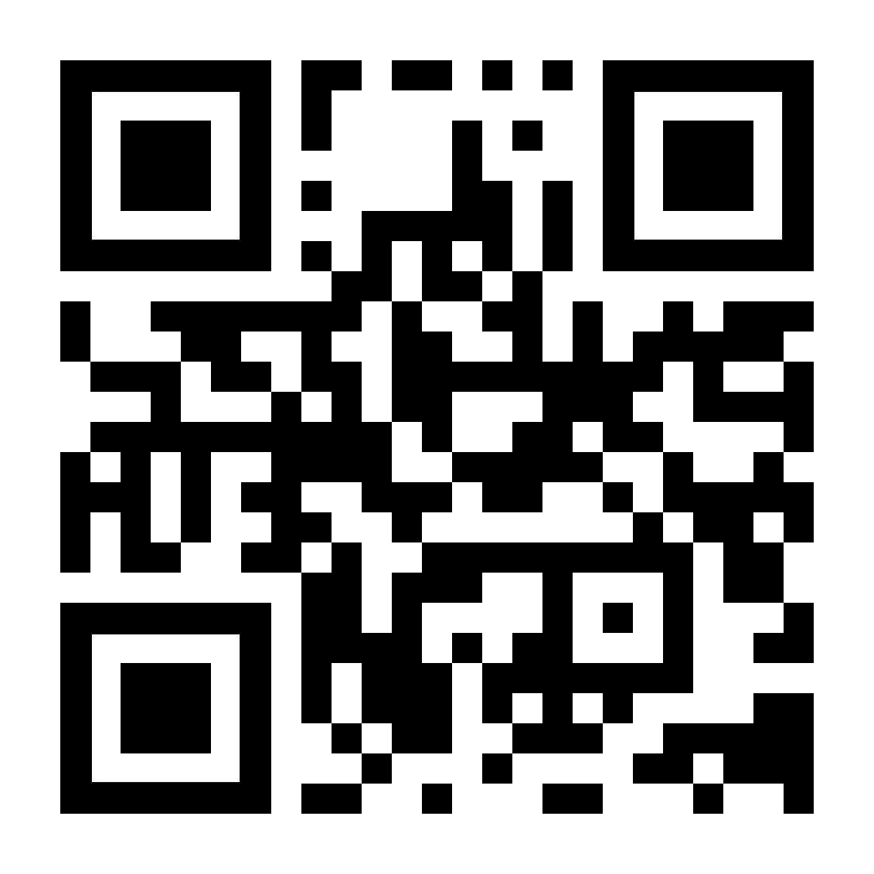
<<Full Name>>
<<Issued>>
<<Expires>>
Prince Sultan Cardiac Center
ZZ21328
<<Instructor ID>>
Riyadh, Saudi Arabia
<<eCard Code>>

Slide 2
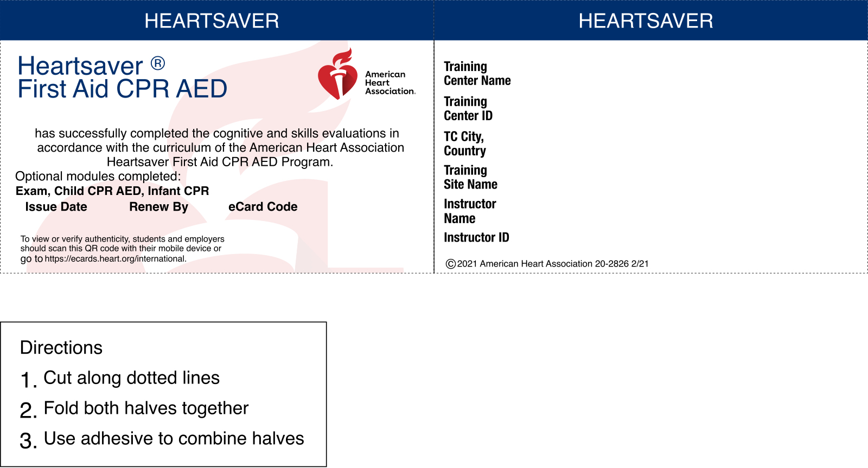
Prince Sultan Cardiac Center
<<Full Name>>
ZZ21328
Riyadh, Saudi Arabia
<<Issued>>
<<Expires>>
<<eCard Code>>
<<Instructor ID>>

