Slide 1
Python Fundamentals
Yasmin Ali Fadel

Slide 2
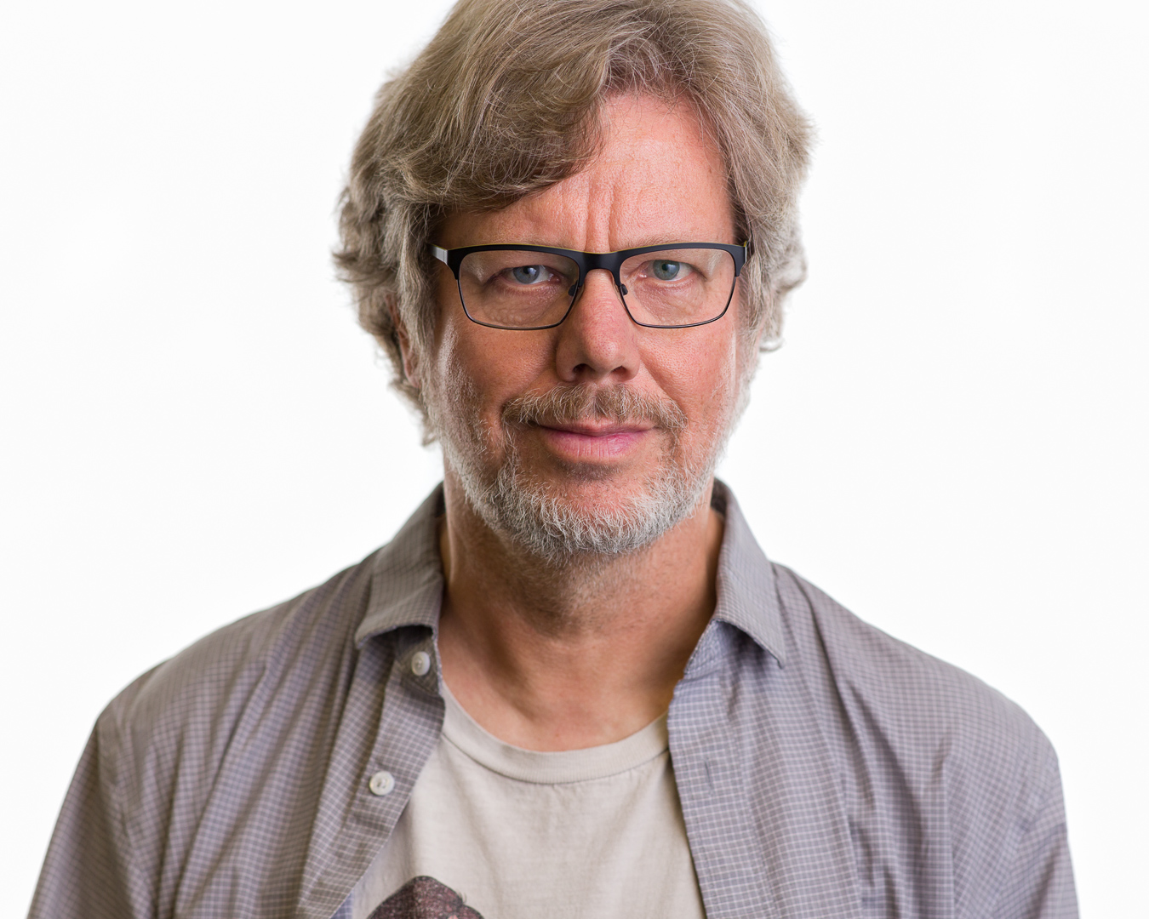
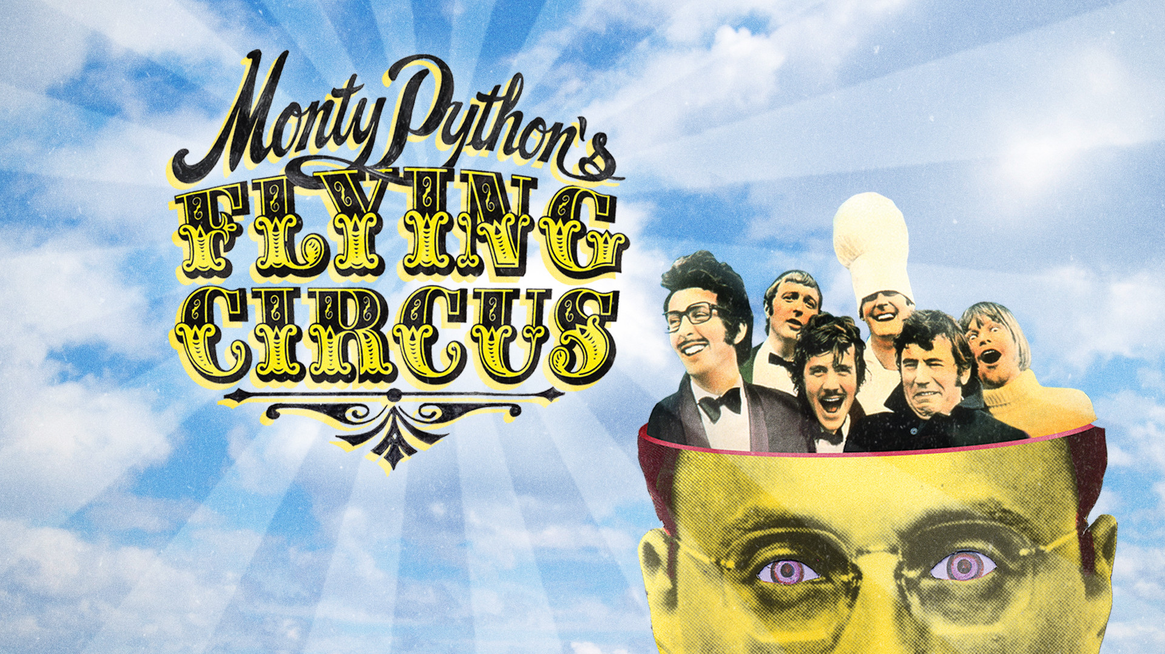
Python History
Guido van Rossum Starting developing in 1980
First release in 1991.
Named python based on
Monty Python's Flying Circus
https://x.com/gvanrossum?lang=en

Slide 3
Python Characteristics
Open Source:
Cost-free programming language.
Utilized in several sectors and disciplines as a result.
General-purpose
Dynamically Typed
High-level
Interpreted
Garbage-Collected
Purely Object-Oriented

Slide 4
Python Generally Purposed
Python is used for multiple tasks
Data Science & Machine Learning:
TensorFlow, PyTorch, Scikit-learn, Matplotlib, Scipy, Hugging Face, OpenCV, NLTK
Desktop Applications
Tkinter, PyGTK, PyQt
Mobile Applications
Used in cross-platforms using: Kivy or BeeWare
Web Applications:
Django Flask, Pyramid, CherryPy
Data web Scrapping:
BeautifulSoup
3D CAD Applications
VTK, Blender, SiTK

Slide 5
Python Dynamically Typed
Variable determined at runtime. You do not have to declare data types
X = 10 → X is an integer
X = “Hello” → X is a string

Slide 6
Python High Level
Written in user friendly language
Focus more on what you want to do rather than how the computer will do it
Make programming faster and more efficient for humans
Low level languages:
Assembly Language:
MOV AX, 1 ; Move the value 1 into register AX
ADD AX, 2 ; Add the value 2 to register AX

Slide 7
Python Compilation and Interpreted
Interpretation:
The source code is executed line by line.
Advantages:
Ease of Use: Easier to test and debug
Portability: The same source code can typically run on any platform with the appropriate interpreter.
Disadvantages:
Performance: Generally slower execution
Runtime Errors: Errors can only be detected during execution.

Slide 8
Python Compilation and Interpreted
Compilation:
Entire source code is translated into machine code.
The compiler generates an executable file or bytecode file that the computer can run
Advantages:
Performance: Generally faster execution because the translation is done beforehand.
Optimization: Compilers often optimize the code for better performance.
Disadvantages:
Compilation Time: Requires a separate compilation step before execution.
Portability: Executables are platform-specific and may need to be recompiled for different platforms.

Slide 9
Python Compilation and Interpreted
Interpreted, but it is first compiled into bytecode (.pyc files) “lower-level”
pyc files executed by the Python interpreter
This bytecode compilation speeds up subsequent executions.
.pyc files:
stored in a __pycache__ directory within the same directory as the source code file.
The content is binary and not intended to be manually edited or viewed.
EX:
424d 0d0a 1a0a 0000 0000 0000 0000 0000

Slide 10
Garbage-Collected
Python automatically manages memory allocation and deallocation
Garbage collection
Cleaning up objects that are no longer in use.

Slide 11
Python Purely Object-Oriented
Everything in Python is an object, including numbers, strings, functions, and classes.
Object-oriented programming principles in Python.
Python focus on structuring code around objects, which are instances of classes.
Organizing and managing complex software projects by promoting reusable and modular code.
Principles:
Encapsulation
Abstraction
Inheritance
Polymorphism

Slide 12
Python Variables
Name given to a memory location
Naming:
The variable's first character must be an underscore or alphabet (_).
White space and special characters (!, @, #, %, etc.) are not allowed in the identifier name.
Identifier name should not be like any watchword characterized in the language.
Names of identifiers are case-sensitive X ≠ x
Valid names:
Camel Case → newVariable
Pascal Case → NewVariable
Snake Case → new_variable

Slide 13
Object “variable” reference
a = 50
b = a
50
a
b
Memory Location
50
a
b = 100
Memory Location
100
b

Slide 14
Multiple Assignment
x = y = z =50
a, b, c=5,10,15
50
X Y Z
5
10
15
a b c

Slide 15
Python data types
Numbers
Int, Float, complex
Sequence Type
String, list, Tuple, Dictionary
Boolean
Default values True or False
Set
unordered collection

Slide 16
Python data types
a = 5 → int
b = 4.5 → float
c = 1+3j → complex “contains an arranged pair” “imaginary”
s = ‘apple’ → string
l = [1,’hi’] → list “mutable (can change after creation)”
t = (‘hi’, ’world’) → tuple “immutable (Cannot be changed)”
d = {1:’dog’, 2:’cat’} → dictionary “Key-Value pairs” mutable
b = True → Boolean
S = {‘dog’, 2, ‘car’,10} → set “unordered collection mutable”
n = None → None type

Slide 17


Python casting data types
int() → output integer
float() →output float
complex() → output complex number

Slide 18
Random module
Perform random actions such as generating random numbers, printing random a value for a list or string
Usage import random

Slide 19
Python Strings
Strings in Python are arrays of bytes representing unicode characters.
Python does not have a character data type.
Single character is simply a string with a length of 1.

Slide 20
Escape characters
\’ →Single Quote
\\ →Backslash
\n →New Line
\t →Tab
\b →Backspace

