Slide 1
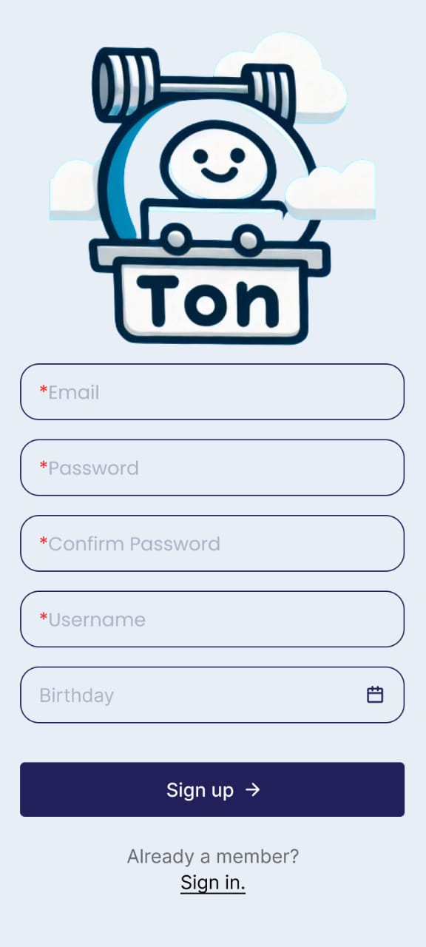
Ton Task Mobile Application

Slide 2
Team Members
Kareem Walid Mabrouk
ElEmam Elsayed
Mahmoud Ayman
Osama Ashraf

Slide 3

01
The Ton Task application is a management tool that adds and shares tasks.
is a management tool that adds and shares tasks.
Project Specs
Ton Task mobile application can be installed
on multiple platforms
02

Slide 4
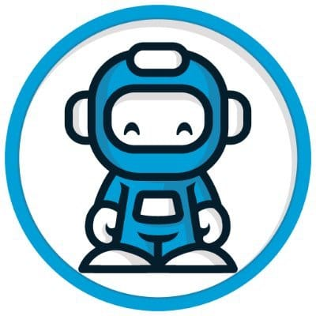
Why Choose Ton Task Application?
Increased Productivity:
Cost-Effective
Scalable
User-Friendly

Slide 5
Project Environment
Trello
To design high-level test cases
Google Sheet
To design low-level test cases

Slide 6
Thank You!

