Slide 1
Online Payment Fraud Analysis

Slide 2
Table of contents
01
02
03
04
Define the problem and your scope
Data Understanding
How the dataset was chosen to solve which problem
What does each column indicate and how could it help to get insights
Perspectives and Insights
PowerBi Methodology
What are the perspectives that could provide insights
Steps of using of visualizing tool to hunt the information treasures

Slide 3
01
Problem definition

Slide 4
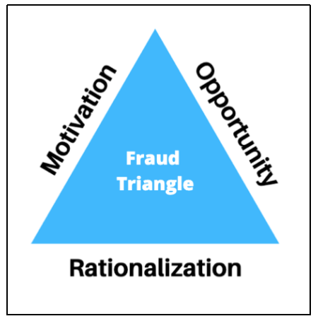
What is Fraud?
What is fraud ?
Fraud types
What is our scope ?

Slide 5
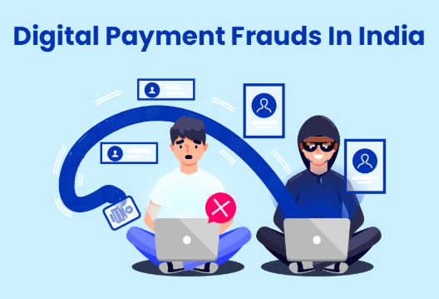
Why India ?
Online Fraud is so critical problem which every house face and India is the first Ranked one
Highest Online fraud rate
Large various Community
Solving there solves everywhere

Slide 6
Data Understanding, Cleaning

Slide 7
Dataset cover wide perspectives

Slide 8
Dataset cover wide perspectives
Customer Data
Transaction data
Merchant data
ALL customer who had suspicious transactions
Transaction date and ID
Merchant name, address, state,
Credit Type
Fraud risk
The card type and the band which the card belongs to
How risky to face a fraud

Slide 9
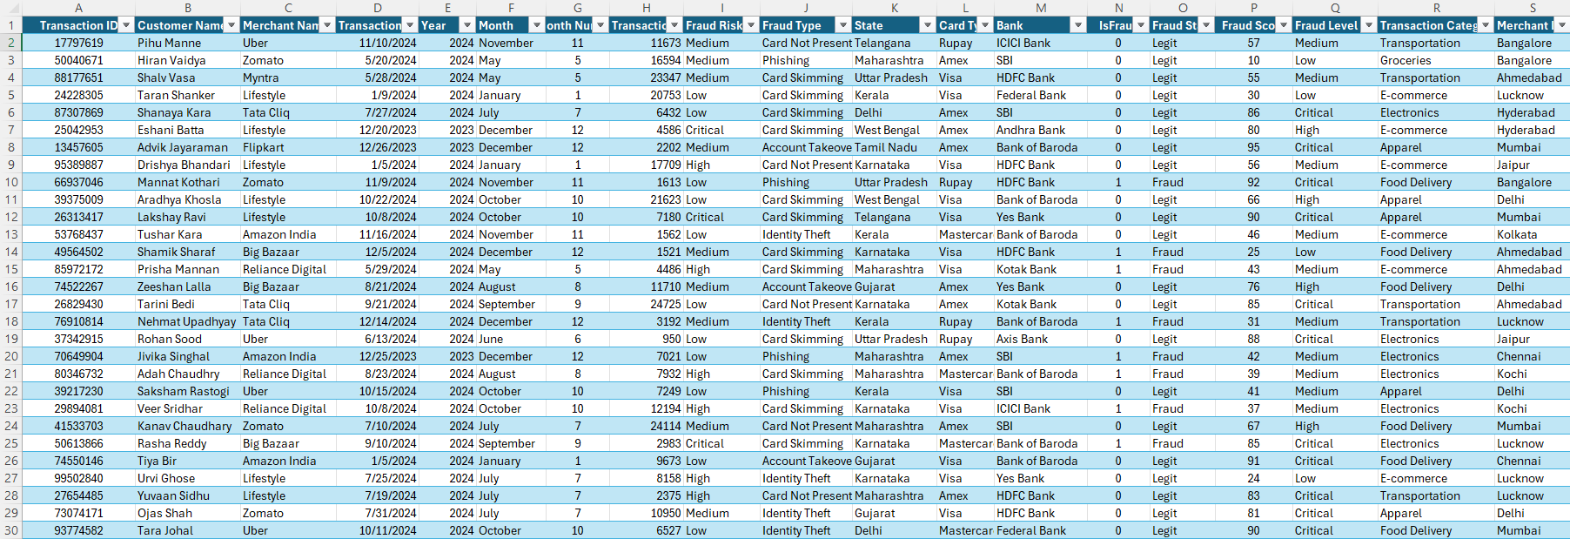
Dataset cover wide perspectives

Slide 10
What is perspective ?
25%
50%
75%
Location Analysis
Seasonal Analysis
Fraud types Analysis

Slide 11
Power Bi

Slide 12
Power Bi
Power Query
Filters and Navigations
Dax Measures
Integrated dashboard

Slide 13
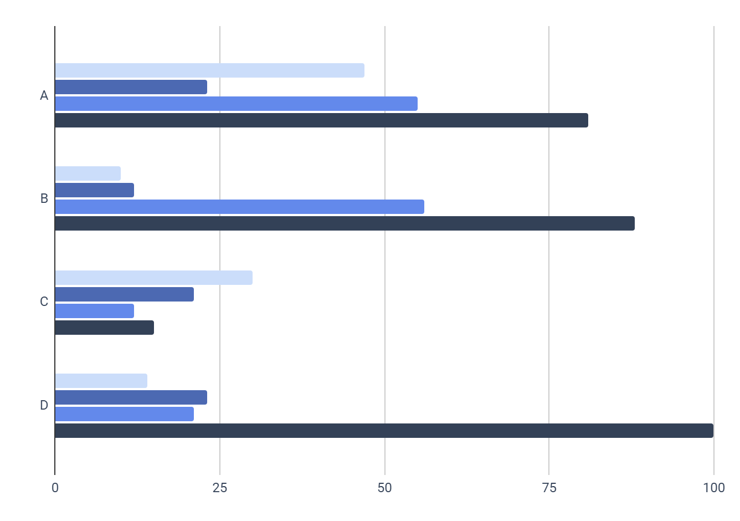
Dashboard Content
Overview
Location Analysis
Fraud types Analysis
Detailed Analysis
A look at the whole perspectives
Describe distribution over locations
Describe fraudes over different types
Combating the whole parameters

Slide 14
Thanks!
Do you have any questions?
Prepared By /
Alaa Ahmed Kareem Mahmoud
Rawan Osama Mohamed Allam
Sama Mostafa Omar Ashraf

