Slide 1

Assiut University
Computer Vision
Faculty of Computer Science
1

Slide 2
about
Team(40)
[1] Kareem Amr Ebrahem Abdulrahman 162020440
[2] Abdulrahman Zakariaa Senousi Khaled 162020340
[3] Taha Mostafa Abbas Aqili 162020324
2

Slide 3
Task description :
AI Coach app : determine whether exercise is right or wrong using computer vision and AI.
Three exercises were worked on: pull up, walk, and sit up
3

Slide 4
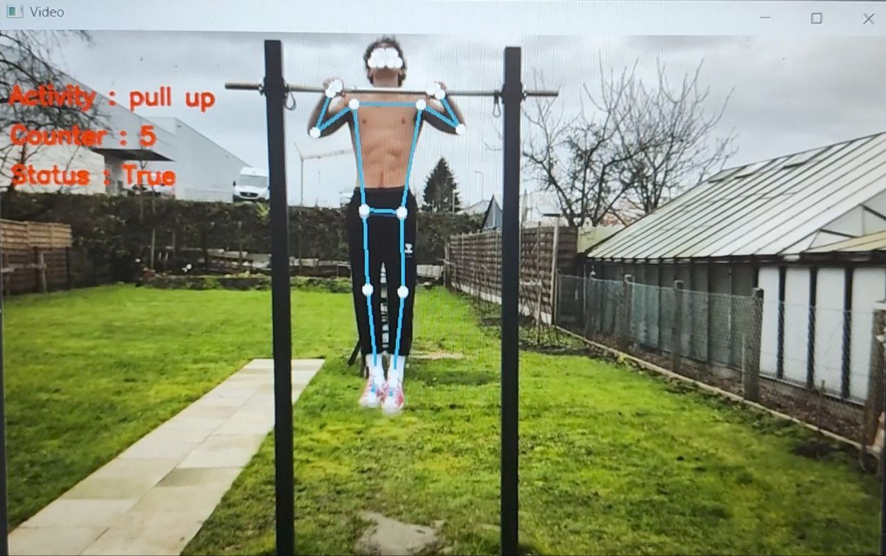
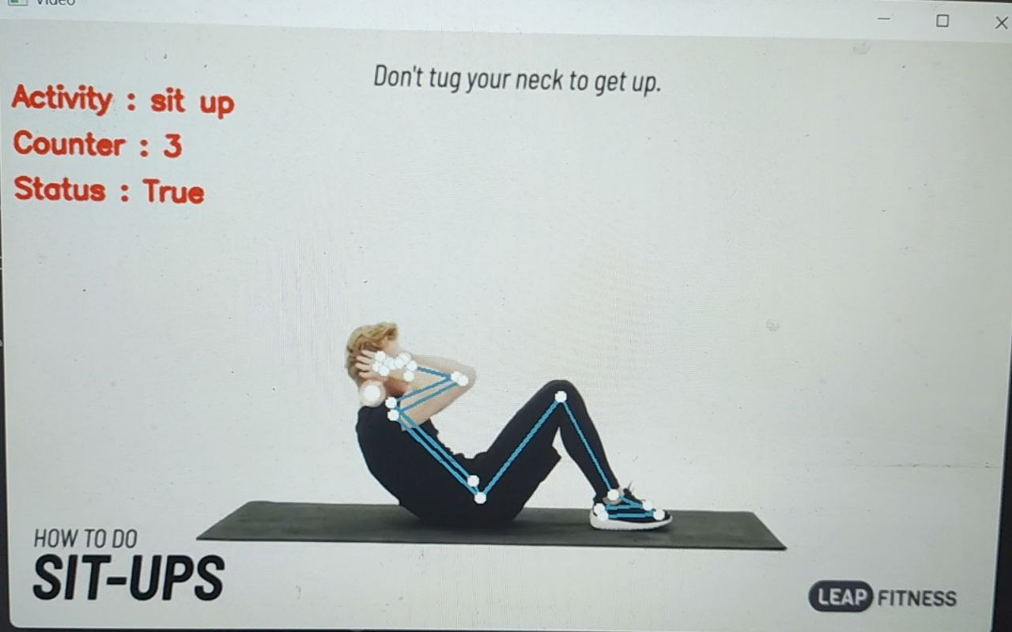
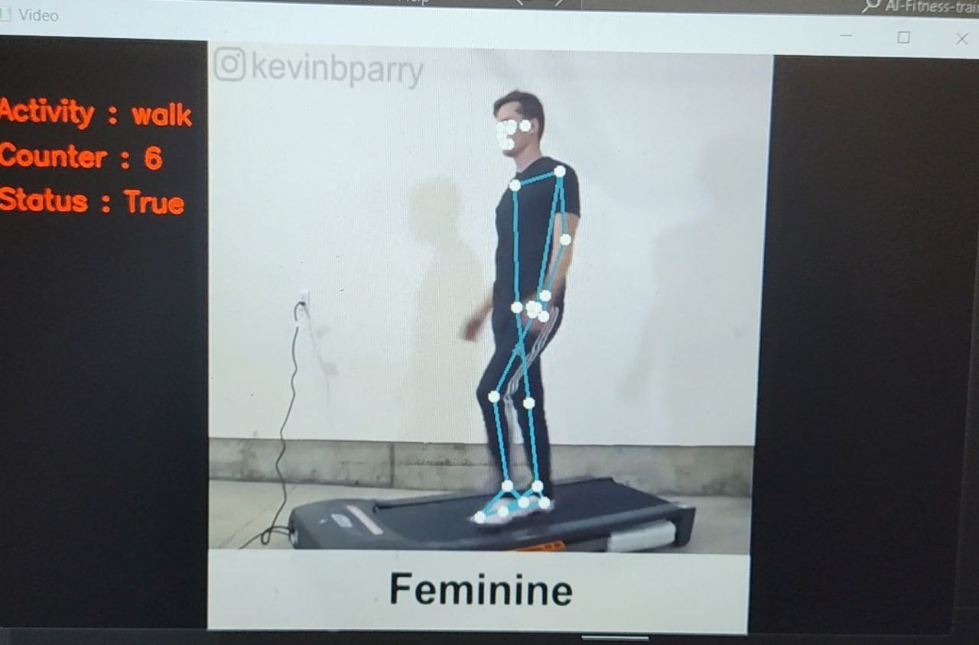
DEMO
GitHub link to us project : https://github.com/KareemAlassal/CV_Project_2.git
4

Slide 5
Contribution
1-Imports libraries (pandas (pd), OpenCV (CV2), NumPy (np), argparse, and mediapipe (mp), Import BodyPartAngle,Import TypeOfExercise .
2-Use BodyPartAngle to calculate angles of different body parts based on their landmark locations from MediaPipe's pose estimation, angle as the left/right arm, leg, neck, and abdomen.
3-Use TypeOfExercise inherits from BodyPartAngle and uses body part angles to count repetitions for specific exercises.
4-Argument parser (argparse) is used to get the exercise type and optionally a video source from the command line.
5-MediaPipe Pose (mp_pose) is set up for pose estimation with minimum confidence thresholds
5

Slide 6
Contribution
6-A loop is started to process video frames:
• Frame is read from the video source (webcam or video file).
• The frame is resized and converted to RGB format for MediaPipe processing.
• Pose estimation is performed on the frame to detect body landmarks.
• The frame is converted back to BGR format
• If pose landmarks are detected:
▪ The calculate_exercise function is called based on the exercise type to update repetition counter and movement state.
▪ A helper function score_table (not shown in the code) is likely used to display exercise information on the frame (repetitions, etc.).
• Detected pose landmarks are drawn on the frame for visualization.
• The frame is displayed.
6

Slide 7
Data
The training dataset consists of 25K images with a single person in the scene performing fitness exercises. All of these images were annotated by humans.
images size is 200 * 200 pixel
8

Slide 8
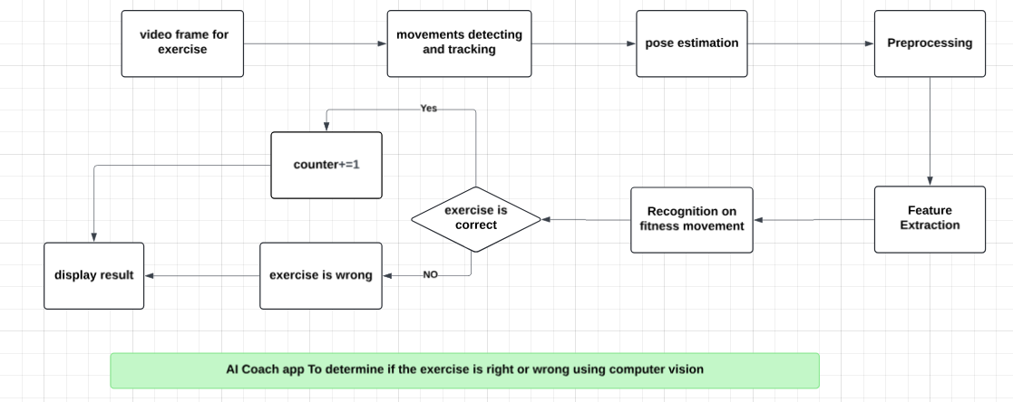
Project architecture
9

Slide 9
Methods
1- Pose Estimation
Use MediaPipe for landmark detection.
Input vuideo from camera or video file.
The frame is resized to 800x480 pixels and converted to RGB color space using Open-cv.
2- Calculate angle
Inside the function, it calculates the position of the (nose, left elbow, and right elbow) for Pull-up exercise based on landmarks.
(right knee and left knee) for Walk exercise based on landmarks.
10

Slide 10
Methods
calculates the angle of the abdomen for Sit-up exercise.
3- Counter
Pull-up : computes the average shoulder height using the y-coordinates of the left and right elbows If the nose is above the average shoulder height and status is True, it increments the counter and sets status to False.
Walk : it checks whether the left knee is positioned in front of right knee or right knee is positioned in front of left knee.
Sit-up : If the angle is less than 55 degrees and status is True, it increments the counter and sets status to False.Otherwise, if the angle is greater than 105 degrees and status is False, it sets status back to True.
10

Slide 11
Results
The measure accuracy.
The model achieves 75% accuracy on the test data.
11

Slide 12
Thanks
11

