Slide 1
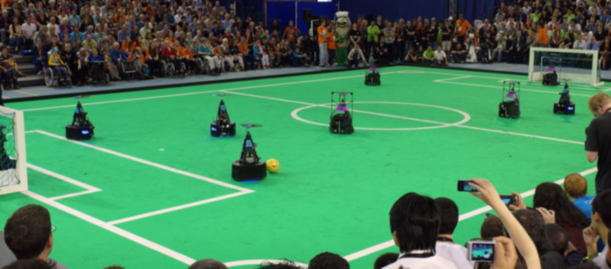
Deliverables
27/02/2024
Department of Mathematics and Computer Science, EngD. Mechatronic Systems Design

Slide 2
Project Deliverables
Which team touched the ball last time before it went out of the field while the game was in play?
According to the referee, determining to whom to give the throw-ins and whether it is a corner, or a goal kick is difficult.
The scenario is quite frequent in a football match.
Detecting who touched the ball last time is technically challenging to detect because of the edge cases.
Not yet implemented by the previous teams. However, the previous teams have implemented ball out-of-play.
Communicating to the referee about the team whose player touched the ball last before the ball went out of play.
Assistant to the referee, to communicate which team touched the ball before the ball went out of play.
A simple UI with minimal information or a pop-up notification.
There can be other decisions just before the ball goes out of play, like a collision between two players. These events will be deciding who should resume the match. Considering this, not making this an automated system, but rather an assistant to the referee.
Testing with a 2 vs 2 match of 10 min long officiated by a human referee.
Notes:
Deniz?

Slide 3
Scenarios of a player touching the ball
The normal cases of touch are:
Dribbling with the ball
Passing the ball to another player
Receiving the ball
Shooting the ball to the goalpost
Blocking the shot
Clearing the ball from the penalty area of the player
Moreover, there are a lot of edge cases in this scenario, they are:
Touching both the keeper and goalpost
Touching two players at the same time
Scraping the ball
Spinning of the ball
Touching without moving the ball
Two players from opposing teams are contesting for the ball near the line.
Notes:
Deniz?

