Slide 1
Video Subtitles Detector Program
Students:
Salma Sherif Ibrahim 20200227
Nada Mostafa Mohamed 20200594
Kareem Abd El-Moneam fawzy 20200391
Shrook Mohsen Samir 20200253

Slide 2
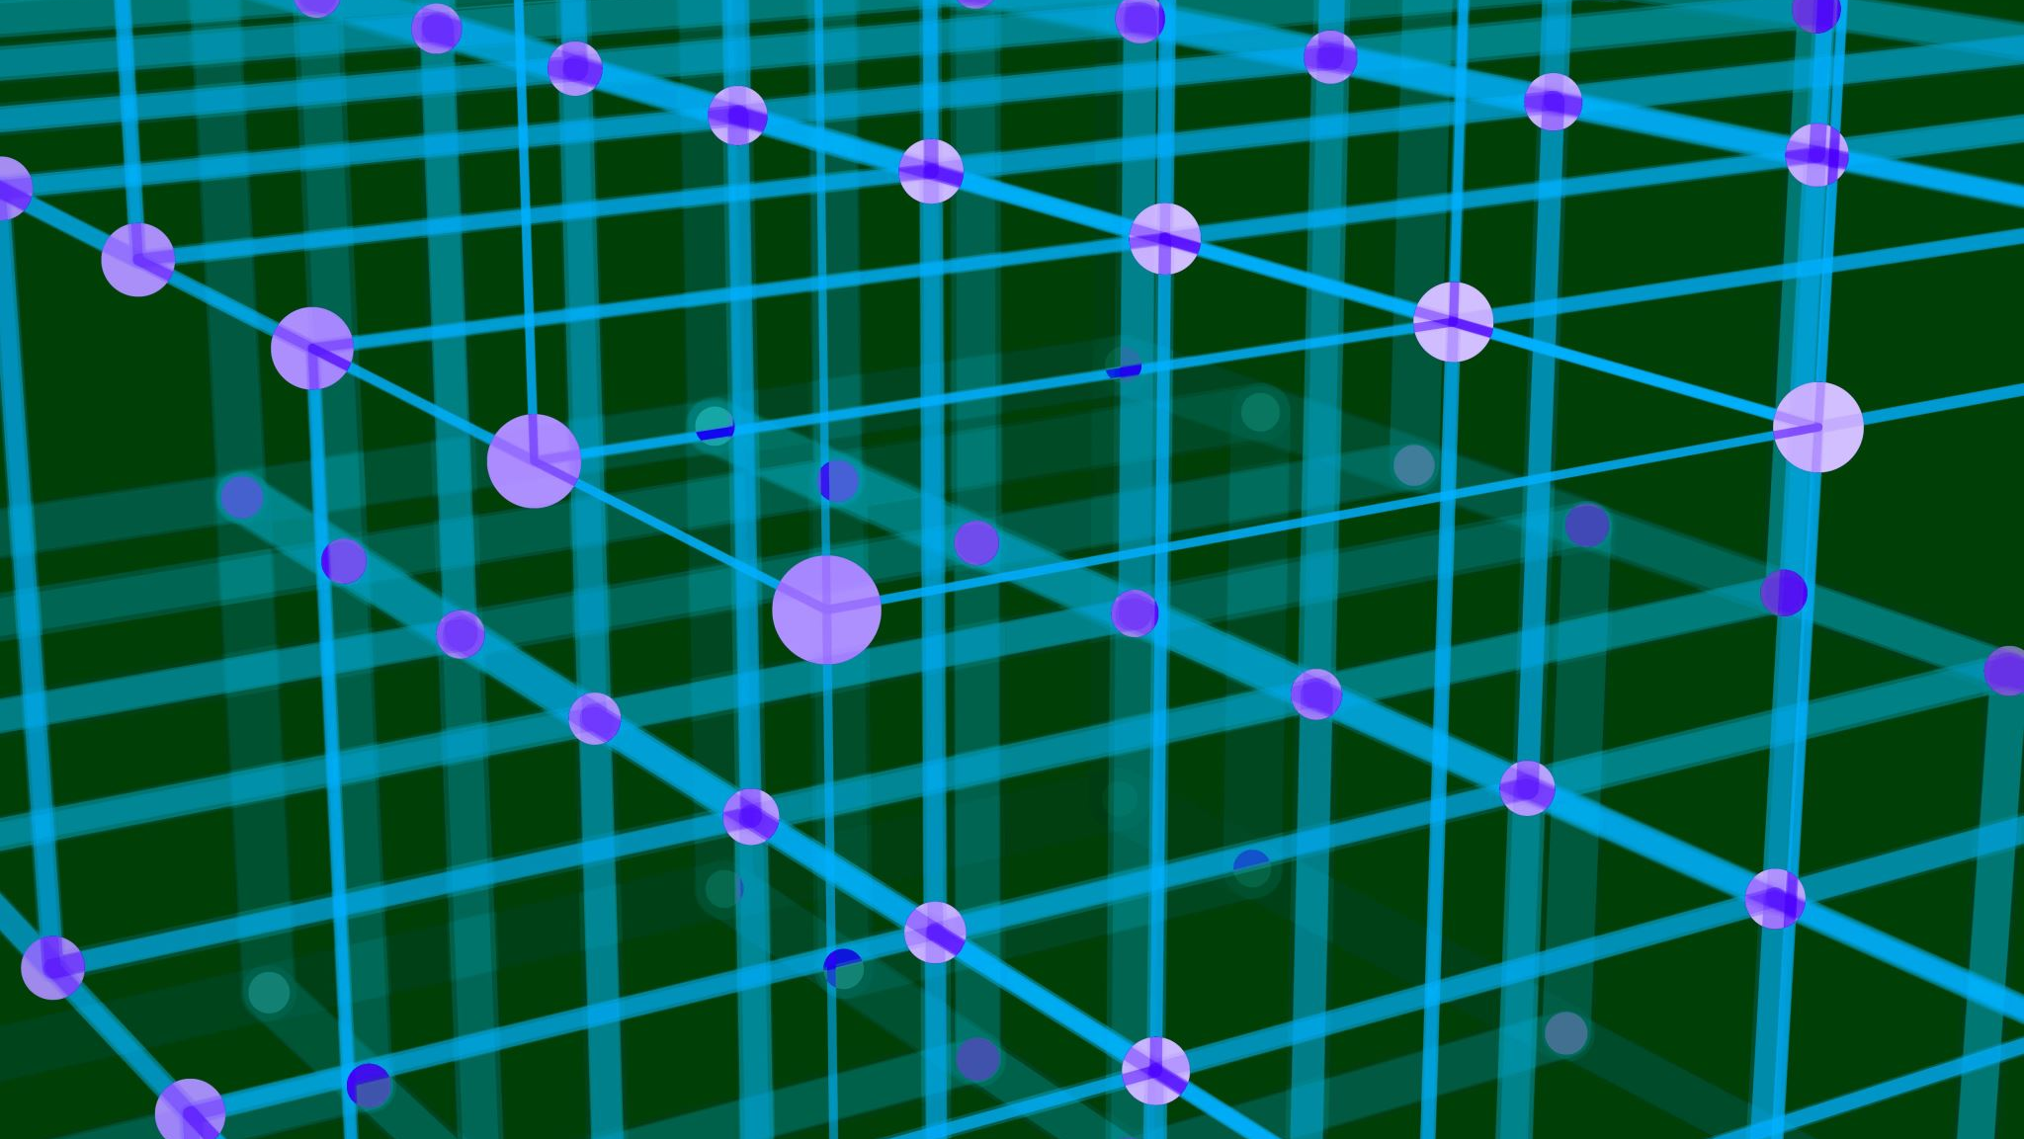
Methodology

Slide 3
I. Reading and Processing the Video:
Reading the Video File:
We uses OpenCV (by import cv2) to read video file.
Processing: For each frame in the video:
Original frame is saved.
Converting frame into grayscale (by cv2.cvtColor() ).
Blurring is applied to reduce noise.
Thresholding is used to further reduce noise.
Subtitles and words are segmented

Slide 4
II. Preprocessing & Noise Removal:
Grayscale Conversion:
converting frames to grayscale using
cv2.cvtColor(frame, cv2.COLOR_BGR2GRAY)
Blurring:
Gaussian blur is applied to reduce noise in the frame.
Thresholding:
convert the blurred frame to binary for easier segmentation.

Slide 5
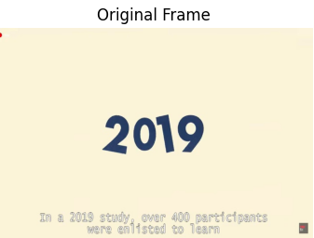
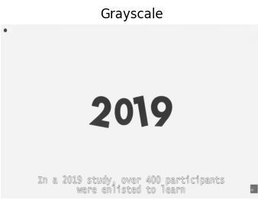
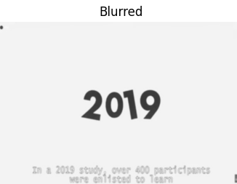
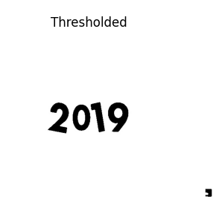
Example’s steps:

Slide 6
III. Segmentation:
Segmenting Words:
Identify and draw bounding boxes around words in the frame.
Segmenting Subtitles:
Identify subtitle regions and draws bounding boxes around them.
Segmenting Another Area:
segments another specific area in the frame using a different region of interest.

Slide 7
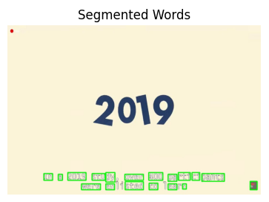
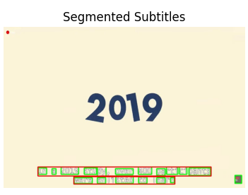
Segmentation’s steps:

Slide 8
IV. Calculating Bounding Box Dimensions:
Bounding Box Calculation:
Bounding boxes are calculated around detected contours.
Contours are identified within the specified region based on the top and bottom region percentages then bounding rectangles (cv2.boundingRect) are drawn around these contours.
It also merges bounding boxes to form a single bounding box for each line of subtitles.
Adjustments and Filtering:
Adjustments are made to coordinates for different regions and small regions are filtered out based on width and height thresholds.

Slide 9
Output Video Creation:
After processing and segmentation, the segmented frames are used to create a new output video file.
Then the segmented frames directory is removed using shutil.rmtree() function after creating the output video.

Slide 10
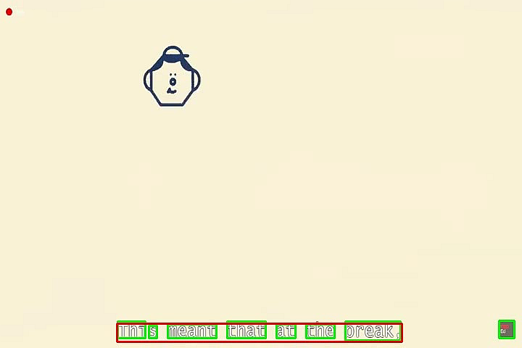
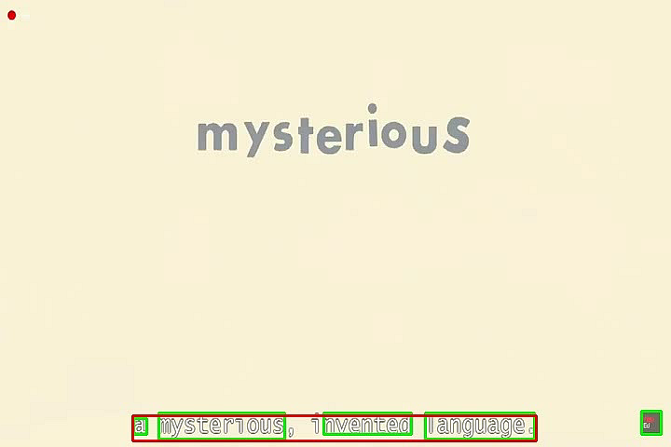
Results:

