Slide 1

OmniRate
Kareem Nashef ,Mohamad Khalaily ,Ahmad idres.

Slide 2
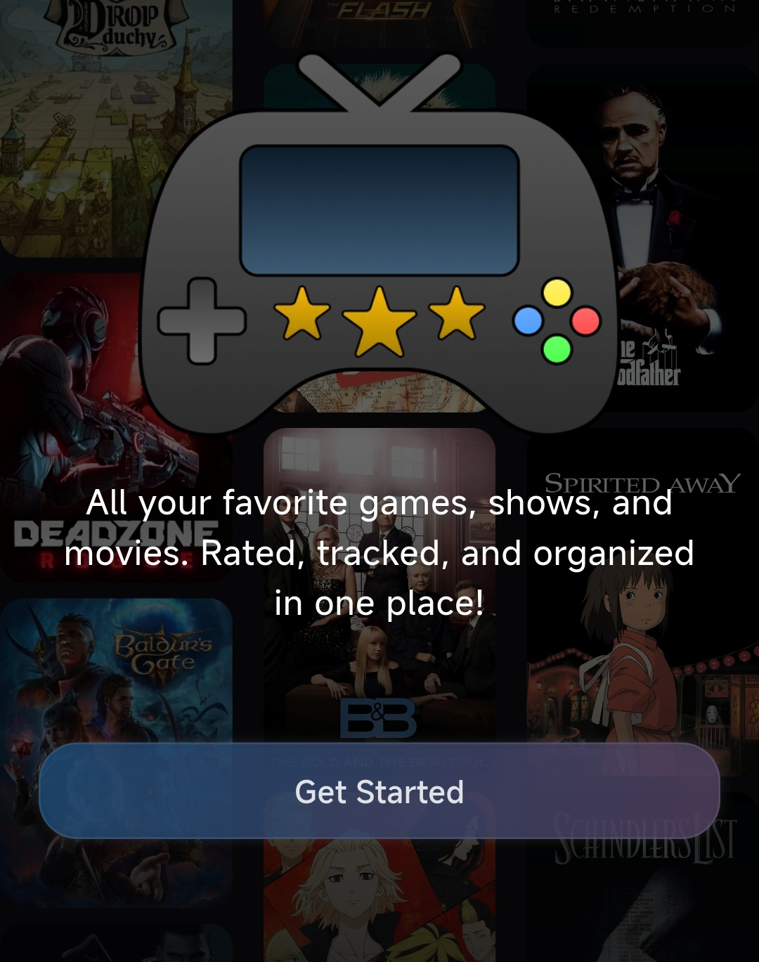
Your Media Hub Reimagined
Discover, organize, and rate your favourite media
Seamless lists and tracking
Sleek, user-friendly design
Everything in one app

Slide 3
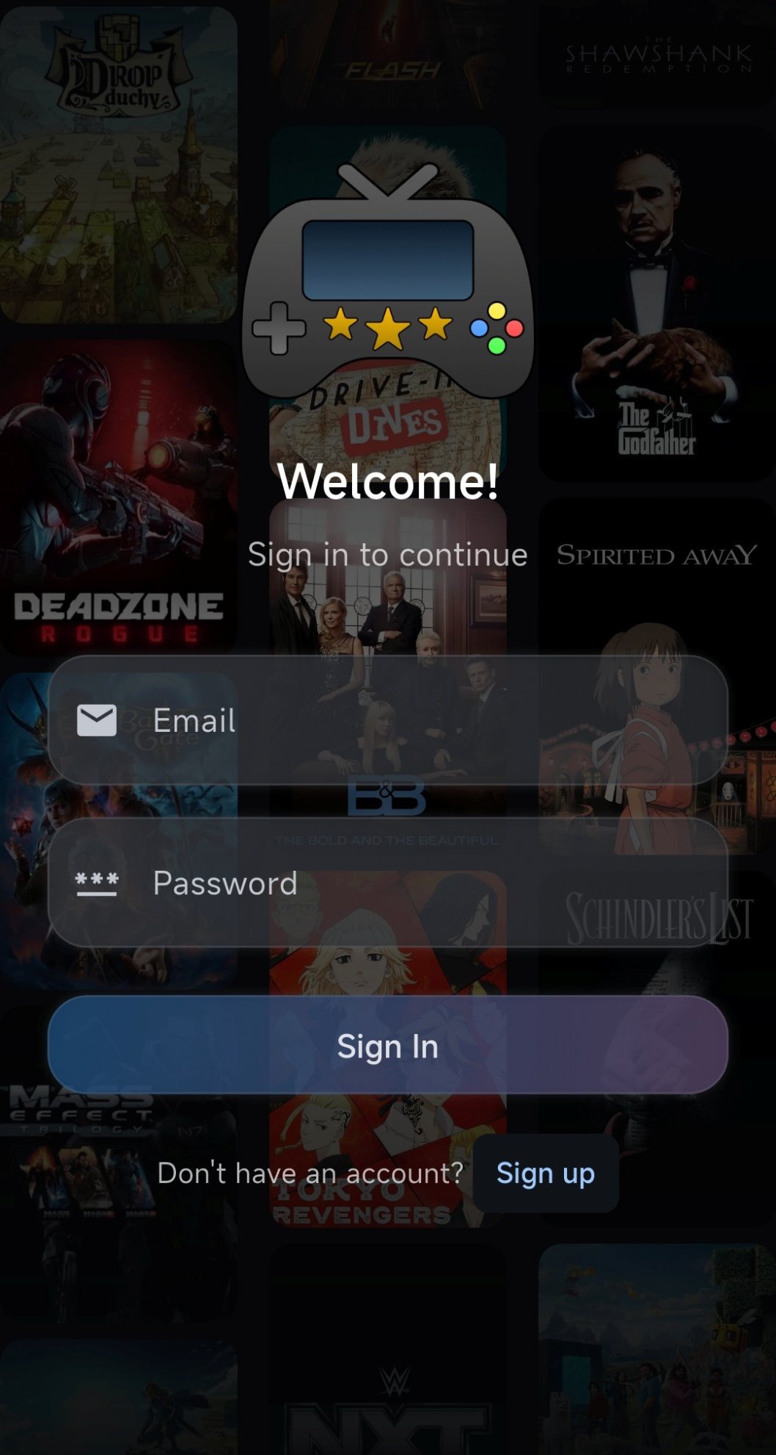
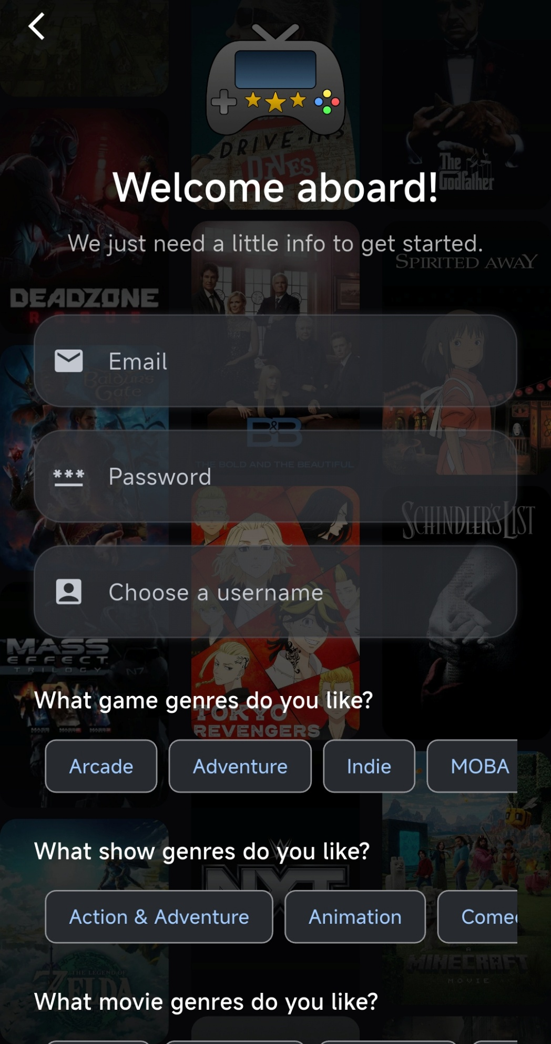
Simple & Personalized Sign In
Quick sign in with email and password
Easy sign up with a personal touch
Pick your favourite genres to get tailored suggestions from the start

Slide 4
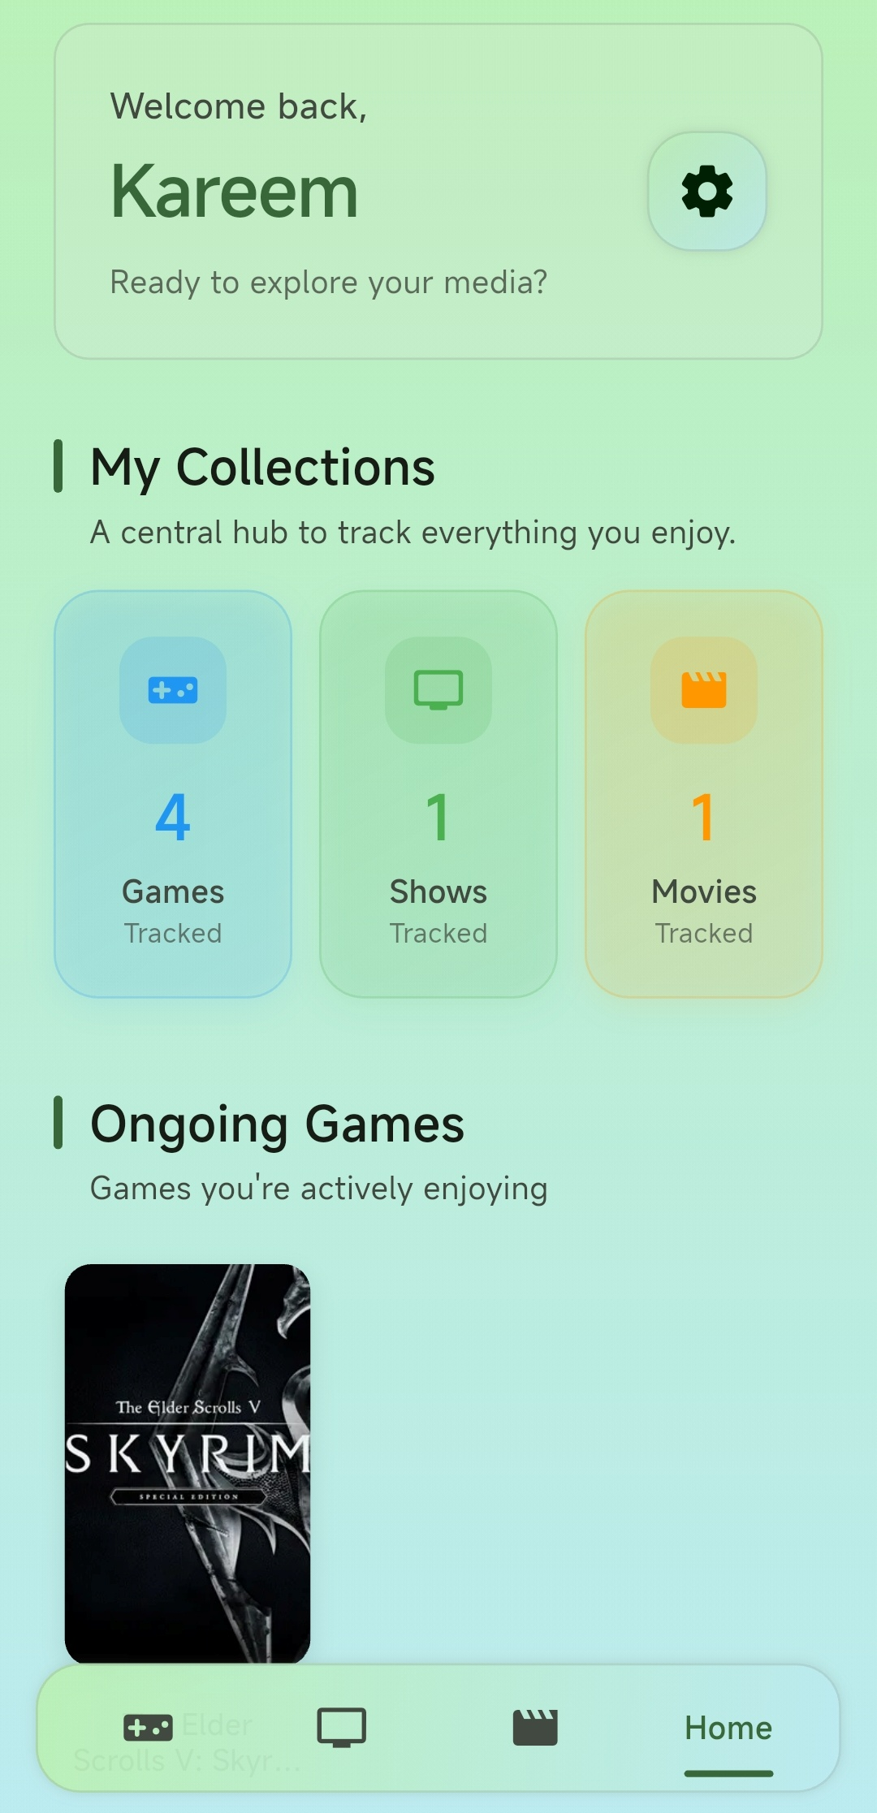
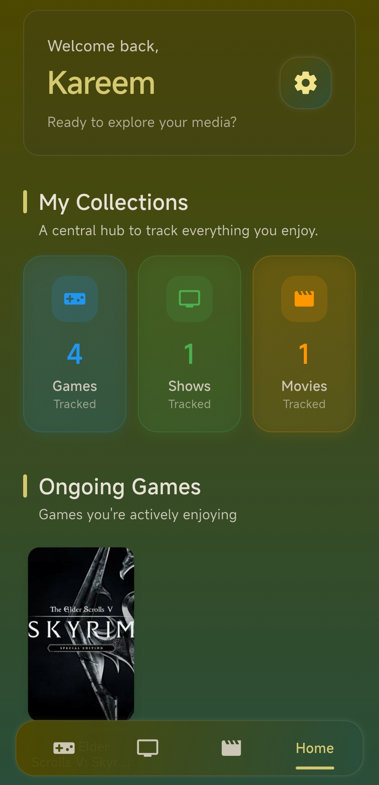
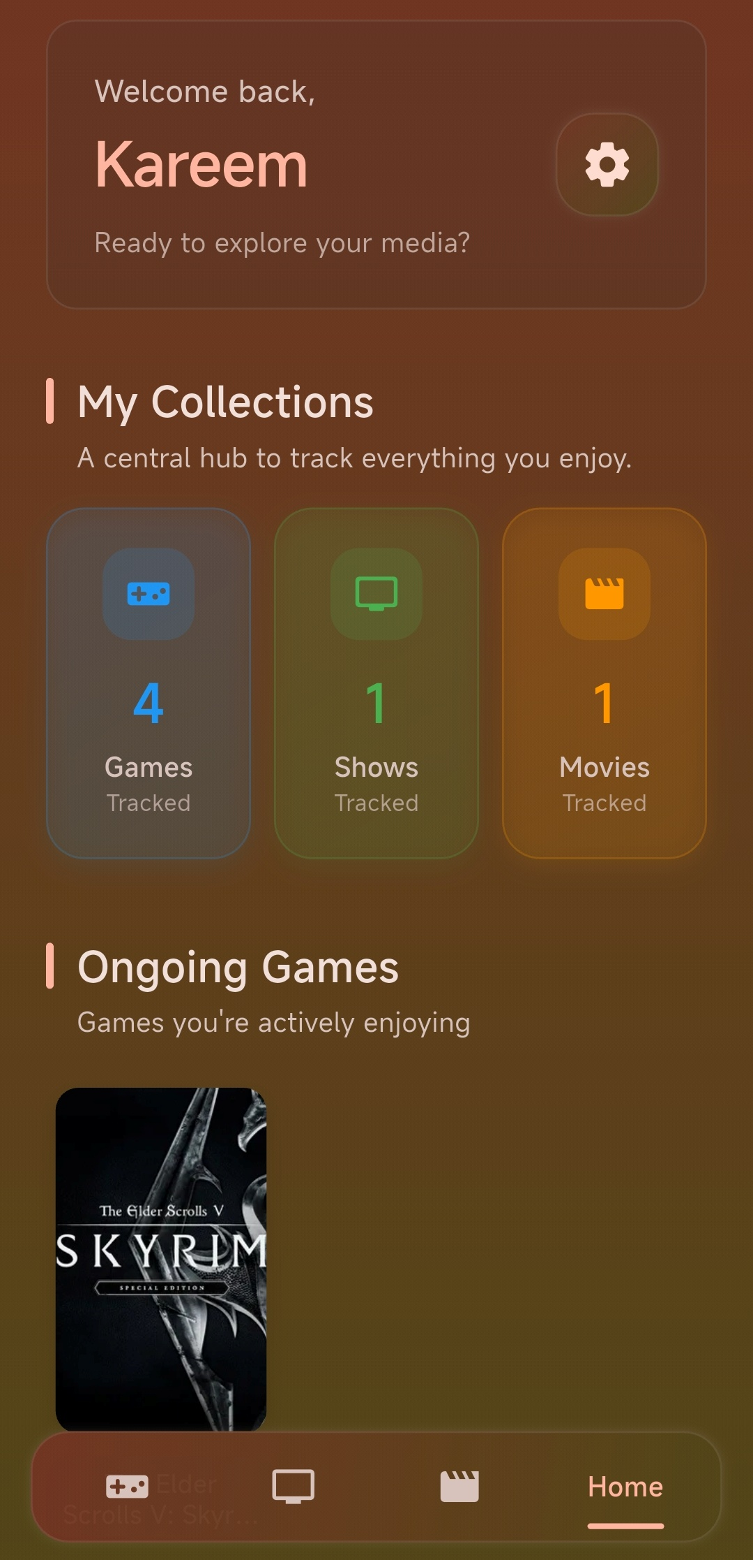
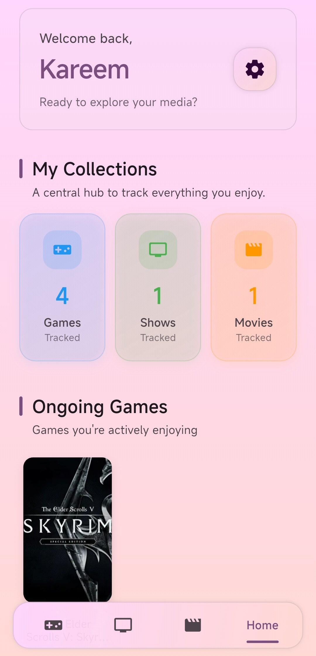
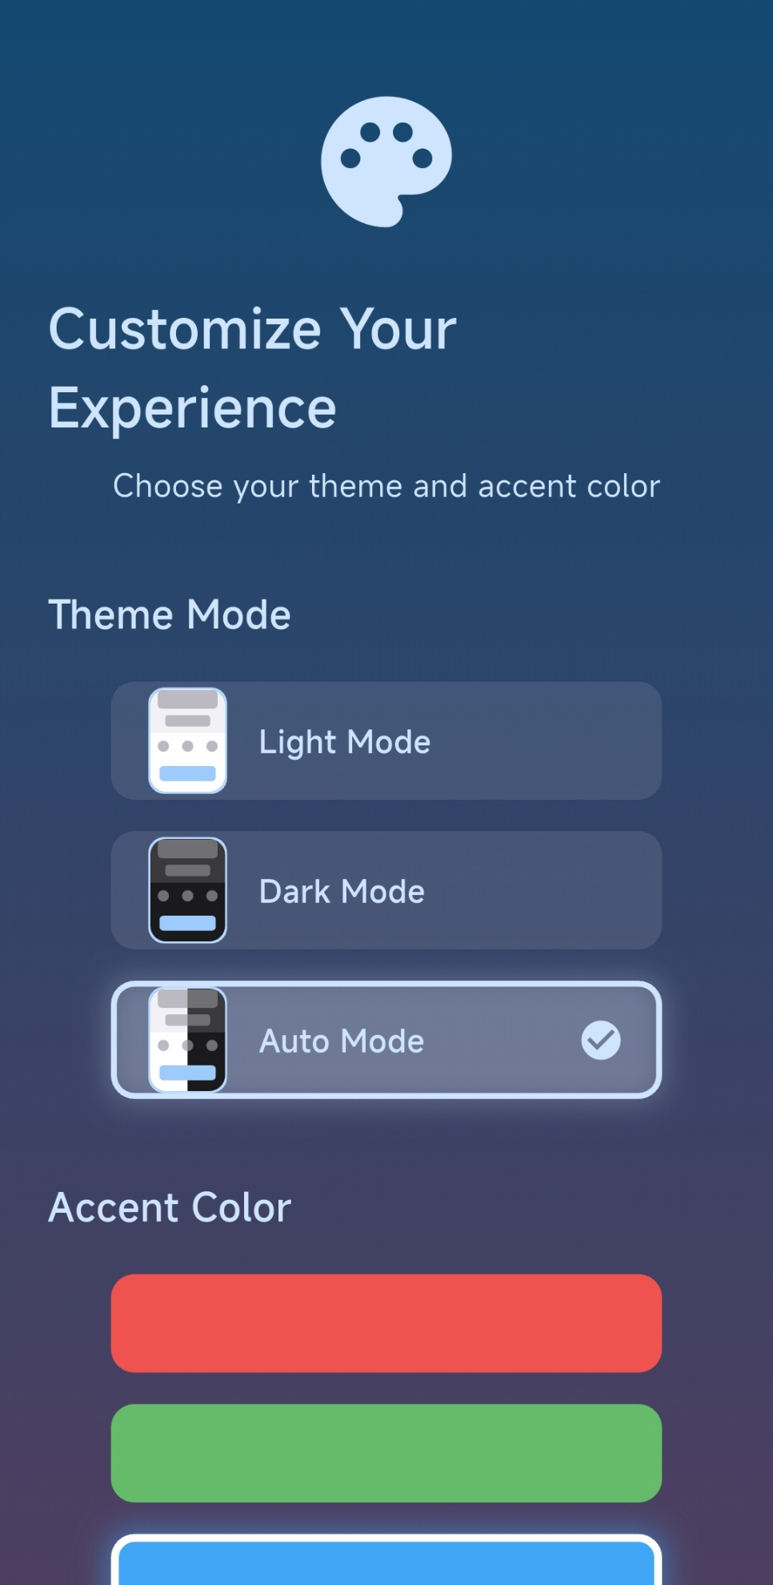
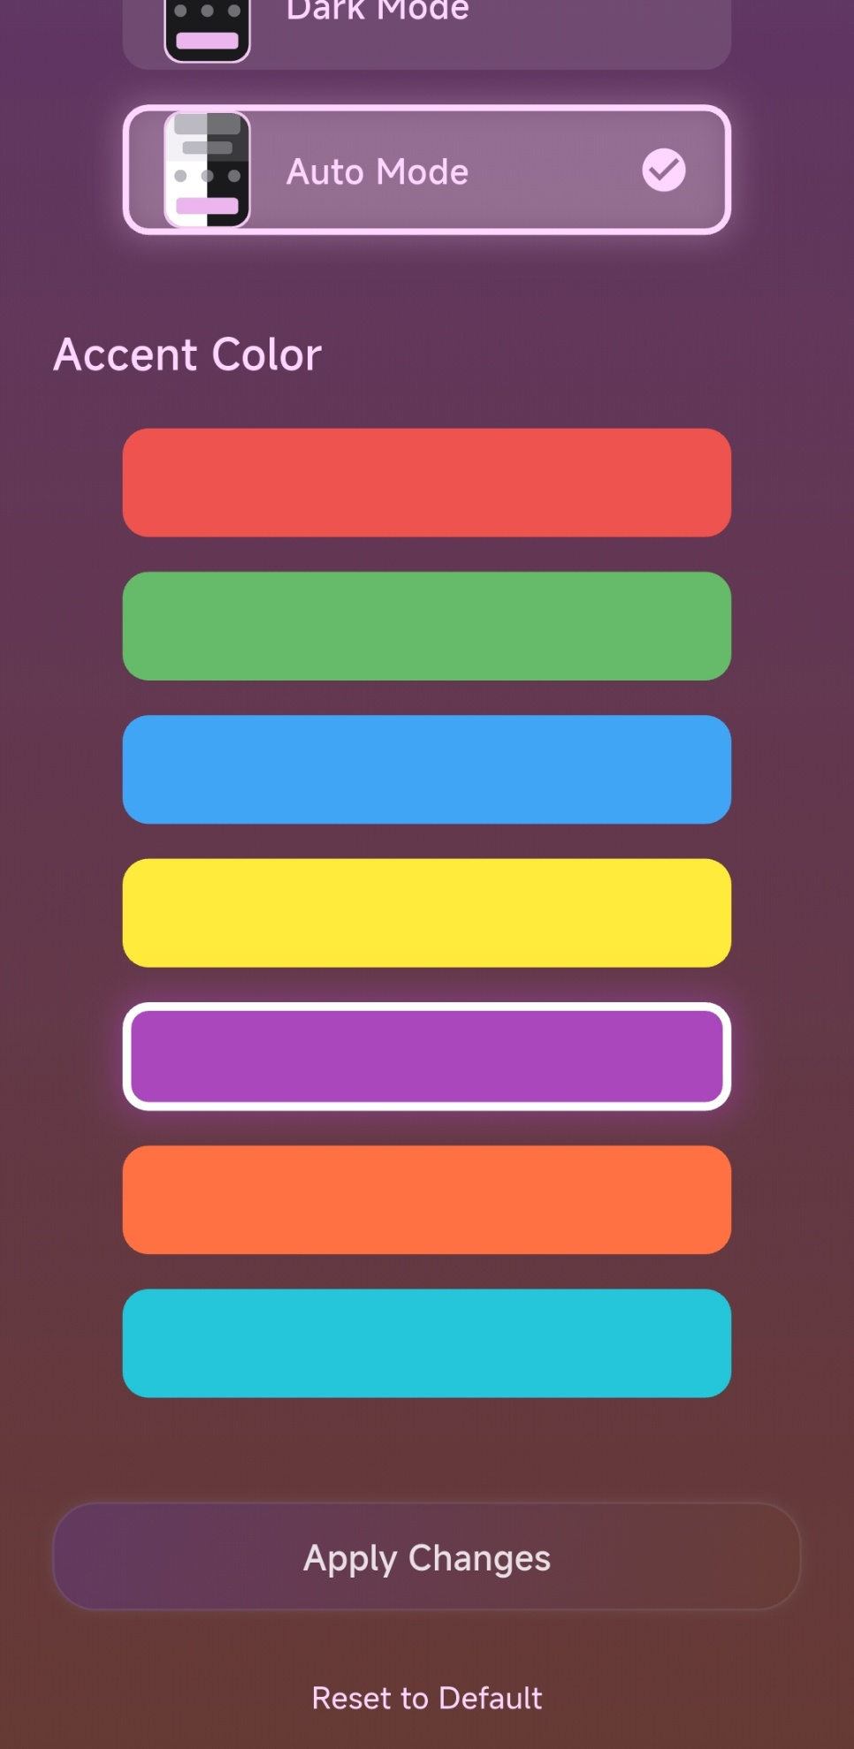
Make It Yours
Choose between light or dark mode
Pick an accent color — it transforms everything
Powered by Material 3 for a fully dynamic look

Slide 5
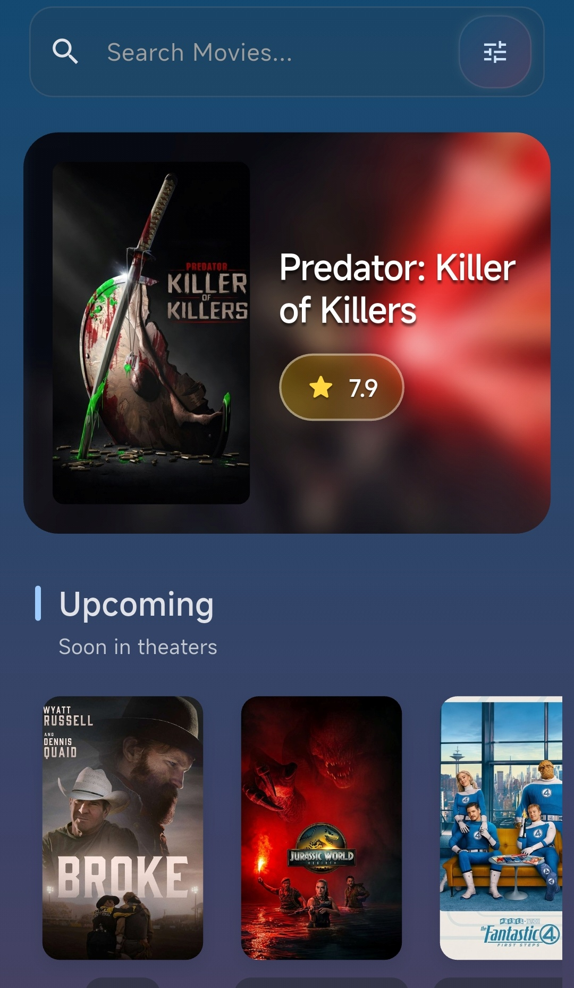
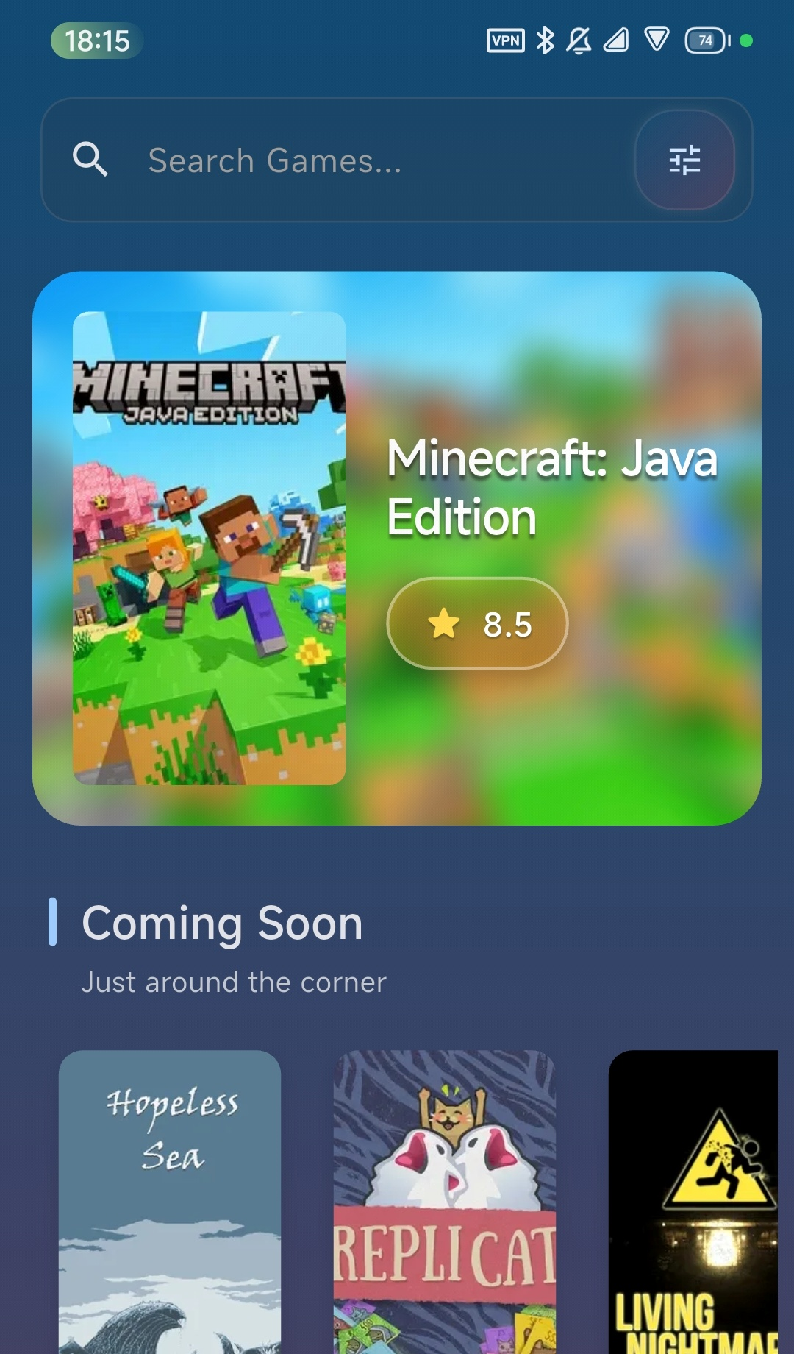
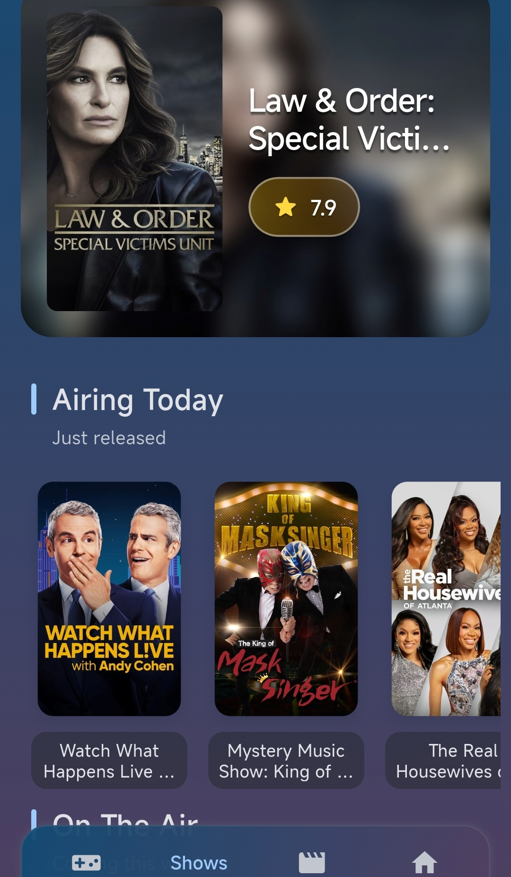

Slide 6
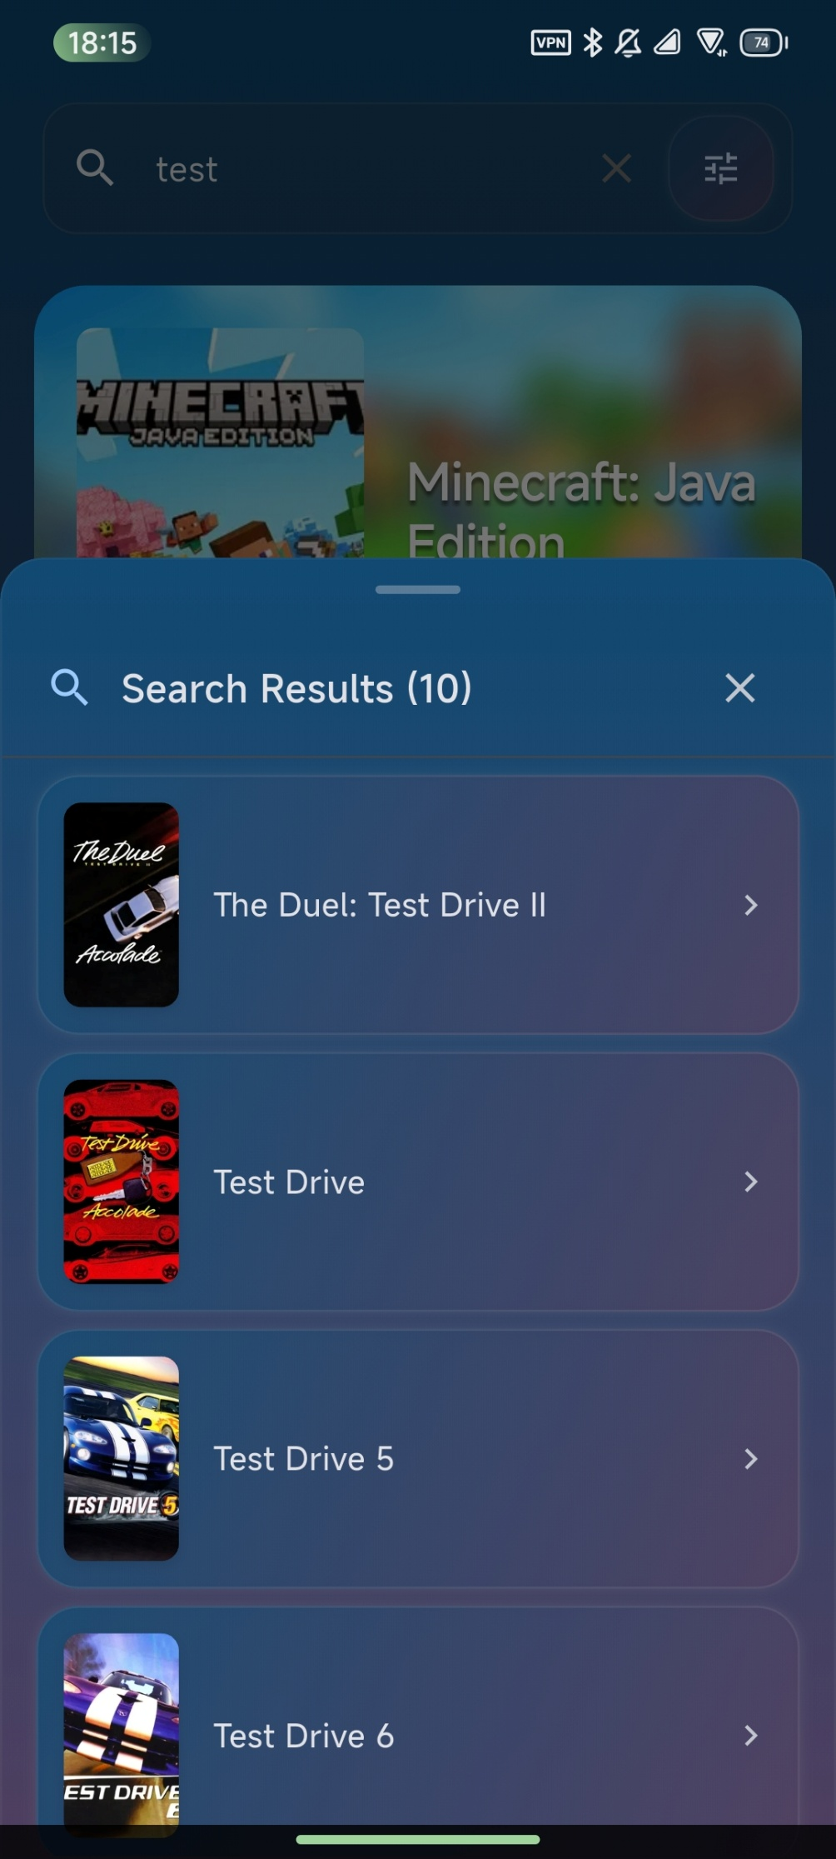
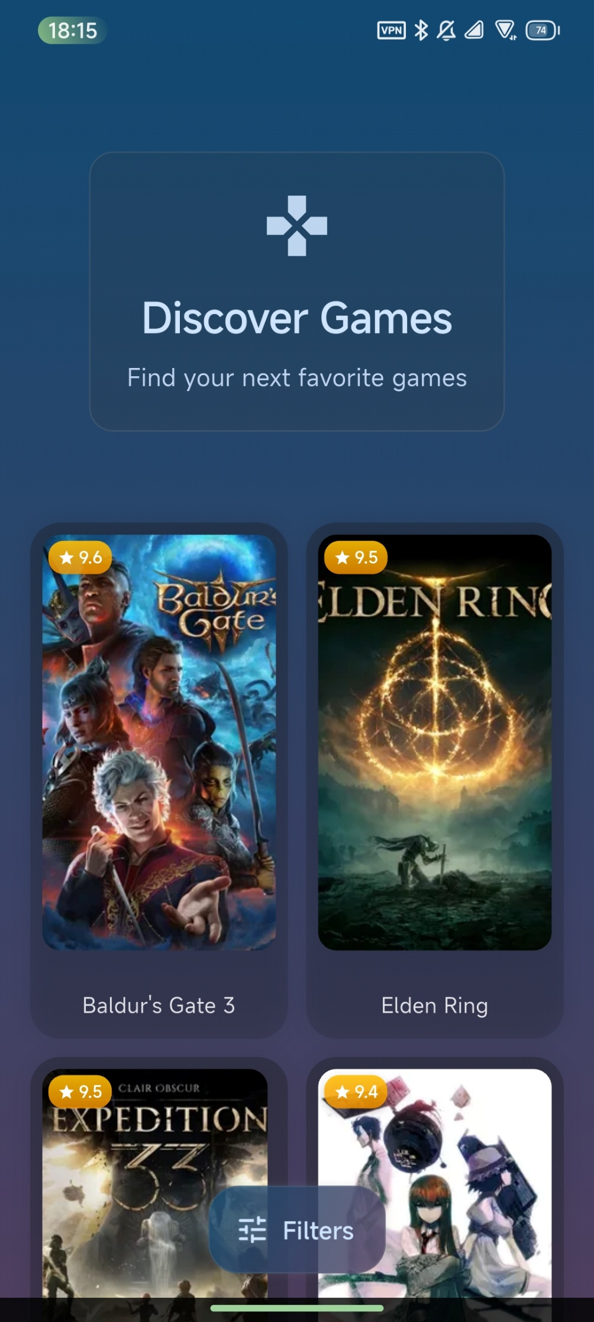
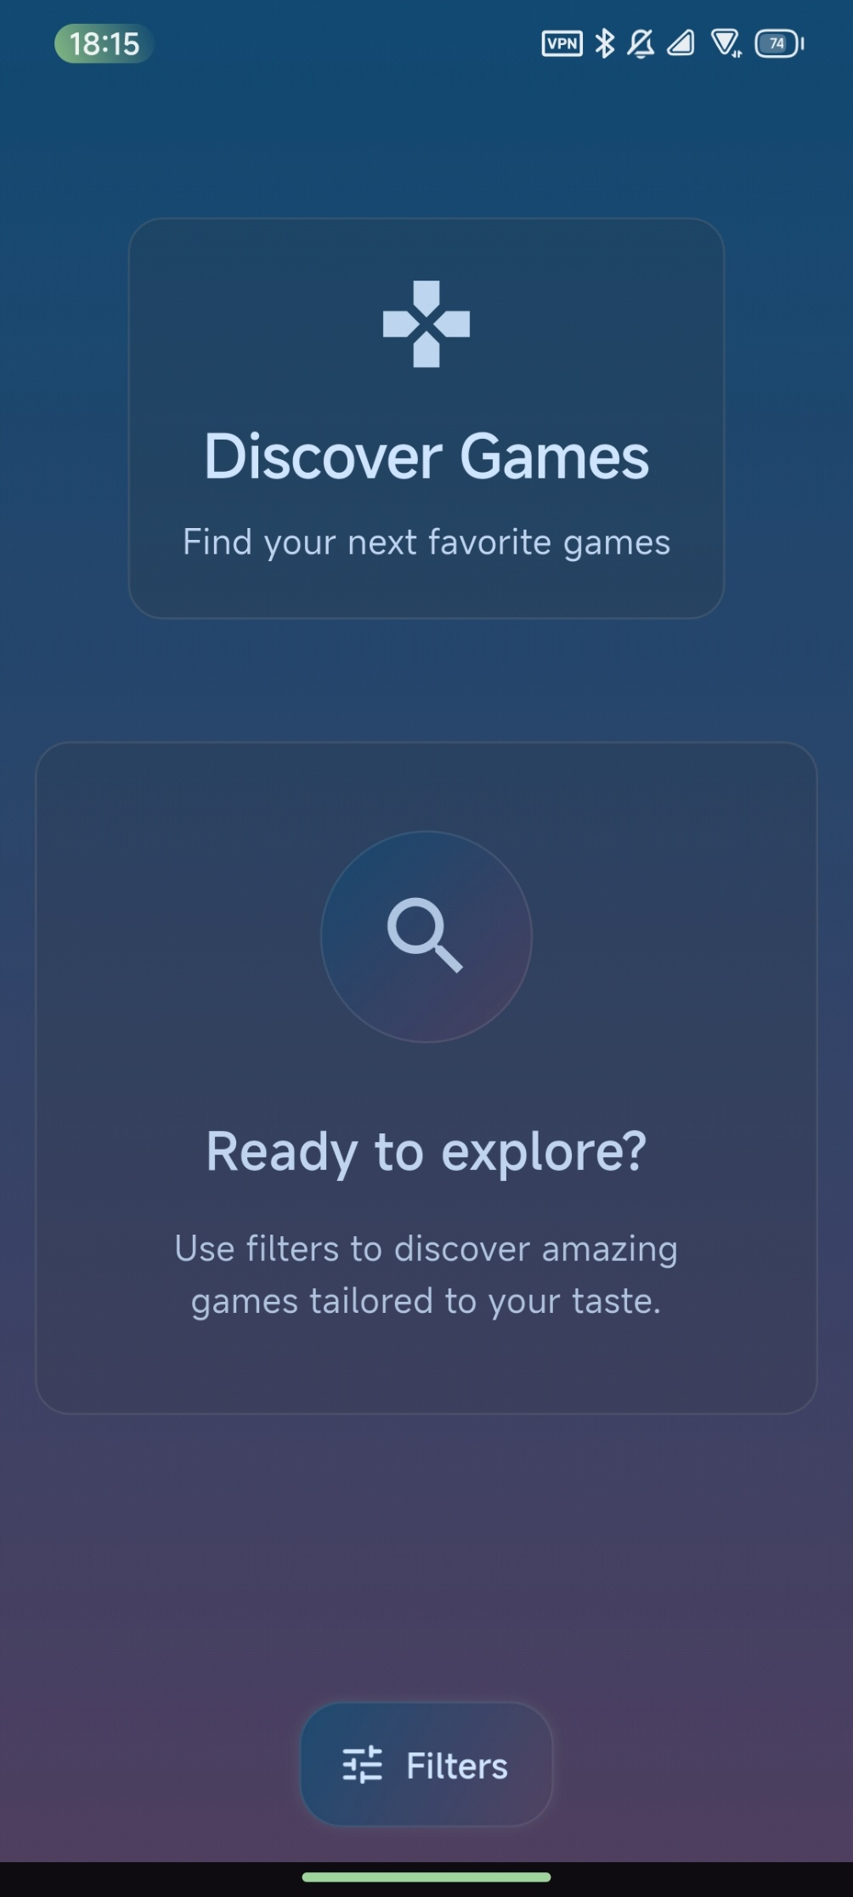
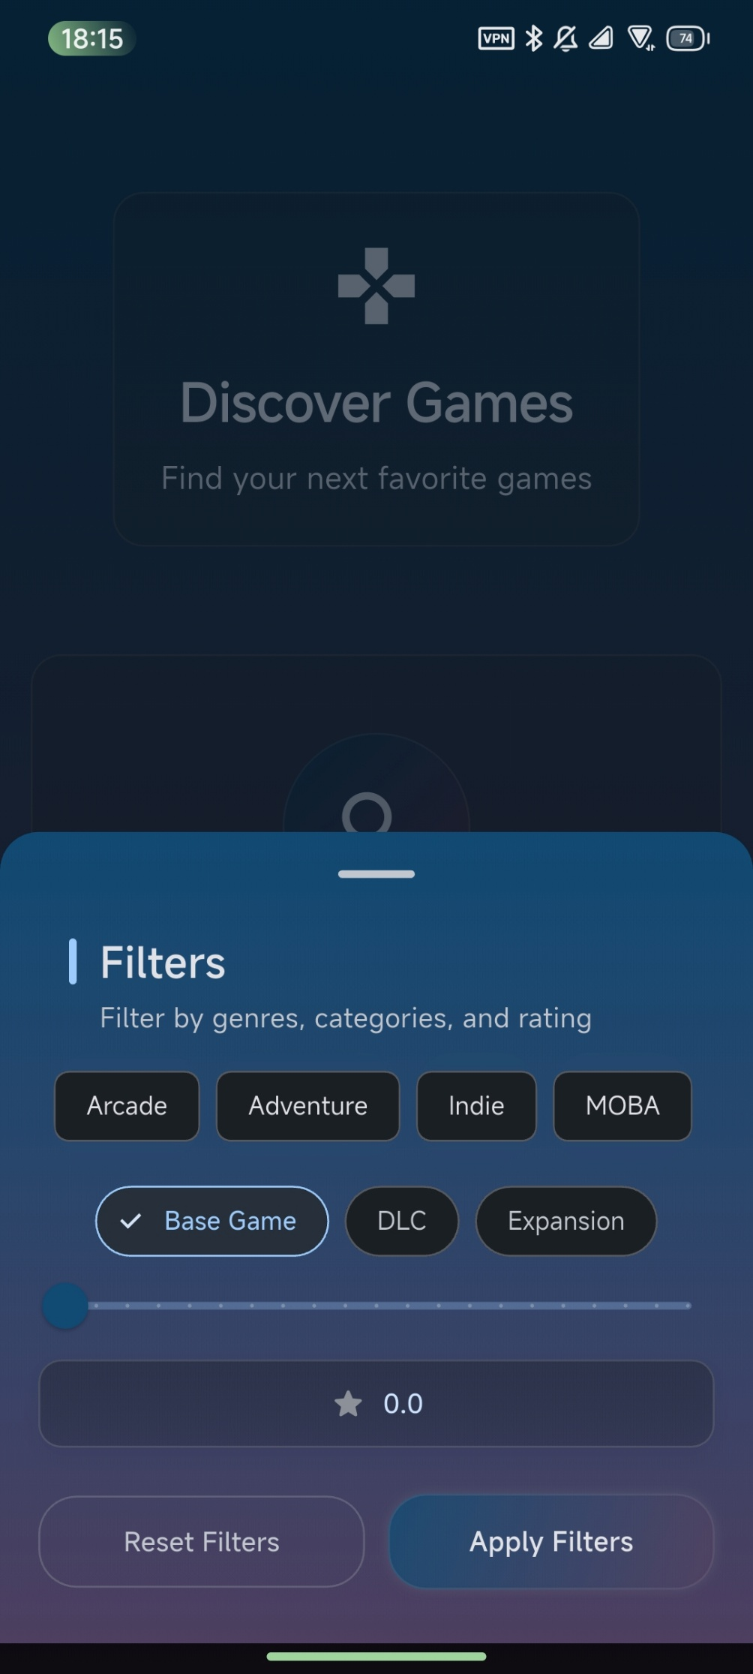

Slide 7
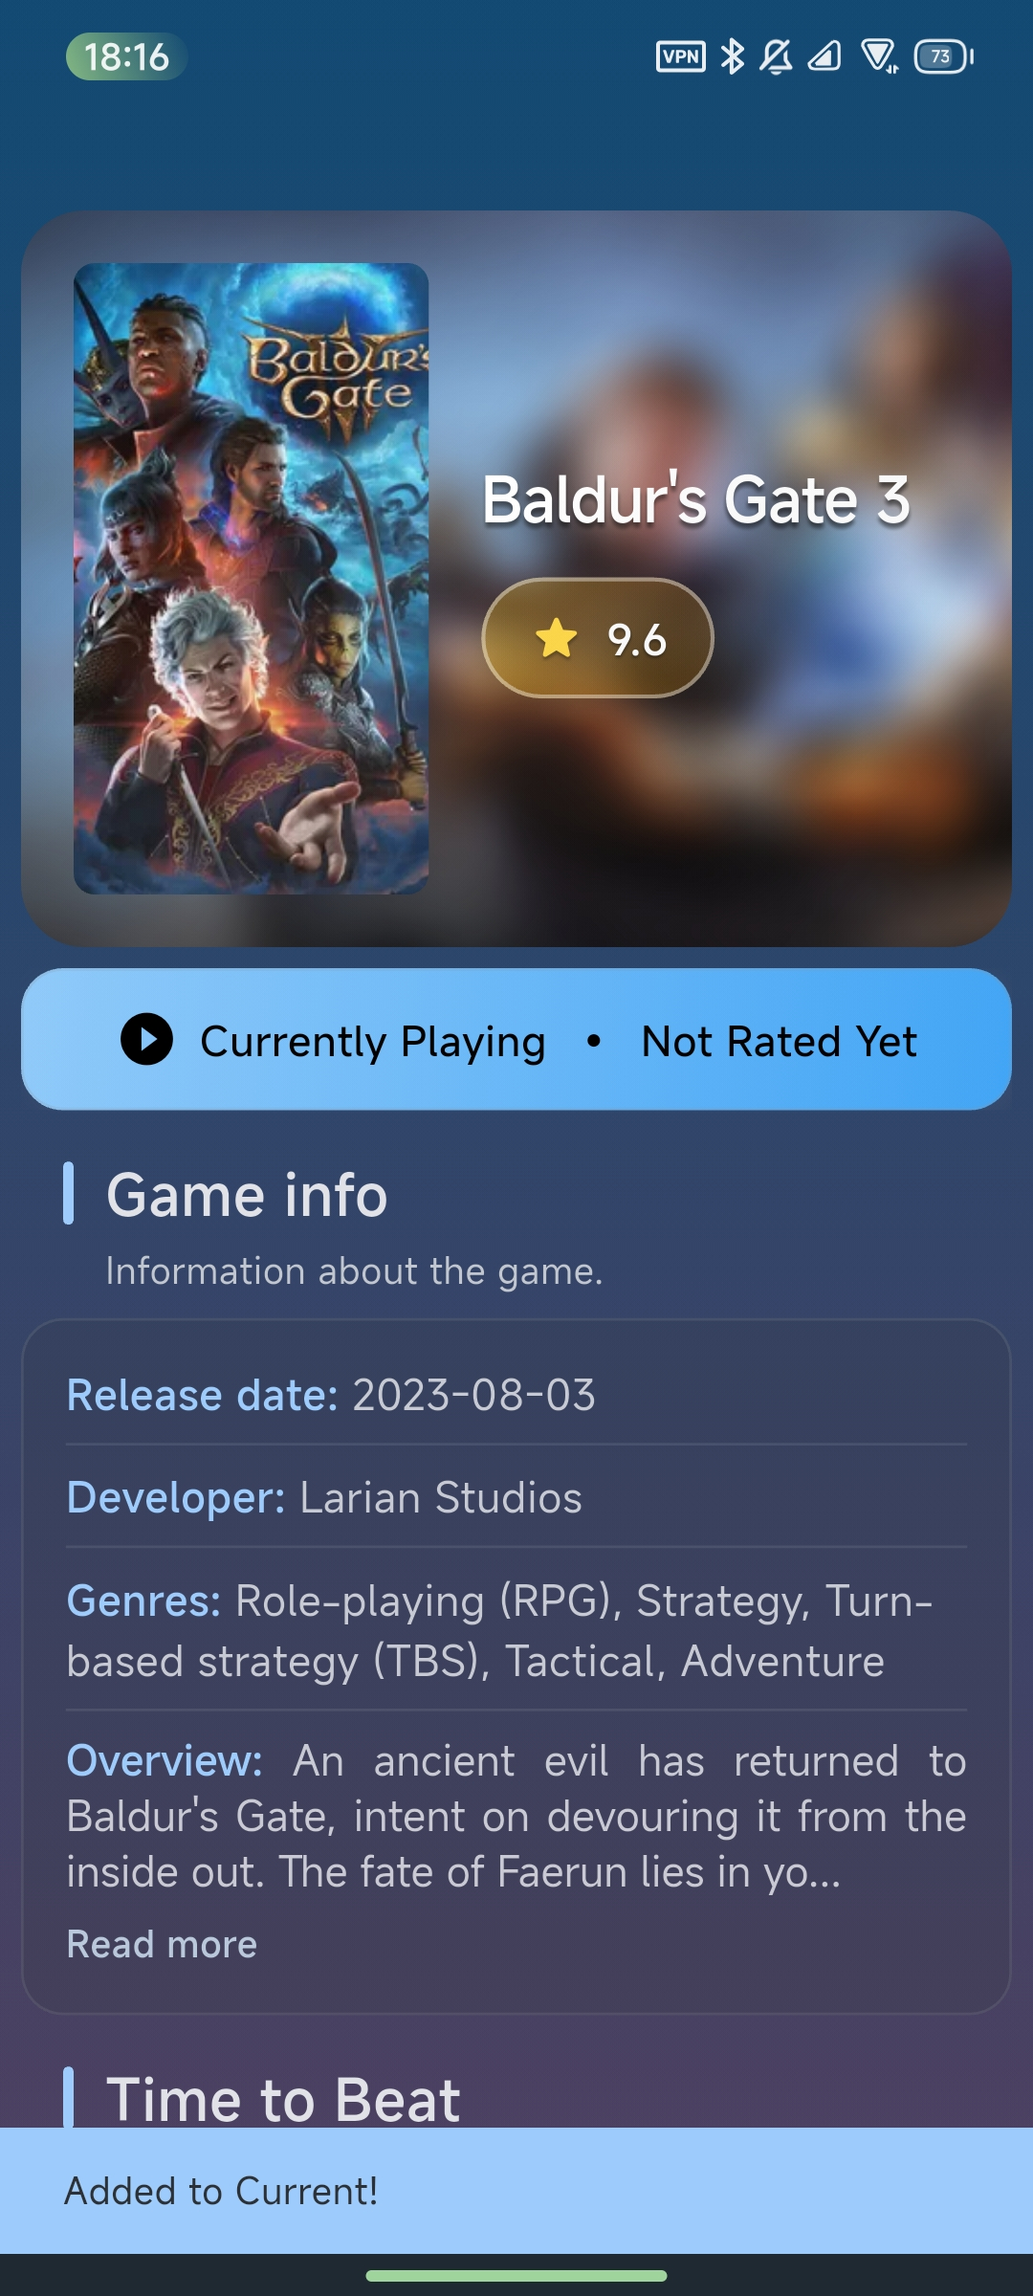
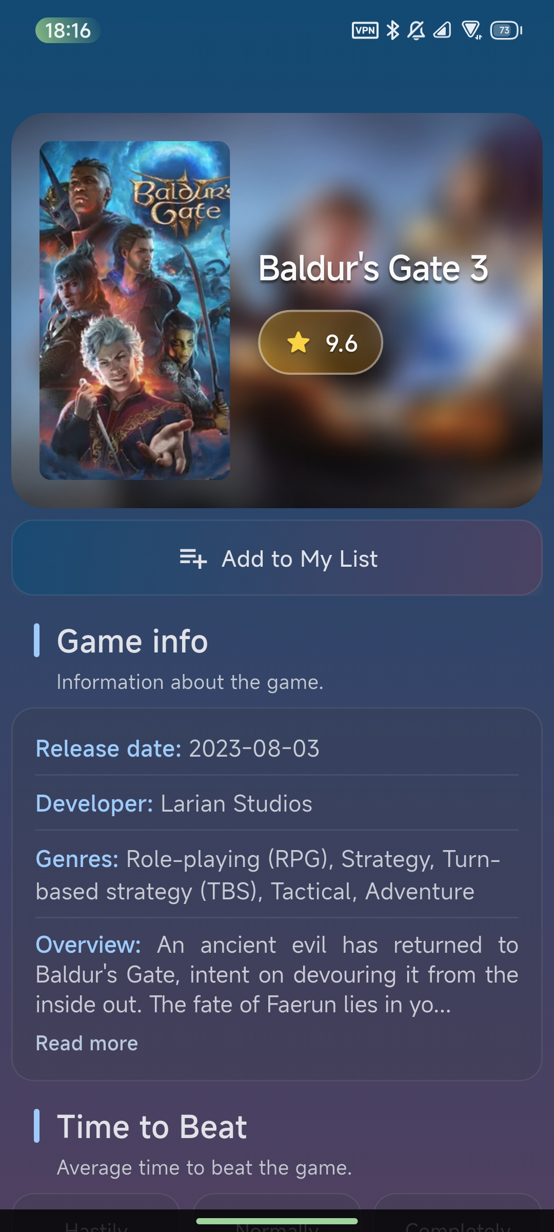
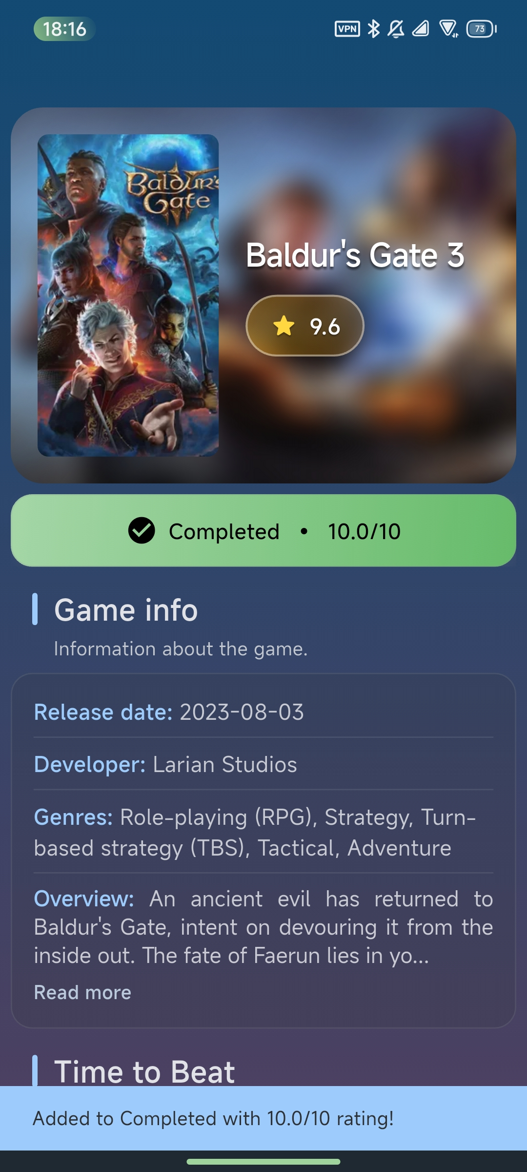
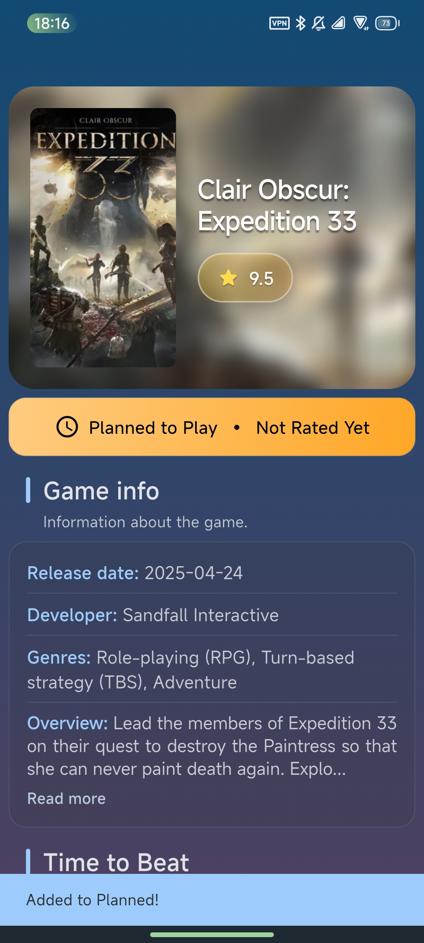
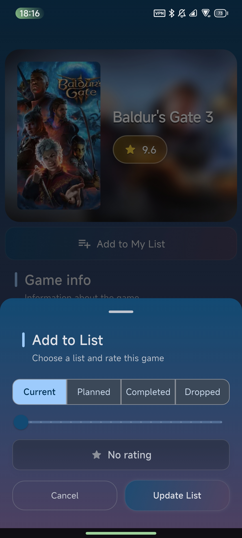
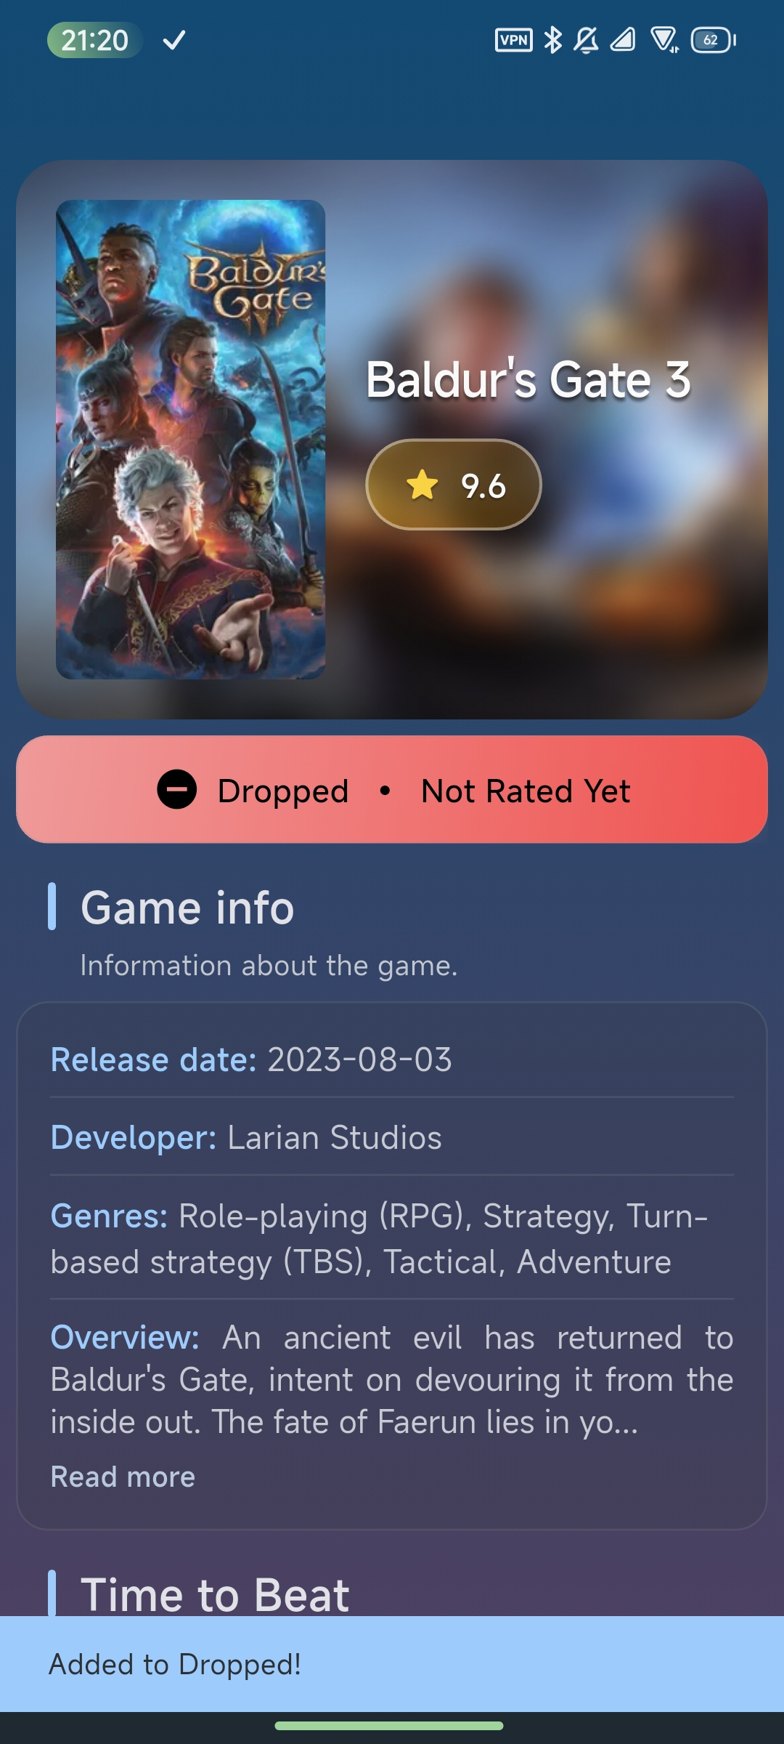

Slide 8
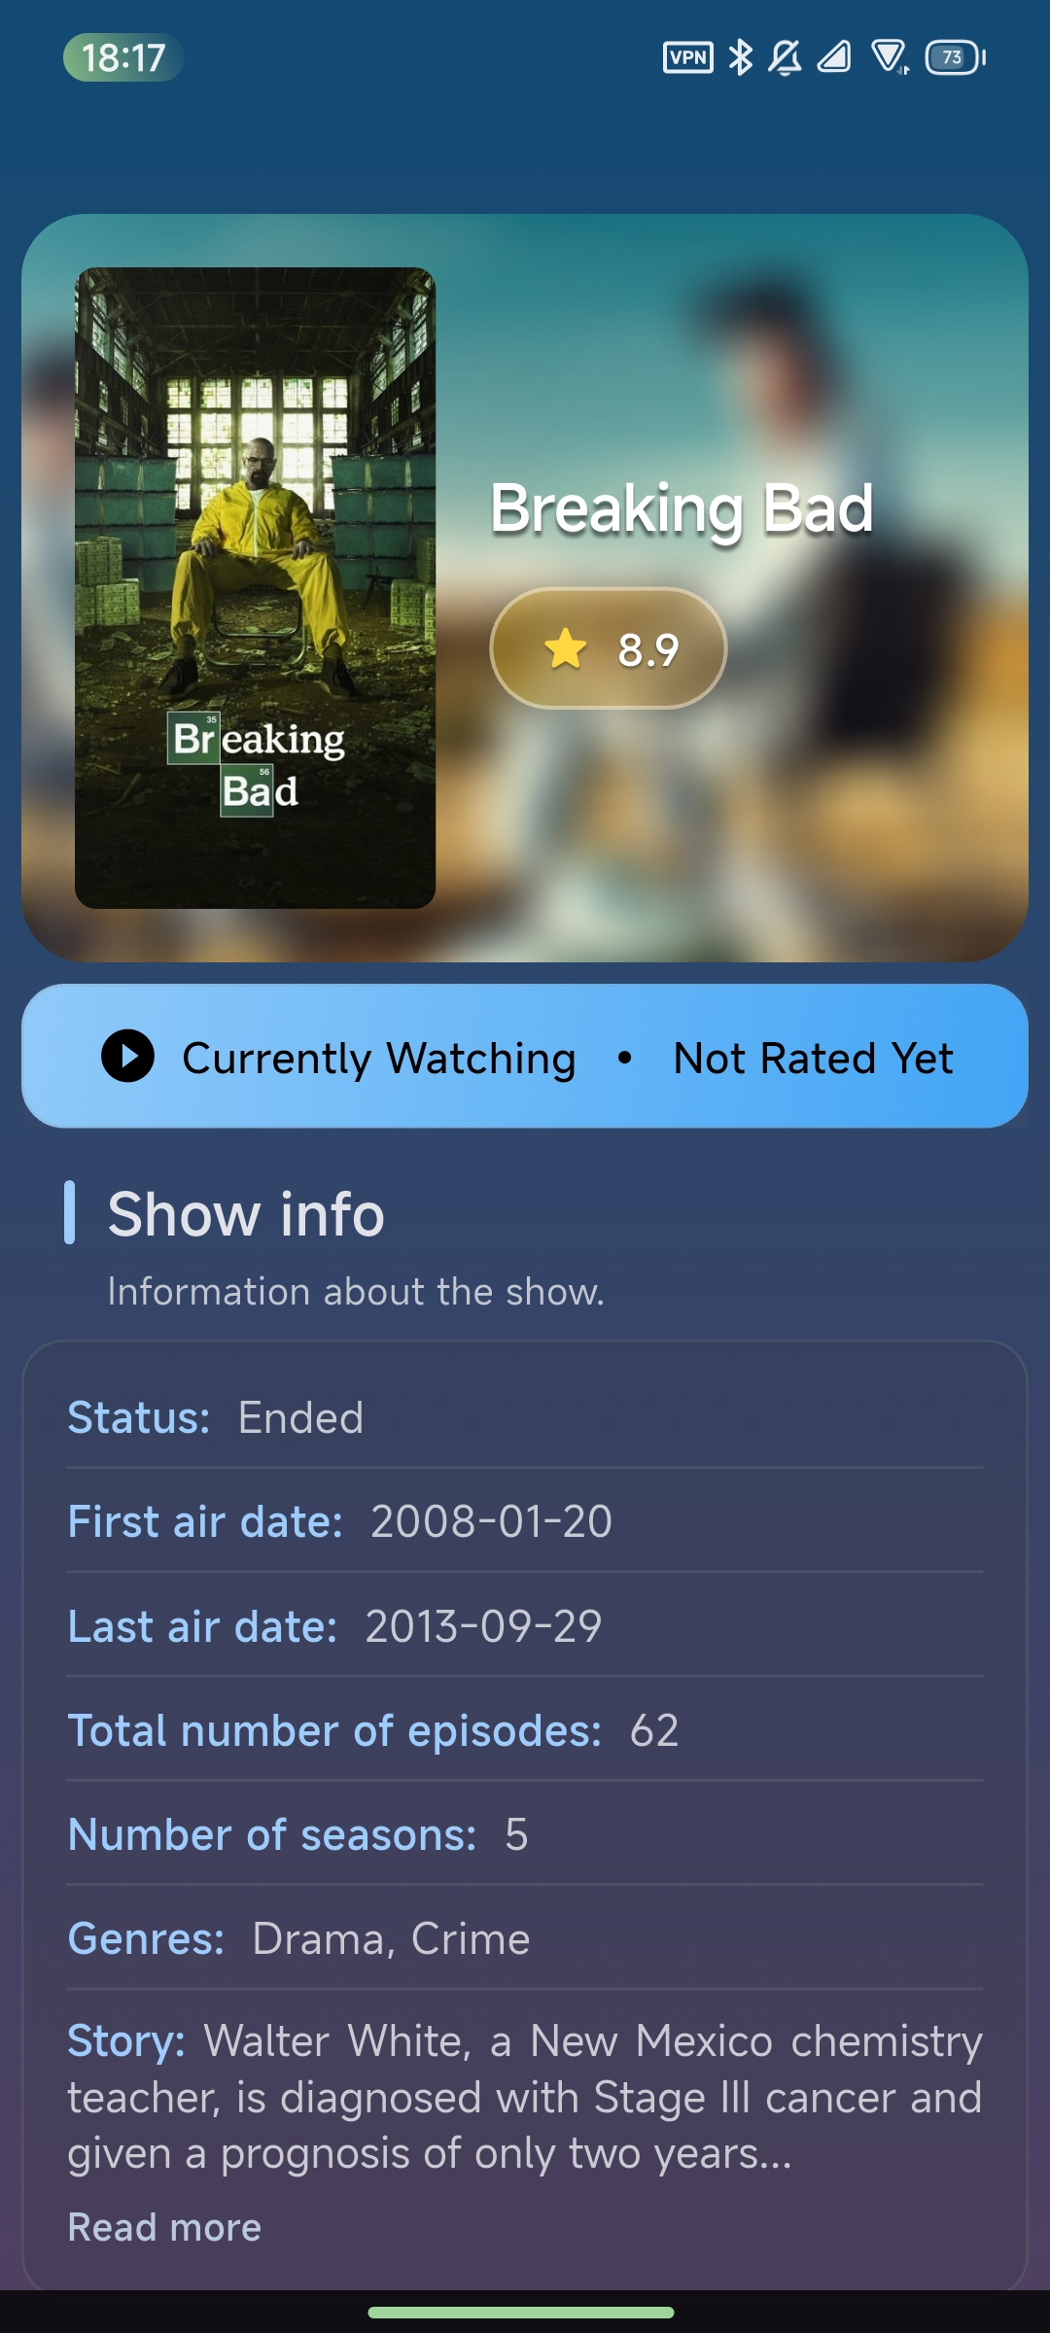
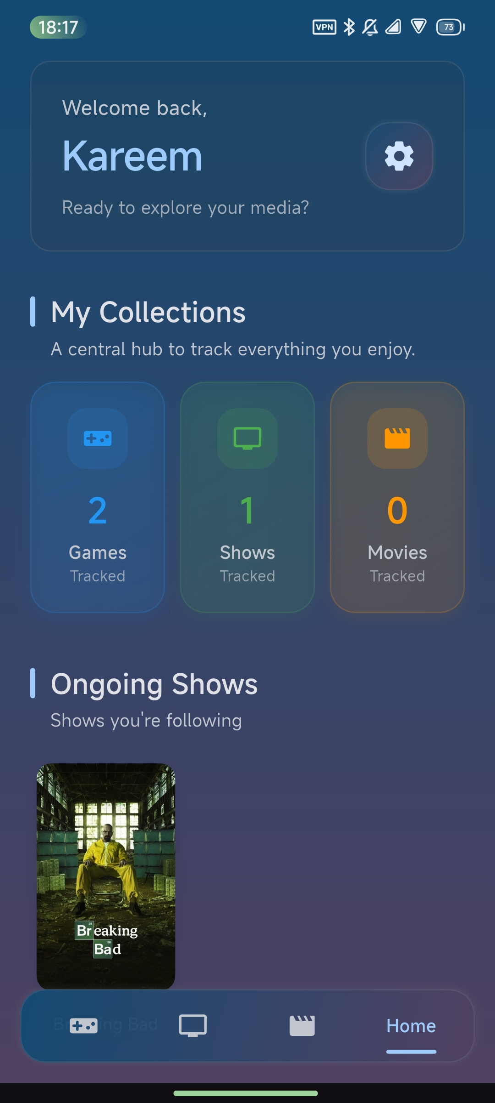

Slide 9
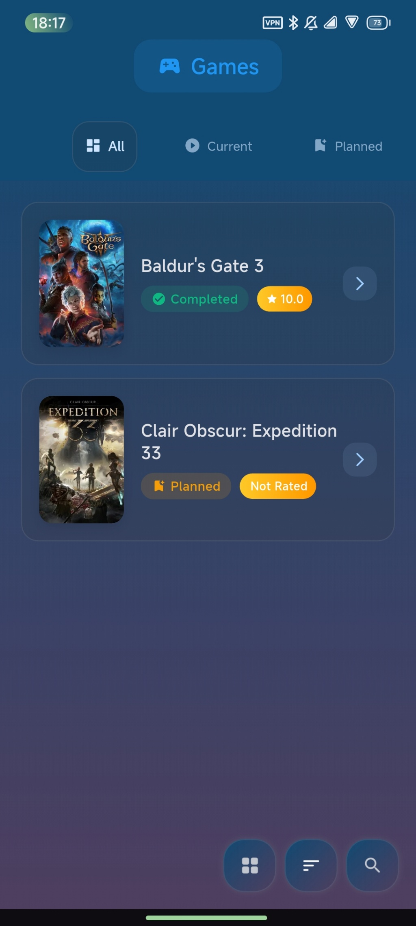

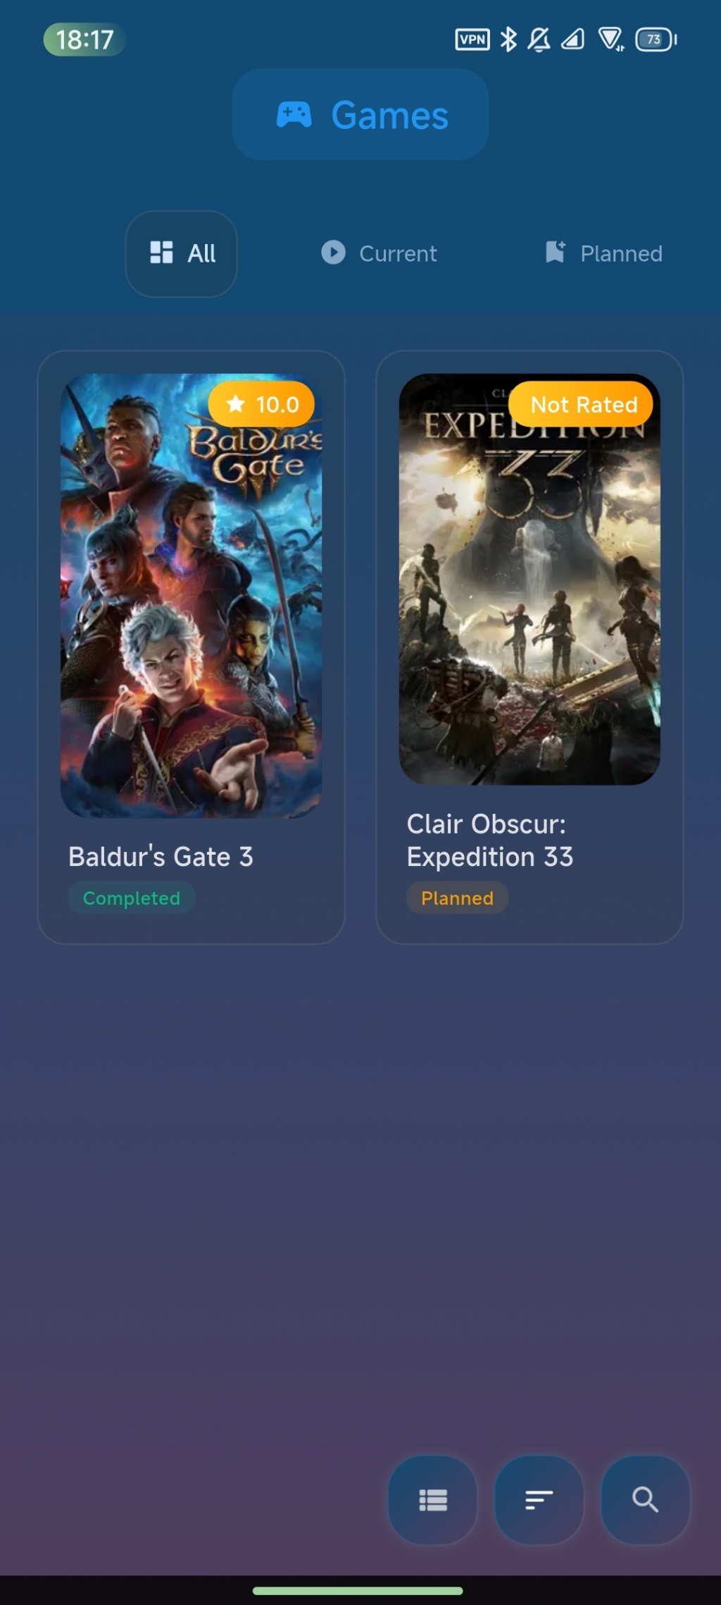
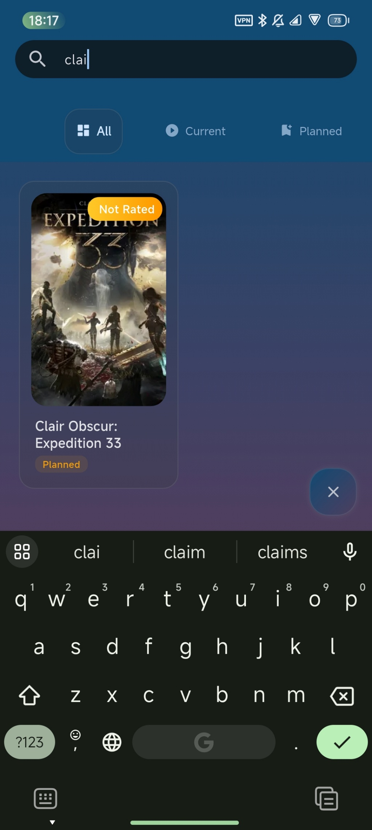

Slide 10
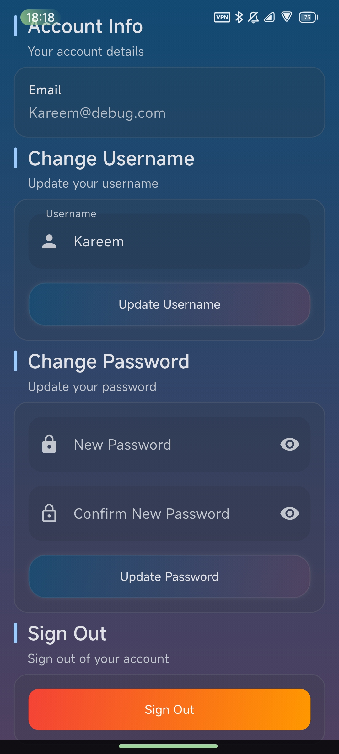
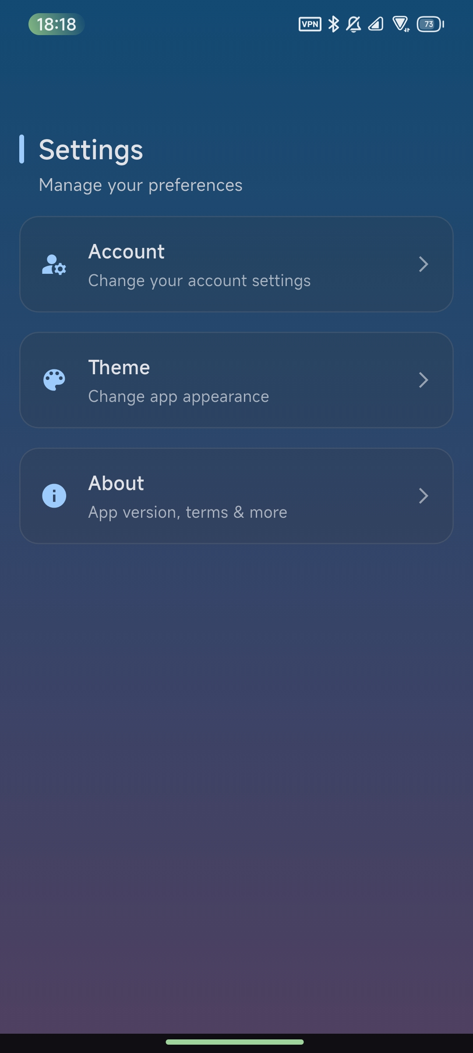
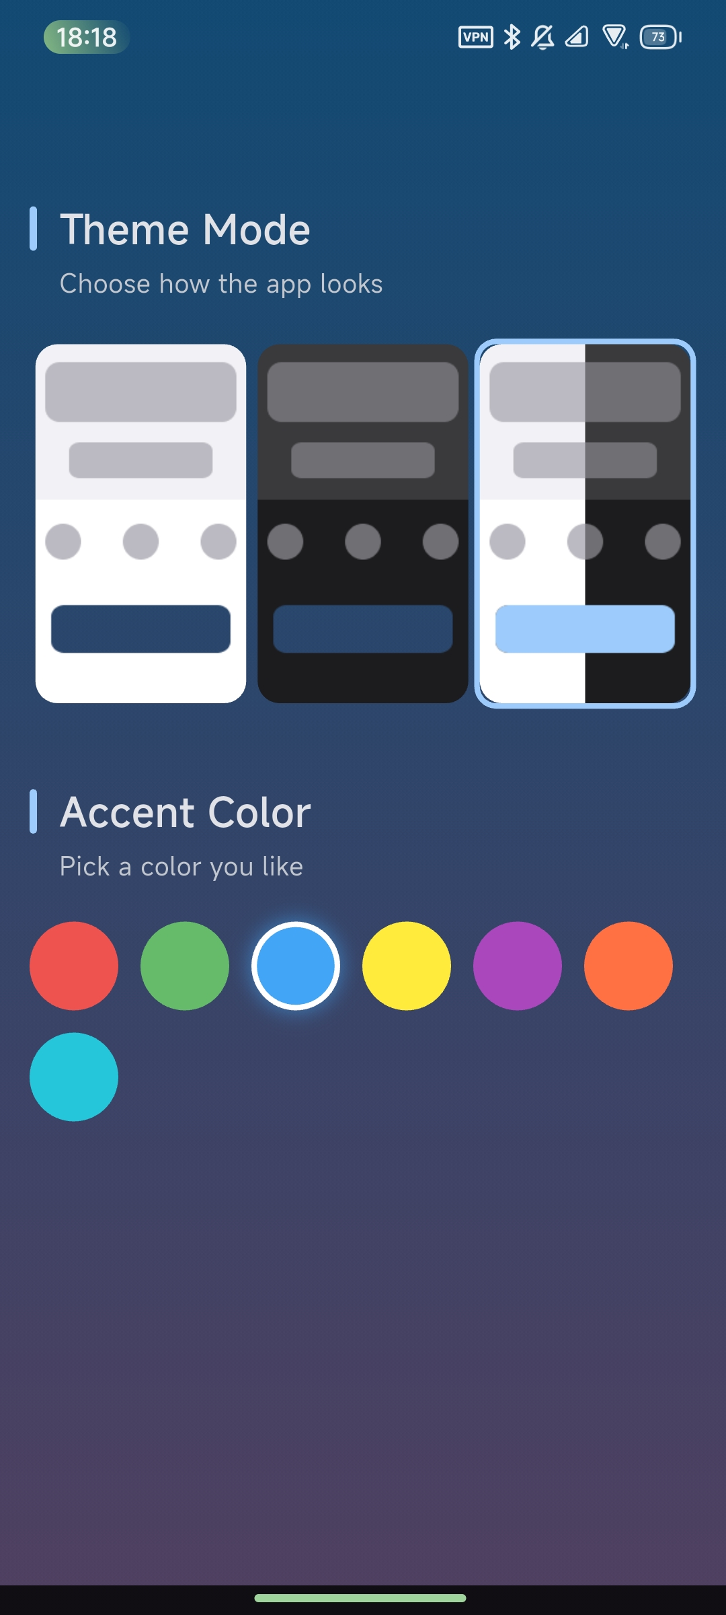
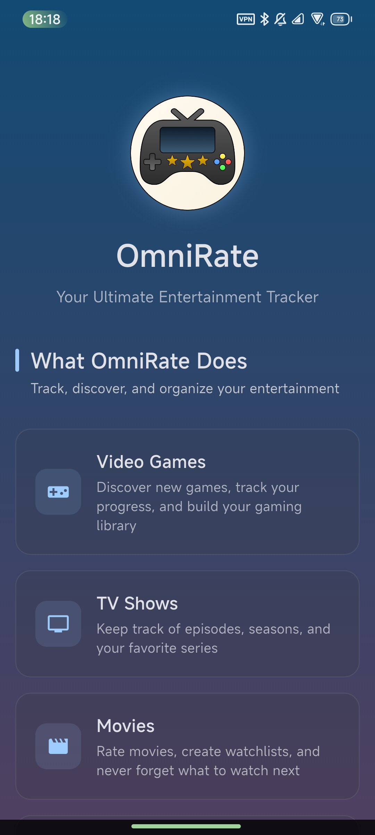

Slide 11
Tech Stack & Challenges
IGDB, Rate limits, custom queue, batching, multiqueries
TMDB, Unreliable endpoints manual API call config
Hive, First-time use, local caching to reduce API calls
Firebase, Syncing lists with Hive for cross-device access
Custom made builds, navigation bar, carousels, animated artworks
Consistent theme in every element in the app
Providers, for changing vars that affect the entire app
Base classes for inheritance

Slide 12
What’s Next?
AI-powered media recommendations
Social features to connect and share
Profiles, friends, feeds, and comments

