Slide 1
Cyclistic Membership Campaign
Marketing Analyst Team
May 2021
Notes:
Cyclistic is a fictional cycling company that offers various subscription plans to its customers, with over 600 stations all over the city, the packages cover both member and casual cyclists, the executive team figured that memberships harvests more revenue for the company. So we’re about to explore that

Slide 2
Problem vs Solution
Problem: Revenue can maximized by increasing the member base.
Solution: Marketing campaigns based on solid data aims at converting casual users to members.
Notes:
My task here, with the help of the team would first be identifying the different behaviors between both casual and member users , then after careful investigation of the data provided (provided by station’s logs) we should be able to come up with clever ways to convert casual users to a members.

Slide 3
Analytical Goals
WHY: Does member users represent more revenue to the company.
HOW: Targeting certain behaviors of different groups as a base for marketing campaings.
Notes:
The data was provided by Motivate International Inc (License Provided), a company that operates the City of Chicago’s Divvy bicycle sharing service. The source makes the data reliable, original and cited. The information is new too as it dates Year 2021. Moreover, the company grants full access to the data.
As for the data itself, sure some insights can be extracted, for instance, types of riders are provided (casual or annual), bicycle type, as well as the duration of each ride, those metrics would be investigated carefully to try find patterns. No duplicates were found, also each column seems to be in a correct format.
I managed to upload the data to a google drive in a spreadsheet for other data analyst is to join the case study. Data integrity was checked by inspecting the column’s correct format, checking for duplications and the size of the data. However, rides with 0 ride duration time where cleaned from the data to avoid outliners. New calculated fields where created through the software to represent the new columns, a dashboard was also created using the app for presenting. Finaly, As you see here Microsoft Power Point is then used for documentation and to present important information and illustrations.

Slide 4
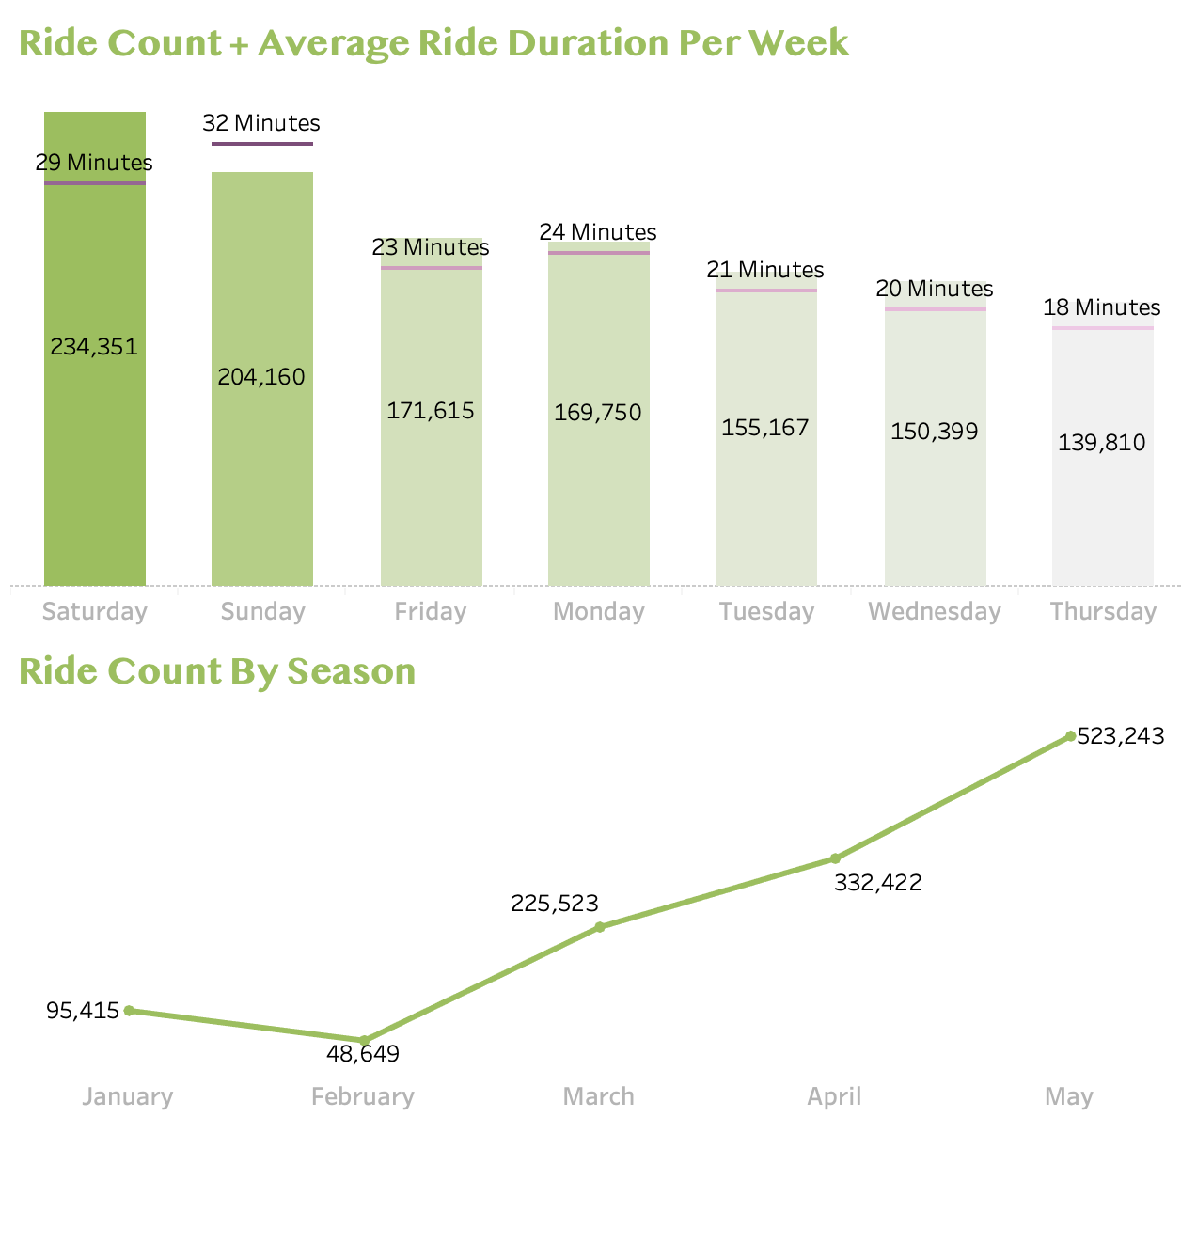
Overall Behavior
Most rides are recorded on the weekend with average 24 minutes
Huge rise of ride count as we approach spring.
Notes:
An overview analysis was performed to get quick summary of the data

Slide 5
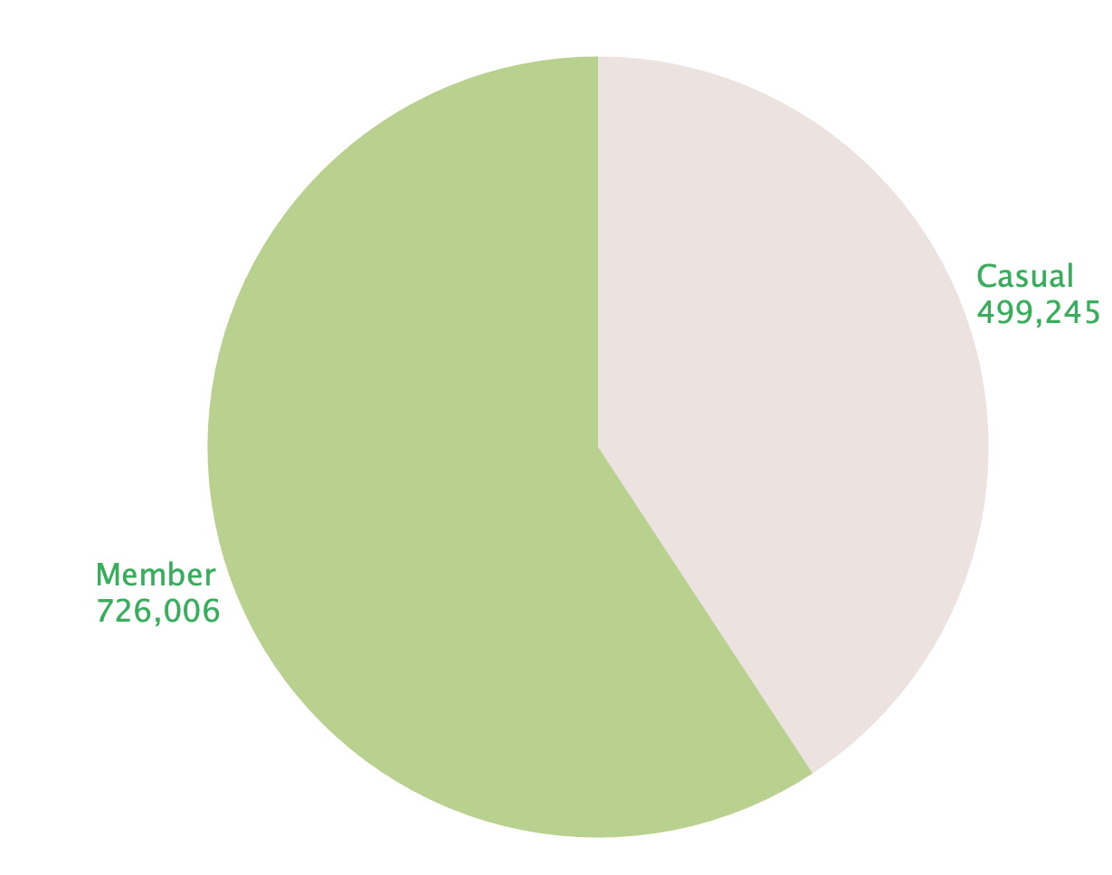
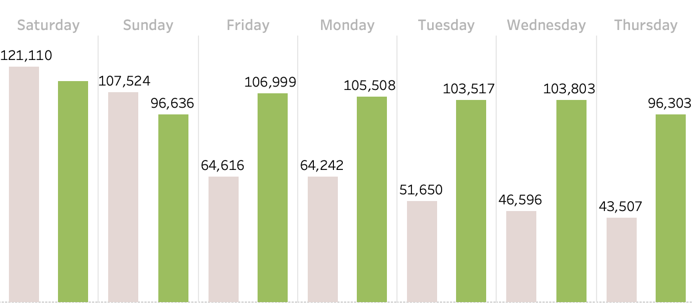
WHY: Does member users represent more revenue to the company.
Members represent more overall rides.
Members ride are more consistent throughout the week
Notes:
Then I drove a bit deeper to try figure what data reveals why members bring more value than casual members

Slide 6
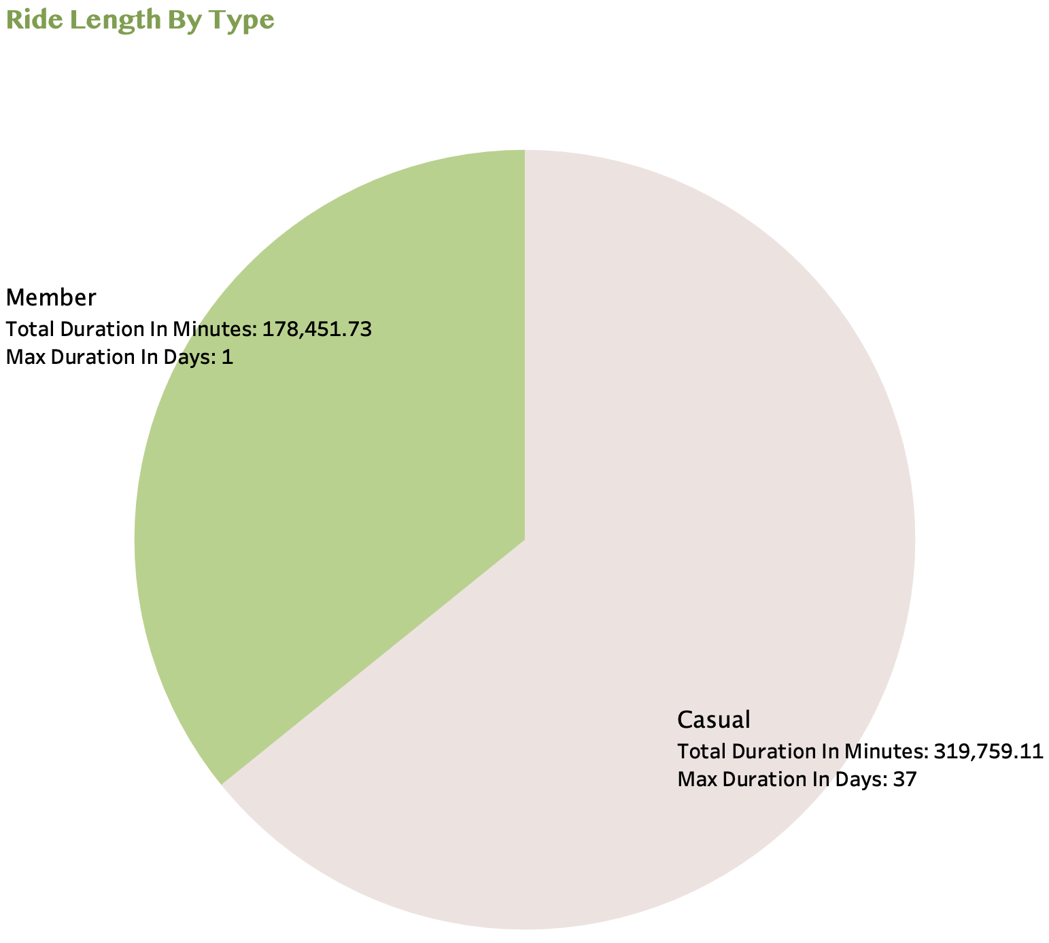
HOW: Targeting certain behaviors of different groups as a base for marketing campaings: Observation 1
Casual users spend more time on rides.
Casual users has maximum ride duration of 37 days
Conclusion: It would be cheaper for casual users who spend more time in a ride to have an actual membership
Notes:
I then wanted to know which casual user behaviors we can target in our next marketing campaign.

Slide 7
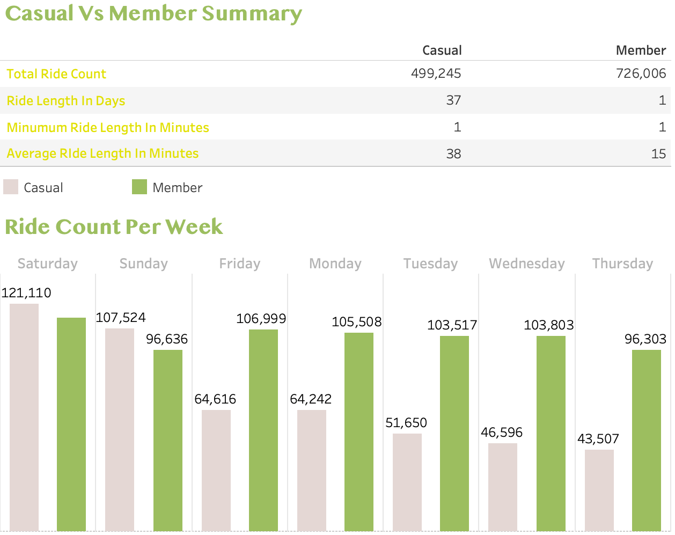
HOW: Targeting certain behaviors of different groups as a base for marketing campaings: Observation 2
Most casual users use the ride service on the weekends.
Conclusion: Flexible weekend membership.

Slide 8
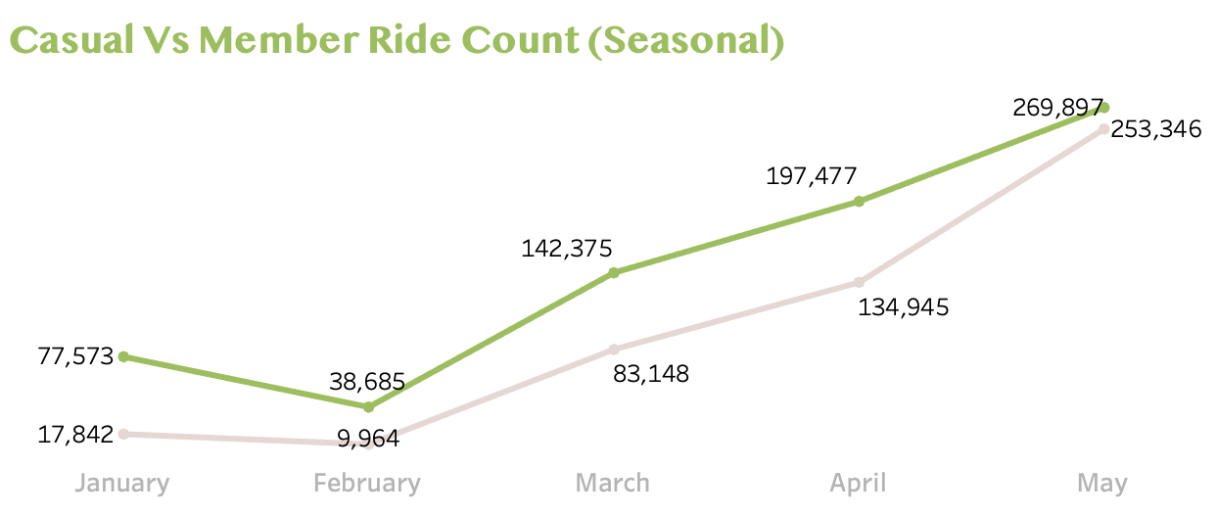
HOW: Targeting certain behaviors of different groups as a base for marketing campaings: Observation 3
Ride counts performed by both casual and member users spike up as we move away from winter, approaching spring.
Conclusion: Best time for launch of marketing campaign.
Notes:
We now have an overall perspective as well as more detailed view between different behaviors of casual users compared to members.

Slide 9
In Summary
Why: Members represent a more consistent income with a larger ride count to the company.
How: Casual users can be targeted on certain part of the year with flexible membership offers. Moreover, certain casual users need to be aware of how creating a membership could be cheaper.
Notes:
Last but least I concluded the following

Slide 10
Next Steps
Try update logging system with more variables, such as rider’s id to open doors for member specific analysis.
Repeat Analysis in 6 months after the system update, also by then we would be have more seasonal data available.

