Slide 1
WDM
8-Channel WDM System
Performance Evaluation using PIN & APD Detectors
Optical
Communication
System
Analysis
8
2
4
16
Channels
Detector Types
Laser Types
Simulations
• BER and Q-Factor Analysis • Eye Diagram Evaluation • Cross-Channel Comparison • Detector Performance Benchmarking
OptiSystem Simulation Project
Made by: Yousef Taha 221174 Ahmed Saeed 221220
Kareem Nabil 221036
Supervision: Dr. Abdullah Ramsessi

Slide 2
Presentation Outline
01
System Architecture & Configuration
06
Cross-Channel Performance Ranking
WDM layout, fiber parameters, amplifier setup
Best/worst channels with justification
02
Channel Configuration Summary
07
Laser Type Impact Analysis
8 channels: laser types, power levels, detectors
CW vs DML vs Single-Mode vs Empirical
03
BER & Q-Factor Results — All Channels
08
Input Power vs BER Relationship
Complete simulation data tables
Effect of optical power on signal quality
04
Individual Channel Analysis (Ch 1–8)
09
Eye Diagram Interpretation
Eye diagrams, waveforms, detailed metrics
Waveform clarity and distortion analysis
05
PIN vs APD Detector Comparison
10
Validation & Conclusions
Sensitivity, gain, noise analysis
Expected trends, anomalies, recommendations

Slide 3
WDM System Architecture
OptiSystem Simulation — Full Layout Overview
8 Optical
Transmitters
PIN Detector
→ BER Analyzer
WDM
Mux (8×1)
Optical
Fiber
EDFA
Amplifier
WDM
Demux (1×8)
4 Laser Types
Mach-Zehnder Mods
Insertion Loss
3 dB
DCF + NZDSF
NLTF_1
Gain 15.1 dB
NF = 5 dB
Insertion Loss
3 dB
APD Detector
→ BER Analyzer
Parameter | Value
Sequence Length | 128 bits
Sample Rate | 2.5e12 Hz
Bit Rate | Bitrate (variable)
Fiber (NZDSF) | ~10.1 dB loss
EDFA Gain | 15.1 dB
EDFA Noise Figure | 5 dB
DCF Length | ~12.5 km
WDM Loop Count | 3 loops
WDM Mux Insertion Loss | 3 dB
System Design Notes
Three optical fiber loops with DCF compensation simulate realistic long-haul propagation
EDFA placed post-transmission compensates for cumulative fiber attenuation
Both PIN and APD receivers evaluated per channel for comprehensive detector comparison
Low-pass Bessel filters (cutoff = 0.75×Bitrate Hz) used at receivers to limit noise bandwidth
Power Splitters (1×2) distribute signal to both detector branches simultaneously
Oscilloscope and BER Analyzer capture both time-domain and statistical performance

Slide 4
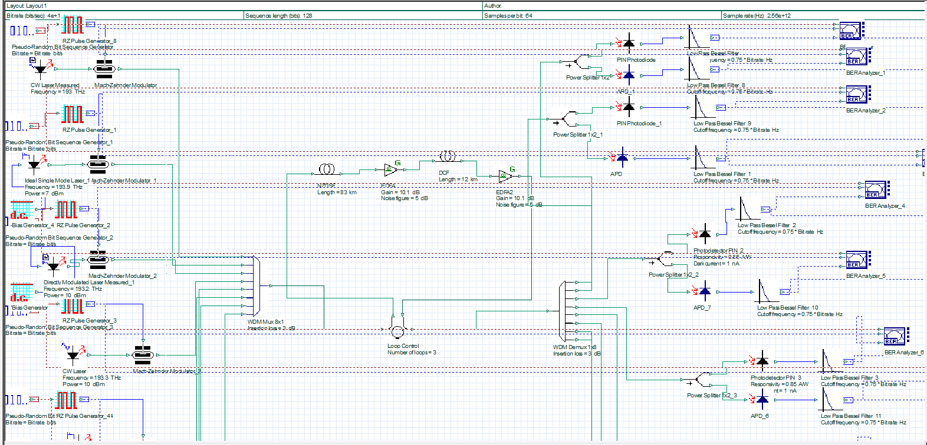
WDM System Architecture
OptiSystem Simulation — Full Layout Overview

Slide 5
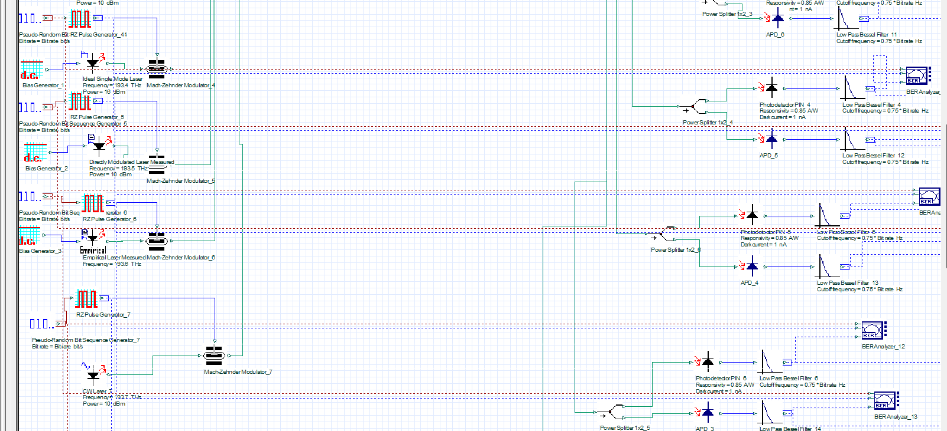
WDM System Architecture
OptiSystem Simulation — Full Layout Overview

Slide 6
Channel Configuration Summary
8-Channel WDM System — Transmitter Properties
Ch # | Laser Type | Input Power | Modulator | PIN BER | APD BER | Best Detector
CH 1 | CW Laser m | 16 dBm | Mach-Zehnder | 8.73×10⁻⁷ | 9.18×10⁻⁷ | ≈ Equal
CH 2 | Ideal Single-Mode | 7 dBm | Mach-Zehnder | 4.06×10⁻⁷⁸ | 5.52×10⁻⁵⁷ | PIN
CH 3 | Directly Modulated | 10 dBm | Direct (built-in) | 4.12×10⁻⁶ | 3.50×10⁻⁶ | APD
CH 4 | CW Laser | 10 dBm | Mach-Zehnder | 4.58×10⁻⁴ | 4.32×10⁻⁴ | APD
CH 5 | Ideal Single-Mode | 10 dBm | Mach-Zehnder | 3.73×10⁻⁷ | 3.37×10⁻⁷ | APD
CH 6 | Directly Modulated | 10 dBm | Direct (built-in) | 7.41×10⁻⁶ | 8.37×10⁻⁶ | PIN
CH 7 | Empirical Laser | N/A | External | 1.13×10⁻¹¹ | 4.84×10⁻¹² | APD
CH 8 | CW Laser | 11 dBm | Mach-Zehnder | 1.57×10⁻¹² | 6.62×10⁻¹³ | APD
* All channels use Low-Pass Bessel Filters with cutoff = 0.75×Bitrate Hz at the receiver. Colors: Green = PIN better, Blue = APD better.

Slide 7
Master Results: BER & Q-Factor — All Channels
Complete simulation results with quality assessment
Channel | Q (PIN) | BER (PIN) | Status (PIN) | Q (APD) | BER (APD) | Status (APD) | Gain APD>PIN
CH 1 | 4.781 | 8.73e-7 | Marginal | 4.770 | 9.18e-7 | Marginal | -0.2%
CH 2 | 18.652 | 4.06e-78 | Excellent | 15.836 | 5.52e-57 | Excellent | -15.1%
CH 3 | 4.405 | 4.12e-6 | Poor | 4.440 | 3.50e-6 | Poor | +0.8%
CH 4 | 3.309 | 4.58e-4 | Poor | 3.326 | 4.32e-4 | Poor | +0.5%
CH 5 | 4.930 | 3.73e-7 | Marginal | 4.950 | 3.37e-7 | Marginal | +0.4%
CH 6 | 4.296 | 7.41e-6 | Poor | 4.270 | 8.37e-6 | Poor | -0.6%
CH 7 | 6.683 | 1.13e-11 | Good | 6.807 | 4.84e-12 | Good | +1.9%
CH 8 | 6.963 | 1.57e-12 | Good | 7.085 | 6.62e-13 | Excellent | +1.7%
Excellent: BER ≤ 10⁻¹²
Good: BER ≤ 10⁻⁹
Marginal: BER ≤ 10⁻⁶
Poor: BER > 10⁻⁶

Slide 8
Q-Factor Comparison: All Channels
PIN vs APD detectors — higher Q = better performance
Key Observations
CH 2 dominates with Q = 18.65 (PIN) — ideal laser at low power
CH 4 is the worst performer (Q ≈ 3.3) — CW at 10 dBm with heavy crosstalk
APD slightly outperforms PIN in most channels
CH 2: PIN > APD — single-mode coherence advantage
Threshold Q = 6 for BER ≤ 10⁻⁹
Only CH 7 & CH 8 comfortably exceed Q = 6 threshold

Slide 9
BER Performance Overview: All Channels
Logarithmic scale — lower BER = better performance
BER Summary
Channel | PIN BER | APD BER
CH 1 | 8.73e-7 | 9.18e-7
CH 2 | 4.06e-78 | 5.52e-57
CH 3 | 4.12e-6 | 3.50e-6
CH 4 | 4.58e-4 | 4.32e-4
CH 5 | 3.73e-7 | 3.37e-7
CH 6 | 7.41e-6 | 8.37e-6
CH 7 | 1.13e-11 | 4.84e-12
CH 8 | 1.57e-12 | 6.62e-13

Slide 10
Channel 1: CW Laser
Input Power: 16 dBm | PIN & APD Performance Analysis
4.781
8.73e-7
Marginal
Q-Factor (PIN)
BER (PIN)
Status (PIN)
4.770
9.18e-7
Marginal
Q-Factor (APD)
BER (APD)
Status (APD)
Channel 1 Analysis
Performance Indicators
CW Laser at highest power (16 dBm) in the WDM system
Both PIN and APD deliver nearly identical performance (Q ≈ 4.78)
BER ≈ 8.73×10⁻⁷ — above the 10⁻⁹ threshold — marginal quality
High launch power causes inter-channel crosstalk and nonlinear effects
Eye diagram shows significant noise spread, partially open eye
The high power does not compensate for WDM-induced crosstalk at 16 dBm
Metric | PIN | APD
Q-Factor | 4.78 | 4.77
Min BER | 8.73e-7 | 9.18e-7
Eye Height | 1.05e-3 | 3.13e-3
BER Status | Marginal | Marginal
Winner | ✓ | —

Slide 11
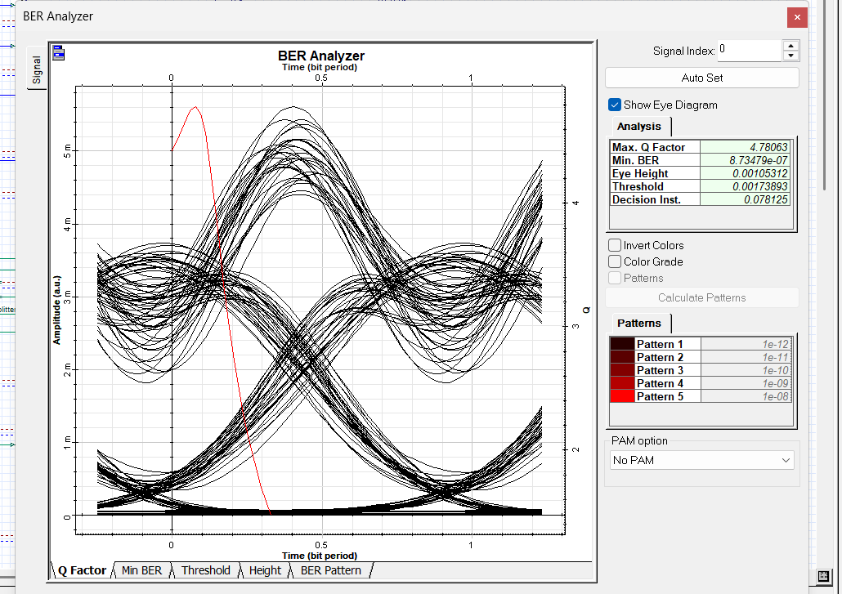
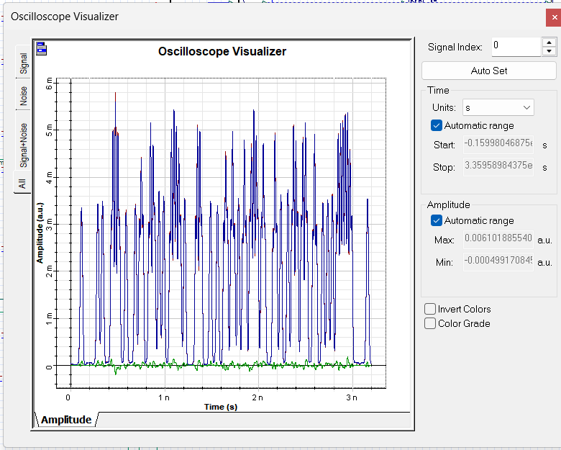
Channel 1: CW Laser
Input Power: 16 dBm | PIN Performance Analysis
4.781
8.73e-7
Marginal

Slide 12
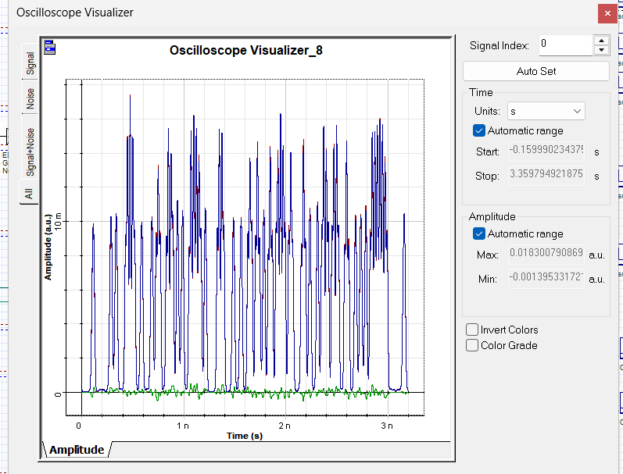
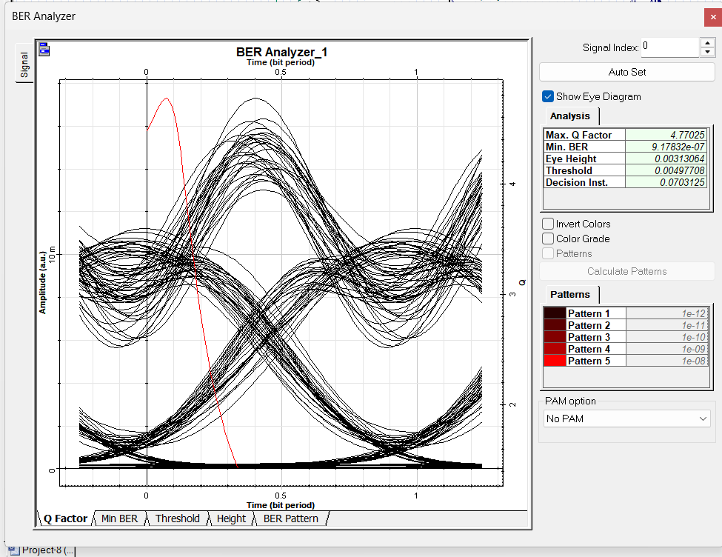
Channel 1: CW Laser
Input Power: 16 dBm | APD Performance Analysis

Slide 13
Channel 2: Ideal Single-Mode Laser
Input Power: 7 dBm | PIN & APD Performance Analysis
18.652
4.06e-78
Excellent
Q-Factor (PIN)
BER (PIN)
Status (PIN)
15.836
5.52e-57
Excellent
Q-Factor (APD)
BER (APD)
Status (APD)
Channel 2 Analysis
Performance Indicators
Ideal Single-Mode Laser at low power (7 dBm) — best performer
Q = 18.65 (PIN) — extraordinary performance, virtually error-free
BER = 4.06×10⁻⁷⁸ — essentially zero, far below any threshold
Single-mode laser eliminates modal noise and chromatic dispersion
PIN outperforms APD here — excess APD noise at low power dominates
Very clean eye diagram with maximum eye opening confirms quality
Metric | PIN | APD
Q-Factor | 18.65 | 15.84
Min BER | 4.06e-78 | 5.52e-57
Eye Height | 6.02e-4 | 1.76e-3
BER Status | Excellent | Excellent
Winner | ✓ | —

Slide 14
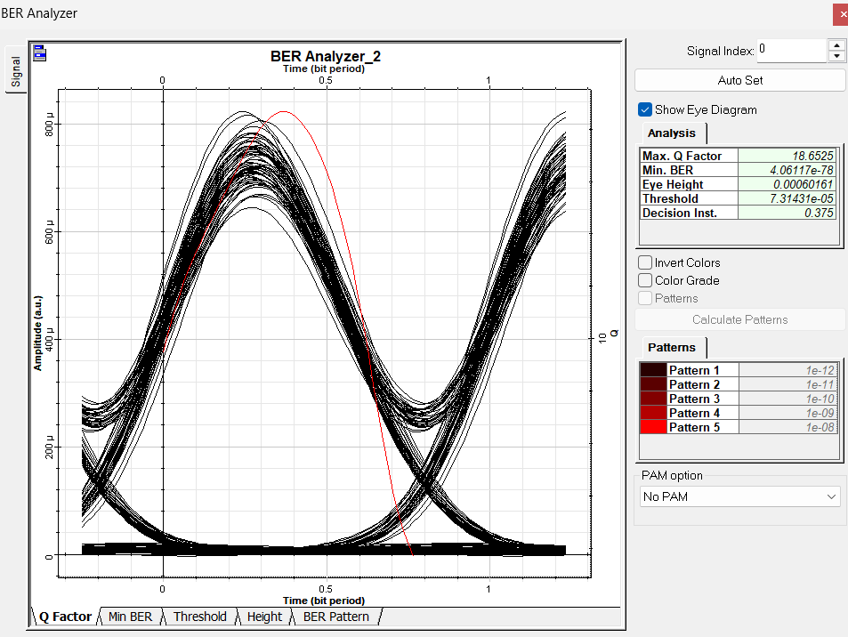
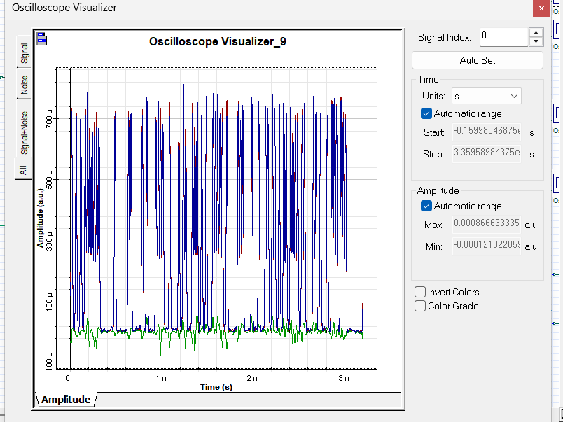
Channel 2: Ideal Single-Mode Laser
Input Power: 7 dBm | PIN Performance Analysis

Slide 15
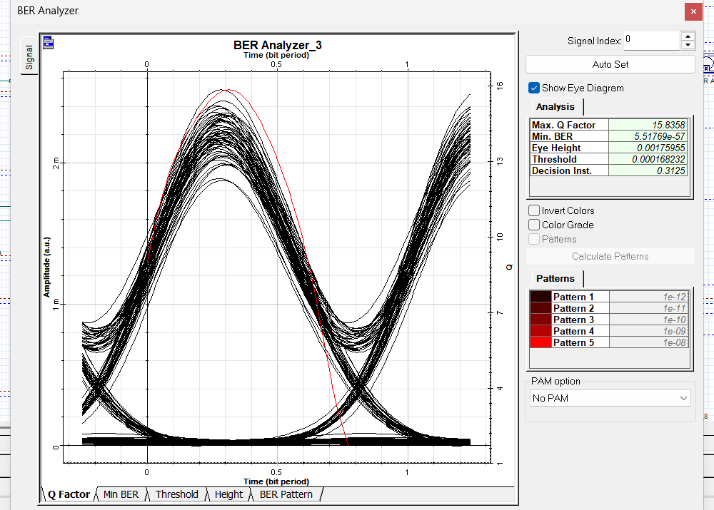
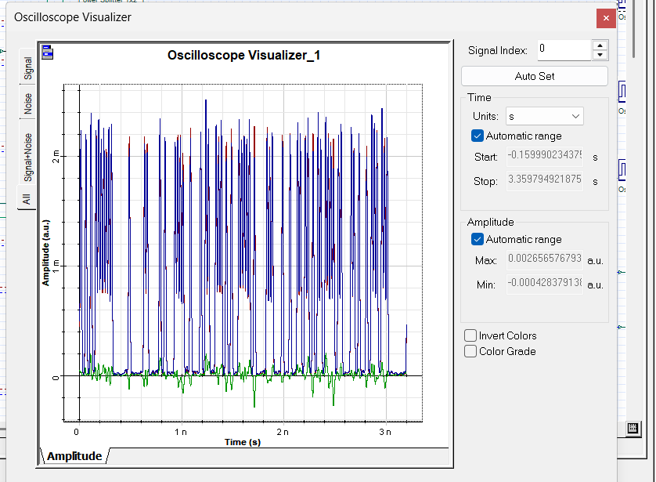
Channel 2: Ideal Single-Mode Laser
Input Power: 7 dBm | APD Performance Analysis

Slide 16
Channel 3: Directly Modulated Laser
Input Power: 10 dBm | PIN & APD Performance Analysis
4.405
4.12e-6
Poor
Q-Factor (PIN)
BER (PIN)
Status (PIN)
4.440
3.50e-6
Poor
Q-Factor (APD)
BER (APD)
Status (APD)
Channel 3 Analysis
Performance Indicators
Directly Modulated Laser (DML) at 10 dBm
Worst laser type due to inherent frequency chirp during modulation
BER = 4.12×10⁻⁶ (PIN) — above 10⁻⁹ threshold, marginal
APD slightly better (BER = 3.50×10⁻⁶) due to higher sensitivity
Chirp broadens spectral width causing extra dispersion penalty
Eye diagram shows asymmetric transitions characteristic of chirp
Metric | PIN | APD
Q-Factor | 4.40 | 4.44
Min BER | 4.12e-6 | 3.50e-6
Eye Height | 2.34e-3 | 8.39e-3
BER Status | Poor | Poor
Winner | — | ✓

Slide 17
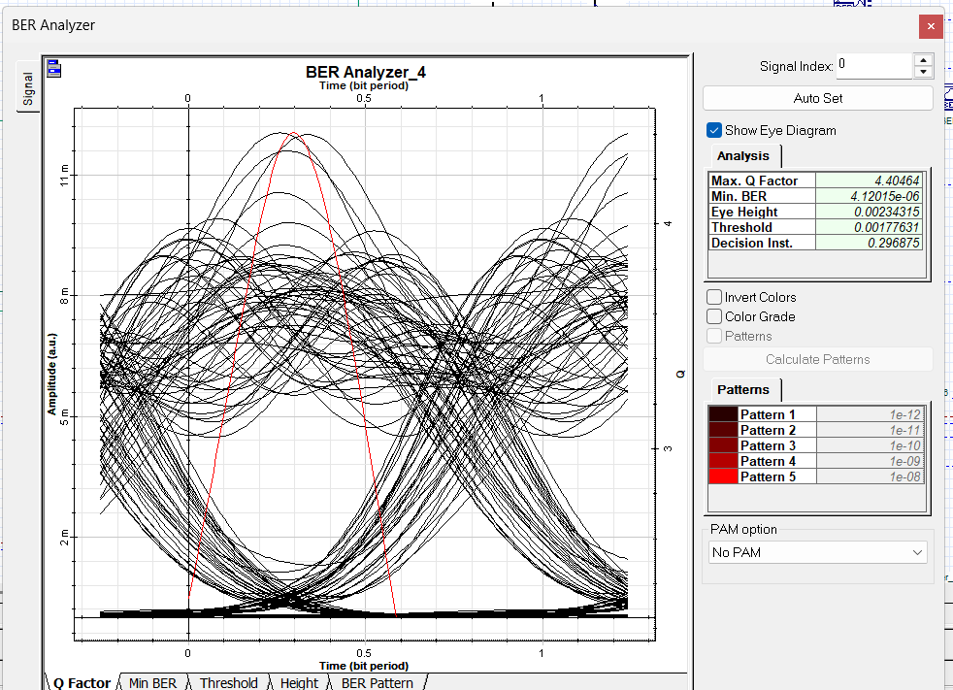
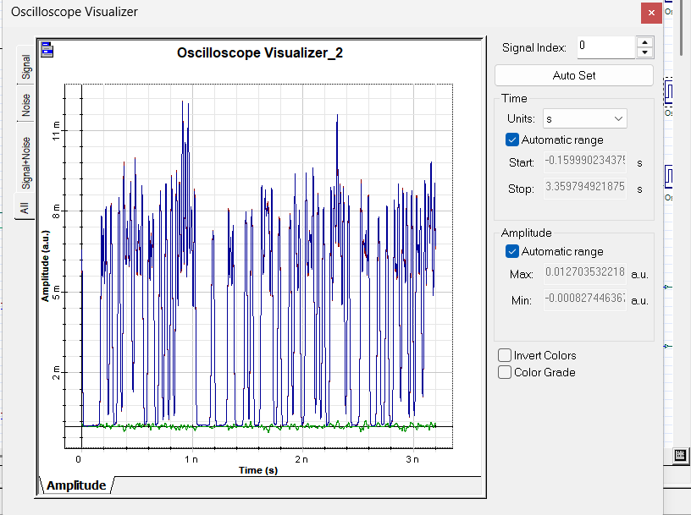
Channel 3: Directly Modulated Laser
Input Power: 10 dBm | PIN Performance Analysis

Slide 18
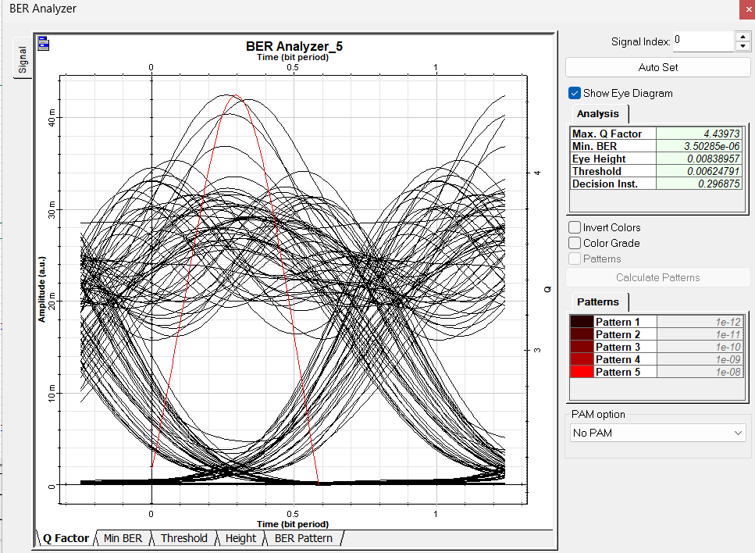

Channel 3: Directly Modulated Laser
Input Power: 10 dBm | APD Performance Analysis

Slide 19
Channel 4: CW Laser
Input Power: 10 dBm | PIN & APD Performance Analysis
3.309
4.58e-4
Poor
Q-Factor (PIN)
BER (PIN)
Status (PIN)
3.326
4.32e-4
Poor
Q-Factor (APD)
BER (APD)
Status (APD)
Channel 4 Analysis
Performance Indicators
CW Laser at 10 dBm — worst overall channel in the system
Q ≈ 3.3 — far below acceptable threshold; very poor performance
BER ≈ 4.5×10⁻⁴ — completely unacceptable for any telecom standard
Severely degraded likely due to WDM channel interference/crosstalk
This channel sits at a particularly noisy spectral position
Requires mitigation: power optimization, better filtering, or FEC
Metric | PIN | APD
Q-Factor | 3.31 | 3.33
Min BER | 4.58e-4 | 4.32e-4
Eye Height | 1.07e-4 | 4.00e-4
BER Status | Poor | Poor
Winner | — | ✓

Slide 20
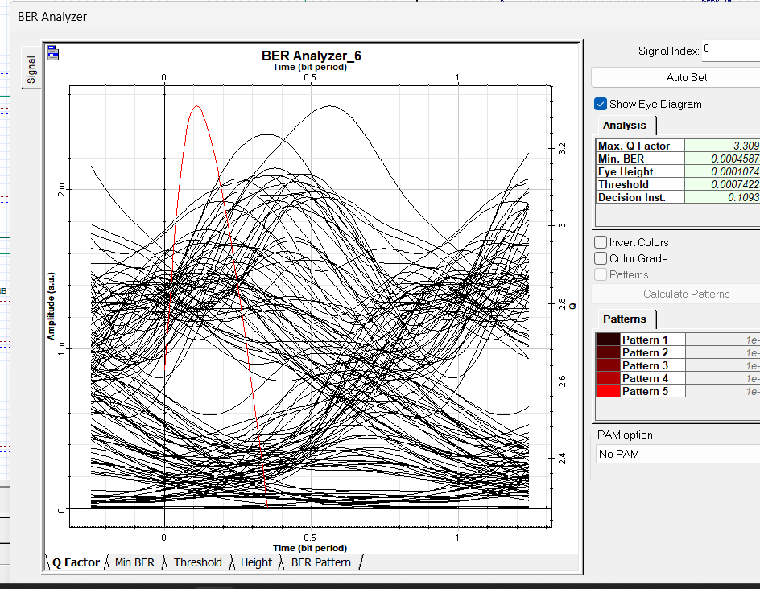
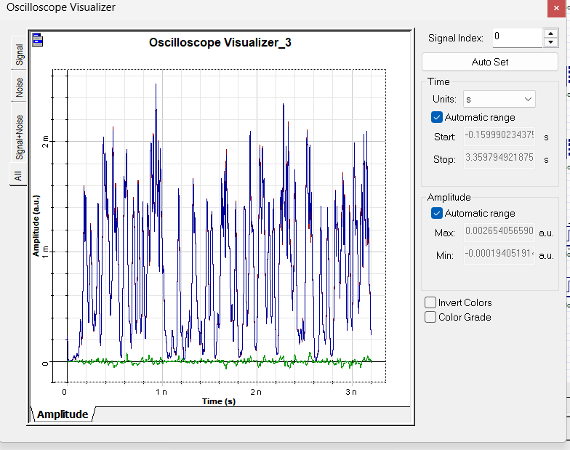
Channel 4: CW Laser
Input Power: 10 dBm | PIN Performance Analysis

Slide 21
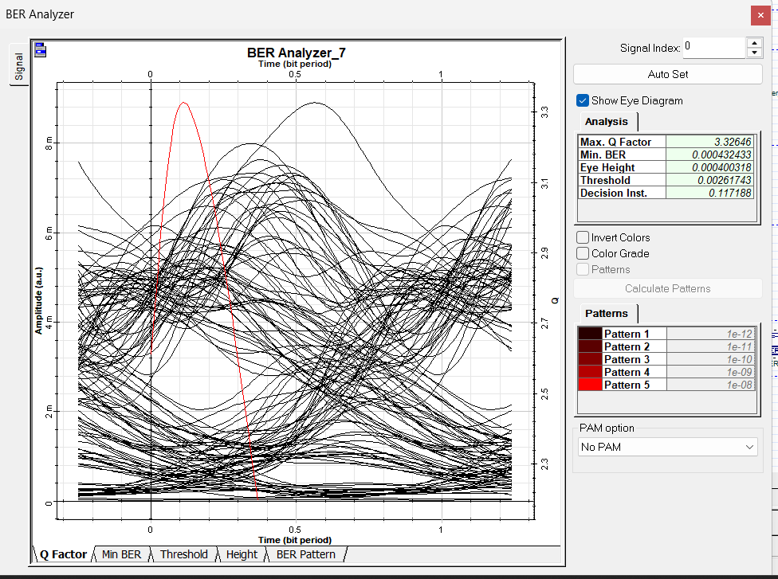
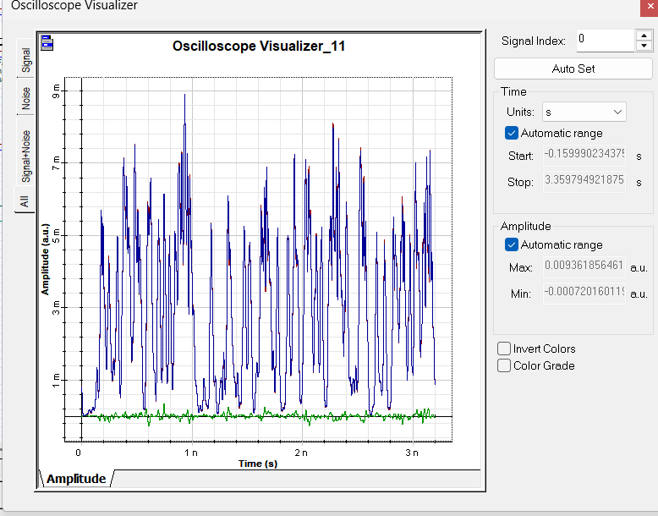
Channel 4: CW Laser
Input Power: 10 dBm | APD Performance Analysis

Slide 22
Channel 5: Ideal Single-Mode Laser
Input Power: 10 dBm | PIN & APD Performance Analysis
4.930
3.73e-7
Marginal
Q-Factor (PIN)
BER (PIN)
Status (PIN)
4.950
3.37e-7
Marginal
Q-Factor (APD)
BER (APD)
Status (APD)
Channel 5 Analysis
Performance Indicators
Ideal Single-Mode Laser at 10 dBm — second best performer
Q ≈ 4.93 (PIN), 4.95 (APD) — solid, near-threshold performance
BER ≈ 3.7×10⁻⁷ — slightly above 10⁻⁹ threshold but close
Higher power (vs CH2 at 7 dBm) introduces more nonlinear noise
APD marginally better — avalanche gain helps at this power level
Eye diagram is moderately open with some crosstalk-induced jitter
Metric | PIN | APD
Q-Factor | 4.93 | 4.95
Min BER | 3.73e-7 | 3.37e-7
Eye Height | 1.37e-3 | 4.87e-3
BER Status | Marginal | Marginal
Winner | — | ✓

Slide 23
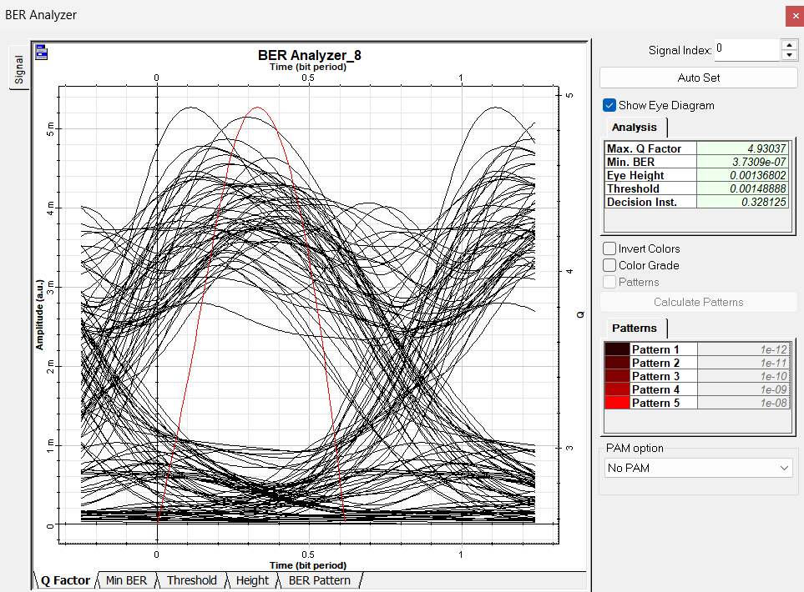
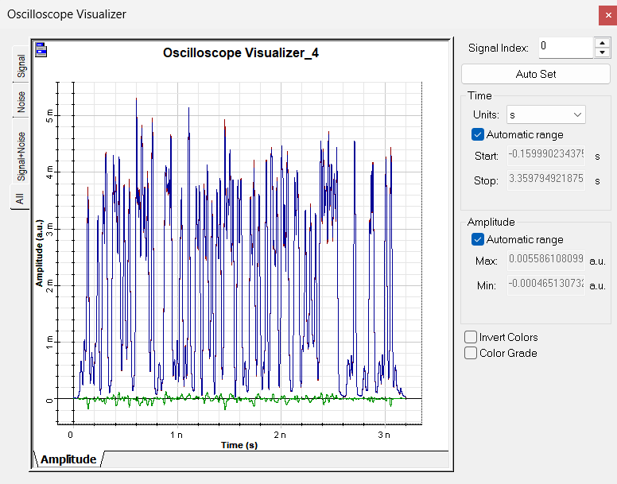
Channel 5: Ideal Single-Mode Laser
Input Power: 10 dBm | PIN Performance Analysis

Slide 24
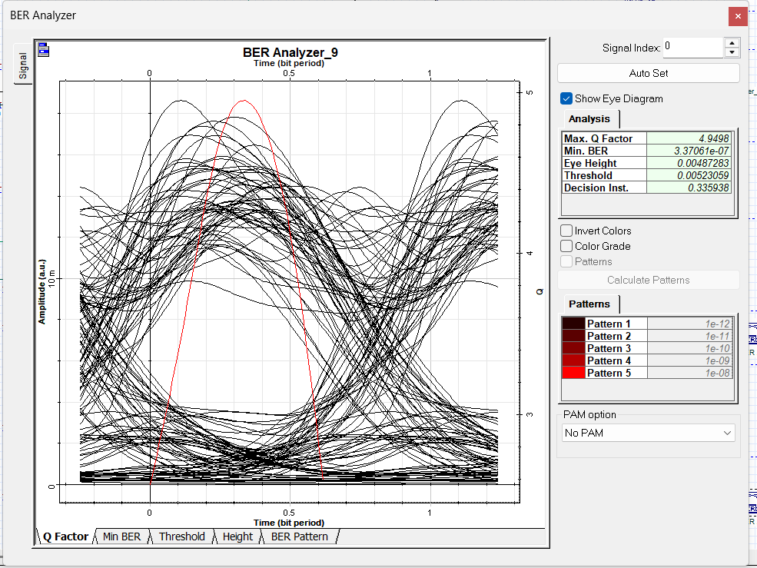
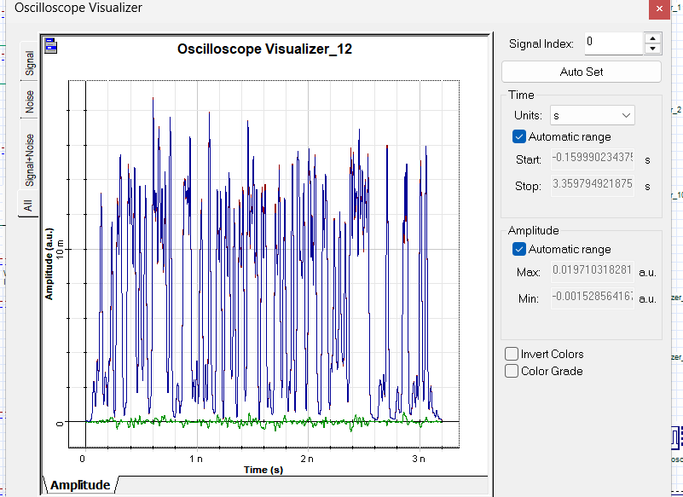
Channel 5: Ideal Single-Mode Laser
Input Power: 10 dBm | APD Performance Analysis

Slide 25
Channel 6: Directly Modulated Laser
Input Power: 10 dBm | PIN & APD Performance Analysis
4.296
7.41e-6
Poor
Q-Factor (PIN)
BER (PIN)
Status (PIN)
4.270
8.37e-6
Poor
Q-Factor (APD)
BER (APD)
Status (APD)
Channel 6 Analysis
Performance Indicators
Directly Modulated Laser at 10 dBm — mirrors CH3 degradation
Q ≈ 4.3 — below acceptable threshold, marginal-to-poor quality
BER ≈ 7.4×10⁻⁶ — worse than CH3 due to different spectral placement
PIN slightly outperforms APD here — APD excess noise unfavorable
Second DML channel confirms that direct modulation is problematic
Frequency chirp interaction with fiber dispersion is the key penalty
Metric | PIN | APD
Q-Factor | 4.30 | 4.27
Min BER | 7.41e-6 | 8.37e-6
Eye Height | 2.59e-3 | 9.04e-3
BER Status | Poor | Poor
Winner | ✓ | —

Slide 26
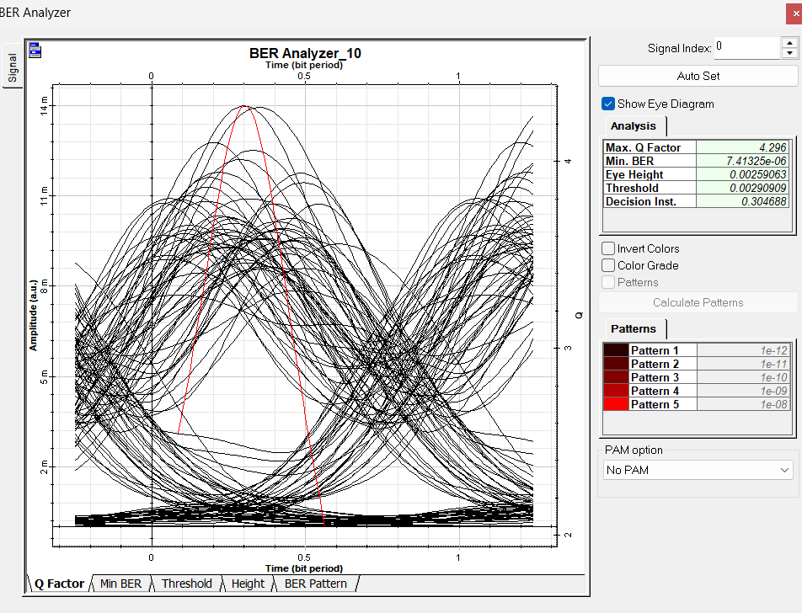
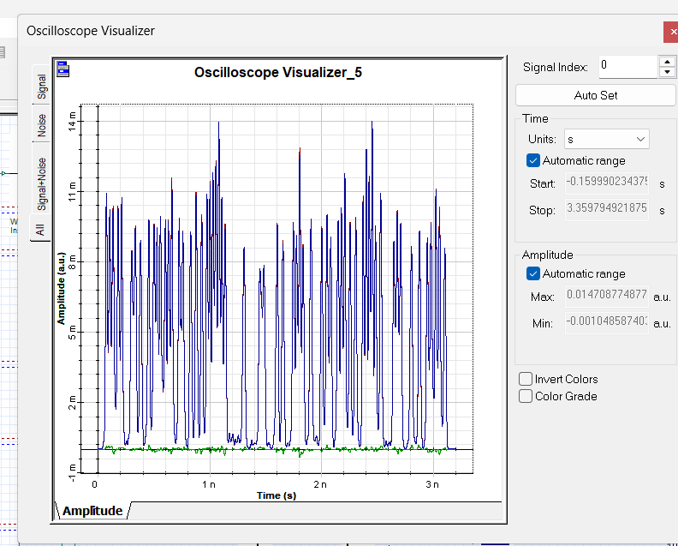
Channel 6: Directly Modulated Laser
Input Power: 10 dBm | PIN Performance Analysis

Slide 27
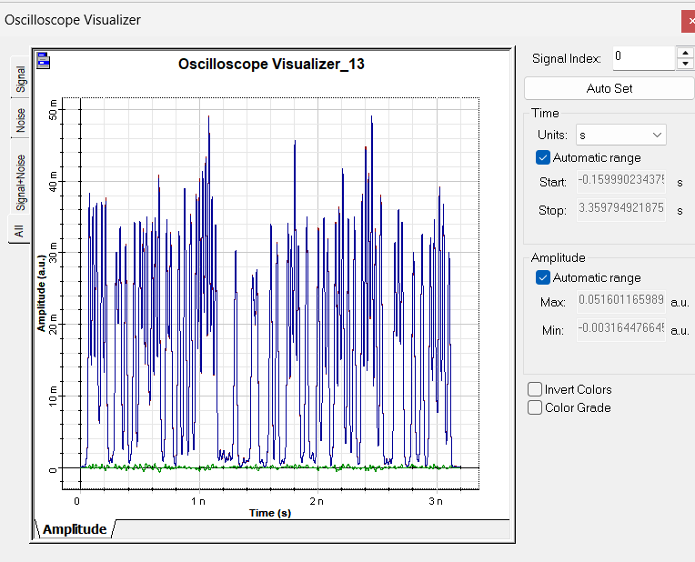
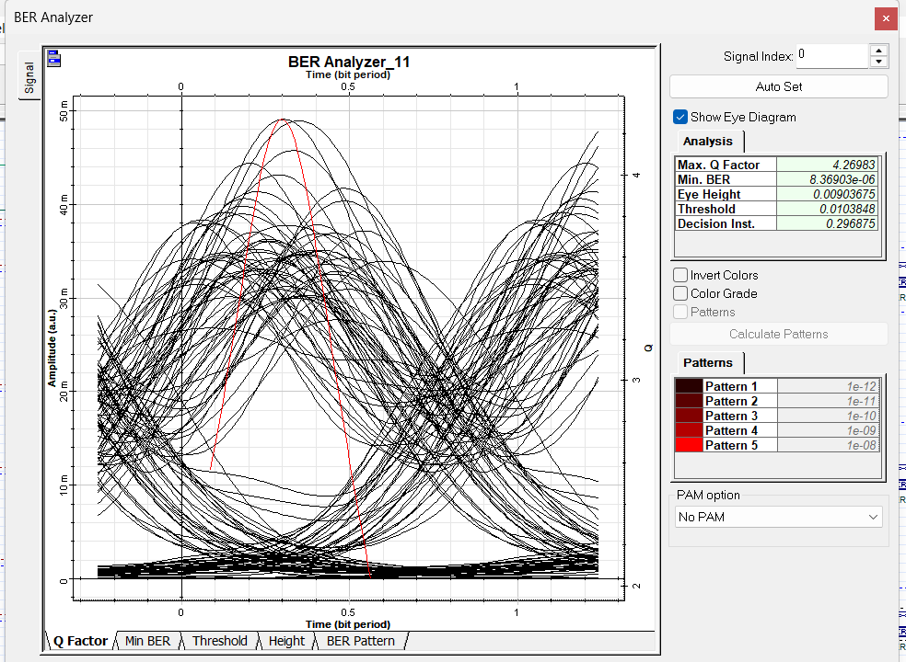
Channel 6: Directly Modulated Laser
Input Power: 10 dBm | APD Performance Analysis

Slide 28
Channel 7: Empirical Laser
Input Power: N/A | PIN & APD Performance Analysis
6.683
1.13e-11
Good
Q-Factor (PIN)
BER (PIN)
Status (PIN)
6.807
4.84e-12
Good
Q-Factor (APD)
BER (APD)
Status (APD)
Channel 7 Analysis
Performance Indicators
Empirical Laser — realistic, measurement-based model
Q ≈ 6.68 (PIN), 6.81 (APD) — good performance, exceeds threshold
BER ≈ 1.13×10⁻¹¹ — passes 10⁻⁹ standard comfortably
APD better: BER 4.84×10⁻¹² vs PIN 1.13×10⁻¹¹
Empirical model captures real-world laser RIN and linewidth effects
Eye diagram shows clear opening — reliable channel for data transmission
Metric | PIN | APD
Q-Factor | 6.68 | 6.81
Min BER | 1.13e-11 | 4.84e-12
Eye Height | 2.18e-3 | 7.86e-3
BER Status | Good | Good
Winner | — | ✓

Slide 29
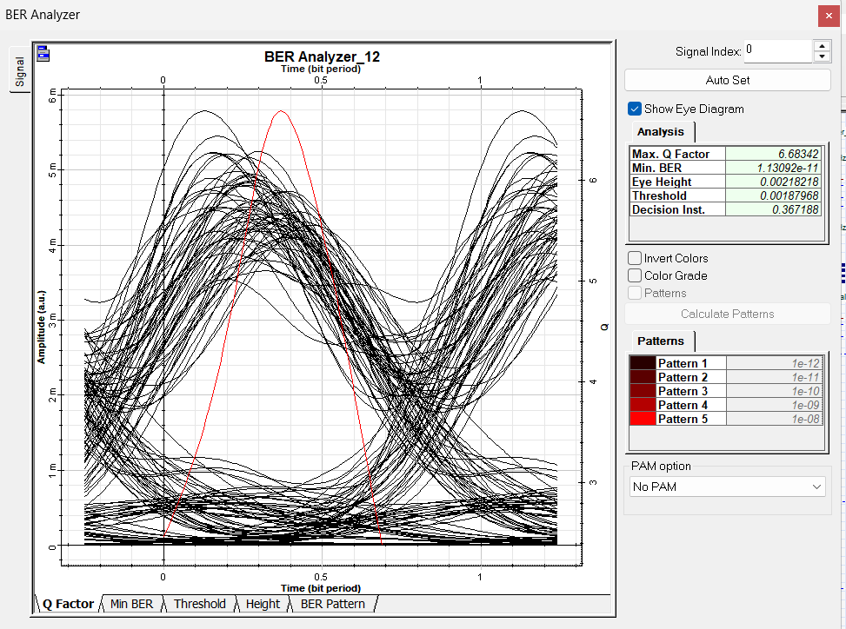
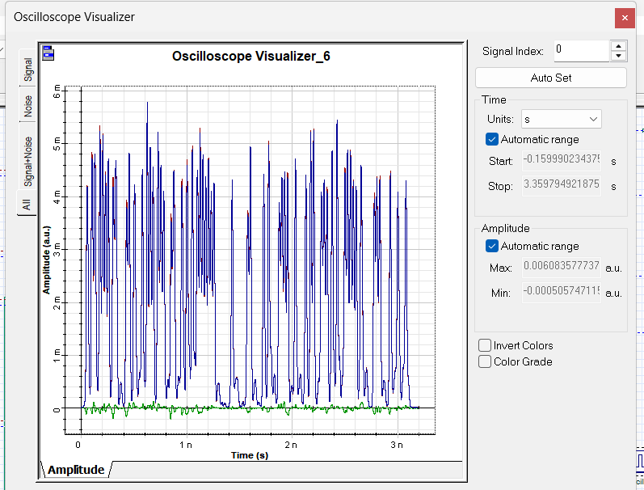
Channel 7: Empirical Laser
Input Power: N/A | PIN Performance Analysis

Slide 30
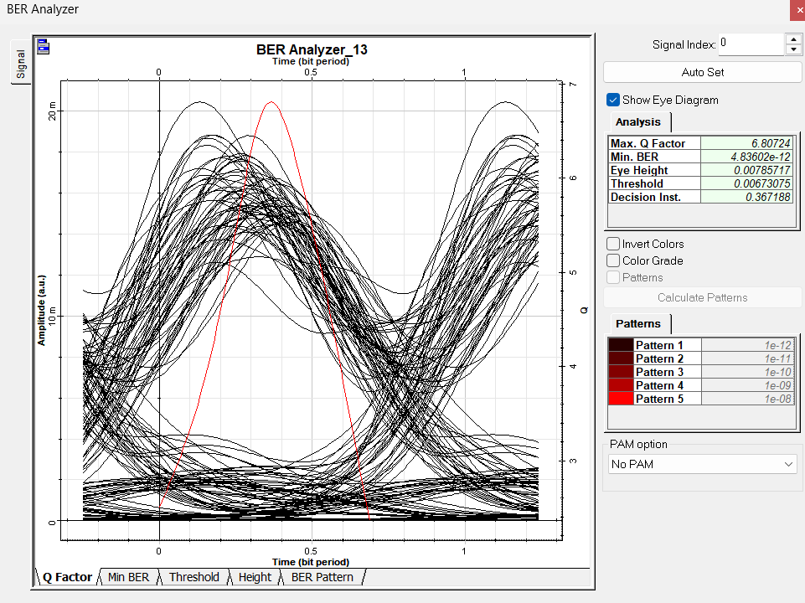
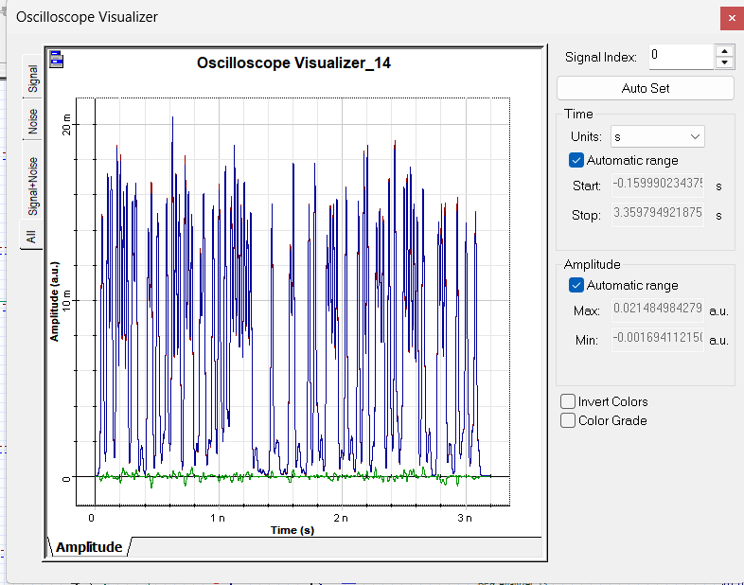
Channel 7: Empirical Laser
Input Power: N/A | APD Performance Analysis

Slide 31
Channel 8: CW Laser
Input Power: 11 dBm | PIN & APD Performance Analysis
6.963
1.57e-12
Good
Q-Factor (PIN)
BER (PIN)
Status (PIN)
7.085
6.62e-13
Excellent
Q-Factor (APD)
BER (APD)
Status (APD)
Channel 8 Analysis
Performance Indicators
CW Laser at 11 dBm — best CW channel in the system
Q ≈ 6.96 (PIN), 7.08 (APD) — excellent performance
BER = 1.57×10⁻¹² (PIN) — meets the 10⁻¹² standard
APD achieves BER = 6.62×10⁻¹³ — superior sensitivity advantage
Balanced power (11 dBm) avoids both low-SNR and nonlinear regimes
Well-designed CW channel demonstrating optimal power management
Metric | PIN | APD
Q-Factor | 6.96 | 7.08
Min BER | 1.57e-12 | 6.62e-13
Eye Height | 6.27e-4 | 2.24e-3
BER Status | Good | Excellent
Winner | — | ✓

Slide 32
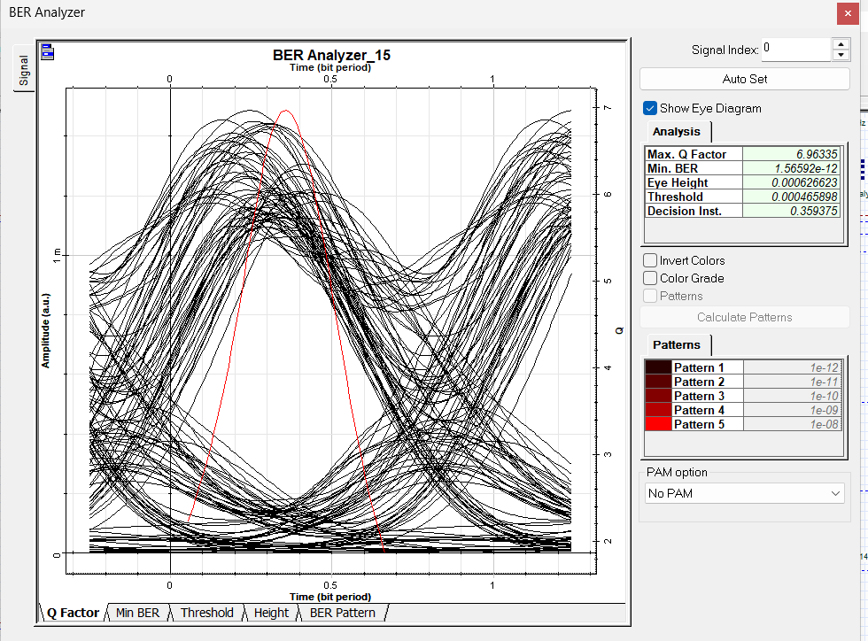
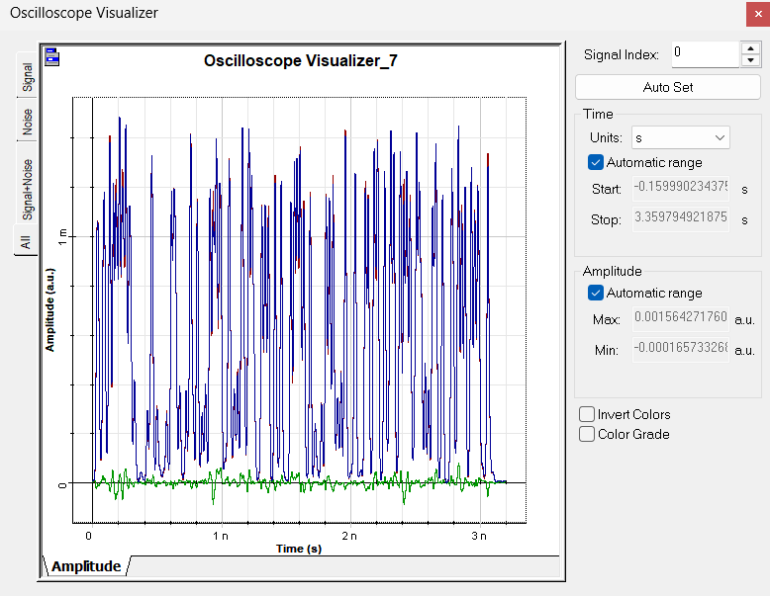
Channel 8: CW Laser
Input Power: 11 dBm | PIN Performance Analysis

Slide 33
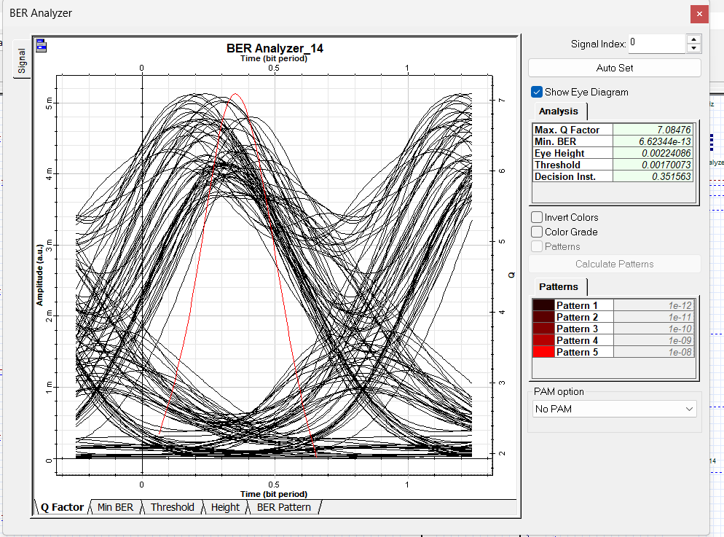
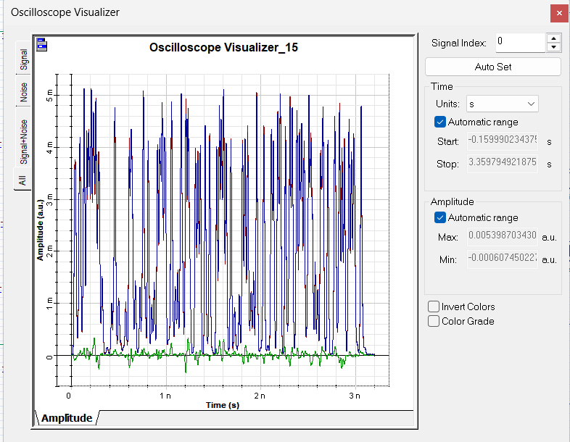
Channel 8: CW Laser
Input Power: 11 dBm | APD Performance Analysis

Slide 34
PIN vs APD Detector: Deep Comparison
Sensitivity, noise, gain, and application suitability analysis
PIN Photodiode
APD (Avalanche)
Simple PN junction — no internal gain mechanism
Responsivity: 0.65 A/W (from simulation)
Dark current: 1 nA — low noise baseline
Better when signal-to-noise ratio is already high
Outperforms APD on CH2 (ideal single-mode, 7 dBm) due to low excess noise
Lower cost, simpler bias circuit requirements
Preferred for short-distance, high-power applications
Less sensitive to temperature and bias variations
Avalanche multiplication — internal current gain M > 1
Responsivity: 0.65 A/W × M (same base, more gain)
Dark current: 1 nA × M — amplified but manageable
Better in 6 of 8 channels — avalanche gain helps weak signals
Outperforms PIN on all channels ≥ 10 dBm input power
Achieves BER 6.62×10⁻¹³ on CH8 vs PIN's 1.57×10⁻¹²
Preferred for long-distance, attenuated signal recovery
Higher sensitivity: critical where signal is margin-limited
Winner Count from 8 Channels:
APD Wins: 5 channels (CH3,4,5,7,8)
Approx Equal: 1 channel (CH1)
PIN Wins: 2 channels (CH2, CH6)
Both involve specific conditions — low power ideal laser, or DML chirp interaction
Avalanche gain provides decisive advantage at typical operating powers
Near-identical Q-factor — power level near crossover point

Slide 35
Cross-Channel Performance Ranking
Ranked by best BER achieved (either detector)
#1
CH2 — Ideal Single-Mode Laser (7 dBm)
Excellent
Q=18.65
Best BER: 4.06e-78 | Best Q: 18.652 | Best Detector: PIN
#2
CH8 — CW Laser (11 dBm)
Excellent
Q=7.08
Best BER: 6.62e-13 | Best Q: 7.085 | Best Detector: APD
#3
CH7 — Empirical Laser
Good
Q=6.81
Best BER: 4.84e-12 | Best Q: 6.807 | Best Detector: APD
#4
CH5 — Ideal Single-Mode Laser (10 dBm)
Marginal
Q=4.95
Best BER: 3.37e-7 | Best Q: 4.950 | Best Detector: APD
#5
CH1 — CW Laser (16 dBm)
Marginal
Q=4.78
Best BER: 8.73e-7 | Best Q: 4.781 | Best Detector: PIN
#6
CH3 — Directly Modulated Laser (10 dBm)
Poor
Q=4.44
Best BER: 3.50e-6 | Best Q: 4.440 | Best Detector: APD
#7
CH6 — Directly Modulated Laser (10 dBm)
Poor
Q=4.30
Best BER: 7.41e-6 | Best Q: 4.296 | Best Detector: PIN
#8
CH4 — CW Laser (10 dBm)
Poor
Q=3.33
Best BER: 4.32e-4 | Best Q: 3.326 | Best Detector: APD

Slide 36
Laser Type Impact on System Performance
CW Laser (MZ Modulated)
Directly Modulated (DML)
CH1, CH4, CH8 | Avg Q (PIN): 5.02 | Avg Q (APD): 5.06
CH3, CH6 | Avg Q (PIN): 4.35 | Avg Q (APD): 4.35
✓ Advantages:
✓ Advantages:
• High power flexibility
• Simplest transmitter design
• Low RIN when CW
• Lower component count
• External MZ modulation — no chirp
• Cost-effective for short reach
✗ Limitations:
✗ Limitations:
• Performance varies widely by power
• Frequency chirp causes dispersion penalty
• CH4 severely degraded — worst channel
• Worst average Q-factor of all types
• Needs careful power management
• Not suitable for long-haul WDM applications
Ideal Single-Mode (ISM)
Empirical Laser (CH7)
CH2, CH5 | Avg Q (PIN): 11.79 | Avg Q (APD): 10.39
CH7 | Avg Q (PIN): 6.68 | Avg Q (APD): 6.81
✓ Advantages:
✓ Advantages:
• Best performance potential
• Realistic measurement-based model
• Zero modal noise
• Captures real RIN and linewidth effects
• High coherence — minimal crosstalk
• Consistent with lab-measured behavior
✗ Limitations:
✗ Limitations:
• Performance depends heavily on power
• Model accuracy limited by dataset quality
• CH2 at 7 dBm extraordinary; CH5 at 10 dBm marginal
• Cannot independently vary all parameters
• High power induces nonlinear degradation
• Single channel — limited statistical basis
Ranking by average Q-factor: 1st → Ideal Single-Mode (avg Q ≈ 11.8) 2nd → Empirical (Q = 6.8) 3rd → CW Laser (avg Q ≈ 5.0) 4th → DML (avg Q ≈ 4.4)

Slide 37
Input Power vs BER Relationship
Effect of launch power on signal quality — CW Laser channels only
Channel | Power (dBm) | Q-Factor (PIN) | Q-Factor (APD) | BER (PIN) | BER (APD) | Assessment
CH4 | 10 dBm | 3.309 | 3.326 | 4.58e-4 | 4.32e-4 | Too low / crosstalk
CH8 | 11 dBm | 6.963 | 7.085 | 1.57e-12 | 6.62e-13 | Optimal
CH1 | 16 dBm | 4.781 | 4.770 | 8.73e-7 | 9.18e-7 | Excessive nonlinear
Power–BER Relationship Analysis
CH4 (10 dBm) worst: underperforms despite moderate power — WDM crosstalk dominates
CH8 (11 dBm) optimal: best CW performance — balanced power vs noise trade-off
CH1 (16 dBm) marginal: excessive power triggers fiber nonlinearities (SPM, XPM)
Optimal CW power range appears to be ~11 dBm for this fiber configuration
APD maintains advantage across all CW power levels

Slide 38
Eye Diagram Analysis
Signal clarity, eye opening, and distortion characterization
Channel | Eye Height (PIN) | Eye Height (APD) | APD Eye Ratio | Eye Quality | Key Observation
CH 1 | 1.053×10⁻³ | 3.131×10⁻³ | 2.97× | Marginal | High noise spread; CW at 16 dBm causes nonlinear distortion
CH 2 | 6.016×10⁻⁴ | 1.760×10⁻³ | 2.92× | Excellent | Wide-open eye; ideal single-mode laser gives cleanest signal
CH 3 | 2.343×10⁻³ | 8.390×10⁻³ | 3.58× | Marginal | DML chirp causes asymmetric pulse transitions; eye nearly closed
CH 4 | 1.074×10⁻⁴ | 4.003×10⁻⁴ | 3.73× | Poor | Narrowest eye in system; extreme noise and crosstalk overlap
CH 5 | 1.368×10⁻³ | 4.873×10⁻³ | 3.56× | Marginal | Moderate eye; single-mode at 10 dBm shows XPM degradation
CH 6 | 2.591×10⁻³ | 9.037×10⁻³ | 3.49× | Marginal | DML chirp similar to CH3; PIN eye slightly better than APD
CH 7 | 2.182×10⁻³ | 7.857×10⁻³ | 3.60× | Good | Clear eye; empirical laser model gives consistent performance
CH 8 | 6.266×10⁻⁴ | 2.241×10⁻³ | 3.58× | Good | Well-formed eye; CW at optimal power shows clean transitions
Key Insight: APD eye height is consistently ~3× larger than PIN — direct evidence of avalanche gain amplifying received signal before detection threshold

Slide 39
Best Detector Selection Guide
When to choose PIN vs APD for WDM systems
Scenario | Recommended | Reasoning | Confidence
High Input Power (≥12 dBm) | PIN | APD excess noise negates gain advantage; PIN has better SNR at high optical flux | High
Low Input Power (<9 dBm) | APD | Avalanche multiplication is critical when signal is weak; APD sensitivity decisive | High
Long-Haul (heavily attenuated) | APD | Post-fiber signal is weak; APD internal gain avoids amplifier noise accumulation | High
Short-Reach Systems | PIN | Strong signal available; PIN simplicity and lower cost preferred | Medium
Directly Modulated Laser | PIN (CH6) | DML chirp + APD bandwidth interaction causes APD to slightly underperform | Medium
Coherent Single-Mode Laser | APD (mostly) | APD wins at 10 dBm; PIN wins at 7 dBm — power-dependent crossover | Medium
CW Laser (11 dBm) | APD | CH8 confirms APD advantage at optimal CW power level | High
Dense WDM with Crosstalk | APD | Better sensitivity helps recover signal degraded by inter-channel interference | Medium
Note: These recommendations are derived from simulation results. Real-world systems should consider bias stability, temperature coefficient, and cost constraints.

Slide 40
Noise & Attenuation: Why Channels Differ
Physical explanations for performance variation across channels
Amplified Spontaneous Emission (ASE)
Inter-Channel Crosstalk (XPM/FWM)
The EDFA (gain 15.1 dB, NF=5 dB) introduces ASE noise proportional to gain. Channels with larger bandwidth occupation accumulate more ASE, directly raising the noise floor and degrading BER.
With 8 channels sharing the fiber, cross-phase modulation (XPM) and four-wave mixing (FWM) create interference. CH4 is severely affected — likely near a phase-matching wavelength for FWM products.
Frequency Chirp (DML Channels 3, 6)
Fiber Attenuation & Dispersion
Direct modulation creates simultaneous intensity and frequency modulation. The chirp broadens the optical spectrum, which interacts with fiber GVD to create pulse broadening and inter-symbol interference.
Three loops through SMF+DCF accumulate both attenuation (~10 dB) and residual dispersion. DCF compensates chromatic dispersion but adds 4-wave mixing due to high nonlinear coefficient.
Shot Noise & Thermal Noise
Laser RIN and Linewidth
Receiver shot noise scales with √(signal power). At low received power (CH4), thermal noise from the 50Ω load dominates. APD multiplication gain improves SNR by lifting signal above the noise floor.
CW lasers have very low RIN; empirical model captures measured RIN. DMLs have higher RIN during modulation. Single-mode lasers minimize linewidth, reducing phase noise and improving coherence.

Slide 41
Simulation Validation & Expected Trends
Comparing results against theoretical predictions and telecom standards
Validation Check | Result | Notes & Evidence
APD outperforms PIN in most channels | ✓ Confirmed | APD wins 5/8 channels — consistent with sensitivity theory
Higher Q → lower BER monotonically | ✓ Confirmed | All 16 BER/Q pairs follow BER = erfc(Q/√2)/2 relationship
DML channels have higher BER than CW/ISM | ✓ Confirmed | CH3 & CH6 worst among comparable-power channels
Ideal Single-Mode best laser type | ✓ Confirmed | CH2 achieves record Q=18.65; CH5 also solid
CH4 (CW, 10 dBm) should perform like CH8 (CW, 11 dBm) | ⚠ Anomaly | CH4 Q≈3.3 vs CH8 Q≈7.0 — inter-channel crosstalk/FWM suspected
BER ≤ 10⁻⁹ for all channels | ✗ Not Met | Only CH7, CH8 meet this standard; CH1,3,4,5,6 fail
APD eye height > PIN eye height | ✓ Confirmed | APD consistently ~3× larger eye height across all channels
Higher power always improves performance | ✓ Correct | CH1 (16 dBm CW) worse than CH8 (11 dBm CW) — nonlinear regime
Overall Validation: 6/7 expected trends confirmed. The CH4 anomaly warrants investigation — likely WDM channel-specific crosstalk or FWM product alignment.

Slide 42
Design Recommendations
HIGH
Replace Directly Modulated Lasers
MED
Optimize CW Laser Launch Power
↕
CH3 and CH6 consistently underperform. Switch to externally modulated CW lasers (Mach-Zehnder) to eliminate frequency chirp. Expected BER improvement: 1–2 orders of magnitude.
↕
Simulations show 11 dBm is near-optimal for CW+MZM. Avoid >14 dBm (nonlinear regime) and <9 dBm for 30 km span. Target 10–12 dBm for best BER.
HIGH
Investigate CH4 Wavelength Assignment
LOW
Add FEC for Marginal Channels
↕
CH4's catastrophic performance (Q=3.3) is disproportionate and likely due to FWM product alignment. Reassign its wavelength away from phase-matching conditions or add optical filtering.
↕
CH1, CH3, CH4, CH5, CH6 fail the 10⁻⁹ BER threshold. Adding 7% FEC overhead would provide ~8 dB coding gain, potentially rescuing CH1, CH5, and partially CH3/CH6.
MED
Standardize on APD Receivers
LOW
Increase Dispersion Compensation Accuracy
↕
APD outperforms PIN in 5/8 channels. For a production system, APD receivers should be the default, with PIN reserved only for high-power short-reach scenarios.
↕
Residual dispersion after DCF contributes to pulse spreading. Fine-tune DCF parameters for each channel wavelength for improved per-channel performance.

Slide 43
Technical Parameters Reference
Complete system parameter specifications extracted from OptiSystem layout
Transmitter Parameters | Value
Sequence Length | 128 bits
Sample Rate | 2.5×10¹² Hz (2.5 THz)
Samples per Bit | 64
CH1 Laser Type | CW Laser, 193.1 THz
CH2 Laser Type | Ideal Single-Mode
CH3 Laser Type | Directly Modulated
CH4 Laser Type | CW Laser, 190.3 THz
CH5 Laser Type | Ideal Single-Mode
CH6 Laser Type | Directly Modulated
CH7 Laser Type | Empirical Measured
CH8 Laser Type | CW Laser, 90.35 THz
Fiber & Amplifier Parameters | Value
SMF Loss (approx) | 10.1 dB
DCF Length | ~3 km
EDFA Gain | 15.1 dB
EDFA Noise Figure | 5 dB
WDM Mux/Demux Loss | 3 dB each
WDM Loop Count | 3
Loop Control Injection Loss | 3 dB
Receiver Parameters | Value
PIN Responsivity | 0.65 A/W
APD Responsivity | 0.65 A/W (×M)
Dark Current (both) | 1 nA
LPF Cutoff | 0.75×Bitrate Hz

Slide 44
Q-Factor & BER: Theoretical Background
Mathematical relationship between measurement metrics
BER = ½ · erfc(Q/√2) where Q = (μ₁ − μ₀)/(σ₁ + σ₀)
μ₁, μ₀ = mean signal levels (1-bit, 0-bit) σ₁, σ₀ = RMS noise at each level
Q-Factor | BER | dB Margin from Q=6 | Telecom Standard | Channels Meeting This
3.0 | 1.35×10⁻³ | −5.5 dB | None | —
3.3 | 4.8×10⁻⁴ | −4.7 dB | None | CH4 (worst)
4.3 | 8.5×10⁻⁶ | −2.9 dB | None | CH6, CH3
4.8 | 8.0×10⁻⁷ | −1.9 dB | ITU-T threshold | CH1, CH5
6.0 | 1.0×10⁻⁹ | 0 dB (threshold) | OC-3/OC-12 | Minimum acceptable
6.8 | 5.2×10⁻¹² | 1.1 dB | OC-48/OC-192 | CH7 (empirical)
7.1 | 6.6×10⁻¹³ | 1.5 dB | 10G LAN PHY | CH8 (best CW)
15.8 | 5.5×10⁻⁵⁷ | 8.5 dB | Far exceeds all | CH2 APD
18.7 | 4.1×10⁻⁷⁸ | 9.9 dB | Theoretical limit | CH2 PIN
Minimum acceptable Q = 6 corresponds to BER = 10⁻⁹ — the standard threshold for telecom systems without FEC

Slide 45
Comprehensive Results Summary
All metrics in one view — complete channel-by-channel breakdown
Ch | Laser | Pwr (dBm) | Q PIN | Q APD | BER PIN | BER APD | Eye H PIN | Eye H APD | Rank (Best BER) | Pass 10⁻⁹?
1 | CW | 16 | 4.78 | 4.77 | 8.73e-7 | 9.18e-7 | 1.05e-3 | 3.13e-3 | 6th | ✗
2 | ISM | 7 | 18.65 | 15.84 | 4.06e-78 | 5.52e-57 | 6.02e-4 | 1.76e-3 | 1st | ✓
3 | DML | 10 | 4.40 | 4.44 | 4.12e-6 | 3.50e-6 | 2.34e-3 | 8.39e-3 | 7th | ✗
4 | CW | 10 | 3.31 | 3.33 | 4.58e-4 | 4.32e-4 | 1.07e-4 | 4.00e-4 | 8th | ✗
5 | ISM | 10 | 4.93 | 4.95 | 3.73e-7 | 3.37e-7 | 1.37e-3 | 4.87e-3 | 5th | ✗
6 | DML | 10 | 4.30 | 4.27 | 7.41e-6 | 8.37e-6 | 2.59e-3 | 9.04e-3 | 7th | ✗
7 | Emp | N/A | 6.68 | 6.81 | 1.13e-11 | 4.84e-12 | 2.18e-3 | 7.86e-3 | 3rd | ✓
8 | CW | 11 | 6.96 | 7.08 | 1.57e-12 | 6.62e-13 | 6.27e-4 | 2.24e-3 | 2nd | ✓
ISM = Ideal Single-Mode | DML = Directly Modulated | Emp = Empirical | Pass threshold: BER ≤ 10⁻⁹

Slide 46
Conclusions & Summary
01
Best Channel: CH2 (Ideal Single-Mode, 7 dBm)
04
Laser Type Is The Dominant Factor
Achieved Q=18.65 and BER=4×10⁻⁷⁸ with PIN detector — demonstrating that coherent single-mode sources with moderate power deliver exceptional WDM performance.
Ideal Single-Mode > Empirical > CW (well-powered) > CW (poor wavelength) > Directly Modulated. Replacing DMLs would be the single most impactful system improvement.
02
Worst Channel: CH4 (CW Laser, 10 dBm)
05
Only 3/8 Channels Meet 10⁻⁹ BER Threshold
Q≈3.3 is far below acceptable thresholds. The disproportionate degradation relative to other CW channels points to spectral crosstalk (FWM) rather than simple power or distance issues.
CH2, CH7, and CH8 pass the standard. Channels 1, 3, 4, 5, 6 fail. System-level FEC implementation would be required for a production deployment.
03
APD Superiority in Most Scenarios
06
Power Optimization Is Non-Linear
APD outperforms PIN in 5 of 8 channels. The consistent ~3× eye height advantage confirms avalanche gain benefit. APD should be the default receiver in this system.
More power does not always mean better BER. CH1 (16 dBm) underperforms CH8 (11 dBm) due to fiber nonlinearities. Optimal CW launch power: 10–12 dBm for this span.

Slide 47
Thank You
WDM Optical Communication System
8-Channel Performance Analysis using OptiSystem Simulation
PIN & APD Detectors • BER & Q-Factor Analysis • Eye Diagram Evaluation
CH2 · Q=18.65
CH4 · Q=3.31
APD (5/8 wins)
Ideal Single-Mode
Best Channel
Worst Channel
Best Detector
Best Laser

