Slide 1
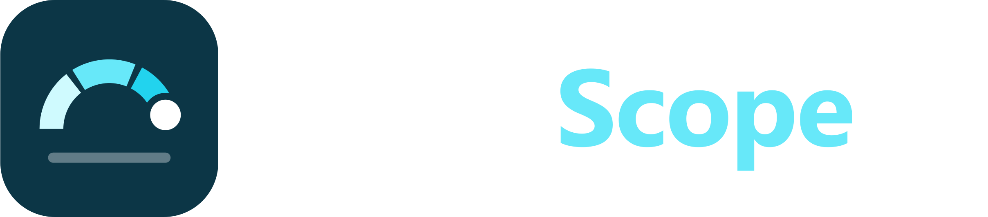
A six-question diabetes risk check
Built from 229,474 CDC survey responses to find people who should get a blood-sugar test
NextGen Institute | Machine Learning final project | Idea 11: Diabetes Risk Screening Tool
Notes:
Hi everyone. Our project is SugarScope, a diabetes risk screening tool. The idea is simple: a person answers six short questions, about a minute of their time, and gets a risk level that tells them whether it is worth asking for a blood-sugar test. We built it on 229,474 responses to the CDC's Behavioral Risk Factor Surveillance System, the BRFSS health survey. In the next ten minutes we will cover the problem, the data, what the exploration taught us, the models we compared, the results, and how the short questionnaire and the app came out of that work. We will finish with our recommendation and the limits you should keep in mind. The short version: six questions keep about the same screening power as all twenty-one.

Slide 2
Diabetes often goes unnoticed for years
1
No early symptoms
Early type 2 diabetes usually feels like nothing, so people do not ask for a test.
15.3%
2
Testing is easy; choosing who to test is hard
of 229,474 survey respondents report diagnosed diabetes
An HbA1c or fasting-glucose test confirms it, but clinics cannot test everyone every year.
3
Risk factors are easy to ask about
Goal: rank people by risk so the tests go to those most likely to have it.
Blood pressure, cholesterol, weight, age and general health are answers people already know.
Notes:
Diabetes is common, and many people who have them do not know it. The reason is that the early stages have no clear symptoms. The diagnosis itself is not the problem: an HbA1c or fasting-glucose blood test is cheap and reliable. The hard part is deciding who should get that test, because a clinic or a community programme cannot test everyone every year. The good news is that the main risk factors are things people already know about themselves: whether a doctor told them they have high blood pressure or high cholesterol, their weight, their age, and how they rate their general health. In our data, 15.3% of respondents report diagnosed diabetes. So the goal of this project is ranking, not diagnosis: put the people most likely to have it at the front of the queue for a test.

Slide 3
Who uses it, and why recall is the metric
Individual
Clinic or health worker
Programme planner
Should I ask my doctor for a blood-sugar test?
Who in today's list should be referred for a test first?
Which cut-off fits our testing budget?
Why recall
84.7%
A missed case stays undiagnosed; a false alarm costs one cheap blood test.
We set the decision threshold so that recall is at least 80%, then compare precision, PR-AUC and Brier score.
Accuracy is misleading here: always answering "no" scores high accuracy and finds nobody.
accuracy of the always-"no" baseline, with 0% recall
Notes:
There are three users. An individual wants to know whether it is worth asking a doctor for a test. A clinic or community health worker wants to know who to refer first. And a programme planner wants to choose a cut-off that fits a testing budget. All three make the same kind of decision: test or do not test. That is why we optimise recall. If we miss a person who has diabetes, they stay undiagnosed. If we flag someone who turns out to be fine, the cost is one cheap blood test. So we fixed the decision threshold to reach at least 80% recall and then compared models on precision, PR-AUC and calibration. Accuracy is a trap on this data: a model that always says no is 84.7% accurate and finds nobody.

Slide 4
Data: the CDC BRFSS health survey
253,680
24,206
raw survey responses
exact duplicates dropped
229,474
21
rows used for modelling
questions (features)
Source: CDC BRFSS 2015, via the UCI ML Repository.
Target: diagnosed diabetes = 1; prediabetes counts as 0.
Duplicates dropped before the split, so no row is in both train and test.
Notes:
Our data is the CDC's BRFSS telephone health survey for 2015, in the cleaned version published on the UCI Machine Learning Repository. It has 253,680 responses and 21 questions, mostly yes or no answers plus a few scales like BMI, age group and general health. The target is whether the person reports diagnosed diabetes; prediabetes is coded 0. The main cleaning step was duplicates. Because the answers are small codes, 24,206 rows were exact copies of another row. If we kept them, the same answer pattern could appear in both the training and the test set, which inflates the test score. So we dropped them before splitting, leaving 229,474 rows. The classes are imbalanced: 15.3% positive, 84.7% negative, which drives how we trained and evaluated.

Slide 5
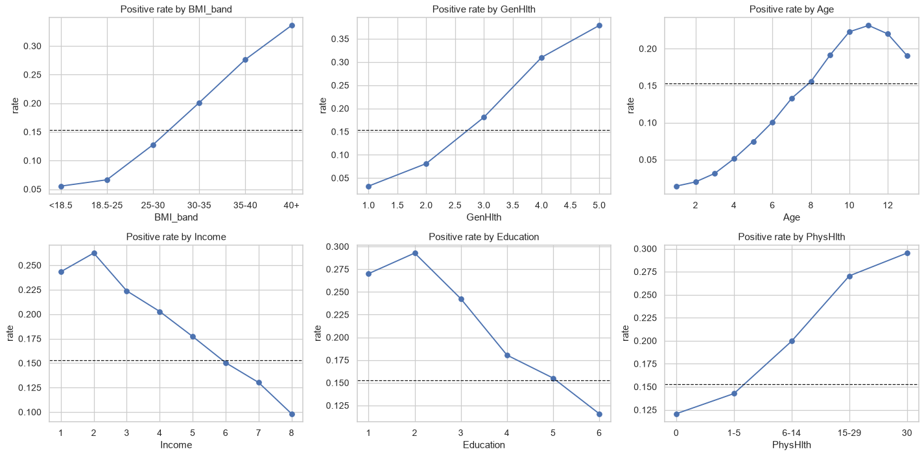
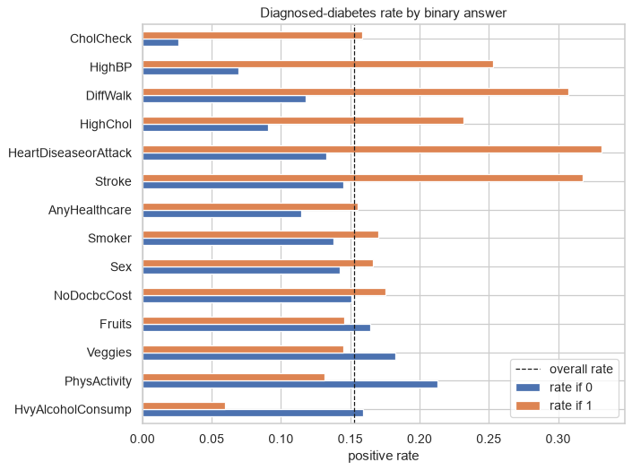
What the exploration showed
Rate climbs steadily with BMI, age and worse general health.
High blood pressure and high cholesterol: several times the rate.
Lower income and education go with higher rates.
Notes:
Three things stood out in the exploration. First, on the left: the rate of diagnosed diabetes climbs almost in a straight line with BMI band, with age, and with how poorly people rate their general health. The dashed line is the overall rate, and the extremes sit far above and below it. Second, on the right, the yes or no questions: people told they have high blood pressure or high cholesterol have several times the rate of those who were not. Heart disease, stroke and difficulty walking also matter, but fewer people say yes to them. Third, there is a clear social gradient: lower income and lower education go with higher rates. These patterns told us early that a handful of questions probably carry most of the signal, which is what we later tested with the short questionnaire.

Slide 6
Approach: a leak-free pipeline, tuned for screening
1
2
3
4
5
Split
Pipeline
Compare
Tune
Calibrate
Stratified 80 / 20 train-test split after de-duplication. Test set used once.
Scaling lives inside the pipeline, so it is fit on training folds only.
Dummy baseline, logistic regression, random forest, gradient boosting; each with no weighting, class weights or SMOTE.
Randomised search with stratified cross-validation, scored on PR-AUC.
Isotonic calibration, then the threshold that reaches 80% recall out-of-fold.
No leakage: duplicates removed before the split, every preprocessing step fit inside cross-validation, threshold chosen on training data, test set touched once at the end.
Notes:
Here is the approach in five steps. We split the de-duplicated data 80 to 20, stratified by the target, and kept the test set locked until the very end. All preprocessing, like scaling, sits inside a scikit-learn pipeline, so it is learned on the training folds only. We compared a dummy baseline with logistic regression, random forest and histogram gradient boosting, and for each one we tried three ways of handling the imbalance: nothing, class weights, and SMOTE oversampling, which runs inside the cross-validation folds. Then we tuned the main candidates with randomised search, scored on PR-AUC because that metric focuses on the positive class. Finally we calibrated the probabilities with isotonic regression and picked the threshold that reaches 80% recall using out-of-fold predictions on the training data, never the test set.

Slide 7
Results on the held-out test set
Model (threshold) | Recall | Precision | F1 | ROC-AUC | PR-AUC | Brier
Baseline: always "no" | 0.000 | 0.000 | 0.000 | 0.500 | 0.153 | 0.130
Logistic regression (0.5) | 0.154 | 0.539 | 0.239 | 0.810 | 0.414 | 0.107
Random forest (0.5) | 0.105 | 0.632 | 0.181 | 0.817 | 0.444 | 0.105
Gradient boosting (0.5) | 0.154 | 0.606 | 0.245 | 0.818 | 0.445 | 0.105
Final: boosting, calibrated (0.147) | 0.799 | 0.314 | 0.451 | 0.819 | 0.444 | 0.105
Short, 6 questions (0.143) | 0.812 | 0.302 | 0.440 | 0.812 | 0.433 | 0.106
79.9%
recall of the final model, up from 15.4% at the default 0.5 cut-off
PR-AUC 0.444 vs 0.153 for the baseline. Lower Brier = better calibrated.
Test set: 45,895 people, never used for training or tuning. Rows 2 to 4 use the default 0.5 cut-off.
Notes:
This is the test set, used once. The baseline finds nobody, and its PR-AUC of 0.153 is just the share of positives. All three tuned models rank people well, with ROC-AUC from 0.810 to 0.818, but at the default 0.5 cut-off they catch only a small share of cases: gradient boosting reaches 15.4% recall. The fix is the threshold, not a different model. Our final model is gradient boosting with calibrated probabilities and a cut-off of 0.147. It reaches 79.9% recall with 31.4% precision, so roughly one in three people it flags really has diagnosed diabetes, about double the base rate. PR-AUC is 0.444 and the Brier score is the lowest in the table. The last row is the six-question model, which is nearly as good.

Slide 8
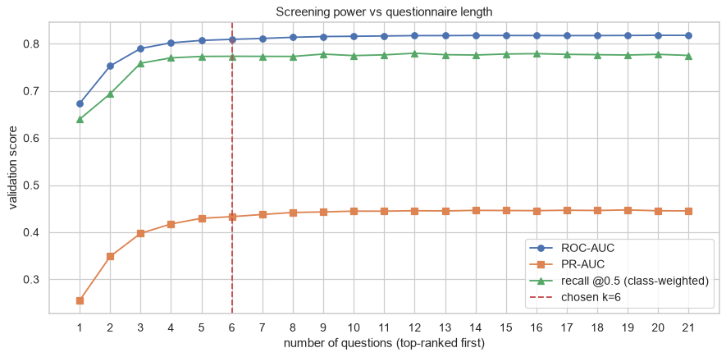
6 questions keep almost all of the screening power
The six questions
High blood pressure
High cholesterol
BMI (height, weight)
General health
Sex
Age
Recall 81.2% vs 79.9%
ROC-AUC 0.812 vs 0.819, with 6 of 21 questions
Notes:
This chart is the core of the product. We ranked the 21 questions by permutation importance and retrained the model with the top one, top two, and so on, measuring validation scores each time. The curves rise fast and then go flat: after about five or six questions, extra questions add almost nothing. We chose six, the dashed line: high blood pressure, high cholesterol, BMI, general health, sex and age. On the test set, with its own threshold, the six-question model reaches 81.2% recall against 79.9% for the full model, and ROC-AUC 0.812 against 0.819. In practice that means a one-minute check instead of a long form, and people are far more likely to finish it.

Slide 9
Population segments and the screening cost planner
At the screening cut-off (assumed $20 per test)
$64
$131
per case found with SugarScope
per case found testing everyone
61%
20%
fewer tests than testing everyone
of cases missed at this cut-off
Highest-risk group: walking difficulty, many poor physical-health days. Suggested action: priority outreach and a blood-sugar test now.
The app's planner moves the cut-off and shows cases caught against cost.
Notes:
Beyond individual risk we added two tools for planners. On the left, k-means clustering on ten health answers found 4 population segments. The highest-risk group, people with walking difficulty and many poor physical-health days, makes up 19% of respondents and has a 32% rate of diagnosed diabetes, so it is the natural target for priority outreach. On the right is the cost planner. With an assumed $20 per blood test, testing everyone costs about $131 per case found. Testing only the people SugarScope flags costs about $64 per case found and needs 61% fewer tests, at the price of missing 20% of cases. The test price is an assumption, so the app lets planners change the cut-off and see the trade-off live.

Slide 10
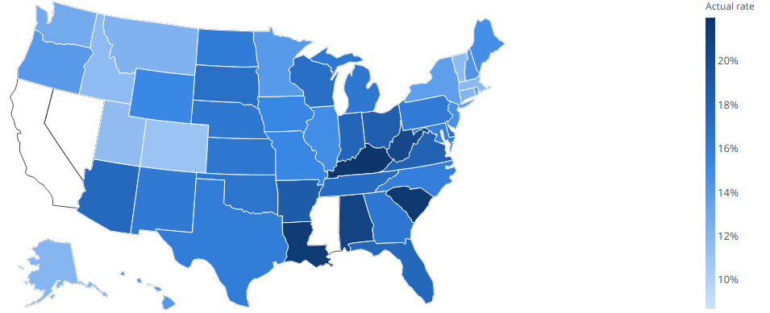
Does it hold up in later survey years?
1,210,322
0.804
rows, 5 BRFSS years
ROC-AUC 2025, retrained on 2015–2019
Actual rate by state, 2025 (app's state view)
Retraining gives the same AUC (0.804 vs 0.803): the drift is in the population, not the model.
Notes:
A model trained on one survey year can drift, so we tested it on later years. We rebuilt the same 21 questions from the raw BRFSS files for 2015, 2017, 2019, 2021, 2025: 1,210,322 rows in total. The other years are skipped because some of the questions were not asked. The saved model, without any change, still ranks people well: ROC-AUC 0.831 in 2017, 0.824 in 2019, 0.819 in 2021, 0.803 in 2025. Recall at the fixed cut-off slips from 0.789 to 0.761. To see whether a newer model would do better, we retrained on 2015-2019. It gets the same ROC-AUC, 0.804 in 2025 against 0.803. So the drop comes from the population changing, not from the model going stale, and the practical fix is to recalibrate the cut-off on recent local data.

Slide 11
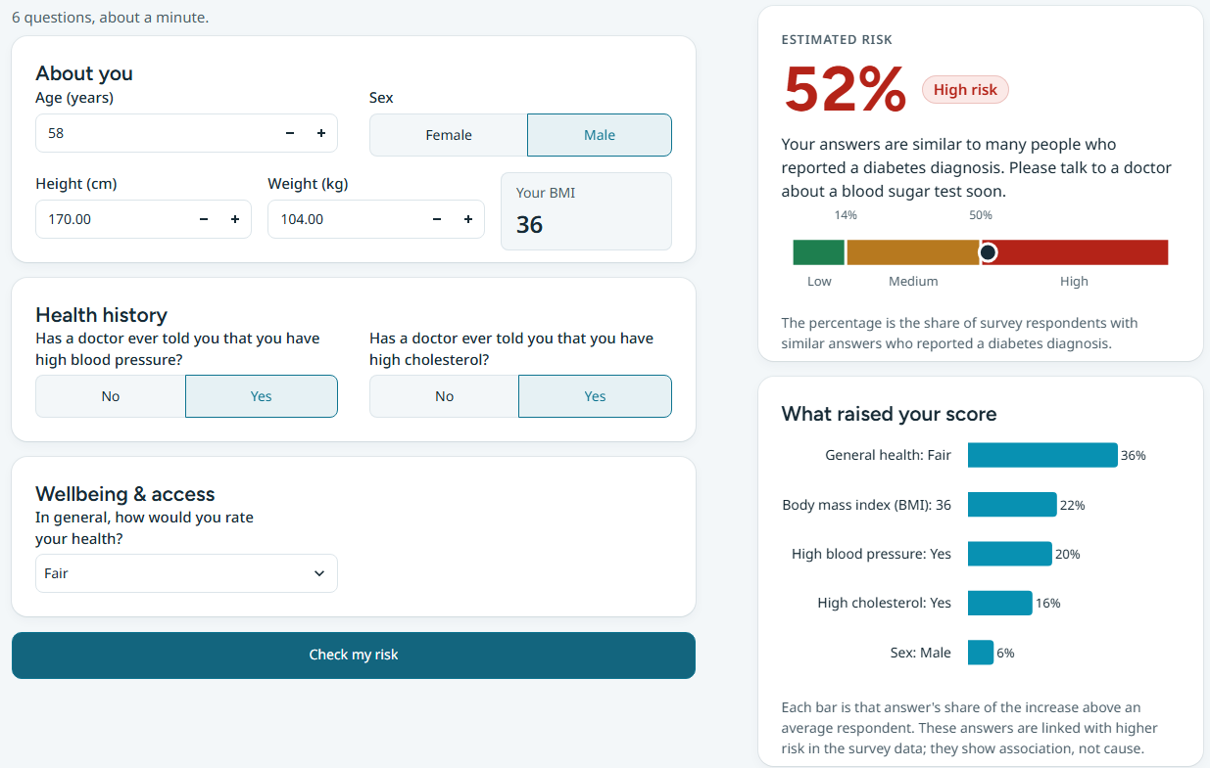
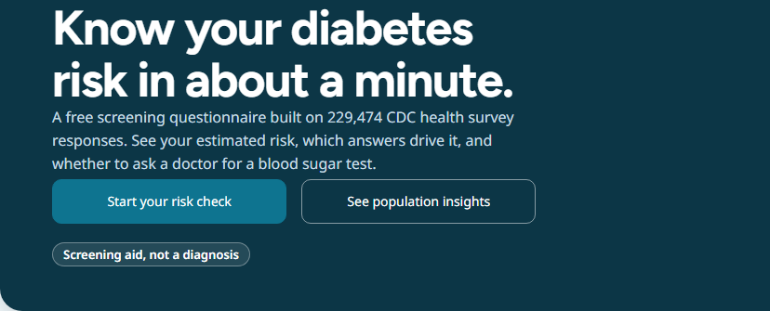
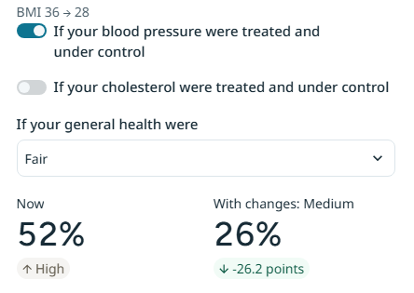
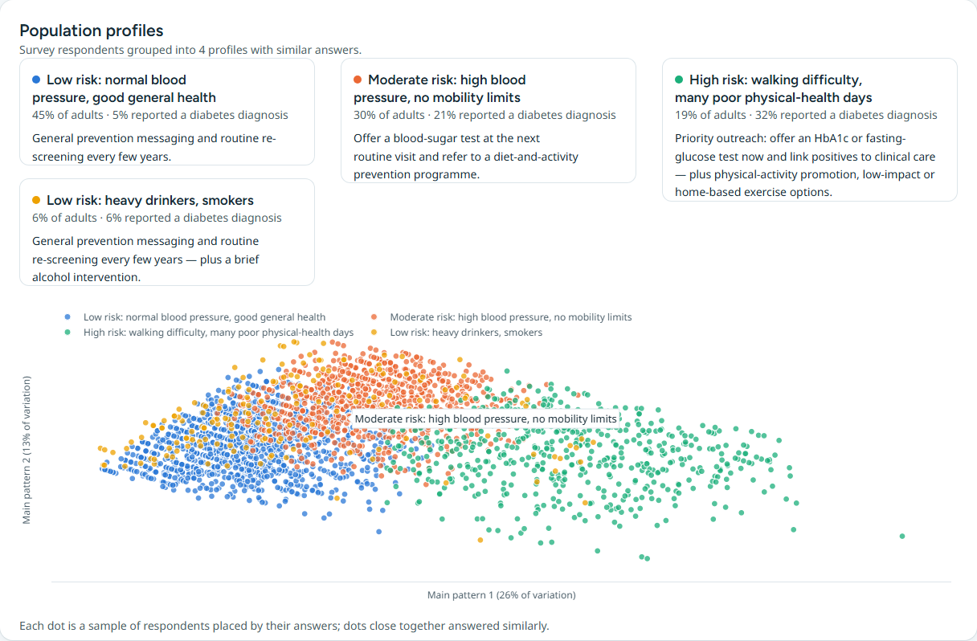
The product: SugarScope
Quick check
6 questions, about a minute
Full check
all 21 questions, with the factors behind the result
What-if
see how the risk changes with lower weight or more activity
Population insights
segments and the screening cost planner
Live demo: Streamlit app. Screening aid, not a diagnosis.
Notes:
This is SugarScope, the Streamlit app we deployed. The quick check asks the 6 questions and takes about a minute; there is no sign-up and nothing is stored. The result shows a probability, a risk level of low, moderate or high, and the answers that pushed the risk up or down. The full check uses all 21 questions for people who want more detail. The what-if panel lets someone move the weight slider or tick regular exercise and watch the risk change, which turns a score into something they can act on. The population insights tab holds the segments and the cost planner for clinics and planners. Every page says clearly that this is a screening aid and not a medical diagnosis. Let me show the short demo now.

Slide 12
Recommendation
Use the 6-question model as a first-step screen at cut-off 0.143: it catches 81% of cases while sending about 41% of people for a blood test.
Limitations
Next steps
Self-reported answers, one training year
Recall much lower for young adults
Prediabetes not captured (counted as 0)
Test cost in the planner is an assumption
A screening aid, never a diagnosis
Validate across states (later years: done, slide 10)
Recalibrate the cut-off on recent local data
Pilot with a clinic and confirm with HbA1c tests
Add a separate cut-off for younger age groups
Notes:
Our recommendation: use the 6-question model as the first step of a screening programme, with the cut-off at 0.143. It catches about 81% of people with diagnosed diabetes while sending around 41% of those screened for a blood test, instead of everyone. There are real limits. The answers are self-reported, the model was trained on a single survey year, and prediabetes is not captured: it is coded as no diabetes. Recall is much lower for young adults, simply because diabetes is rare at that age, so a single cut-off under-serves them. The test cost in the planner is our assumption. And this is a screening aid, never a diagnosis. Next, we want to validate across states, recalibrate on recent local data, pilot it with a clinic using real HbA1c results, and consider a separate cut-off for younger people. Thank you, we are happy to take questions.

